Slide 1
Understanding and Improving Latency
of DRAM-Based Memory Systems
Thesis Oral
Kevin Chang
Committee:
Prof. Onur Mutlu (Chair)
Prof. James Hoe
Prof. Kayvon Fatahalian
Prof. Stephen Keckler (NVIDIA, UT Austin)
Prof. Moinuddin Qureshi (Georgia Tech.)
Committee:
Prof. Onur Mutlu (Chair)
Prof. James Hoe
Prof. Kayvon Fatahalian
Prof. Stephen Keckler (NVIDIA, UT Austin)
Prof. Moinuddin Qureshi (Georgia Tech.)

Slide 2
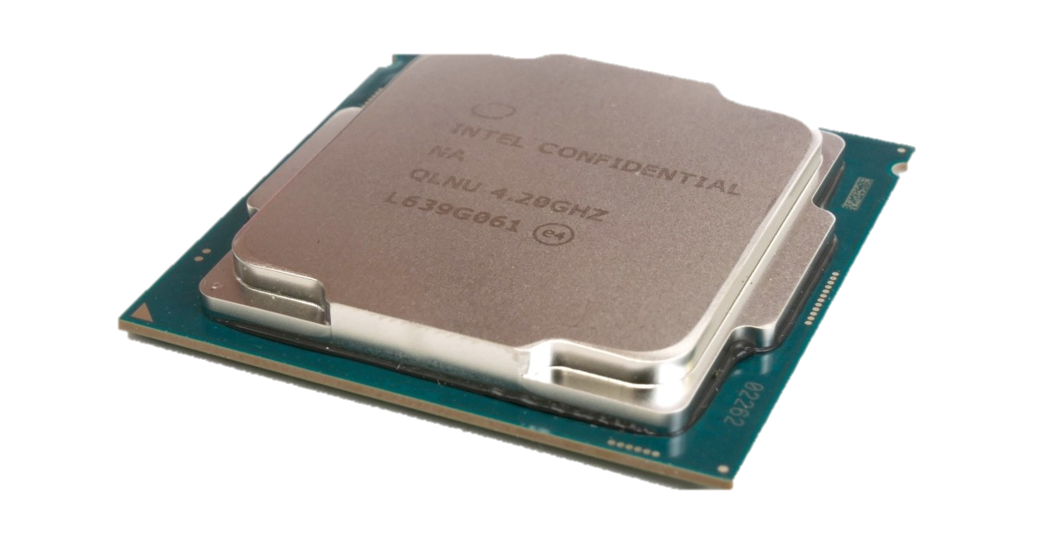
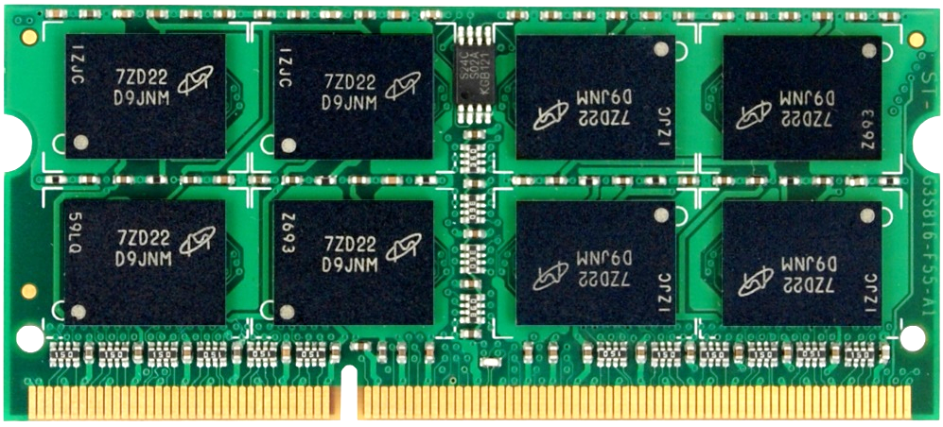
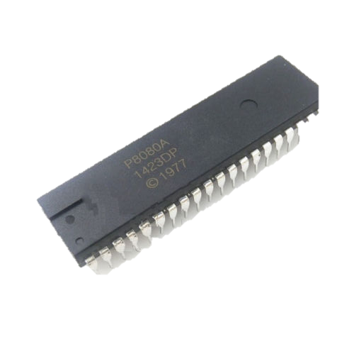
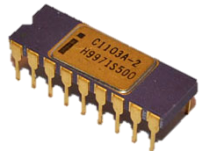
The March For “Moore”
4B transistors
8Gb
4K transistors
1Kb
Intel 8080, 1974
Intel 1103, 1970
Processor
Main Memory
or
DRAM (Dynamic Random Access Memory)

Slide 3
PROBLEM
DRAM latency has been relatively stagnant

Slide 4
Main Memory Latency Lags Behind
128x
20x
1.3x
Memory latency remains almost constant

Slide 5
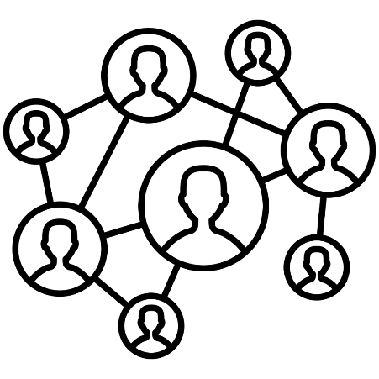



DRAM Latency Is Critical for Performance
In-memory Databases
[Mao+, EuroSys’12;
Clapp+ (Intel), IISWC’15]
Graph/Tree Processing
[Xu+, IISWC’12; Umuroglu+, FPL’15]
Long memory latency → performance bottleneck
In-Memory Data Analytics
[Clapp+ (Intel), IISWC’15;
Awan+, BDCloud’15]
Datacenter workloads
[Kanev+ (Google), ISCA’15]

Slide 6
Goal
Improve latency of DRAM (main memory)

Slide 7
Different DRAM Latency Problems
1. Slow bulk data movement between two memory locations
3. High standard latency to mitigate cell variation
DRAM
chip
CPU
Voltage
2. Refresh delays memory accesses
4. Voltage affects latency

Slide 8
Thesis Statement
Memory latency can be significantly reduced with a multitude of low-cost architectural techniques that aim to reduce different causes of long latency

Slide 9
Contributions

Slide 10


Low-Cost Architectural
Features in DRAM
Understanding and overcoming the latency limitation in DRAM
Understanding and Exploiting
Latency Variation in DRAM
(FLY-DRAM) [SIGMETRICS’16]
1. Slow bulk data movement between two memory locations
3. High standard latency to mitigate cell variation
Low-Cost Inter-Linked Subarrays (LISA) [HPCA’16]
DRAM
CPU
Voltage
2. Refresh delays memory accesses
4. Voltage affects latency
Mitigating Refresh Latency by Parallelizing Accesses with Refreshes (DSARP) [HPCA’14]
Understanding and Exploiting
Latency-Voltage Trade-Off
(Voltron) [SIGMETRICS’17]

Slide 11
DRAM Background
What’s inside a DRAM chip?
How to access DRAM?
How long does accessing data take?

Slide 12
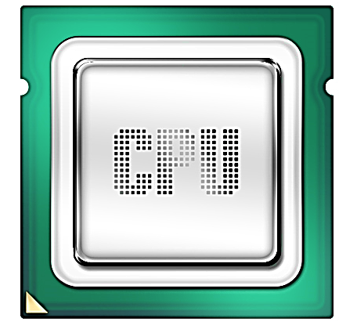
High-Level DRAM Organization
DRAM
chip
DRAM
Channel
DIMM
(Dual in-line memory module)

Slide 13
Chips
DRAM Cell
Subarray
Bank
Bitline
Subarray
Row Decoder
Wordline
Internal Data Bus
512 x 8Kb
S
S
S
S
P
P
P
P
Row Buffer
64b
S
Sense amplifier
P
Precharge unit
I/O

Slide 14
Reading Data From DRAM
1
ACTIVATE: Store the row
into the row buffer
1
1
1
1
2
READ: Select the target
column and drive to CPU
S
S
S
To Bank I/O
S
P
P
P
P
3
PRECHARGE: Reset the bitlines for a new ACTIVATE

Slide 15
DRAM Access Latency
1
Activation latency: tRCD
(13ns / 50 cycles)
2
Precharge latency: tRP
(13ns / 50 cycles)
Command
ACTIVATE
READ
PRECHARGE
Data
1
1
1
1
Cache line (64B)
Duration
Next
ACT

Slide 16
Low-Cost Architectural
Features in DRAM
Understanding and overcoming the latency limitation in DRAM
Understanding and Exploiting
Latency Variation in DRAM
(FLY-DRAM) [SIGMETRICS’16]
1. Slow bulk data movement between two memory locations
3. High standard latency to mitigate cell variation
Low-Cost Inter-Linked Subarrays (LISA) [HPCA’16]
DRAM
CPU
Voltage
2. Refresh delays memory accesses
4. Voltage affects latency
Mitigating Refresh Latency by Parallelizing Accesses with Refreshes (DSARP) [HPCA’14]
Understanding and Exploiting
Latency-Voltage Trade-Off
(Voltron) [SIGMETRICS’17]

Slide 17
Problem: Inefficient Bulk Data Movement
Bulk data movement is a key operation in many applications
  memmove & memcpy: 5% cycles in Google’s datacenter [Kanev+, ISCA’15]
Core
Core
LLC
Memory Controller
src
Channel
Core
Core
64 bits
dst
CPU
Memory
Long latency and high energy

Slide 18
Move Data inside DRAM?

Slide 19
Moving Data Inside DRAM?
8Kb
Bank
512
rows
Subarray 1
Bank
Subarray 2
Bank
Subarray 3
…
…
Bank
Subarray N
DRAM
Internal
Data Bus (64b)
Goal: Provide a new substrate to enable
wide connectivity between subarrays
Low connectivity in DRAM is the fundamental bottleneck for bulk data movement

Slide 20

Our proposal:
Low-Cost Inter-Linked SubArrays (LISA)

Slide 21
Observations
1
Bitlines serve as a bus that is
as wide as a row
S
S
S
S
P
P
P
P
2
Bitlines between subarrays are close but disconnected
Internal Data Bus (64b)
S
S
S
S
P
P
P
P
…

Slide 22

Low-Cost Interlinked Subarrays (LISA)
S
S
S
S
Interconnect bitlines of adjacent subarrays in a bank using
isolation transistors (links)
P
P
P
P
ON
8kb
64b
S
S
S
S
P
P
P
P
…

Slide 23
Low-Cost Interlinked Subarrays (LISA)
Row Buffer Movement (RBM): Move a row of data in an activated row buffer to a precharged one
4KB data in 8ns
→ 500 GB/s, 26x bandwidth of a DDR4-2400 channel
0.8% DRAM chip area overhead
S
S
S
S
Charge
Sharing
P
P
P
P
ON
8kb
64b
LISA forms a wide datapath b/w subarrays
S
S
S
S
P
P
P
P
…

Slide 24
Three New Applications of LISA to Reduce Latency
1 Fast bulk data copy

Slide 25

1. Rapid Inter-Subarray Copying (RISC)
Goal: Efficiently copy a row across subarrays
Key idea: Use RBM to form a new command sequence
Subarray 1
1
src row
Activate src row
S
S
S
S
2
P
P
P
P
RBM SA1→SA2
Subarray 2
Reduces row-copy latency by 9x,
DRAM energy by 48x
dst row
3
Activate dst row
(write row buffer into dst row)
S
S
S
S
P
P
P
P

Slide 26
Methodology
Cycle-level simulator: Ramulator [Kim+, CAL’15]
Four out-of-order cores
Two DDR3-1600 channels
Benchmarks: TPC, STREAM, SPEC2006, DynoGraph, random, bootup, forkbench, shell script

Slide 27
RISC Outperforms Prior Work
[Seshadri+, MICRO’13]
-5%
66%
-55%
-24%
Rapid Inter-Subarray Copying (RISC) using LISA improves system performance
50 workloads
50 workloads
RowClone limits bank-level parallelism

Slide 28
Three New Applications of LISA to Reduce Latency
1 Fast bulk data copy
2 In-DRAM caching

Slide 29
2. Variable Latency DRAM (VILLA)
Goal: Reduce access latency with low area overhead
Motivation: Trade-off between area and latency
Long Bitline
Short Bitline
  Lower resistance and capacitance
High latency
Low latency
High area overhead

Slide 30
2. Variable Latency DRAM (VILLA)
Key idea: Heterogeneous DRAM design by adding a few fast subarrays as a low-cost cache in each bank
Benefits: Reduce access latency for frequently-accessed data
Slow Subarray
512
rows
Challenge: How to move data efficiently from slow to fast subarrays?
32
rows
Fast Subarray
LISA: Cache rows rapidly from slow to fast subarrays
Reduces hot data access latency by 2.2x
at only 1.6% area overhead
Slow Subarray

Slide 31
VILLA Improves System Performance by Caching Hot Data
Max: 16%
Avg: 5%
LISA enables an effective in-DRAM caching scheme

Slide 32
Three New Applications of LISA to Reduce Latency
1 Fast bulk data copy
2 In-DRAM caching
3 Fast precharge

Slide 33
3. Linked Precharge (LIP)
Problem: The precharge time is limited by the strength of one precharge unit
Linked Precharge (LIP): LISA precharges a subarray using multiple precharge units
S
S
S
S
S
S
S
S
on
P
P
P
P
P
P
P
P
Activated row
Activated row
Reduces precharge latency by 2.6x
Precharging
Linked
Precharging
S
S
S
S
on
S
S
S
S
on
P
P
P
P
P
P
P
P
Conventional DRAM
LISA DRAM

Slide 34
LIP Improves System Performance by Accelerating Precharge
Max: 13%
Avg: 8%
LISA reduces precharge latency

Slide 35
Latency Reduction of LISA
Latency of Operations
x64
x64
READ
WRITE
ACTIVATE
PRECHARGE
9x
1.7x
1.5x
VILLA
VILLA
4KB data copying
2.6x
LIP
LISA is a versatile substrate that enables
many new techniques

Slide 36
Low-Cost Architectural
Features in DRAM
Understanding and overcoming the latency limitation in DRAM
Understanding and Exploiting
Latency Variation in DRAM
(FLY-DRAM) [SIGMETRICS’16]
1. Slow bulk data movement between two memory locations
3. High standard latency to mitigate cell variation
Low-Cost Inter-Linked Subarrays (LISA) [HPCA’16]
DRAM
CPU
Voltage
2. Refresh delays memory accesses
4. Voltage affects latency
Mitigating Refresh Latency by Parallelizing Accesses with Refreshes (DSARP) [HPCA’14]
Understanding and Exploiting
Latency-Voltage Trade-Off
(Voltron) [SIGMETRICS’17]

Slide 37
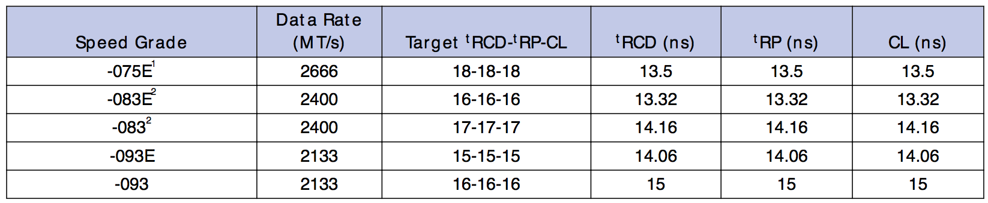
What Does DRAM Latency Mean to You?
DRAM latency: Delay as specified in DRAM standards
Memory controllers use these standardized latency to access DRAM
Key question: How does reducing latency affect DRAM accesses?
“The purpose of this Standard is to define the minimum set of requirements for JEDEC compliant … SDRAM devices”
(p.1) JEDEC DDRx standard

Slide 38
Goals
1 Understand and characterize reduced-latency behavior in modern DRAM chips
2
2 Develop a mechanism that exploits our observation to improve DRAM latency

Slide 39
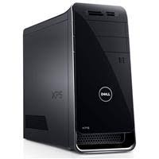
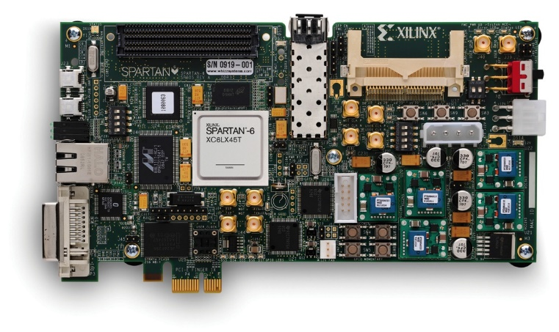
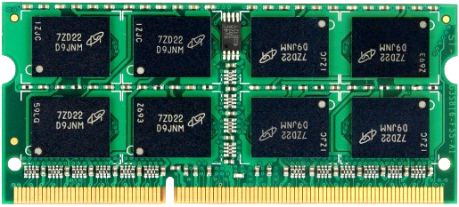
Experimental Setup
Custom FPGA-based infrastructure
  Existing systems: Commands are generated and controlled by HW
PCIe
DDR3
PC
FPGA
DIMM

Slide 40
Experiments
Swept each timing parameter to read data
  Time step of 2.5ns (FPGA cycle time)
Check the correctness of data read back from DRAM
  Any errors (bit flips)?
Tested 240 DDR3 DRAM chips from three vendors
  30 DIMMs
  Capacity: 1GB

Slide 41
Experimental Results
Activation Latency

Slide 42
Variation in Activation Errors
Results from 7500 rounds over 240 chips
Rife with errors
No Errors
Many errors
8KB (one row)
Very few errors
<10 bits
step size
Activation Latency/tRCD (ns)
Modern DRAM chips exhibit
significant variation in activation latency
13.1ns
standard
Different characteristics across cells

Slide 43

DRAM Latency Variation
Imperfect manufacturing process →
latency variation in timing parameters
DRAM A
DRAM B
DRAM C
Slow cells
Low
High
DRAM Latency

Slide 44
Experimental Results
Precharge Latency

Slide 45
Variation in Precharge Errors
Results from 4000 rounds over 240 chips
Rife with errors
Many errors
No Errors
100 rows
Very few errors
8KB (one row)
step size
Precharge Latency/tRP (ns)
13.1ns
standard
Modern DRAM chips exhibit significant variation in precharge latency

Slide 46
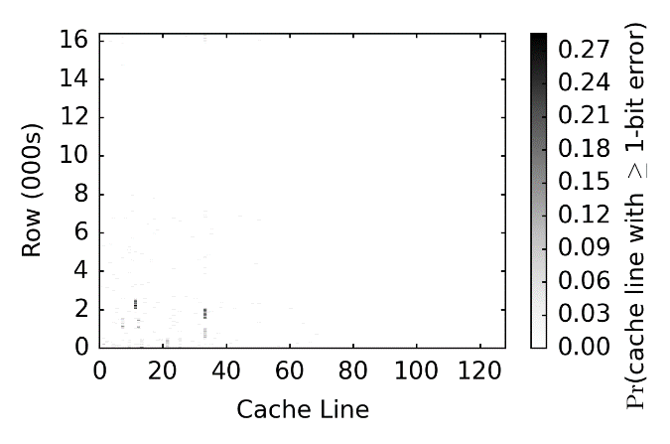
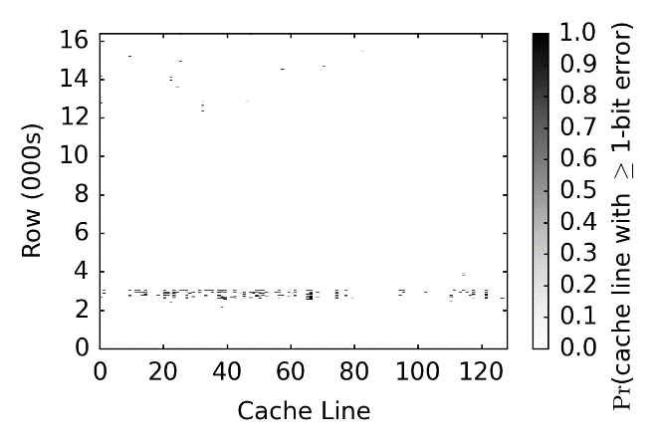
Spatial Locality of Slow Cells
One DIMM: tRCD=7.5ns
One DIMM: tRP=7.5ns
Slow cells are concentrated
at certain regions

Slide 47

Mechanism:
Flexible-Latency (FLY) DRAM
FLY

Slide 48
Mechanism to Reduce DRAM Latency
Observation: DRAM timing errors (slow DRAM cells) are concentrated on certain regions
Flexible-LatencY (FLY) DRAM
  A memory controller design that reduces latency
Key idea:
  1) Divide memory into regions of different latencies
  2) Memory controller: Use lower latency for regions without slow cells; higher latency for other regions
Latency profile through DRAM vendors or online tests

Slide 49
Benefits of FLY-DRAM
19.7%
19.5%
17.6%
Fast cells (%)
0%
83%
99%
FLY-DRAM improves performance
by exploiting latency variation in DRAM
100%

Slide 50
Latency Reduction of FLY-DRAM
Latency of Operations
x64
x64
READ
WRITE
ACTIVATE
PRECHARGE
9x
1.7x
1.5x
VILLA
VILLA
4KB data copying
2.6x
LIP
1.7x
1.7x
FLY
FLY
Experimental demonstration of latency variation enables techniques to reduce latency

Slide 51

Low-Cost Architectural
Features in DRAM
Understanding and overcoming the latency limitation in DRAM
Understanding and Exploiting
Latency Variation in DRAM
(FLY-DRAM) [SIGMETRICS’16]
1. Slow bulk data movement between two memory locations
3. High standard latency to mitigate cell variation
Low-Cost Inter-Linked Subarrays (LISA) [HPCA’16]
DRAM
CPU
Voltage
2. Refresh delays memory accesses
4. Voltage affects latency
Mitigating Refresh Latency by Parallelizing Accesses with Refreshes (DSARP) [HPCA’14]
Understanding and Exploiting
Latency-Voltage Trade-Off
(Voltron) [SIGMETRICS’17]

Slide 52
Motivation
DRAM voltage is an important factor that affects:
latency, power, and reliability
Goal: Understand the relationship between latency and DRAM voltage and exploit this trade-off

Slide 53
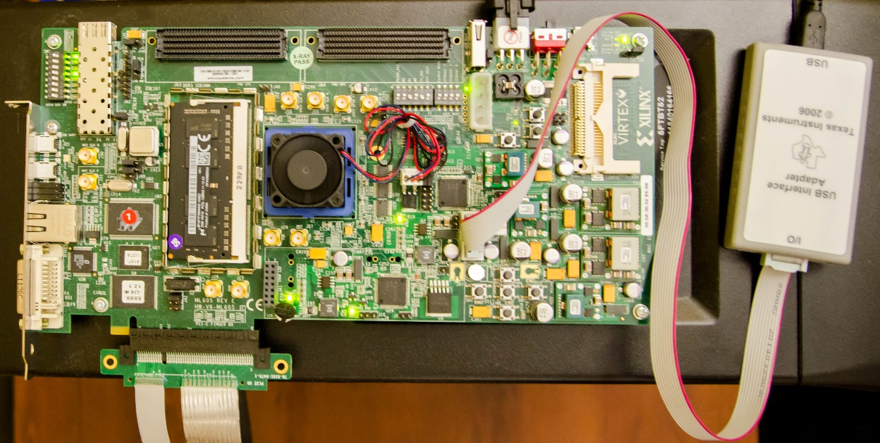
Methodology
FPGA platform
Tested 124 DDR3L DRAM chips (31 DIMMs)
Voltage
Controller
DIMM

Slide 54
Key Result: Voltage vs. Latency
Circuit-level SPICE simulation
Potential latency range
Trade-off between access latency and voltage

Slide 55
Goal and Key Observation
Goal: Exploit the trade-off between voltage and latency to reduce energy consumption
Approach: Reduce voltage
  Performance loss due to increased latency
  Energy: Function of time (performance) and power (voltage)
Observation: Application’s performance loss due to higher latency has a strong linear relationship with its memory intensity

Slide 56
Mechanism: Voltron
Build a performance (linear) model to predict performance loss based on the selected voltage value
Use the model to select a minimum voltage that satisfies a performance loss target specified by the user
Results: Reduces system energy by 7.3% with a small performance loss of 1.8%

Slide 57
Reducing Latency by Exploiting
Voltage-Latency Trade-Off
Voltron exploits the latency-voltage trade-off to improve energy efficiency
Another perspective: Increase voltage to reduce latency

Slide 58
Low-Cost Architectural
Features in DRAM
Understanding and overcoming the latency limitation in DRAM
Understanding and Exploiting
Latency Variation in DRAM
(FLY-DRAM) [SIGMETRICS’16]
1. Slow bulk data movement between two memory locations
3. High standard latency to mitigate cell variation
Low-Cost Inter-Linked Subarrays (LISA) [HPCA’16]
DRAM
CPU
Voltage
2. Refresh delays memory accesses
4. Voltage affects latency
Mitigating Refresh Latency by Parallelizing Accesses with Refreshes (DSARP) [HPCA’14]
Understanding and Exploiting
Latency-Voltage Trade-Off
(Voltron) [SIGMETRICS’17]

Slide 59
Summary of DSARP
Problem: Refreshing DRAM blocks memory accesses
  Prolongs latency of memory requests
Goal: Reduce refresh-induced latency on demand requests
Key observation: Some subarrays and I/O remain completely idle during refresh
Dynamic Subarray Access-Refresh Parallelization (DSARP):
  DRAM modification to enable idle DRAM subarrays to serve accesses during refresh
  0.7% DRAM area overhead
20.2% system performance improvement for 8-core systems using 32Gb DRAM

Slide 60
Prior Work on Low-Latency DRAM
Uniform short-bitlines DRAM: FCRAM, RLDRAM
  Large area overhead (30% - 80%)
Heterogeneous bitline design
  TL-DRAM: Intra-subarray [Lee+, HPCA’13]
  Requires two fast rows to cache one slow row
  CHARM: Inter-bank [Son+, ISCA’13]
  High movement cost between slow and fast banks
SRAM cache in DRAM [Hidaka+, IEEE Micro’90]
  Large area overhead (38% for 64KB) and complex control
Our work:
  Low cost
  Detailed experimental understanding via characterization of commodity chips

Slide 61
CONCLUSION

Slide 62
Conclusion
Memory latency has remained mostly constant over the past decade
  System performance bottleneck for modern applications
Simple and low-cost architectural mechanisms
  New DRAM substrate for fast inter-subarray data movement
  Refresh architecture to mitigate refresh interference
Understanding latency behavior in commodity DRAM
  Experimental characterization of:
  1) Latency variation inside DRAM
  2) Relationship between latency and DRAM voltage

Slide 63
Thesis Statement
Memory latency can be significantly reduced with a multitude of low-cost architectural techniques that aim to reduce different causes of long latency

Slide 64
Future Research Direction
Latency characterization and optimization for other memory technologies
  eDRAM
  Non-volatile memory: PCM, STT-RAM, etc.
Understanding other aspects of DRAM
  Variation in power/energy consumption
  Security/reliability

Slide 65
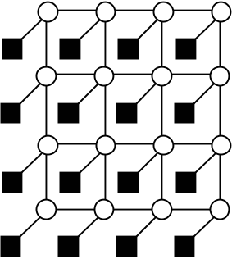
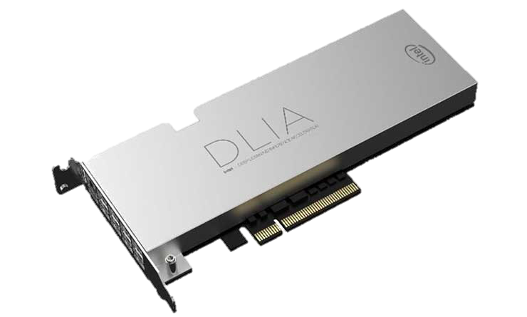
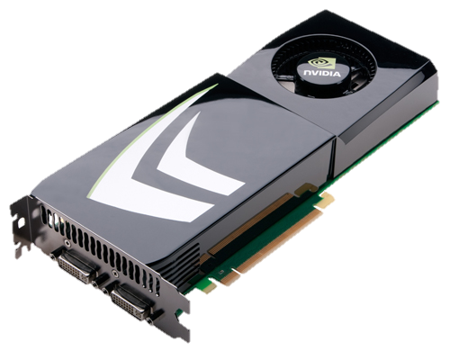


Other Areas Investigated
Energy Efficient Networks-On-Chip
[NOCS’12, SBACPAD’12, SBACPAD’14]
Memory Schedulers for Heterogeneous Systems
[ISCA’12, TACO’16]
Low-latency DRAM Architecture
[HPCA’15]
DRAM Testing Platform
[HPCA’17]

Slide 66


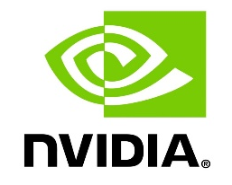


Acknowledgements
Onur Mutlu
James Hoe, Kayvon Fatahalian, Moinuddin Qureshi, and
Steve Keckler
Safari group: Rachata Ausavarungnirun, Amirali Boroumand, Chris Fallin, Saugata Ghose, Hasan Hassan, Kevin Hsieh, Ben Jaiyen, Abhijith Kashyap, Samira Khan, Yoongu Kim, Donghyuk Lee, Yang Li, Jamie Liu, Yixin Luo, Justin Meza, Gennady Pekhimenko, Vivek Seshadri, Lavanya Subramanian, Nandita Vijaykumar, Hanbin Yoon, Hongyi Xin
Georgia Tech. collaborators: Prashant Nair, Jaewoong Sim
CALCM group
Friends
Family — parents, sister, and girlfriend
Intern mentors and industry collaborators:

Slide 67
Sponsors
Intel and SRC for my fellowship
NSF and DOE
Facebook, Google, Intel, NVIDIA, VMware, Samsung

Slide 68
Thesis Related Publications
Improving DRAM Performance by Parallelizing Refreshes with Accesses
Kevin Chang, Donghyuk Lee, Zeshan Chishti, Alaa Alameldeen, Chris Wilkerson, Yoongu Kim, Onur Mutlu
HPCA 2014
Low-Cost Inter-Linked Subarrays (LISA): Enabling Fast Inter-Subarray Data Movement in DRAM
Kevin Chang, Prashant J. Nair, Donghyuk Lee, Saugata Ghose, Moinuddin K. Qureshi, and
Onur Mutlu
HPCA 2016
Understanding Latency Variation in Modern DRAM Chips: Experimental Characterization, Analysis, and Optimization
Kevin Chang, Abhijith Kashyap, Hasan Hassan Samira Khan, Kevin Hsieh, Donghyuk Lee, Saugata Ghose, Gennady Pekhimenko, Tianshi Li, Onur Mutlu
SIGMETRICS 2016
Understanding Reduced-Voltage Operation in Modern DRAM Devices: Experimental Characterization, Analysis, and Mechanisms
Kevin Chang, Abdullah Giray Yağlikçi, Saugata Ghose, Aditya Agrawal, Niladrish Chatterjee, Abhijith Kashyap, Donghyuk Lee, Mike O’connor, Hasan Hassan, Onur Mutlu
SIGMETRICS 2017

Slide 69
Understanding and Improving Latency
of DRAM-Based Memory Systems
Thesis Oral
Kevin Chang
Committee:
Prof. Onur Mutlu (Chair)
Prof. James Hoe
Prof. Kayvon Fatahalian
Prof. Stephen Keckler (NVIDIA, UT Austin)
Prof. Moinuddin Qureshi (Georgia Tech.)
Committee:
Prof. Onur Mutlu (Chair)
Prof. James Hoe
Prof. Kayvon Fatahalian
Prof. Stephen Keckler (NVIDIA, UT Austin)
Prof. Moinuddin Qureshi (Georgia Tech.)

