Slide 1


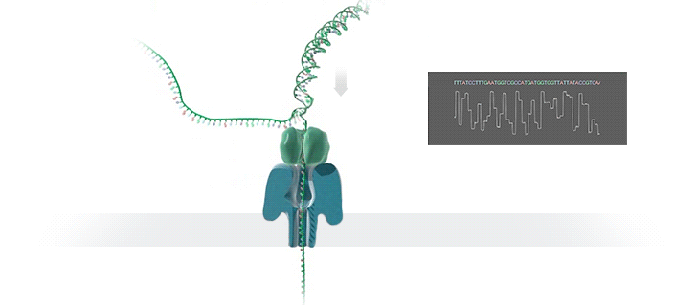
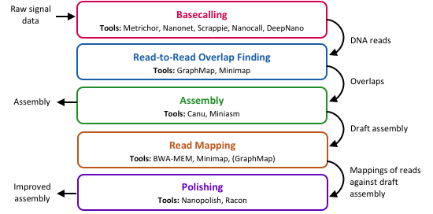
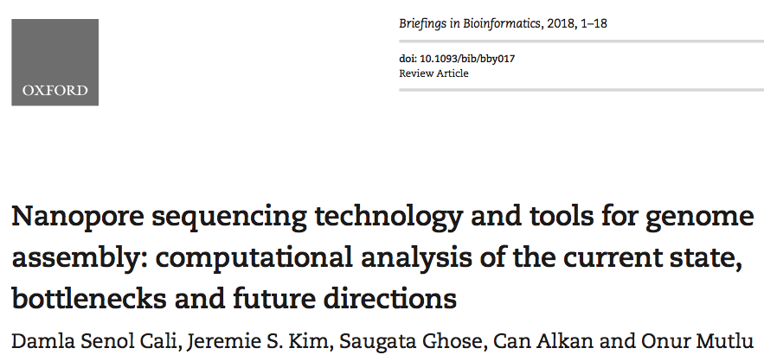

Nanopore Sequencing Technology and Tools for Genome Assembly:
Computational Analysis of the Current State, Bottlenecks and Future Directions
Damla Senol Cali¹, Jeremie S. Kim^{1,3}, Saugata Ghose¹, Can Alkan² and Onur Mutlu^{3,1}
¹ Carnegie Mellon University, Pittsburgh, PA, USA ² Bilkent University, Ankara, Turkey ³ ETH Zürich, Zürich, Switzerland
Nanopore Sequencing
Advantages
Challenges
Nanopore sequencing is an emerging and a promising single-molecule DNA sequencing technology.
Nanopore is a nano-scale hole. In nanopore sequencers, an ionic current passes through the nanopores. When the DNA strand passes through the nanopore, the sequencer measures the
change in current. This change is used to identify the bases in the strand with the help of different electrochemical structures of the different bases.
Does not require nucleotide labeling for detection during sequencing,
Relies on the electronic or chemical structure of the different nucleotides for identification,
Allows generating very long reads, and
Provides portability, low cost, and high throughput.
One major drawback: high error rates
Nanopore sequence analysis tools need to:
      overcome high error rates, and
      take better advantage of the technology
Faster tools are critically needed to:
      take better advantage of the real-time data production capability of MinION, and
      enable fast, real-time data analysis
Our Goal
Nanopore Genome Assembly Pipeline
Comprehensively analyze the multiple steps and the associated state-of-the-art tools in genome assembly pipelines using nanopore sequence data in terms of accuracy, performance, memory usage, and scalability.
Reveal bottlenecks and trade-offs that different combinations of tools lead to.
Provide guidelines for both practitioners, such that they can determine the appropriate tools and tool combinations that can satisfy their goals, and tool developers, such that they can make design choices to improve current and future tools.
Results and Analysis
 | Step 1 Wall Clock Time (h:m:s) | Step 1 Memory Usage (GB) | Step 2 Wall Clock Time (h:m:s) | Step 2 Memory Usage (GB) | Step 3 Wall Clock Time (h:m:s) | Step 3 Memory Usage (GB) | Number of Contigs | Identity (%) | Coverage (%)
Metrichor + Canu | – | – | – | – | 44:12:31 | 5.76 | 1 | 98.05 | 99.92
Metrichor + Minimap + Miniasm |  |  | 2:15 | 12.30 | 00:01:09 | 1.96 | 1 | 87.71 | 94.85
Metrichor + GraphMap + Miniasm |  |  | 6:14 | 56.58 | 00:01:05 | 1.82 | 2 | 86.22 | 96.95
Nanonet + Canu | 17:52:42 | 1.89 | – | – | 11:32:40 | 5.27 | 1 | 97.92 | 99.97
Nanonet + Minimap + Miniasm |  |  | 1:13 | 9.45 | 00:00:33 | 0.69 | 1 | 85.50 | 92.76
Nanonet + GraphMap + Miniasm |  |  | 3:18 | 29.16 | 00:00:32 | 0.65 | 1 | 85.36 | 91.16
Scrappie + Canu | 03:11:41 | 13.36 | – | – | 33:47:41 | 5.75 | 1 | 98.46 | 99.90
Scrappie + Minimap + Miniasm |  |  | 2:52 | 12.40 | 00:01:29 | 1.98 | 8 | 86.94 | 90.04
Scrappie + GraphMap + Miniasm |  |  | 7:26 | 38.31 | 00:01:23 | 1.87 | 1 | 86.78 | 89.86
Nanocall + Canu | 47:04:53 | 37.73 | – | – | 01:35:23 | 3.77 | 86 | 93.33 | 28.93
Nanocall + Minimap + Miniasm |  |  | 1:15 | 12.19 | 00:00:20 | 0.47 | 5 | 80.52 | 42.92
Nanocall + GraphMap + Miniasm |  |  | 5:14 | 56.78 | 00:00:16 | 0.30 | 3 | 80.51 | 41.32
DeepNano + Canu | 23:54:34 | 8.38 | – | – | 01:15:48 | 3.61 | 106 | 92.75 | 99.16
DeepNano + Minimap + Miniasm |  |  | 1:50 | 11.71 | 00:01:03 | 1.31 | 1 | 82.38 | 65.00
DeepNano + GraphMap + Miniasm |  |  | 5:18 | 54.64 | 00:00:58 | 1.10 | 1 | 82.39 | 64.92
  Observation 1: The choice of the tool for the basecalling step plays an important role to overcome the high error rates of nanopore sequencing technology. Basecalling with RNNs (e.g., Metrichor, Nanonet, Scrappie) provides higher accuracy and higher speed than basecalling with HMMs. Also, the newest basecaller of ONT, Scrappie, has the potential to overcome the homopolymer basecalling problem.
  Observation 2: Scrappie and Nanocall have a linear increase in memory usage when number of threads increases. In contrast, Nanonet has a constant memory usage for all evaluated thread units.
  Observation 3: When the number of threads exceeds the number of physical cores, the simultaneous multithreading (SMT) overhead prevents continued linear speedup of Nanonet, Scrappie and Nanocall.
Observation 4: Using minimizers instead of all k-mers, as done by Minimap, does not affect the overall accuracy of the first three steps of the pipeline.
Observation 5: By storing minimizers, Minimap has a much lower memory usage and thus much higher performance than GraphMap.
Observation 6: There is a trade-off between accuracy and performance when deciding on the appropriate tool for the assembly step. Canu provides higher accuracy than Miniasm, with the help of the error-correction step that is present in its own pipeline. However, Canu is much more computationally intensive and greatly slower (i.e., by 1096.3x) than Miniasm.
Miniasm is suitable for fast initial analysis, and the quality of its assembly can be increased with an additional polishing step.
Observation 7: The choice of BWA-MEM and Minimap for the read mapping step does not affect the accuracy of the polishing step. However, BWA-MEM is computationally more expensive than Minimap.
Observation 8: Both Nanopolish and Racon significantly increase the accuracy of the draft assemblies. However, Nanopolish is computationally much more intensive and greatly slower than Racon.
For more results, analysis and recommendations, please refer to:
BiB version
arXiv version
Contact: Damla Senol Cali, dsenol@andrew.cmu.edu

