Slide 1
Design-Induced Latency Variation in Modern DRAM Chips:
Characterization, Analysis, and
Latency Reduction Mechanisms
Donghyuk Lee^{1,2} Samira Khan³ Lavanya Subramanian²
Saugata Ghose² Rachata Ausavarungnirun²
Gennady Pekhimenko⁴ Vivek Seshadri⁴ Onur Mutlu^{5,2}
¹NVIDIA ²Carnegie Mellon University
³University of Virginia ⁴Microsoft Research ⁵ETH Zürich
June 7, 2017
Notes:
Hello. My name is Donghyuk Lee.
Thank you for attending my thesis defense.
Today, I will talk about reducing DRAM latency at low cost by exploiting heterogeneity.

Slide 2
What Is Design-Induced Variation?
fast
slow
across column
inherently slow
distance from wordline driver
slow
across row
wordline drivers
distance from sense amplifier
fast
Inherently fast
sense amplifiers
Systematic variation in cell access times
caused by the physical organization of DRAM
Notes:
As we described, cells in a mat have different distances from peripheral logic.
Cells in different rows have different distance from the sense amplifiers.
Cells in different columns have different distance from the wordline drivers.
Therefore, some regions are inherently faster than other regions,
and some regions are inherently slower than other regions.
We call this architectural variation.

Slide 3
Executive Summary
Design-Induced Variation
  Inherently slow regions due to DRAM cell array organization
  Goal: Use design-induced variation to reduce DRAM latency
Analysis: Characterization of 96 real DRAM modules
  Three types of systematic variation due to design
  Great potential to reduce DRAM latency at low cost
Our Approach: DIVA-DRAM
  DIVA Profiling: Reliably reduce DRAM latency
    Profile only cells in inherently slow regions
    Use error correction (ECC) for slow cells that are not profiled
  DIVA Shuffling: Exploit variation to improve ECC reliability
15.1%/14.2% higher performance for 2-/8-core workloads
Notes:
Let me summarize.
DRAM has inherently slow regions due to its cell array organization, which leads to high DRAM latency.
We call this architectural variation.
We propose two mechanisms to exploit architectural variation for reducing DRAM latency.
First is AVA profiling, a dynamic & low cost latency optimization technique.
Second is AVA Shuffling, a mechanism to reduce ECC uncorrectable errors.
Our characterization shows the significant potential to lower DRAM timing parameters.
Our system performance evaluation shows that
our mechanisms provide significant performance improvement.

Slide 4
Presentation Outline
DRAM Background
DRAM Background
Experimental Study of Design-Induced Variation
  Goal: Understand, identify inherently slower regions
  Methodology: Profile 96 real DRAM modules
  by using FPGA-based DRAM test infrastructure
Exploiting Design-Induced Variation
  DIVA Profiling: Using low-cost slow region profiling
  to reliably and dynamically reduce DRAM latency
  DIVA Shuffling: Using variation across data bursts
  to reduce uncorrectable errors
Notes:
In order to exploit architectural variation for reducing DRAM latency,
we first do experimental study to identify and characterize architectural variation.
We evaluate 96 real DRAM modules
by using our FPGA-based DRAM test infrastructure,
similar to what we used for AL-DRAM.
We then propose two mechanisms to leverage architectural variation for reducing DRAM latency.
Let me describe our experimental study.

Slide 5
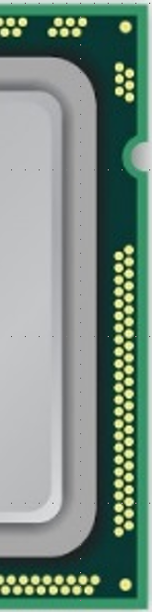
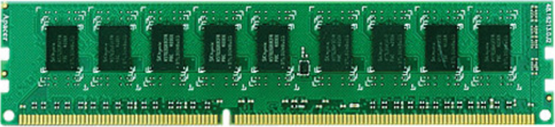
High-Level DRAM Organization
memory channel: 64-bit data bus
8-bit data bus per chip
DRAM
chip
data
burst
8 chips X 8 bits X 8 bursts = 64 bytes
Processor
Read request
DIMM
dual in-line memory module
Notes:
The figure plots the memory channel connection between process and DRAM module.
Usually memory channel has 64-bit data bus that consist of eight 8-bit data bus, dedicated to each DRAM chip.
Each DRAM chip transfer data as eight burst of eight bit data.
Therefore, 64-bit data from a DRAM chip are from different locations in a row.
Therefore, data bits in a request might have different error characteristics.

Slide 6
Organization Inside a DRAM Chip
DRAM cell
DRAM mat
global wordline
wordline
drivers
row decoder
row group
row decoder
sense amplifiers

Slide 7
DRAM Operations
Memory controller sends commands to DRAM
row decoder
column
column
column
column
Activation: Open one row in each mat
  Row decoder, wordline drivers select a row of cells
  Each cell in the row shares charge with a sense amplifier
Read: Send one column of data from sense amplifiers to CPU
Precharge: Prepare mats for next row
Timing parameters: how long to wait for each step to finish

Slide 8
DRAM Timing Parameters
Standard timing parameters are dictated by
the worst case
Must ensure reliable operation for:
  The smallest cell with the smallest charge in
  all DRAM modules (process variation)
  The highest operating temperature allowed
  (charge leakage)
Large timing margin for the common case
Can we use design-induced variation
to find and use common-case latency at low cost?
Goal: Lower common-case latency

Slide 9
Presentation Outline
DRAM Background
DRAM Background
Experimental Study of Design-Induced Variation
  Goal: Understand, identify inherently slower regions
  Methodology: Profile 96 real DRAM modules
  by using FPGA-based DRAM test infrastructure
Experimental Study of Design-Induced Variation
  Goal: Understand, identify inherently slower regions
  Methodology: Profile 96 real DRAM modules
  by using FPGA-based DRAM test infrastructure
Exploiting Design-Induced Variation
  DIVA Profiling: Using low-cost slow region profiling
  to reliably and dynamically reduce DRAM latency
  DIVA Shuffling: Using variation across data bursts
  to reduce uncorrectable errors
Notes:
In order to exploit architectural variation for reducing DRAM latency,
we first do experimental study to identify and characterize architectural variation.
We evaluate 96 real DRAM modules
by using our FPGA-based DRAM test infrastructure,
similar to what we used for AL-DRAM.
We then propose two mechanisms to leverage architectural variation for reducing DRAM latency.
Let me describe our experimental study.

Slide 10
Expected DRAM Characteristics
Variation
  Some regions are slower than others
  If we reduce DRAM latency, slower regions are more vulnerable to errors
Repeatability
  Latency (error) characteristics repeat periodically,
  if the same component (e.g., mat) is duplicated
Similarity
  Characteristics repeat across different organizations (e.g., chip/DIMM) that share same design
Notes:
Instead, we provide expected characteristics if there exists architectural variation.
First, we expect the variation in latency across regions in a mat.
For example, some regions are slower than other regions,
or some regions are more vulnerable than other regions when accessing reduced latency.
Second, we expect that latency or error characteristics periodically repeat
because mats are duplicated to form a bank.
Third, we expect that latency or error characteristic is similar across different chip/DIMM,
if they are manufactured by the same company at the same manufacturing time.

Slide 11
Characterization Methodology
We use error behavior when we reduce latency to infer DRAM organization and characteristics
  FPGA-based memory controller infrastructure
Notes:
Instead, we provide expected characteristics if there exists architectural variation.
First, we expect the variation in latency across regions in a mat.
For example, some regions are slower than other regions,
or some regions are more vulnerable than other regions when accessing reduced latency.
Second, we expect that latency or error characteristics periodically repeat
because mats are duplicated to form a bank.
Third, we expect that latency or error characteristic is similar across different chip/DIMM,
if they are manufactured by the same company at the same manufacturing time.

Slide 12
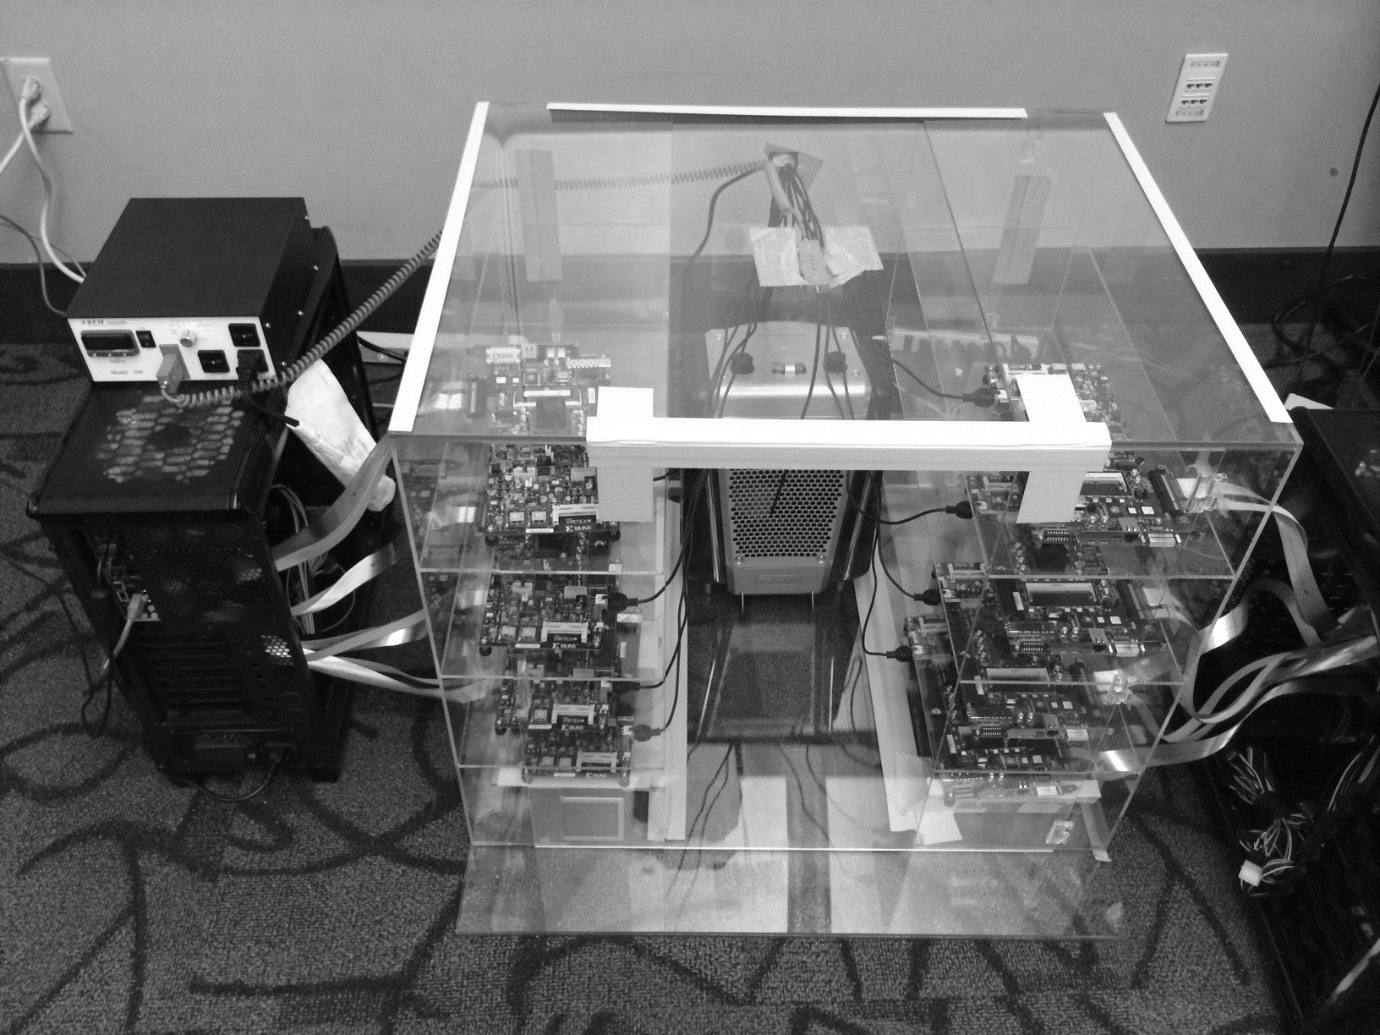
DRAM Testing Infrastructure
Temperature
Controller
FPGAs
Heater
FPGAs
PC
Tested 96 DIMMs from three vendors
Notes:
This is the photo of our infrastructure, that we built mostly from scratch.
For higher throughput, we employ eight FPGAs, all of which are enclosed in thermally-regulated environment.

Slide 13
Characterization Methodology
We use error behavior when we reduce latency to infer DRAM organization and characteristics
  FPGA-based memory controller infrastructure
  We reverse engineer row address mapping
  Lower tRP (precharge timing parameter) to 7.5 ns
We characterize three types of variation
  Variation across columns
  Variation across rows
  Variation across data bursts
Data and circuit model will be available on GitHub: https://github.com/CMU-SAFARI/DIVA-DRAM
Notes:
Instead, we provide expected characteristics if there exists architectural variation.
First, we expect the variation in latency across regions in a mat.
For example, some regions are slower than other regions,
or some regions are more vulnerable than other regions when accessing reduced latency.
Second, we expect that latency or error characteristics periodically repeat
because mats are duplicated to form a bank.
Third, we expect that latency or error characteristic is similar across different chip/DIMM,
if they are manufactured by the same company at the same manufacturing time.

Slide 14
1. Variation Across Rows
darker cells are faster
global wordline
512 rows
row decoder
row group
row decoder
sweep across rows
512 rows
Latency characteristics vary across 512 rows
Latency characteristics repeat every 512 rows
Same organization repeats every 512 rows
Notes:
First, we observe the variation in rows caused by variation in distance between cell and sense amplifier.
A row of mats are connected to row decoder by global wordline.
Majority DRAMs use 512 rows in a mat,
And cells in different rows have different distance from sense amplifier, leading to variation in latency.
Since mats are duplicated to build bigger cell array,
latency characteristic repeats every 512 rows when sweeping rows.

Slide 15
1.2. Periodic Row Variation Behavior
Sorting with Discovered Row Mapping
Erroneous Request Count
sorted row address
Row error (latency) characteristics
periodically repeat every 512 rows
Notes:
In left figure, we sort the rows as erroneous request count.
As we can see, the erroneous request mostly linearly increase.
Then, we apply this sorted order of rows to each 512-row group in right figure.
As we can see, we observe similar characteristics every 512-row group.
Therefore, error characteristic periodically repeats every 512 rows.
We conclude that the distance from sense amplifier expose variation in erroneous request count,
which also expose variation in latency.

Slide 16
2. Variation Across Columns
darker cells are faster
global wordline
row decoder
Column latency depends on
distance from row decoder, wordline driver
Notes:
Second, we observe the latency variation in columns caused by variation in distance between cell and wordline driver.
A row of mats are connected to row decoder by global wordline.
To transfer data to offchip,
sense amplifiers are connected to global sense amplifier and
the global sense amplifier is connected to IO interface, which is connected to the memory channel.
When a row of cells are activated through both global wordline and wordline,
The time to access cells are varied, due to the distance from wordline driver and row decoder.
Then, sense amplifiers detect all data from the activated cells.
Then, fractions of data in sense amplifiers are transferred to global sense amplifier, based on the issued column address.
Therefore, on read requests with different columns,
cells in different locations are transferred to global sense amplifier, which leads to different latency characteristics.

Slide 17
2. Variation Across Columns
Erroneous Request Count
Column error (latency) characteristics have
specific patterns that repeat across row groups
Notes:
We sweep columns at tRP 7.5ns, the same as row address sweeping evaluation.
We observe that two specific patterns in this DRAM modules,
Some rows induces more errors from 96th to 128th row as shown in left figure,
Some rows induces more errors from 80th to 96th row as shown in right figure.
Unfortunately, due to mismatch between external and internal address,
it is not possible to further analyze the root cause of this.
However, this results shows that specific regions in a mat induce induces more errors,
and thus the regions are slower than other regions

Slide 18
3. Variation Across Data Bursts
Processor
Read request
DIMM
64-bit data bus in memory channel
8-bit data bus per chip
A
B
C
D
E
F
G
H
Chip 1
A
B
C
D
E
F
G
H
Chip 2
A
B
C
D
E
F
G
H
Chip 3
A
B
C
D
E
F
G
H
Chip 4
A
B
C
D
E
F
G
H
Chip 5
A
B
C
D
E
F
G
H
Chip 6
A
B
C
D
E
F
G
H
Chip 7
A
B
C
D
E
F
G
H
Chip 8
64-bit data from different locations in the same row in the same chip
Notes:
The figure plots the memory channel connection between process and DRAM module.
Usually memory channel has 64-bit data bus that consist of eight 8-bit data bus, dedicated to each DRAM chip.
Each DRAM chip transfer data as eight burst of eight bit data.
Therefore, 64-bit data from a DRAM chip are from different locations in a row.
Therefore, data bits in a request might have different error characteristics.

Slide 19
3. Variation Across Data Bursts
Error Count
A
B
C
D
E
F
G
H
data bits in 8 data bursts
Specific bits in a request induce more errors
Notes:
The figure shows that error count in Y-axis and data bits in 64-bit data in eight data burst.
As we can see, specific bits in a request induce more errors.

Slide 20
Summary: Design-Induced Variation
Systematic variation across rows
  Slow cells further from sense amplifier
Systematic variation across columns
  Slow cells further from row decoder
  Slow cells further from wordline driver
Systematic variation across data bursts
  Slow cells at certain bits in a burst
  Clustering of errors
Can we use design-induced variation
to find and use common-case latency at low cost?
Notes:
Instead, we provide expected characteristics if there exists architectural variation.
First, we expect the variation in latency across regions in a mat.
For example, some regions are slower than other regions,
or some regions are more vulnerable than other regions when accessing reduced latency.
Second, we expect that latency or error characteristics periodically repeat
because mats are duplicated to form a bank.
Third, we expect that latency or error characteristic is similar across different chip/DIMM,
if they are manufactured by the same company at the same manufacturing time.

Slide 21
Presentation Outline
DRAM Background
Experimental Study of Design-Induced Variation
  Goal: Understand, identify inherently slower regions
  Methodology: Profile 96 real DRAM modules
  by using FPGA-based DRAM test infrastructure
Experimental Study of Design-Induced Variation
  Goal: Understand, identify inherently slower regions
  Methodology: Profile 96 real DRAM modules
  by using FPGA-based DRAM test infrastructure
Exploiting Design-Induced Variation
  DIVA Profiling: Using low-cost slow region profiling
  to reliably and dynamically reduce DRAM latency
  DIVA Shuffling: Using variation across data bursts
  to reduce uncorrectable errors
Exploiting Design-Induced Variation
  DIVA Profiling: Using low-cost slow region profiling
  to reliably and dynamically reduce DRAM latency
  DIVA Shuffling: Using variation across data bursts
  to reduce uncorrectable errors
Notes:
In order to exploit architectural variation for reducing DRAM latency,
we first do experimental study to identify and characterize architectural variation.
We evaluate 96 real DRAM modules
by using our FPGA-based DRAM test infrastructure,
similar to what we used for AL-DRAM.
We then propose two mechanisms to leverage architectural variation for reducing DRAM latency.
Let me describe our experimental study.

Slide 22
Challenges of Lowering Latency
Static DRAM latency (e.g., AL-DRAM [HPCA 2015])
  DRAM vendors need to provide fixed timings, increasing testing costs
  Doesn’t account for latency changes over time (e.g., aging and wear out)
Conventional online profiling
  Takes long time (high cost) to profile all DRAM cells
Our Goal:
Use design-induced variation to minimize profiling
Notes:
We first explain challenges for reducing DRAM latency.
The first problem is static DRAM latency.
In the policy using static DRAM latency, DRAM vendors need to provide standard timing parameters, increasing test cost.
Furthermore, the static DRAM latency does not take into account latency changes over time.
A solution to mitigate the problem of static DRAM latency is using online profiling mechanism.
However, conventional online profiling takes long time to test all DRAM cells.
Our goal is enable dynamic and low cost online latency optimization.

Slide 23
1. DIVA Profiling
Design-Induced-Variation-Aware
inherently slow
wordline driver
sense amplifier
Profile only slow regions to determine latency
Notes:
We propoe AVA Online profiling.
The key idea is profiling only slow regions to determine latency, leading to low cost online DRAM test.

Slide 24
What About Process Variation?
Design-Induced-Variation-Aware
slow cells
inherently slow
process
variation
architectural
variation
wordline driver
random error
localized error
error-correcting codes (ECC)
online profiling
sense amplifier
Combine ECC & online profiling
→ Reliably reduce DRAM latency at low cost
Notes:
However, due to the process variation, some cells are more vulnerable than other cells, as the figure show.
These cells are randomly distributed while cells in the slow regions cause localized error.
To address both type of cells,
We integrate conventional ECC to correct the process variation induced errors.
Therefore, combining ECC and online profiling leads to reliably reducing DRAM latency.

Slide 25
Correction with Conventional ECC
Processor
Read request
DIMM
64-bit data bus in memory channel
8-bit data bus per chip
Error-Correcting Code (ECC)
Notes:
Let me move on our second mechanims.
The figure now shows one more DRAM chips and its dedicated channel.

Slide 26
Challenge of Conventional ECC
Processor
DIMM
error
8-bit data bus per chip
uncorrectable by ECC
uncorrectable by ECC
Clusters of slow cells due to design-induced variation lead to more uncorrectable errors
Notes:
The challenge in conventional ECC with reducing DRAM latency is that
due to architectural variation, specific bits induces more errors which exist in the same ECC codeword.
Therefore, it induces ECC uncorrectable errors.

Slide 27
2. DIVA Shuffling
Design-Induced-Variation-Aware
Processor
DIMM
error
8-bit data bus per chip
uncorrectable by ECC
uncorrectable by ECC
How do DIVA Profiling and DIVA Shuffling perform?
Shuffle data bursts
→ Reduce uncorrectable errors
Notes:
Our mechanism, AVA Data Shuffling, is
distributing this architectural variation induced error over other data bursts.
Using this mechanism, AVA Data Shuffling reduces ECC uncorrectable error.

Slide 28
DIVA Shuffling Improves ECC
DIVA
DIVA
DIVA
Fraction of Errors Removed
42.0%
16.1%
33 DIMMs
average
DIVA Shuffling uses architectural variation to improve error correction using the same codeword
Notes:
This figure shows the effectiveness of ECC with/without AVA Shuffling.
We reduces tRP timing parameters and plot the fractions of uncorrectable and correctable errors in 33 DRAM modules.
The gray portion represents the fractions of uncorrectable errors and blue bars represent ECC correctable error without AVA Shuffling.
Then, we apply AVA Shuffling on top of ECC and plot how much additional fraction of errors can be corrected in red bars.
By using our mechanism, 26% of uncorrectable errors on average of all DRAM modules can be corrected,
which are not possible to be correction with conventional ECC.

Slide 29
DIVA-DRAM Reduces Latency
Read
Write
Latency Reduction
DIVA-DRAM reduces latency more aggressively
and uses ECC to correct random slow cells
DIVA
DIVA
DIVA
DIVA
How do DRAM latency reductions translate to system performance?
Notes:
The figure compares latency reduction by using AL-DRAM, AVA Profiling, and both AVA Profiling and Shuffling.
As we can, using AVA profiling and shuffling enables more latency reduction compared to AL-DRAM.
This is mainly because ECC corrects the worst cells in a DRAM module, reducing more latency.
Therefore, we conclude that AVA-DRAM reduces latency significantly.

Slide 30
DIVA-DRAM Improves Performance
32 single-core benchmarks: SPEC, Stream, TPC, GUPS
96 multicore workloads constructed with benchmarks
DIVA
DIVA
System Performance Improvement
DIVA-DRAM outperforms the best prior work
and can adapt to dynamic latency changes
Notes:
The figure compares system performance improvement
by using AL-DRAM, AVA Profiling, and both AVA Profiling and Shuffling.
Due to the latency reduction, our mechanisms provide significant performance improvement compared to baseline conventional DRAM.
Compared to AL-DRAM, AVA-DRAM improves performance without increasing test cost during manufacturing time,
and optimizes DRAM latency when DRAM latency characteristic changes over time.

Slide 31
Conclusion
Design-Induced Variation: Inherently slow regions
due to DRAM cell array organization
Analysis: Characterization of 96 real DRAM modules
  Three types of systematic variation due to design
  Great potential to reduce DRAM latency at low cost
Our Approach: DIVA-DRAM
  DIVA Profiling: Reliably reduce DRAM latency
    Profile only cells in inherently slow regions
    Use error correction (ECC) for slow cells that are not profiled
  DIVA Shuffling: Exploit variation to improve ECC reliability
15.1%/14.2% higher performance for 2-/8-core workloads
Notes:
Let me summarize.
DRAM has inherently slow regions due to its cell array organization, which leads to high DRAM latency.
We call this architectural variation.
We propose two mechanisms to exploit architectural variation for reducing DRAM latency.
First is AVA profiling, a dynamic & low cost latency optimization technique.
Second is AVA Shuffling, a mechanism to reduce ECC uncorrectable errors.
Our characterization shows the significant potential to lower DRAM timing parameters.
Our system performance evaluation shows that
our mechanisms provide significant performance improvement.

Slide 32
Design-Induced Latency Variation in Modern DRAM Chips:
Characterization, Analysis, and
Latency Reduction Mechanisms
Donghyuk Lee^{1,2} Samira Khan³ Lavanya Subramanian²
Saugata Ghose² Rachata Ausavarungnirun²
Gennady Pekhimenko⁴ Vivek Seshadri⁴ Onur Mutlu^{5,2}
¹NVIDIA ²Carnegie Mellon University
³University of Virginia ⁴Microsoft Research ⁵ETH Zürich
Data, Circuit Model Will Be Available at https://github.com/CMU-SAFARI/DIVA-DRAM
Notes:
Hello. My name is Donghyuk Lee.
Thank you for attending my thesis defense.
Today, I will talk about reducing DRAM latency at low cost by exploiting heterogeneity.

Slide 33
Backup Slides

Slide 34
Hierarchical Organization of DRAM

Slide 35
Sending Data From a DRAM Chip
row decoder
global sense amplifiers
64 bits
IO interface
8 bits X 8 bursts
Data in a request → transferred as multiple data bursts

Slide 36
DRAM Stores Data as Charge
DRAM cell
Three steps of charge movement
1. Sensing
2. Restore
3. Precharge
Sense amplifier
Notes:
The right figure shows DRAM organization which is consists of DRAM cells and sense-amplifiers.
There are three steps for accessing DRAM.
First, when DRAM selects one of rows in its cell array, the selected cells drive their charge to sense-amplifiers.
Then, sense-amplifiers detect the charge, recognizing data of cells.
We call this operation as sensing.
Second, after sensing data from DRAM cells, sense-amplifiers drive charge to the cells for reconstructing original data.
We call this operation as restore.
Third, after restoring the cell data, DRAM deselects the accessed row and puts the sense-amplifiers to original state for next access.
We call this operation as precharge.
As shown in these three steps, DRAM operation is charge movement between cell and sense-amplifier.

Slide 37
DRAM Charge over Time
cell
cell
Data 1
charge
Sense amplifier
Sense amplifier
Data 0
Timing Parameters
Sensing
Restore
time
In theory
margin
In practice
Why does DRAM need the extra timing margin?
Notes:
Timing parameters exist to ensure sufficient movement of charge.
The figure shows the timeline for accessing DRAM in X-axis and Y-axis shows the charge amount in DRAM cell and sense-amplifier.
When selecting a row of cells, each cell drives their charge toward to the corresponding sense-amplifier.
If driven charge is more than enough to detect the data, the sense-amplifier starts to restore data by driving charge toward the cell.
This restore operation finishes when the cell is fully charged.
Ideally, DRAM timing parameters are just enough for the sufficient movement of charge.
However, in practice, there are large margin in DRAM timing parameters.
Why are these margin required?

Slide 38
Two Reasons for Timing Margin
1. Process Variation
  DRAM cells are not equal
  Leads to extra timing margin for cell that can store small amount of charge
1. Process Variation
  DRAM cells are not equal
  Leads to extra timing margin for cells that can store large amount of charge
1. Process Variation
  DRAM cells are not equal
  Leads to extra timing margin for cell that can store small amount of charge;
2. Temperature Dependence
  DRAM leaks more charge at higher temperature
  Leads to extra timing margin when operating at low temperature
Notes:
There are two reasons for the margin in DRAM timing parameters.
First is process variation and second is temperature dependence.
Let me introduce the first factor, process variation.

Slide 39
DRAM Cells are Not Equal
Ideal
Real
Smallest cell
Largest cell
Same size →
Different size →
Large variation in cell size →
Same charge →
Different charge →
Large variation in charge →
Same latency
Different latency
Large variation in access latency
Notes:
Ideally, DRAM would have uniform cells which have same size, thereby having same access latency.
Unfortunately, due to process variation, each cell has different size, thereby having different access latency.
Therefore, DRAM shows large variation in both charge amount in its cell and access latency to its cell.

Slide 40
Two Reasons for Timing Margin
1. Process Variation
  DRAM cells are not equal
  Leads to extra timing margin for cells that can store large amount of charge
2. Temperature Dependence
  DRAM leaks more charge at higher temperature
  Leads to extra timing margin when operating at low temperature
2. Temperature Dependence
  DRAM leaks more charge at higher temperature
  Leads to extra timing margin when operating at low temperature
2. Temperature Dependence
  DRAM leaks more charge at higher temperature
  Leads to extra timing margin when operating at low temperature
Notes:
There are two reasons for the margin in DRAM timing parameters.
First is process variation and second is temperature dependence.
Let me introduce the first factor, process variation.

Slide 41

Charge Leakage $∝$ Temperature
Room Temp.
Hot Temp. (85°C)
Cells store small charge at high temperature
and large charge at low temperature
→ Large variation in access latency
Small leakage
Large leakage
Notes:
DRAM leakage increases the variation.
DRAM loses their charge over time and loses more charge at higher temperature.
Therefore, DRAM cell has smallest charge when operating at hot temperature, for example 85C which is the highest temperature guaranteed by DRAM standard.
This temperature dependence increases the variation in DRAM cell charge.

Slide 42
DRAM Timing Parameters
DRAM timing parameters are dictated by the worst case
  The smallest cell with the smallest charge in all DRAM products
  Operating at the highest temperature
Large timing margin for the common case
Can lower latency for the common case

Slide 43
DRAM Timing Parameters
1
Activation latency: tRCD
(13ns / 50 cycles)
2
Precharge latency: tRP
(13ns / 50 cycles)
Command
ACTIVATE
READ
PRECHARGE
Data
1
1
1
1
Cache line (64B)
Duration
Next
ACT

Slide 44
Design-Induced Variation in Open Bitline DRAM

Slide 45
Challenge: External ≠ Internal
DRAM chip
External address
Address mapping
IO interface
Internal address
External address ≠ Internal address
Notes:
As a first step, we explain a challenge for profiling architectural variation.
This figure shows a DRAM chip, which consists of the cell array and IO interface.
To access DRAM, we need to issue commands with address, which we call external address.
Then, the cell array receives internal address, corresponding to the external address.
The problem is that this internal and external addresses do not need to be equal,
and the mapping between external an internal addresses is not exposed to out of DRAM vendors.
Therefore, it makes difficult to know the relative cell locations in a mat, corresponding to the external address.

Slide 46
DRAM-Internal vs. DRAM-External
IntMSB | IntMID | IntLSB
1 | 1 | 1
1 | 1 | 0
1 | 0 | 1
1 | 0 | 0
0 | 1 | 1
0 | 1 | 0
0 | 0 | 1
0 | 0 | 0
7
6
5
4
3
2
1
0
ExtMID | ExtMSB | ExtLSB
1 | 1 | 1
1 | 1 | 0
0 | 1 | 1
0 | 1 | 0
1 | 0 | 0
1 | 0 | 1
0 | 0 | 1
0 | 0 | 0
7
6
5
4
3
2
1
0
Estimated Mapping
External→Internal
far
high
ExtMSB → IntMID
4/4 = 100%
distance from s/a
error count
ExtMID → IntMSB
4/4 = 100%
ExtLSB → IntLSB
3/4 = 75%
near
low
Estimated Mapping (External → Internal)
Based on Error Counts for the External Address
Notes:
In left figure, we sort the rows as erroneous request count.
As we can see, the erroneous request mostly linearly increase.
Then, we apply this sorted order of rows to each 512-row group in right figure.
As we can see, we observe similar characteristics every 512-row group.
Therefore, error characteristic periodically repeats every 512 rows.
We conclude that the distance from sense amplifier expose variation in erroneous request count,
which also expose variation in latency.

Slide 47
Row Address Mapping Confidence
Confidence

Slide 48
Expected DRAM Characteristics
Variation
  Some regions are slower than others
  Some regions are more vulnerable than others
  when accessed with reduced latency
Repeatability
  Latency (error) characteristics repeat periodically,
  if the same component (e.g., mat) is duplicated
Similarity
  Across different organizations (e.g., chip/DIMM)
  if they share same design
Notes:
Instead, we provide expected characteristics if there exists architectural variation.
First, we expect the variation in latency across regions in a mat.
For example, some regions are slower than other regions,
or some regions are more vulnerable than other regions when accessing reduced latency.
Second, we expect that latency or error characteristics periodically repeat
because mats are duplicated to form a bank.
Third, we expect that latency or error characteristic is similar across different chip/DIMM,
if they are manufactured by the same company at the same manufacturing time.

Slide 49
1.1. Measuring Row Variation
Lower tRP (precharge timing parameter) to 7.5 ns
Erroneous Request Count
row address (mod. 512)
Need to reverse engineer row address mapping
details in our paper
Periodic
Errors
Notes:
We sweep rows in a bank by reducing a timing parameter, tRP from 10ns to 5ns.
Left figure shows tRP 10ns evaluation.
Y-axis shows erroneous request count and
X-axis shows row address from 0 to 512.
The erroneous request count are aggregated as modulo of 512.
In 10ns tRP, we observe mostly random errors,
In 7.5ns tRP, we observe large variation in erroneous request count which shows some periodicity.
In 5ns tRP, we observe most requests shows errors.
We focus more on the operating condition, 7.5ns, that shows large variation in erroneous request count.

Slide 50
1.2. Periodic Row Variation Behavior
Sorting with Discovered Row Mapping
Erroneous Request Count
sorted row address
Row error (latency) characteristics
periodically repeat every 512 rows
Notes:
In left figure, we sort the rows as erroneous request count.
As we can see, the erroneous request mostly linearly increase.
Then, we apply this sorted order of rows to each 512-row group in right figure.
As we can see, we observe similar characteristics every 512-row group.
Therefore, error characteristic periodically repeats every 512 rows.
We conclude that the distance from sense amplifier expose variation in erroneous request count,
which also expose variation in latency.

Slide 51
1.1. Measuring Row Variation
tRP (precharge timing parameter)
10.0 ns
7.5 ns
Erroneous Request Count
Erroneous Request Count
row addr. (mod. 512)
row addr. (mod. 512)
Need to reverse engineer row address mapping
details in our paper
Random
Errors
Periodic
Errors
Notes:
We sweep rows in a bank by reducing a timing parameter, tRP from 10ns to 5ns.
Left figure shows tRP 10ns evaluation.
Y-axis shows erroneous request count and
X-axis shows row address from 0 to 512.
The erroneous request count are aggregated as modulo of 512.
In 10ns tRP, we observe mostly random errors,
In 7.5ns tRP, we observe large variation in erroneous request count which shows some periodicity.
In 5ns tRP, we observe most requests shows errors.
We focus more on the operating condition, 7.5ns, that shows large variation in erroneous request count.

Slide 52
1.1. Variation in Rows
tRP (precharge timing parameter)
10.0 ns
7.5 ns
5.0 ns
Erroneous Request Count
Erroneous Request Count
row addr. (mod. 512)
row addr. (mod. 512)
row addr. (mod. 512)
Random
Errors
Periodic
Errors
Mostly
Errors
Notes:
We sweep rows in a bank by reducing a timing parameter, tRP from 10ns to 5ns.
Left figure shows tRP 10ns evaluation.
Y-axis shows erroneous request count and
X-axis shows row address from 0 to 512.
The erroneous request count are aggregated as modulo of 512.
In 10ns tRP, we observe mostly random errors,
In 7.5ns tRP, we observe large variation in erroneous request count which shows some periodicity.
In 5ns tRP, we observe most requests shows errors.
We focus more on the operating condition, 7.5ns, that shows large variation in erroneous request count.

Slide 53
1.2. Periodic Row Variation Behavior
Aggregated & Sorted
Apply sorted order to each 512-row group
Erroneous Request Count
row address (mod. 512)
row address
Error (latency) characteristics periodically repeat
every 512 rows
Notes:
In left figure, we sort the rows as erroneous request count.
As we can see, the erroneous request mostly linearly increase.
Then, we apply this sorted order of rows to each 512-row group in right figure.
As we can see, we observe similar characteristics every 512-row group.
Therefore, error characteristic periodically repeats every 512 rows.
We conclude that the distance from sense amplifier expose variation in erroneous request count,
which also expose variation in latency.

Slide 54
2. Variation Across Columns
global wordline
row decoder
column
column
column
column
global sense amplifier
64 bits
IO interface
8 bits X 8 bursts
Different columns → data from different locations
→ different characteristics
Notes:
Second, we observe the latency variation in columns caused by variation in distance between cell and wordline driver.
A row of mats are connected to row decoder by global wordline.
To transfer data to offchip,
sense amplifiers are connected to global sense amplifier and
the global sense amplifier is connected to IO interface, which is connected to the memory channel.
When a row of cells are activated through both global wordline and wordline,
The time to access cells are varied, due to the distance from wordline driver and row decoder.
Then, sense amplifiers detect all data from the activated cells.
Then, fractions of data in sense amplifiers are transferred to global sense amplifier, based on the issued column address.
Therefore, on read requests with different columns,
cells in different locations are transferred to global sense amplifier, which leads to different latency characteristics.

Slide 55
3. Variation in Data Bits
row decoder
global sense amplifier
64 bits
IO interface
8 bits X 8 bursts
Data in a request → transferred as multiple data bursts
Notes:
Data in global sense amplifier are transferred to IO interface simultaneously through 64-bit wide bus,
Then IO interface transfer the 64-bit data to memory channel as 8 bursts of 8-bit data.
Therefore,
Data in a request transfers as multiple data bursts.

Slide 56
DIVA-DRAM Evaluation Methodology
Modified version of Ramulator
(cycle accurate DRAM simulator)

Slide 57
Conclusion
Design-Induced Variation exists in DRAM
  Inherently slow regions due to DRAM cell array organization
  Leads to high DRAM latency
Analysis: Characterization of real DRAM modules
  Measured design-induced variation in 96 modules
  Great potential to lower DRAM timing parameters
Our Approach: DIVA-DRAM (Design-Induced Variation Aware)
  DIVA Profiling: Profile only inherently slow regions to determine latency → dynamic & low-cost latency optimization
  DIVA Shuffling: Distribute data from slow regions to different error correction codewords → avoid uncorrectable errors
Significant system performance improvement
(15% for memory-intensive workloads)
Notes:
Let me summarize.
DRAM has inherently slow regions due to its cell array organization, which leads to high DRAM latency.
We call this architectural variation.
We propose two mechanisms to exploit architectural variation for reducing DRAM latency.
First is AVA profiling, a dynamic & low cost latency optimization technique.
Second is AVA Shuffling, a mechanism to reduce ECC uncorrectable errors.
Our characterization shows the significant potential to lower DRAM timing parameters.
Our system performance evaluation shows that
our mechanisms provide significant performance improvement.

Slide 60
10K
10K
1K
1K
Error Count Ratio
Error Count Ratio
100
100
10
10
1
vendor A
vendor B
vendor C
1
vendor A
vendor B
vendor C
Tested DIMMs
Tested DIMMs

Slide 61
global wordline driver
local wordline driver
cell capacitor
access transistor
wordline
. . .
. . .
2
3
. . .
. . .
512 rows (cells per bitline)
bitline
parasitic
resistance & capacitance
. . .
. . .
. . .
. . .
. . .
. . .
1
local sense amplifier
local
sense amplifier
local
sense amplifier
mat
512 columns (cells per wordline)
mat

Slide 62
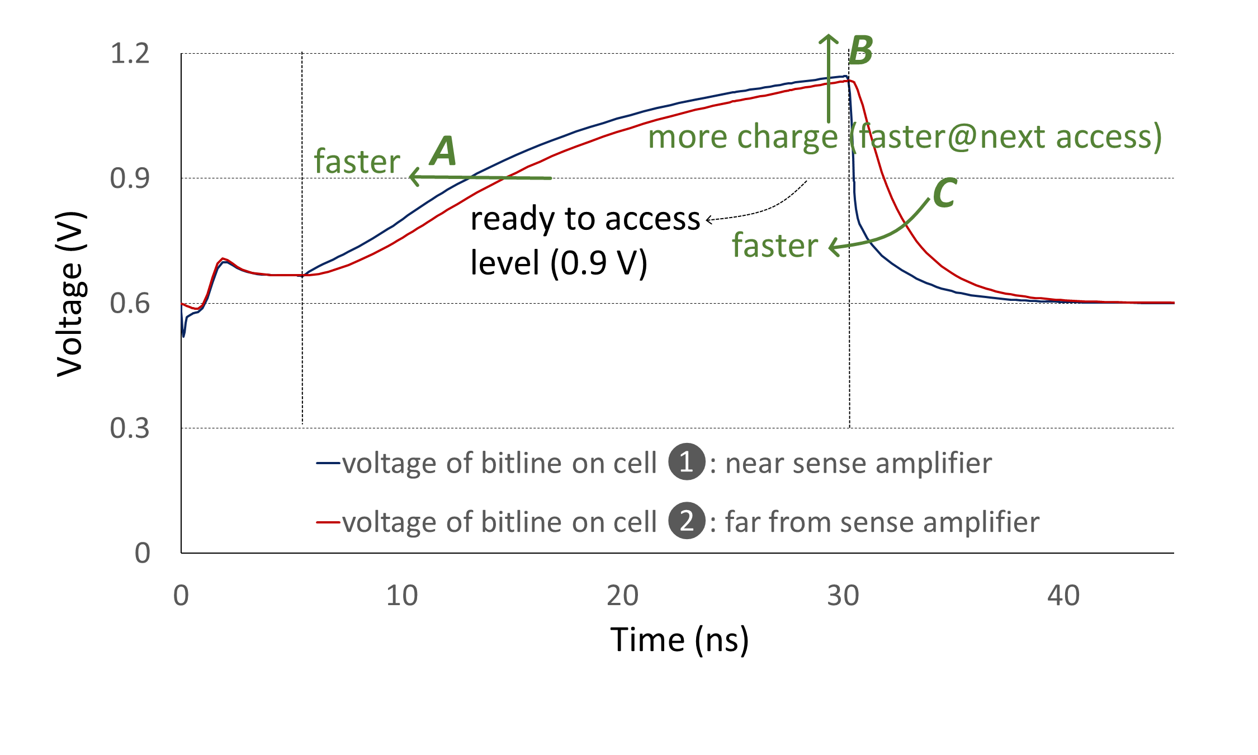

Slide 63
