Slide 1
18-740: Computer Architecture Recitation 4:
Rethinking Memory System Design
Prof. Onur Mutlu
Carnegie Mellon University
Fall 2015
September 22, 2015
Notes:
1

Slide 2
Agenda
Review Assignments for Next Week
Rethinking Memory System Design (Continued)
With a lot of discussion, hopefully

Slide 3
Review Assignments for Next Week

Slide 4
Required Reviews
Due Tuesday Sep 29 @ 3pm
Enter your reviews on the review website
Please discuss ideas and thoughts on Piazza

Slide 5
Review Paper 1 (Required)
Eiman Ebrahimi, Chang Joo Lee, Onur Mutlu, and Yale N. Patt, "Fairness via Source Throttling: A Configurable and High-Performance Fairness Substrate for Multi-Core Memory Systems" Proceedings of the 15th International Conference on Architectural Support for Programming Languages and Operating Systems (ASPLOS), pages 335-346, Pittsburgh, PA, March 2010. Slides (pdf)
Related paper:
Kevin Chang, Rachata Ausavarungnirun, Chris Fallin, and Onur Mutlu, "HAT: Heterogeneous Adaptive Throttling for On-Chip Networks" Proceedings of the 24th International Symposium on Computer Architecture and High Performance Computing (SBAC-PAD), New York, NY, October 2012.

Slide 6
Review Paper 2 (Required)
Rachata Ausavarungnirun, Saugata Ghose, Onur Kayiran, Gabriel L. Loh, Chita R. Das, Mahmut T. Kandemir, and Onur Mutlu, "Exploiting Inter-Warp Heterogeneity to Improve GPGPU Performance" Proceedings of the 24th International Conference on Parallel Architectures and Compilation Techniques (PACT), San Francisco, CA, USA, October 2015.
Related paper:
Wilson W. L. Fung, Ivan Sham, George Yuan, and Tor M. Aamodt, Dynamic Warp Formation and Scheduling for Efficient GPU Control Flow, In proceedings of the 40th IEEE/ACM International Symposium on Microarchitecture (MICRO-40), pp. 407-418, Chicago, IL, December 1-5, 2007. slides. pre-print

Slide 7
Review Paper 3 (Required)
Donghyuk Lee, Yoongu Kim, Vivek Seshadri, Jamie Liu, Lavanya Subramanian, and Onur Mutlu, "Tiered-Latency DRAM: A Low Latency and Low Cost DRAM Architecture" Proceedings of the 19th International Symposium on High-Performance Computer Architecture (HPCA), Shenzhen, China, February 2013. Slides (pptx)
Related paper
Donghyuk Lee, Yoongu Kim, Gennady Pekhimenko, Samira Khan, Vivek Seshadri, Kevin Chang, and Onur Mutlu, "Adaptive-Latency DRAM: Optimizing DRAM Timing for the Common-Case" Proceedings of the 21st International Symposium on High-Performance Computer Architecture (HPCA), Bay Area, CA, February 2015. [Slides (pptx) (pdf)] [Full data sets]

Slide 8
Review Paper 4 (Optional)
Justin Meza, Qiang Wu, Sanjeev Kumar, and Onur Mutlu, "A Large-Scale Study of Flash Memory Errors in the Field" Proceedings of the ACM International Conference on Measurement and Modeling of Computer Systems (SIGMETRICS), Portland, OR, June 2015.
Related paper
Justin Meza, Qiang Wu, Sanjeev Kumar, and Onur Mutlu, "Revisiting Memory Errors in Large-Scale Production Data Centers: Analysis and Modeling of New Trends from the Field" Proceedings of the 45th Annual IEEE/IFIP International Conference on Dependable Systems and Networks (DSN), Rio de Janeiro, Brazil, June 2015. [Slides (pptx) (pdf)] [DRAM Error Model]

Slide 9
Project Proposal
Due Friday
September 25, 2015
Make sure your project is vetted by me before you write your proposal

Slide 10
Still Consider: Another Possible Project
GPU Warp Scheduling Championship
http://adwaitjog.github.io/gpu_scheduling.html

Slide 11
Rethinking Memory System Design

Slide 12
Some Promising Directions
New memory architectures
Rethinking DRAM and flash memory
A lot of hope in fixing DRAM
Enabling emerging NVM technologies
Hybrid memory systems
Single-level memory and storage
A lot of hope in hybrid memory systems and single-level stores
System-level memory/storage QoS
A lot of hope in designing a predictable system

Slide 13
Rethinking DRAM
In-Memory Computation
Refresh
Reliability
Latency
Bandwidth
Energy
Memory Compression

Slide 14
Two Key Questions in 3D Stacked PIM
What is the minimal processing-in-memory support we can provide ?
without changing the system significantly
while achieving significant benefits of processing in 3D-stacked memory
How can we accelerate important applications if we use 3D-stacked memory as a coarse-grained accelerator?
what is the architecture and programming model?
what are the mechanisms for acceleration?

Slide 15
A Scalable Processing-in-Memory Accelerator for Parallel Graph Processing
A Scalable Processing-in-Memory Accelerator
for Parallel Graph Processing (Ahn et al., ISCA 2015)

Slide 16
Large-Scale Graph Processing
Large graphs are everywhere
Scalable large-scale graph processing is challenging
36 Million
Wikipedia Pages
1.4 Billion
Facebook Users
300 Million
Twitter Users
30 Billion
Instagram Photos

Slide 17
Key Bottlenecks in Graph Processing
for (v: graph.vertices) {
for (w: v.successors) {
w.next_rank += weight * v.rank;
}
}
1. Frequent random memory accesses
v
&w
w.rank
w.next_rank
w.edges
weight * v.rank
w
…
2. Little amount of computation

Slide 18
Challenges in Scalable Graph Processing
Challenge 1: How to provide high memory bandwidth to computation units in a practical way?
Processing-in-memory based on 3D-stacked DRAM
Challenge 2: How to design computation units that efficiently exploit large memory bandwidth?
Specialized in-order cores called Tesseract cores
Latency-tolerant programming model
Graph-processing-specific prefetching schemes

Slide 19
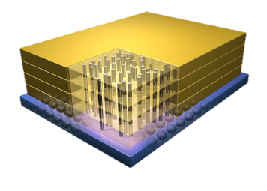
Tesseract System for Graph Processing
Host Processor
Memory-Mapped
Accelerator Interface
(Noncacheable, Physically Addressed)
In-Order Core
DRAM Controller
…
…
LP
PF Buffer
Crossbar Network
…
MTP
…
Message Queue
NI

Slide 20
Tesseract System for Graph Processing
Host Processor
Memory-Mapped
Accelerator Interface
(Noncacheable, Physically Addressed)
In-Order Core
DRAM Controller
…
…
Communications via Remote Function Calls
LP
PF Buffer
Crossbar Network
…
MTP
…
Message Queue
NI

Slide 21
Tesseract System for Graph Processing
Host Processor
Memory-Mapped
Accelerator Interface
(Noncacheable, Physically Addressed)
Prefetching
In-Order Core
DRAM Controller
…
…
LP
PF Buffer
Crossbar Network
…
MTP
…
Message Queue
NI

Slide 22
Evaluated Systems
DDR3-OoO
HMC-OoO
HMC-MC
Tesseract
(with FDP)
(with FDP)
(32-entry MQ, 4KB PF Buffer)
32 Tesseract Cores
8 OoO
4GHz
8 OoO
4GHz
8 OoO
4GHz
8 OoO
4GHz
128 In-Order
2GHz
128 In-Order
2GHz
8 OoO
4GHz
8 OoO
4GHz
8 OoO
4GHz
8 OoO
4GHz
128 In-Order
2GHz
128 In-Order
2GHz
102.4GB/s
640GB/s
640GB/s
8TB/s

Slide 23
Workloads
Five graph processing algorithms
Average teenage follower
Conductance
PageRank
Single-source shortest path
Vertex cover
Three real-world large graphs
ljournal-2008 (social network)
enwiki-2003 (Wikipedia)
indochina-0024 (web graph)
4~7M vertices, 79~194M edges

Slide 24
Tesseract Graph Processing Performance

Slide 25
Tesseract Graph Processing Performance

Slide 26
Effect of Bandwidth & Programming Model
HMC-MC Bandwidth (640GB/s)
Tesseract Bandwidth (8TB/s)
Programming Model
Bandwidth
(No Prefetching)

Slide 27
Memory Energy Consumption (Normalized)
-87%

Slide 28
Tesseract Summary
How can we accelerate large-scale graph processing using 3D-stacked memory as a coarse-grained accelerator?
Tesseract: 3D-stacked PIM accelerator for graph processing
Many in-order cores in a memory chip
New message passing mechanism for latency hiding
New hardware prefetchers for graph processing
Programming interface that exploits our hardware design
Promising results on five graph processing workloads
~14x performance improvement & 87% energy reduction
Scalable: memory-capacity-proportional performance

Slide 29
Two Approaches to In-Memory Processing
1. Minimally change DRAM to enable simple yet powerful computation primitives
RowClone: Fast and Efficient In-DRAM Copy and Initialization of Bulk Data (Seshadri et al., MICRO 2013)
Fast Bulk Bitwise AND and OR in DRAM (Seshadri et al., IEEE CAL 2015)
2. Exploit the control logic in 3D-stacked memory to enable more comprehensive computation near memory
PIM-Enabled Instructions: A Low-Overhead, Locality-Aware Processing-in-Memory Architecture (Ahn et al., ISCA 2015)
A Scalable Processing-in-Memory Accelerator for Parallel Graph Processing (Ahn et al., ISCA 2015)

Slide 30
In-Memory Computation: Summary
It is time to enable mechanisms for performing computation where it makes sense
Push from memory technology
Pull from systems and applications
Multiple approaches for in-memory computation can be successful
Minimally changing DRAM to enable a bulk computation model
Exploiting the control logic in 3D-stacked memory
Approaches require cross-layer cooperation and research
Architecture, systems, compilers, programming models, algorithms, …

Slide 31
Rethinking DRAM
In-Memory Computation
Refresh
Reliability
Latency
Bandwidth
Energy
Memory Compression

Slide 32
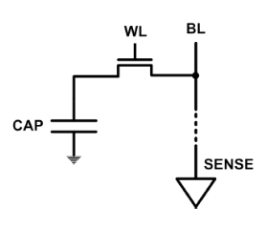
DRAM Refresh
DRAM capacitor charge leaks over time
The memory controller needs to refresh each row periodically to restore charge
Activate each row every N ms
Typical N = 64 ms
Downsides of refresh
-- Energy consumption: Each refresh consumes energy
-- Performance degradation: DRAM rank/bank unavailable while refreshed
-- QoS/predictability impact: (Long) pause times during refresh
-- Refresh rate limits DRAM capacity scaling

Slide 33
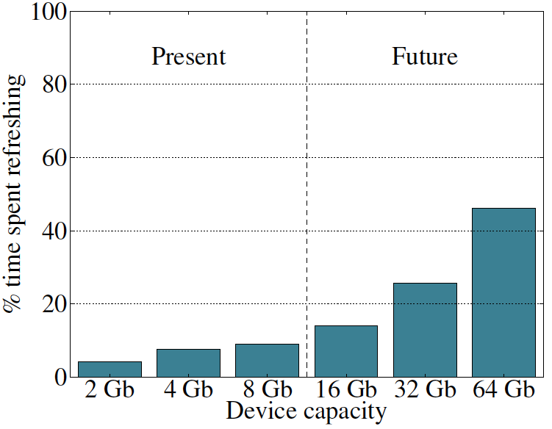
Refresh Overhead: Performance
46%
8%
Liu et al., “RAIDR: Retention-Aware Intelligent DRAM Refresh,” ISCA 2012.

Slide 34
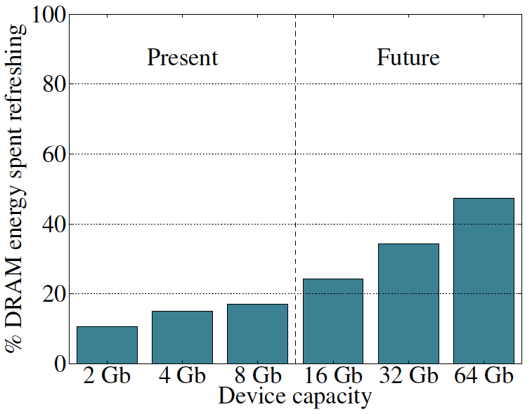
Refresh Overhead: Energy
47%
15%
Liu et al., “RAIDR: Retention-Aware Intelligent DRAM Refresh,” ISCA 2012.

Slide 35
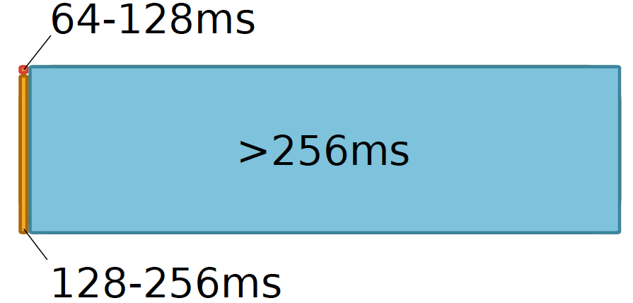
Retention Time Profile of DRAM

Slide 36
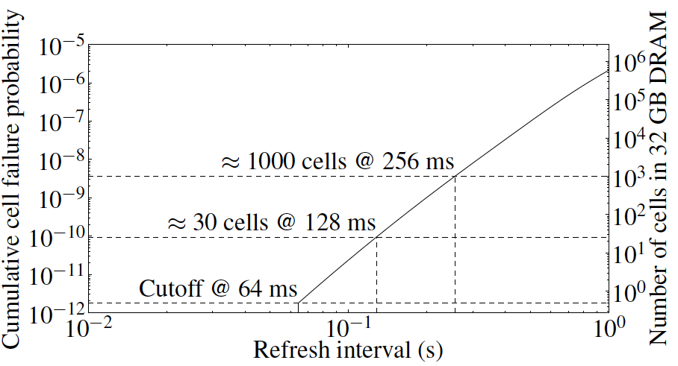
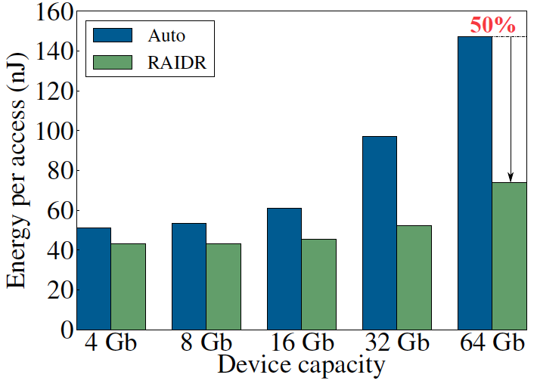
RAIDR: Eliminating Unnecessary Refreshes
Observation: Most DRAM rows can be refreshed much less often without losing data [Kim+, EDL’09][Liu+ ISCA’13]
Key idea: Refresh rows containing weak cells
more frequently, other rows less frequently
1. Profiling: Profile retention time of all rows
2. Binning: Store rows into bins by retention time in memory controller
Efficient storage with Bloom Filters (only 1.25KB for 32GB memory)
3. Refreshing: Memory controller refreshes rows in different bins at different rates
Results: 8-core, 32GB, SPEC, TPC-C, TPC-H
74.6% refresh reduction @ 1.25KB storage
~16%/20% DRAM dynamic/idle power reduction
~9% performance improvement
Benefits increase with DRAM capacity
Liu et al., “RAIDR: Retention-Aware Intelligent DRAM Refresh,” ISCA 2012.

Slide 37
Going Forward (for DRAM and Flash)
How to find out weak memory cells/rows
Liu+, “An Experimental Study of Data Retention Behavior in Modern DRAM Devices: Implications for Retention Time Profiling Mechanisms”, ISCA 2013.
Khan+, “The Efficacy of Error Mitigation Techniques for DRAM Retention Failures: A Comparative Experimental Study,” SIGMETRICS 2014.
Low-cost system-level tolerance of memory errors
Luo+, “Characterizing Application Memory Error Vulnerability to Optimize Data Center Cost,” DSN 2014.
Cai+, “Error Analysis and Retention-Aware Error Management for NAND Flash Memory,” Intel Technology Journal 2013.
Cai+, “Neighbor-Cell Assisted Error Correction for MLC NAND Flash Memories,” SIGMETRICS 2014.
Tolerating cell-to-cell interference at the system level
Kim+, “Flipping Bits in Memory Without Accessing Them: An Experimental Study of DRAM Disturbance Errors,” ISCA 2014.
Cai+, “Program Interference in MLC NAND Flash Memory: Characterization, Modeling, and Mitigation,” ICCD 2013.

Slide 38
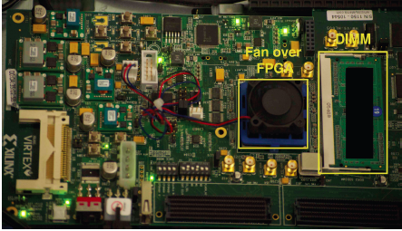
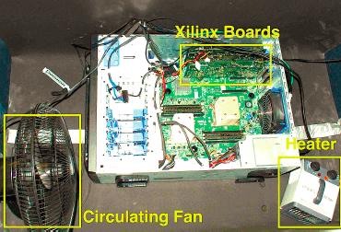
Experimental DRAM Testing Infrastructure
An Experimental Study of Data Retention Behavior in Modern DRAM Devices: Implications for Retention Time Profiling Mechanisms (Liu et al., ISCA 2013)
The Efficacy of Error Mitigation Techniques for DRAM Retention Failures: A Comparative Experimental Study
(Khan et al., SIGMETRICS 2014)
Flipping Bits in Memory Without Accessing Them: An Experimental Study of DRAM Disturbance Errors (Kim et al., ISCA 2014)
Adaptive-Latency DRAM: Optimizing DRAM Timing for the Common-Case (Lee et al., HPCA 2015)
AVATAR: A Variable-Retention-Time (VRT) Aware Refresh for DRAM Systems (Qureshi et al., DSN 2015)

Slide 39
Experimental Infrastructure (DRAM)
Temperature
Controller
FPGAs
Heater
FPGAs
PC
Kim+, “Flipping Bits in Memory Without Accessing Them: An Experimental Study of DRAM Disturbance Errors,” ISCA 2014.

Slide 40
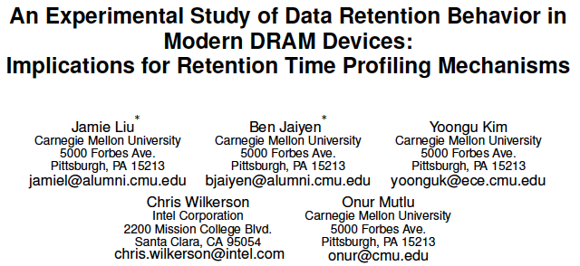
More Information [ISCA’13, SIGMETRICS’14]

Slide 41
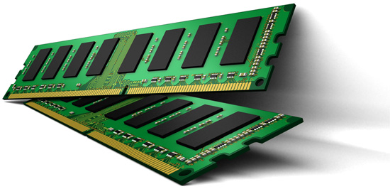
Online Profiling of DRAM In the Field
Initially protect DRAM
with ECC
Periodically test
parts of DRAM
1
2
Test
ECC
Test
Test
Adjust refresh rate and
reduce ECC
3
Optimize DRAM and mitigate errors online
without disturbing the system and applications
Notes:
Based on these observations, we propose that in an online profiling system,

Slide 42
Rethinking DRAM
In-Memory Computation
Refresh
Reliability
Latency
Bandwidth
Energy
Memory Compression

Slide 43
DRAM Latency-Capacity Trend
16X
-20%
DRAM latency continues to be a critical bottleneck, especially for response time-sensitive workloads
Notes:
The figure shows the historical trends of DRAM during the last 12-years, from 2000 to 2011.
We can see that, during this time, DRAM capacity has increased by 16 times.
On the other hand, during the same period of time, DRAM latency has reduced by only 20%.
As a result, the high DRAM latency continues to be a critical bottleneck for system performance.

Slide 44
What Causes the Long Latency?
DRAM Chip
DRAM Chip
cell array
subarray
Subarray
I/O
I/O
I/O
channel
channel
DRAM Latency = Subarray Latency + I/O Latency
DRAM Latency = Subarray Latency + I/O Latency
Dominant
Notes:
To understand what causes the long latency, let me take a look at the DRAM organization.
DRAM consists of two components, the cell array and the I/O circuitry. The cell array consists of multiple subarrays.
To read from a DRAM chip, the data is first accessed from the subarray and then the data is transferred over the channel by the I/O circuitry.
So, the DRAM latency is the sum of the subarray latency and the I/O latency.
We observed that the subarray latency is much higher than the I/O latency.
As a result, subarray is the dominant source of the DRAM latency as we explained in the paper.

Slide 45
Why is the Subarray So Slow?
Subarray
Cell
cell
wordline
bitline: 512 cells
access
row decoder
row decoder
transistor
capacitor
sense amplifier
bitline
sense amplifier
large sense amplifier
Long bitline
Amortizes sense amplifier cost → Small area
Large bitline capacitance → High latency & power
Notes:
The cell’s capacitor is small and can store only a small amount of charge.
That is why a subarray also has sense-amplifiers, which are specialized circuits that can detect the small amount of charge.
Unfortunately, a sense-amplifier size is about *100* times the cell size.
So, to amortize the area of the sense-amplifiers,
hundreds of cells share the same sense-amplifier through a long bitline.
However, a long bitline has a large capacitance that increases latency and power consumption.
Therefore, the long bitline is one of the dominant sources of high latency and high power consumption.
To understand why the subarray is so slow,
let me take a look at the subarray organization.

Slide 46
Trade-Off: Area (Die Size) vs. Latency
Long Bitline
Short Bitline
Faster
Smaller
Trade-Off: Area vs. Latency
Notes:
A naïve way to reduce the DRAM latency is to have short bitlines that have lower latency.
Unfortunately, short bitlines significantly increase the DRAM area.
Therefore, the bitline length exposes an important trade-off between area and latency.

Slide 47
Trade-Off: Area (Die Size) vs. Latency
32
Fancy DRAM
Short Bitline
Commodity DRAM
Long Bitline
64
Cheaper
128
256
512 cells/bitline
GOAL
Faster
Notes:
This figure shows the trade-off between DRAM area and latency as we change the bitline length.
Y-axis is the normalized DRAM area compared to a DRAM using 512 cells/bitline. A lower value is cheaper.
X-axis shows the latency in terms of tRC, an important DRAM timing constraint. A lower value is faster.
Commodity DRAM chips use long bitlines to minimize area cost. On the other hand, shorter bitlines achieve lower latency at higher cost.
Our goal is to achieve the best of both worlds: low latency and low area cost.

Slide 48
Approximating the Best of Both Worlds
Long Bitline
Long Bitline
Our Proposal
Short Bitline
Short Bitline
Small Area
Large Area
Small Area
High Latency
Low Latency
Low Latency
Need Isolation
Add Isolation Transistors
Short Bitline ➔ Fast
Notes:
To sum up, both long and short bitline do not achieve small area and low latency.
Long bitline has small area but has high latency while short bitline has low latency but has large area.
To achieve the best of both worlds, we first start from long bitline, which has small area.
After that, to achieve the low latency of short bitline, we divide the long bitline into two smaller segments.
The bitline length of the segment nearby the sense-amplifier is same as the length of short bitline.
Therefore, the latency of the segment is as low as the latency of the short bitline.
To isolate this fast segment from the other segment, we add isolation transistors that selectively connect the two segments.

Slide 49
Approximating the Best of Both Worlds
Long Bitline
Tiered-Latency DRAM
Our Proposal
Short Bitline
Long Bitline
Short Bitline
Small Area
Small Area
Large Area
High Latency
Low Latency
Low Latency
Small area using long bitline
Low Latency
Notes:
This way, our proposed approach achieves small area and low latency.
We call this new DRAM architecture as Tiered-Latency DRAM

Slide 50
Commodity DRAM vs. TL-DRAM [HPCA 2013]
DRAM Latency (tRC)
DRAM Power
+49%
+23%
(52.5ns)
Latency
Power
–56%
–51%
Near Far
Near Far
Commodity DRAM
Commodity DRAM
TL-DRAM
TL-DRAM
DRAM Area Overhead
~3%: mainly due to the isolation transistors
Notes:
This figure compares the latency.
Y-axis is normalized latency.
Compared to commodity DRAM, TL-DRAM’s near segment has 56% lower latency, while the far segment has 23% higher latency.
The right figure compares the power.
Y-axis is normalized power.
Compared to commodity DRAM, TL-DRAM’s near segment has 51% lower power consumption and the far segment has 49% higher power consumption.
Lastly, mainly due to the isolation transistor, Tiered-latency DRAM increases the die-size by about 3%.

Slide 51
Trade-Off: Area (Die-Area) vs. Latency
32
64
Cheaper
128
256
512 cells/bitline
Near Segment
Far Segment
GOAL
Faster
Notes:
Again, the figure shows the trade-off between area and latency in existing DRAM.
Unlike existing DRAM, TL-DRAM achieves low latency using the near segment while increasing the area by only 3%.
Although the far segment has higher latency than commodity DRAM, we show that efficient use of the near segment enables TL-DRAM to achieve high system performance.

Slide 52
Leveraging Tiered-Latency DRAM
TL-DRAM is a substrate that can be leveraged by the hardware and/or software
Many potential uses
Use near segment as hardware-managed inclusive cache to far segment
Use near segment as hardware-managed exclusive cache to far segment
Profile-based page mapping by operating system
Simply replace DRAM with TL-DRAM
Lee+, “Tiered-Latency DRAM: A Low Latency and Low Cost DRAM Architecture,” HPCA 2013.
Notes:
There are multiple ways to leverage the TL-DRAM substrate by hardware or software.
In this slide, I describe many such ways.
First, the near segment can be used as a hardware-managed inclusive cache to the far segment.
Second, the near segment can be used as a hardware-managed exclusive cache to the far segment.
Third, the operating system can intelligently allocate frequently-accessed pages to the near segment.
Forth mechanism is to simple replace DRAM with TL-DRAM without any near segment handling
While our paper provides detailed explanations and evaluations of first three mechanism,
in this talk, we will focus on the first approach, which is to use the near segment as a hardware managed cache for the far segment.

Slide 53
Performance & Power Consumption
12.4%
11.5%
10.7%
–23%
–24%
–26%
Normalized Performance
Normalized Power
Core-Count (Channel)
Core-Count (Channel)
Using near segment as a cache improves performance and reduces power consumption
Lee+, “Tiered-Latency DRAM: A Low Latency and Low Cost DRAM Architecture,” HPCA 2013.
Notes:
This figure shows the IPC improvement of our three caching mechanisms over commodity DRAM.
All of them improve performance and benefit-based caching shows maximum performance improvement by 12.7%.
The right figure shows the normalized power reduction of our three caching mechanisms over commodity DRAM.
All of them reduce power consumption and benefit-based caching shows maximum power reduction by 23%.
Therefore, using near segment as a cache improves performance and reduces power consumption at the cost of 3% area overhead.

Slide 54
What Else Causes the Long DRAM Latency?
Conservative timing margins!
DRAM timing parameters are set to cover the worst case
Worst-case temperatures
85 degrees vs. common-case
to enable a wide range of operating conditions
Worst-case devices
DRAM cell with smallest charge across any acceptable device
to tolerate process variation at acceptable yield
This leads to large timing margins for the common case

Slide 55
Adaptive-Latency DRAM [HPCA 2015]
Idea: Optimize DRAM timing for the common case
Current temperature
Current DRAM module
Why would this reduce latency?
A DRAM cell can store much more charge in the common case (low temperature, strong cell) than in the worst case
More charge in a DRAM cell
→ Faster sensing, charge restoration, precharging
→ Faster access (read, write, refresh, …)
Lee+, “Adaptive-Latency DRAM: Optimizing DRAM Timing for the Common-Case,” HPCA 2015.

Slide 56
AL-DRAM
Key idea
Optimize DRAM timing parameters online
Two components
DRAM manufacturer provides multiple sets of reliable DRAM timing parameters at different temperatures for each DIMM
System monitors DRAM temperature & uses appropriate DRAM timing parameters
reliable DRAM timing parameters
DRAM temperature
Lee+, “Adaptive-Latency DRAM: Optimizing DRAM Timing for the Common-Case,” HPCA 2015.

Slide 57
Latency Reduction Summary of 115 DIMMs
Latency reduction for read & write (55°C)
Read Latency: 32.7%
Write Latency: 55.1%
Latency reduction for each timing parameter (55°C)
Sensing: 17.3%
Restore: 37.3% (read), 54.8% (write)
Precharge: 35.2%
Lee+, “Adaptive-Latency DRAM: Optimizing DRAM Timing for the Common-Case,” HPCA 2015.

Slide 58
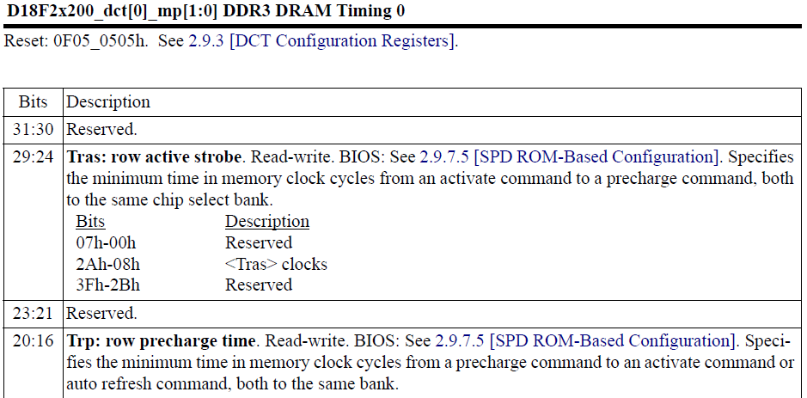
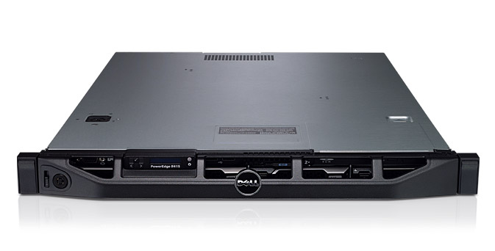
AL-DRAM: Real System Evaluation
System
CPU: AMD 4386 ( 8 Cores, 3.1GHz, 8MB LLC)
DRAM: 4GByte DDR3-1600 (800Mhz Clock)
OS: Linux
Storage: 128GByte SSD
Workload
35 applications from SPEC, STREAM, Parsec, Memcached, Apache, GUPS

Slide 59
AL-DRAM: Single-Core Evaluation
Average
Improvement
6.7%
Performance Improvement
5.0%
1.4%
all-35-workload
AL-DRAM improves performance on a real system

Slide 60
AL-DRAM: Multi-Core Evaluation
Average
Improvement
14.0%
10.4%
Performance Improvement
2.9%
all-35-workload
AL-DRAM provides higher performance for
multi-programmed & multi-threaded workloads

Slide 61
Rethinking DRAM
In-Memory Computation
Refresh
Reliability
Latency
Bandwidth
Energy
Memory Compression

Slide 62
Agenda
Major Trends Affecting Main Memory
The Memory Scaling Problem and Solution Directions
New Memory Architectures
Enabling Emerging Technologies
How Can We Do Better?
Summary

Slide 63
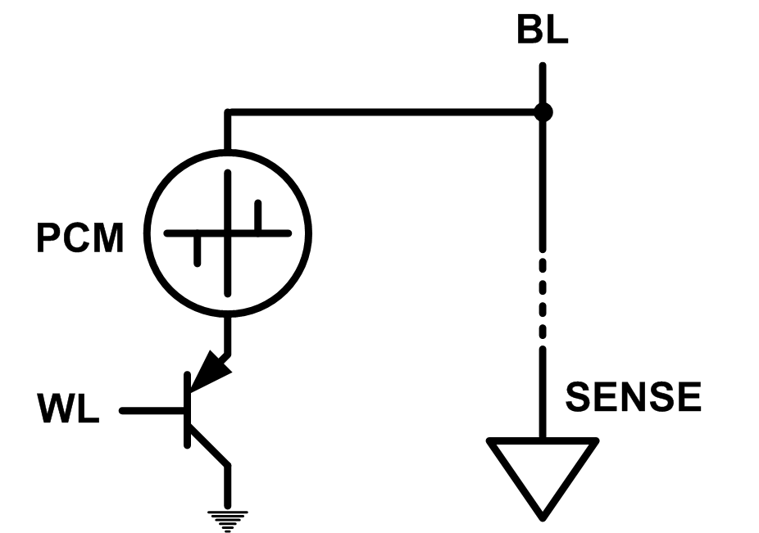
Solution 2: Emerging Memory Technologies
Some emerging resistive memory technologies seem more scalable than DRAM (and they are non-volatile)
Example: Phase Change Memory
Data stored by changing phase of material
Data read by detecting material’s resistance
Expected to scale to 9nm (2022 [ITRS])
Prototyped at 20nm (Raoux+, IBM JRD 2008)
Expected to be denser than DRAM: can store multiple bits/cell
But, emerging technologies have (many) shortcomings
Can they be enabled to replace/augment/surpass DRAM?
Notes:
Even if DRAM continues to scale there could be benefits to examining and enabling these new technologies.

Slide 64
Charge vs. Resistive Memories
Charge Memory (e.g., DRAM, Flash)
Write data by capturing charge Q
Read data by detecting voltage V
Resistive Memory (e.g., PCM, STT-MRAM, memristors)
Write data by pulsing current dQ/dt
Read data by detecting resistance R

Slide 65
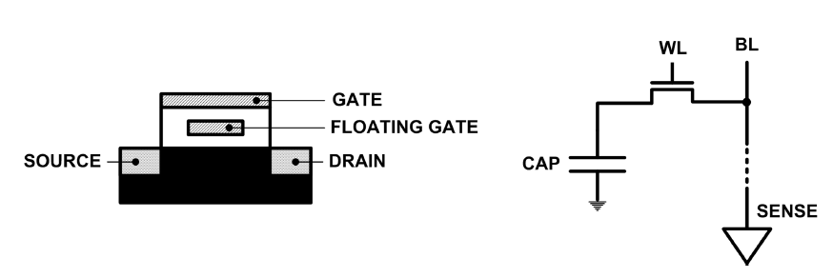
Limits of Charge Memory
Difficult charge placement and control
Flash: floating gate charge
DRAM: capacitor charge, transistor leakage
Reliable sensing becomes difficult as charge storage unit size reduces

Slide 66
Promising Resistive Memory Technologies
PCM
Inject current to change material phase
Resistance determined by phase
STT-MRAM
Inject current to change magnet polarity
Resistance determined by polarity
Memristors/RRAM/ReRAM
Inject current to change atomic structure
Resistance determined by atom distance

Slide 67
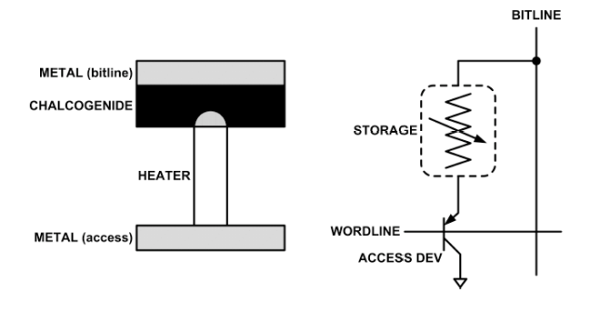
What is Phase Change Memory?
Phase change material (chalcogenide glass) exists in two states:
Amorphous: Low optical reflexivity and high electrical resistivity
Crystalline: High optical reflexivity and low electrical resistivity
PCM is resistive memory: High resistance (0), Low resistance (1)
PCM cell can be switched between states reliably and quickly

Slide 68
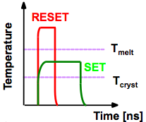
How Does PCM Work?
Write: change phase via current injection
SET: sustained current to heat cell above Tcryst
RESET: cell heated above Tmelt and quenched
Read: detect phase via material resistance
amorphous/crystalline
Large
Current
Small
Current
Memory
Element
SET (cryst)
Low resistance
Access
Device
RESET (amorph)
High resistance
10³-10⁴ Ω
10⁶-10⁷ Ω
Photo Courtesy: Bipin Rajendran, IBM
Slide Courtesy: Moinuddin Qureshi, IBM

Slide 69
Opportunity: PCM Advantages
Scales better than DRAM, Flash
Requires current pulses, which scale linearly with feature size
Expected to scale to 9nm (2022 [ITRS])
Prototyped at 20nm (Raoux+, IBM JRD 2008)
Can be denser than DRAM
Can store multiple bits per cell due to large resistance range
Prototypes with 2 bits/cell in ISSCC’08, 4 bits/cell by 2012
Non-volatile
Retain data for >10 years at 85C
No refresh needed, low idle power

Slide 70
Phase Change Memory Properties
Surveyed prototypes from 2003-2008 (ITRS, IEDM, VLSI, ISSCC)
Derived PCM parameters for F=90nm
Lee, Ipek, Mutlu, Burger, “Architecting Phase Change Memory as a Scalable DRAM Alternative,” ISCA 2009.

Slide 71
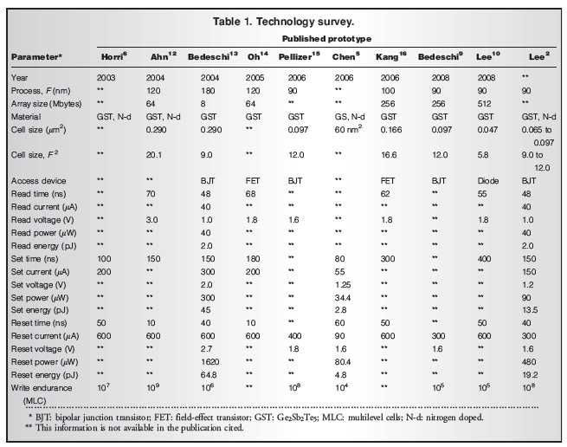

Slide 72
Phase Change Memory Properties: Latency
Latency comparable to, but slower than DRAM
Read Latency
50ns: 4x DRAM, 10⁻³x NAND Flash
Write Latency
150ns: 12x DRAM
Write Bandwidth
5-10 MB/s: 0.1x DRAM, 1x NAND Flash

Slide 73
Phase Change Memory Properties
Dynamic Energy
40 uA Rd, 150 uA Wr
2-43x DRAM, 1x NAND Flash
Endurance
Writes induce phase change at 650C
Contacts degrade from thermal expansion/contraction
10⁸ writes per cell
10⁻⁸x DRAM, 10³x NAND Flash
Cell Size
9-12F² using BJT, single-level cells
1.5x DRAM, 2-3x NAND (will scale with feature size, MLC)

Slide 74
Phase Change Memory: Pros and Cons
Pros over DRAM
Better technology scaling (capacity and cost)
Non volatility
Low idle power (no refresh)
Cons
Higher latencies: ~4-15x DRAM (especially write)
Higher active energy: ~2-50x DRAM (especially write)
Lower endurance (a cell dies after ~10⁸ writes)
Reliability issues (resistance drift)
Challenges in enabling PCM as DRAM replacement/helper:
Mitigate PCM shortcomings
Find the right way to place PCM in the system

Slide 75
PCM-based Main Memory: Research Challenges
Where to place PCM in the memory hierarchy?
Hybrid OS controlled PCM-DRAM
Hybrid OS controlled PCM and hardware-controlled DRAM
Pure PCM main memory
How to mitigate shortcomings of PCM?
How to minimize amount of DRAM in the system?
How to take advantage of (byte-addressable and fast) non-volatile main memory?
Can we design specific-NVM-technology-agnostic techniques?

Slide 76
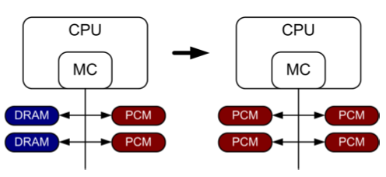
PCM-based Main Memory (I)
How should PCM-based (main) memory be organized?
Hybrid PCM+DRAM [Qureshi+ ISCA’09, Dhiman+ DAC’09]:
How to partition/migrate data between PCM and DRAM

Slide 77
Hybrid Memory Systems: Challenges
Partitioning
Should DRAM be a cache or main memory, or configurable?
What fraction? How many controllers?
Data allocation/movement (energy, performance, lifetime)
Who manages allocation/movement?
What are good control algorithms?
How do we prevent degradation of service due to wearout?
Design of cache hierarchy, memory controllers, OS
Mitigate PCM shortcomings, exploit PCM advantages
Design of PCM/DRAM chips and modules
Rethink the design of PCM/DRAM with new requirements

Slide 78
PCM-based Main Memory (II)
How should PCM-based (main) memory be organized?
Pure PCM main memory [Lee et al., ISCA’09, Top Picks’10]:
How to redesign entire hierarchy (and cores) to overcome PCM shortcomings

Slide 79
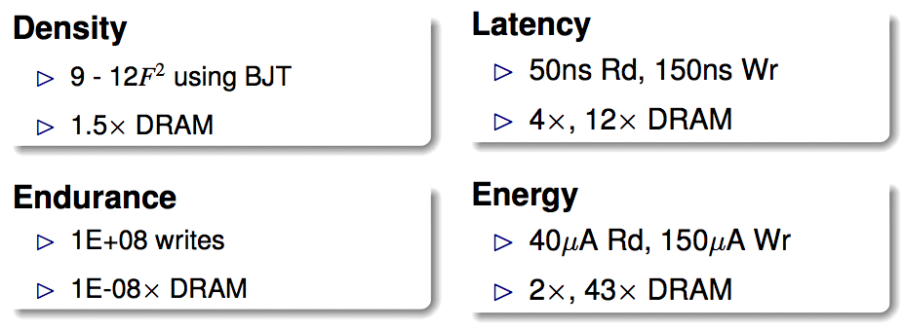
An Initial Study: Replace DRAM with PCM
Lee, Ipek, Mutlu, Burger, “Architecting Phase Change Memory as a Scalable DRAM Alternative,” ISCA 2009.
Surveyed prototypes from 2003-2008 (e.g. IEDM, VLSI, ISSCC)
Derived “average” PCM parameters for F=90nm

Slide 80
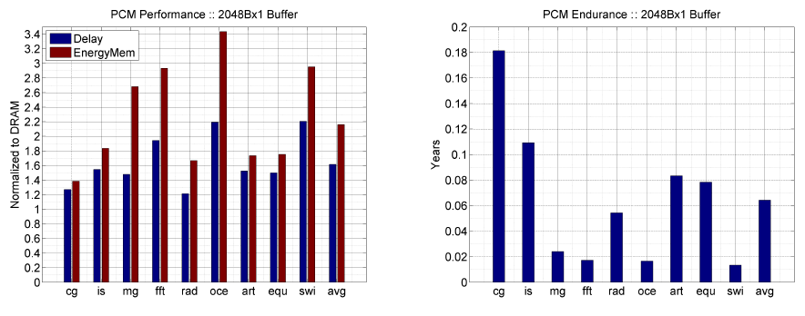
Results: Naïve Replacement of DRAM with PCM
Replace DRAM with PCM in a 4-core, 4MB L2 system
PCM organized the same as DRAM: row buffers, banks, peripherals
1.6x delay, 2.2x energy, 500-hour average lifetime
Lee, Ipek, Mutlu, Burger, “Architecting Phase Change Memory as a Scalable DRAM Alternative,” ISCA 2009.

Slide 81
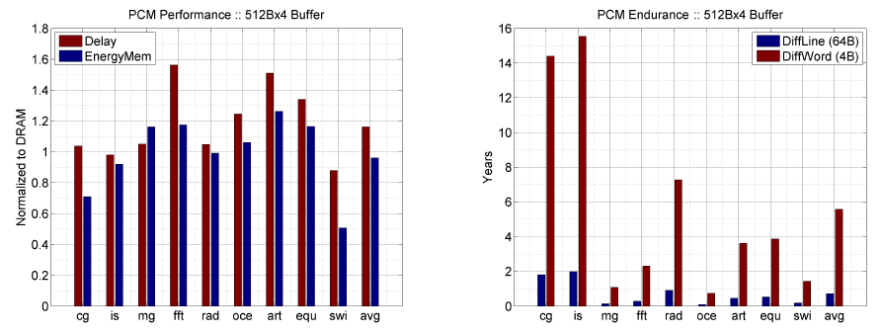
Results: Architected PCM as Main Memory
1.2x delay, 1.0x energy, 5.6-year average lifetime
Scaling improves energy, endurance, density
Caveat 1: Worst-case lifetime is much shorter (no guarantees)
Caveat 2: Intensive applications see large performance and energy hits
Caveat 3: Optimistic PCM parameters?

Slide 82
Solution 3: Hybrid Memory Systems
CPU
Meza+, “Enabling Efficient and Scalable Hybrid Memories,” IEEE Comp. Arch. Letters, 2012.
Yoon+, “Row Buffer Locality Aware Caching Policies for Hybrid Memories,” ICCD 2012 Best Paper Award.
DRAMCtrl
PCM Ctrl
DRAM
Phase Change Memory (or Tech. X)
Fast, durable
Small,
leaky, volatile,
high-cost
Large, non-volatile, low-cost
Slow, wears out, high active energy
Hardware/software manage data allocation and movement
to achieve the best of multiple technologies

Slide 83
18-740: Computer Architecture Recitation 4:
Rethinking Memory System Design
Prof. Onur Mutlu
Carnegie Mellon University
Fall 2015
September 22, 2015
Notes:
83

