Slide 1
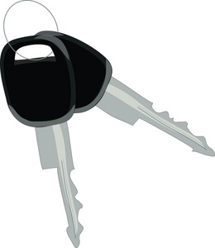
BBackSafe
Team 13
Charlie (Zhaotao) Xu
May Zhai
Andrew Chung
Frank Zhou

Slide 2
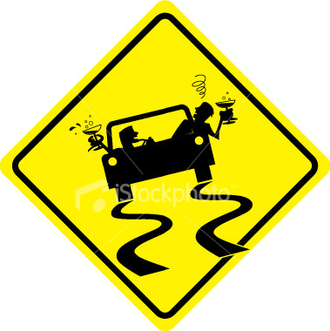
Concept/Motivation
Motivation
Before: drunk driving is the source
of many traffic accidents
112 million DUIs in the US in 2010
BBackSafe aims to protect the
drivers from themselves
Concept
Integrate a breathalyzer and warning system with a car key
Prompts user to pass breathalyzer test before driving
If test fails, car will not start and key will send message to emergency contact via user ' s smartphone
After: number of drunk driving incidents reduced by affordable, versatile device

Slide 3
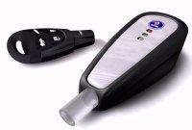
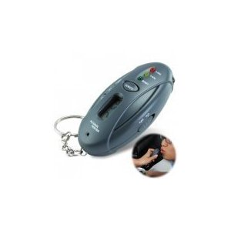
Competitive Analysis
Saab's Alcokey
Expensive, $408 projected
No emergency contact
Compatibility issues
Breathalyzer Key Chains
Cheap, $7
Does not effectively restricts user from driving
No emergency contact
Smart Start Ignition Interlock
$85 Installation fee and $75/month for subscription
Tedious registration process
Target audience is for people convicted of DUIs

Slide 4
Product Matrix
 | Easy installation | Use with any vehicle | Warning system | Prohibits driving | Price
Saab's Alcokey | No | No | No | Yes | $400
Breathalyzer Key Chains | Yes | Yes | No | No | $70
Smart Start Ignition Interlock | No | Yes | Yes | Yes | $85 + monthly fee
Taka TruTouch BAC Reader | No | Yes | No | Yes | $200
BBackSafe | Yes | Yes | Yes | Yes | $150

Slide 5
Requirements
Functional
Alcohol sensor accepts breath sample as input
Sensor obtains digital reading of BAC
If the BAC is greater than 0.08%
Disable starting the car (via Bluetooth)
Send SMS message containing driver’s location to emergency contacts (via Bluetooth)
Otherwise, allow driver to start the car
Non Functional
Reliability: disable car start once test has failed
Portability: size no bigger than a normal car keychain
Timing: provide a response in no more than 5 seconds
Performance: driver can try multiple times until he passes the test

Slide 6
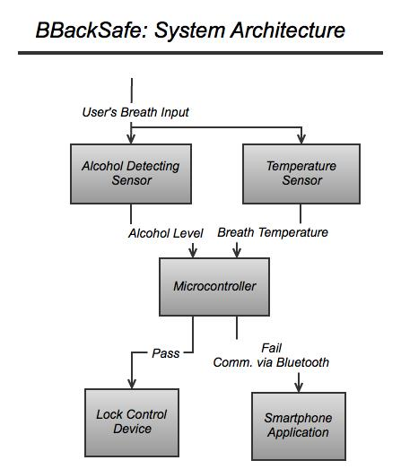
Architecture

Slide 7
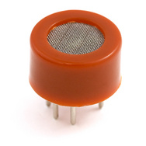
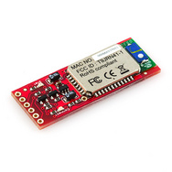
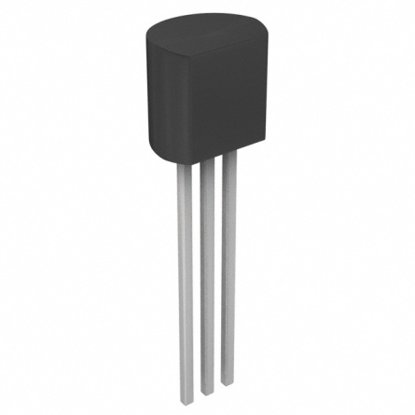
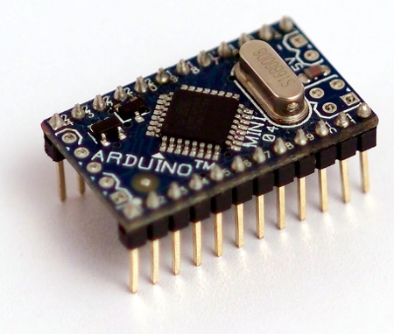
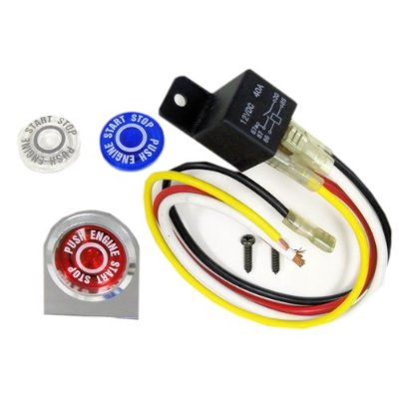
Technical specifications
MQ-3 sensor
Thermometer
Arduino mini
Bluetooth Mate
Engine Starter Igniter
Android client

Slide 8
Risk/Mitigation Strategy
Someone else breathes into key instead
Short battery life
Bluetooth failure
Sensor inaccuracy
Unsupported user behavior
Make system low-power consumption or charge it on car
Test multiple times to make sure it works
Test and tune multiple times

Slide 9
Questions?

