Slide 1
18-447
Computer Architecture
Lecture 25: Main Memory Wrap-Up
Prof. Onur Mutlu
Carnegie Mellon University
Spring 2014, 4/2/2014

Slide 2
Upcoming Seminar on DRAM (April 3)
April 3, Thursday, 4pm, this room (CIC Panther Hollow)
Prof. Rajeev Balasubramonian, Univ. of Utah
Memory Architectures for Emerging Technologies and Workloads
  The memory system will be a growing bottleneck for many workloads running on high-end servers. Performance improvements from technology scaling are also expected to decline in the coming decade. Therefore, new capabilities will be required in memory devices and memory controllers to achieve the next big leaps in performance and energy efficiency. Some of these capabilities will be inspired by emerging workloads (e.g., in-memory big-data, approximate computing, co-scheduled VMs), some will be inspired by new memory technologies (e.g., 3D stacking). The talk will discuss multiple early-stage projects in the Utah Arch lab that focus on DRAM parameter variation, near-data processing, and memory security.

Slide 3
Cloud Workshop All Day on April 4
http://www.industry-academia.org/event-carnegie-mellon-cloud-workshop.html
You need to register to attend. Gates 6115. Many talks:
Keynote: Prof. Onur Mutlu – Carnegie Mellon – "Rethinking Memory System Design for Data-Intensive Computing"
Prof. Rajeev Balasubramonian – Utah – “Practical Approaches to Memory Security in the Cloud”
Bryan Chin – Cavium – “Head in the Clouds - Building a Chip for Scale-out Computing”
Dr. Joon Kim - SK Hynix – “The Future of NVM Memories”
Prof. Andy Pavlo - Carnegie Mellon – “OLTP on NVM: YMMV"
Dr. John Busch – SanDisk – “The Impact of Flash Memory on the Future of Cloud Computing”
Keynote: Prof. Greg Ganger – Carnegie Mellon – “Scheduling Heterogeneous Resources in Cloud Datacenters”
Paul Rad – Rackspace – “OpenStack-Based High Performance Cloud Architecture”
Charles Butler – Ubuntu – “Cloud Service Orchestration with JuJu”
Prof. Mor Harchol-Balter - Carnegie Mellon – “Dynamic Power Management in Data Centers”
Prof. Eric Xing – Carnegie Mellon – “Petuum: A New Platform for Cloud-based Machine Learning to Efficiently Solve Big Data Problems”
Majid Bemanian – Imagination Technologies – “Security in the Cloud and Virtualized Mobile Devices”
Robert Broberg – Cisco – “Cloud Security Challenges and Solutions”

Slide 4
Cloud Career Fair on April 4
http://www.industry-academia.org/event-carnegie-mellon-cloud-workshop.html
Gates 6121, 11am-3pm
Runs in Room 6121 in parallel to the Tech Forum, from 11am to 3PM. IAP members will have informational/recruiting tables on site. During the breaks in the technical presentations and lunch, the Tech Forum attendees can network on lining up an internship or that first full-time engineering job. Students who are only interested and/or able to attend the Career Fair are welcome to do so, but please indicate this specific interest on your registration application (see the “Register Here” button below).

Slide 5
Memory Interference and Scheduling in Multi-Core Systems

Slide 6
Review: PAR-BS Pros and Cons
Upsides:
  First scheduler to address bank parallelism destruction across multiple threads
  Simple mechanism (vs. STFM)
  Batching provides fairness
  Ranking enables parallelism awareness
Downsides:
  Implementation in multiple controllers needs coordination for best performance → too frequent coordination since batching is done frequently
  Does not always prioritize the latency-sensitive applications

Slide 7
TCM:
Thread Cluster Memory Scheduling
Yoongu Kim, Michael Papamichael, Onur Mutlu, and Mor Harchol-Balter,
"Thread Cluster Memory Scheduling:
Exploiting Differences in Memory Access Behavior"
43rd International Symposium on Microarchitecture (MICRO),
pages 65-76, Atlanta, GA, December 2010. Slides (pptx) (pdf)
TCM Micro 2010 Talk

Slide 8
Throughput vs. Fairness
24 cores, 4 memory controllers, 96 workloads
Better fairness
System throughput bias
Better system throughput
Ideal
Fairness bias
No previous memory scheduling algorithm provides both the best fairness and system throughput
Notes:
The problem is that previously proposed scheduling algorithms are biased.
Shown here is a plot, where the x-axis is weighted speedup, a metric of system throughput and system throughput increases as you move towards the right on the x-axis.
The y-axis is maximum slowdown, which is the slowdown of the most unfairly treated thread within a workload. Correspondingly, fairness increases as you move downwards on the y-axis.
Ideally, a memory scheduling algorithm would be situated towards the lower right part of the graph where fairness and system throughput are both high.
However, some previous algorithms are biased towards system throughput, whereas some are biased towards fairness, while others are optimized for neither.
The takeaway is that no previous memory scheduling algorithm provides both the best fairness and system throughput.

Slide 9
Throughput vs. Fairness
Throughput biased approach
Fairness biased approach
  Prioritize less memory-intensive threads
  Take turns accessing memory
  Good for throughput
  Does not starve
thread A
less memory
intensive
thread B
higher
priority
thread C
thread A
thread B
thread C
not prioritized ➔
reduced throughput
starvation ➔ unfairness
Single policy for all threads is insufficient
Notes:
So why do previous algorithms fail?
On the one hand there is the throughput biased approach that prioritizes less memory-intensive threads.
Servicing memory requests from such threads allow them to make progress in the processor, increasing throughput.
However, the most memory-intensive thread, thread C, remains persistently deprioritized and and becomes prone to starvation causing large slowdowns and, ultimately, unfairness.
On the other hand there is the fairness biased approach where threads take turns accessing the memory.
In this case, the most memory-intensive thread does not starve.
However, the least memory-intensive thread, thread A, is not prioritized, leading to reduced throughput.
As you can see, a single policy applied to all threads is insufficient since different threads have different memory access needs.

Slide 10

Achieving the Best of Both Worlds
higher
priority
For Throughput
  Prioritize memory-non-intensive threads
thread
thread
thread
For Fairness
thread
  Unfairness caused by memory-intensive being prioritized over each other
    Shuffle thread ranking
  Memory-intensive threads have
  different vulnerability to interference
    Shuffle asymmetrically
thread
thread
thread
thread
thread
thread
thread
thread
Notes:
So how do we achieve the best of both worlds? Our algorithm is based on the following insights:
First, we would like to prioritize the memory-non-intensive threads to increase system throughput.
Doing so does not degrade unfairness, since memory-non-intensive threads are inherently “light” and rarely cause interference for the memory-intensive threads.
For fairness, we discovered that unfairness is usually caused when one memory-intensive thread is prioritized over another.
As we’ve seen, the most deprioritized thread can starve.
To address this problem, we would like to shuffle their priority so that no single thread is persistently prioritized over another thread.
However, memory-intensive threads are not created equal.
They have different vulnerability to memory interference.
To address their differences, shuffling should be performed in an asymmetric manner.

Slide 11
Thread Cluster Memory Scheduling [Kim+ MICRO’10]
Group threads into two clusters
Prioritize non-intensive cluster
Different policies for each cluster
higher
priority
Memory-non-intensive
Non-intensive
cluster
thread
Throughput
thread
thread
thread
thread
thread
Prioritized
higher
priority
thread
thread
thread
thread
Threads in the system
Memory-intensive
Intensive cluster
Fairness
Notes:
Our algorithm, Thread Cluster Memory Scheduling, first groups threads into two clusters.
Among the threads executing in the system, some are memory-non-intensive whereas some are memory-intensive.
We isolate the memory-non-intensive threads into the non-intensive cluster and the memory-intensive threads into the intensive cluster.
This is so that we can apply different policies for different threads.
Subsequently, we prioritize the non-intensive cluster over the intensive cluster since the non-intensive threads have greater potential for making progress IN THEIR CORES [ONUR].
Finally, we apply different policies within each cluster, one optimized for throughput and the other for fairness.

Slide 12
Clustering Threads
Step1 Sort threads by MPKI (misses per kiloinstruction)
higher
MPKI
thread
thread
thread
thread
thread
thread
Non-intensive
cluster
Intensive
cluster
αT
T
α < 10% ClusterThreshold
T = Total memory bandwidth usage
Step2 Memory bandwidth usage αT divides clusters
Notes:
To group threads into two clusters, we first sort threads according to their MPKI, which stands for last-level cache-misses per kiloinstruction and is a metric of memory intensity.
After sorting, the leftmost thread is the thread with the lowest MPKI.
We then define a quantity called T, which is the total memory bandwidth usage across all threads.
Second, we form the non-intensive cluster by including threads whose bandwidth usage sums up to a certain fraction of the memory bandwidth usage.
That fraction is defined by a parameter called the ClusterThreshold. I will show later in the presentation how adjusting this parameter we can trade off between throughput and fairness.
Lastly, the remaining threads become the intensive cluster.

Slide 13
TCM: Quantum-Based Operation
Previous quantum (~1M cycles)
Current quantum
(~1M cycles)
Time
Shuffle interval
(~1K cycles)
During quantum:
Monitor thread behavior
Memory intensity
Bank-level parallelism
Row-buffer locality
Beginning of quantum:
Perform clustering
Compute niceness of intensive threads
Notes:
Clustering is performed at regular time intervals called quanta.
THIS IS DONE [ONUR] to account for phase changes in threads’ memory access behavior.
During A [ONUR] quantum, TCM monitors each thread’s memory access behavior:
memory intensity, bank-level parallelism, and row-buffer locality.
At the beginning of the next quantum, TCM is invoked to perform clustering and calculate niceness for the intensive threads.
Throughout the quantum, shuffling of the intensive threads is performed periodically.

Slide 14
TCM: Scheduling Algorithm
Highest-rank: Requests from higher ranked threads prioritized
    Non-Intensive cluster > Intensive cluster
    Non-Intensive cluster: lower intensity ➔ higher rank
    Intensive cluster: rank shuffling
Row-hit: Row-buffer hit requests are prioritized
Oldest: Older requests are prioritized
Notes:
To bring it all together, TCM comprises three simple request prioritization rules.
The first is the highest-rank rule, where requests from higher ranked threads are prioritized.
The intensive cluster is prioritized over the non-intensive cluster TO IMPROVE SYSTEM [ONUR] throughput.
Within the intensive cluster, threads are assigned higher rank in the order of decreasing intensity. This, again, is to increase SYSTEM [ONUR] throughput.
Within the non-intensive cluster, the rank of threads are periodically shuffled and does not stay constant, TO ACHIEVE FAIRNESS [ONUR].
As a tie-breaker, the second rule is row-hit where row-buffer hitting requests are prioritized.
Lastly, all else being the same, we prioritize the oldest request.

Slide 15
TCM: Throughput and Fairness
24 cores, 4 memory controllers, 96 workloads
Better fairness
Better system throughput
TCM, a heterogeneous scheduling policy,
provides best fairness and system throughput
Notes:
This figure shows the performance of the four previous scheduling algorithms in addition to TCM, averaged over 96 workloads.
FRFCFS has low system throughput and fairness.
STFM and PAR-BS is biased towards fairness, while ATLAS is biased towards system throughput.
TCM lies towards the lower right part of the figure and provides the best fairness and system throughput.
Compared to ATLAS, TCM provides approx 5% better throughput and 39% better fairness.
Compared to PAR-BS, TCM provides approx 5% better fairness and 8% better throughput.

Slide 16
TCM: Fairness-Throughput Tradeoff
When configuration parameter is varied…
Better fairness
FRFCFS
STFM
Better system throughput
ATLAS
PAR-BS
TCM
Adjusting ClusterThreshold
TCM allows robust fairness-throughput tradeoff

Slide 17
TCM Pros and Cons
Upsides:
  Provides both high fairness and high performance
  Caters to the needs for different types of threads (latency vs. bandwidth sensitive)
  (Relatively) simple
Downsides:
  Scalability to large buffer sizes?
  Robustness of clustering and shuffling algorithms?

Slide 18
Other Ways of Handling Interference

Slide 19
Fundamental Interference Control Techniques
Goal: to reduce/control interference
1. Prioritization or request scheduling
2. Data mapping to banks/channels/ranks
3. Core/source throttling
4. Application/thread scheduling

Slide 20
Memory Channel Partitioning
Memory Channel Partitioning
  Idea: Map badly-interfering applications’ pages to different channels [Muralidhara+, MICRO’11]
Separate data of low/high intensity and low/high row-locality applications
Especially effective in reducing interference of threads with “medium” and “heavy” memory intensity
Time Units
Time Units
Channel 0
Channel 0
5
4
3
2
1
5
4
3
2
1
Bank 0
Bank 0
Core 0
App A
Core 0
App A
Bank 1
Bank 1
Bank 0
Core 1
App B
Bank 0
Core 1
App B
Bank 1
Bank 1
Channel 1
Channel 1
Conventional Page Mapping
Channel Partitioning
Muralidhara et al., “Memory Channel Partitioning,” MICRO’11.

Slide 21
Memory Channel Partitioning (MCP) Mechanism
Hardware
1. Profile applications
2. Classify applications into groups
3. Partition channels between application groups
4. Assign a preferred channel to each application
5. Allocate application pages to preferred channel
System Software

Slide 22
Observations
Applications with very low memory-intensity rarely access memory → Dedicating channels to them results in precious memory bandwidth waste
They have the most potential to keep their cores busy → We would really like to prioritize them
They interfere minimally with other applications → Prioritizing them does not hurt others

Slide 23
Integrated Memory Partitioning and Scheduling (IMPS)
Always prioritize very low memory-intensity applications in the memory scheduler
Use memory channel partitioning to mitigate interference between other applications
Muralidhara et al., “Memory Channel Partitioning,” MICRO’11.

Slide 24
Fundamental Interference Control Techniques
Goal: to reduce/control interference
1. Prioritization or request scheduling
2. Data mapping to banks/channels/ranks
3. Core/source throttling
4. Application/thread scheduling

Slide 25
An Alternative Approach: Source Throttling
Manage inter-thread interference at the cores (sources), not at the shared resources
Dynamically estimate unfairness in the memory system
Feed back this information into a controller
Throttle cores’ memory access rates accordingly
  Whom to throttle and by how much depends on performance target (throughput, fairness, per-thread QoS, etc)
  E.g., if unfairness > system-software-specified target then
  throttle down core causing unfairness &
  throttle up core that was unfairly treated
Ebrahimi et al., “Fairness via Source Throttling,” ASPLOS’10, TOCS’12.

Slide 26
Fairness via Source Throttling (FST) [ASPLOS’10]
Interval 1
Interval 2
Interval 3
Time
⎩
⎪
⎨
⎪
⎧
Slowdown Estimation
FST
Unfairness Estimate
Runtime Unfairness
Evaluation
Runtime Unfairness
Evaluation
Dynamic
Request Throttling
Dynamic
Request Throttling
App-slowest
App-interfering
1- Estimating system unfairness
2- Find app. with the highest slowdown (App-slowest)
3- Find app. causing most interference for App-slowest
(App-interfering)
if (Unfairness Estimate >Target)
{
1-Throttle down App-interfering
(limit injection rate and parallelism)
2-Throttle up App-slowest
}
26

Slide 27
Core (Source) Throttling
Idea: Estimate the slowdown due to (DRAM) interference and throttle down threads that slow down others
  Ebrahimi et al., “Fairness via Source Throttling: A Configurable and High-Performance Fairness Substrate for Multi-Core Memory Systems,” ASPLOS 2010.
Advantages
  + Core/request throttling is easy to implement: no need to change the memory scheduling algorithm
  + Can be a general way of handling shared resource contention
Disadvantages
  - Requires interference/slowdown estimations
  - Thresholds can become difficult to optimize → throughput loss

Slide 28
Fundamental Interference Control Techniques
Goal: to reduce/control interference
1. Prioritization or request scheduling
2. Data mapping to banks/channels/ranks
3. Core/source throttling
4. Application/thread scheduling
Idea: Pick threads that do not badly interfere with each other to be scheduled together on cores sharing the memory system

Slide 29
Handling Interference in Parallel Applications
Threads in a multithreaded application are inter-dependent
Some threads can be on the critical path of execution due to synchronization; some threads are not
How do we schedule requests of inter-dependent threads to maximize multithreaded application performance?
  Idea: Estimate limiter threads likely to be on the critical path and prioritize their requests; shuffle priorities of non-limiter threads to reduce memory interference among them [Ebrahimi+, MICRO’11]
  Hardware/software cooperative limiter thread estimation:
    Thread executing the most contended critical section
    Thread that is falling behind the most in a parallel for loop

Slide 30
Summary: Fundamental Interference Control Techniques
Goal: to reduce/control interference
1. Prioritization or request scheduling
2. Data mapping to banks/channels/ranks
3. Core/source throttling
4. Application/thread scheduling
Best is to combine all. How would you do that?

Slide 31
More on DRAM Controllers

Slide 32
DRAM Power Management
DRAM chips have power modes
Idea: When not accessing a chip power it down
Power states
  Active (highest power)
  All banks idle
  Power-down
  Self-refresh (lowest power)
State transitions incur latency during which the chip cannot be accessed

Slide 33
Why are DRAM Controllers Difficult to Design?
Need to obey DRAM timing constraints for correctness
  There are many (50+) timing constraints in DRAM
  tWTR: Minimum number of cycles to wait before issuing a read command after a write command is issued
  tRC: Minimum number of cycles between the issuing of two consecutive activate commands to the same bank
  …
Need to keep track of many resources to prevent conflicts
  Channels, banks, ranks, data bus, address bus, row buffers
Need to handle DRAM refresh
Need to manage power consumption
Need to optimize for performance (in the presence of constraints)
  Reordering is not simple
  Fairness and QoS needs complicates the scheduling problem

Slide 34
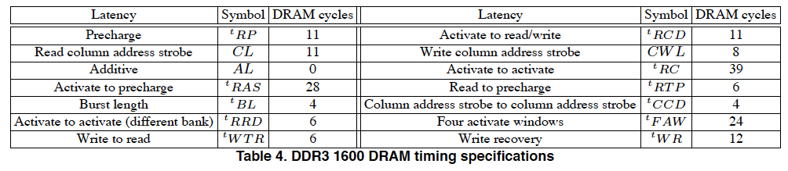
Many DRAM Timing Constraints
From Lee et al., “DRAM-Aware Last-Level Cache Writeback: Reducing Write-Caused Interference in Memory Systems,” HPS Technical Report, April 2010.

Slide 35
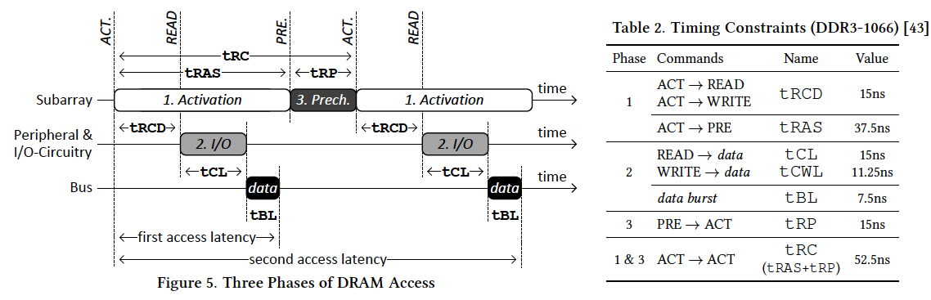
More on DRAM Operation
Kim et al., “A Case for Exploiting Subarray-Level Parallelism (SALP) in DRAM,” ISCA 2012.
Lee et al., “Tiered-Latency DRAM: A Low Latency and Low Cost DRAM Architecture,” HPCA 2013.

Slide 36
Self-Optimizing DRAM Controllers
Problem: DRAM controllers difficult to design → It is difficult for human designers to design a policy that can adapt itself very well to different workloads and different system conditions
Idea: Design a memory controller that adapts its scheduling policy decisions to workload behavior and system conditions using machine learning.
Observation: Reinforcement learning maps nicely to memory control.
Design: Memory controller is a reinforcement learning agent that dynamically and continuously learns and employs the best scheduling policy.
Ipek+, “Self Optimizing Memory Controllers: A Reinforcement Learning Approach,” ISCA 2008.

Slide 37
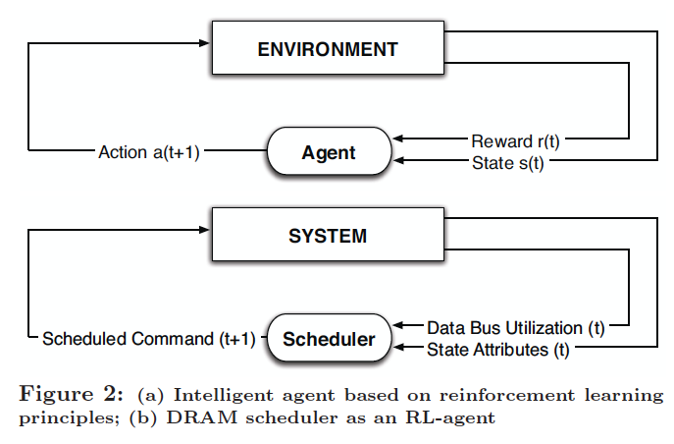
Self-Optimizing DRAM Controllers
Engin Ipek, Onur Mutlu, José F. Martínez, and Rich Caruana,
"Self Optimizing Memory Controllers: A Reinforcement Learning Approach"
Proceedings of the 35th International Symposium on Computer Architecture (ISCA), pages 39-50, Beijing, China, June 2008.
Goal: Learn to choose actions to maximize r₀ + γr₁ + γ²r₂ + … ( 0 ≤ γ < 1)

Slide 38
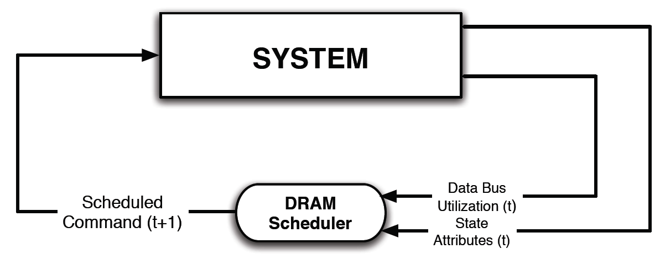
Self-Optimizing DRAM Controllers
Dynamically adapt the memory scheduling policy via interaction with the system at runtime
  Associate system states and actions (commands) with long term reward values
  Schedule command with highest estimated long-term value in each state
  Continuously update state-action values based on feedback from system

Slide 39
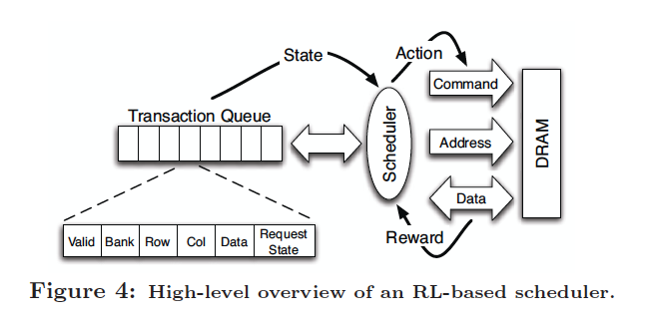
Self-Optimizing DRAM Controllers
Engin Ipek, Onur Mutlu, José F. Martínez, and Rich Caruana,
"Self Optimizing Memory Controllers: A Reinforcement Learning Approach"
Proceedings of the 35th International Symposium on Computer Architecture (ISCA), pages 39-50, Beijing, China, June 2008.

Slide 40
States, Actions, Rewards
Reward function
  +1 for scheduling Read and Write commands
  0 at all other times
State attributes
  Number of reads, writes, and load misses in transaction queue
  Number of pending writes and ROB heads waiting for referenced row
  Request’s relative ROB order
Actions
  Activate
  Write
  Read - load miss
  Read - store miss
  Precharge - pending
  Precharge - preemptive
  NOP

Slide 41
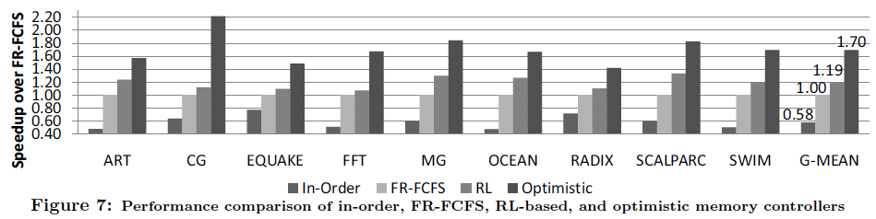
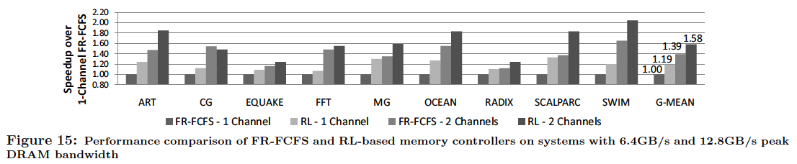
Performance Results

Slide 42
Self Optimizing DRAM Controllers
Advantages
  + Adapts the scheduling policy dynamically to changing workload behavior and to maximize a long-term target
  + Reduces the designer’s burden in finding a good scheduling policy. Designer specifies:
  1) What system variables might be useful
  2) What target to optimize, but not how to optimize it
Disadvantages
  -- Black box: designer much less likely to implement what she cannot easily reason about
  -- How to specify different reward functions that can achieve different objectives? (e.g., fairness, QoS)

Slide 43
DRAM Refresh

Slide 44
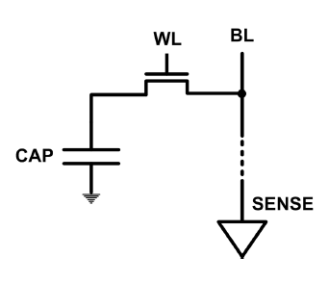
DRAM Refresh
DRAM capacitor charge leaks over time
The memory controller needs to refresh each row periodically to restore charge
  Read and close each row every N ms
  Typical N = 64 ms
Downsides of refresh
-- Energy consumption: Each refresh consumes energy
  -- Performance degradation: DRAM rank/bank unavailable while refreshed
  -- QoS/predictability impact: (Long) pause times during refresh
  -- Refresh rate limits DRAM capacity scaling

Slide 45
DRAM Refresh: Performance
Implications of refresh on performance
  -- DRAM bank unavailable while refreshed
  -- Long pause times: If we refresh all rows in burst, every 64ms the DRAM will be unavailable until refresh ends
Burst refresh: All rows refreshed immediately after one another
Distributed refresh: Each row refreshed at a different time, at regular intervals

Slide 46
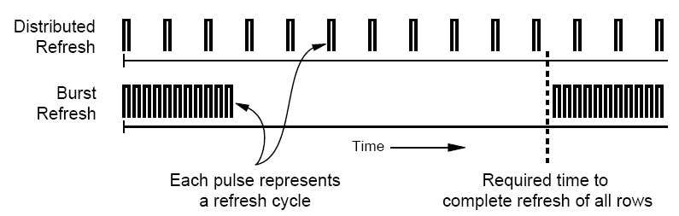
Distributed Refresh
Distributed refresh eliminates long pause times
How else can we reduce the effect of refresh on performance/QoS?
Does distributed refresh reduce refresh impact on energy?
Can we reduce the number of refreshes?

Slide 47
Refresh Today: Auto Refresh
Columns
BANK 0
BANK 1
BANK 2
BANK 3
Rows
Row Buffer
DRAM Bus
A batch of rows are
periodically refreshed
via the auto-refresh command
DRAM CONTROLLER
Notes:
The DRAM system consists of the DRAM banks, the DRAM bus, and the DRAM memory controller. DRAM banks store the data in physical memory. There are multiple DRAM banks to allow multiple memory requests to proceed in parallel.
Each DRAM bank has a 2-dimensional structure, consisting of rows by columns. Data can only be read from a “row buffer”, which acts as a cache that “caches” the last accessed row. As a result, a request that hits in the row buffer can be serviced much faster than a request that misses in the row buffer.
Existing DRAM controllers take advantage of this fact. To maximize DRAM throughput, these controllers prioritize row-hit requests over other requests in their scheduling. All else being equal, they prioritize older accesses over younger accesses. This policy is called the FR-FCFS policy. Note that this scheduling policy is designed for maximizing DRAM throughput and does not distinguish between different threads’ requests at all.
-----------------------------
Explain bank operation at a high level
- An access that is to the row in the row buffer takes a shorter time than to an access that is to another row.
Multiple banks put together to allow for multiple requests to be serviced in parallel
The DRAM controller treats each bank as an independent entity
In each bank, the DRAM controller optimizes for improving row buffer locality to improve DRAM throughput
- It prioritizes row-hit requests over other requests and all else being equal, older requests over younger requests. It is not aware of the different threads accessing it.
The DRAM controller does not coordinate accesses to different banks.
As a result requests of different threads can be serviced in different banks even though a single thread’s requests might be outstanding to multiple banks

Slide 48
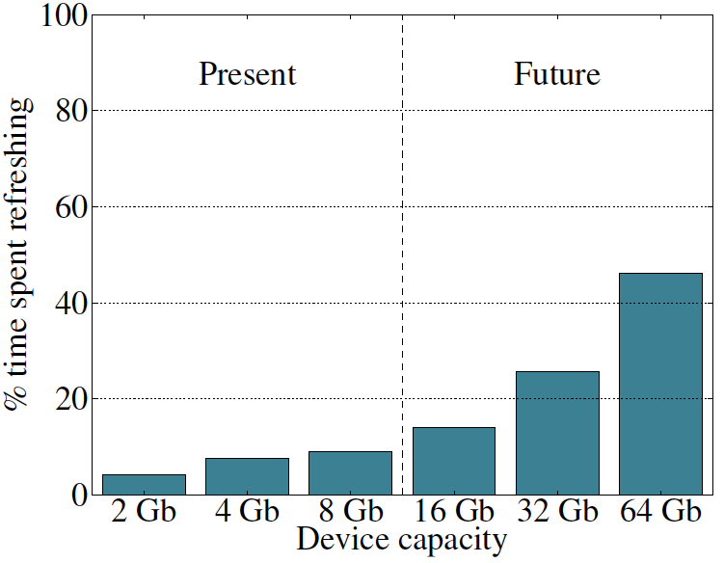
Refresh Overhead: Performance
46%
8%
Liu et al., “RAIDR: Retention-Aware Intelligent DRAM Refresh,” ISCA 2012.

Slide 49
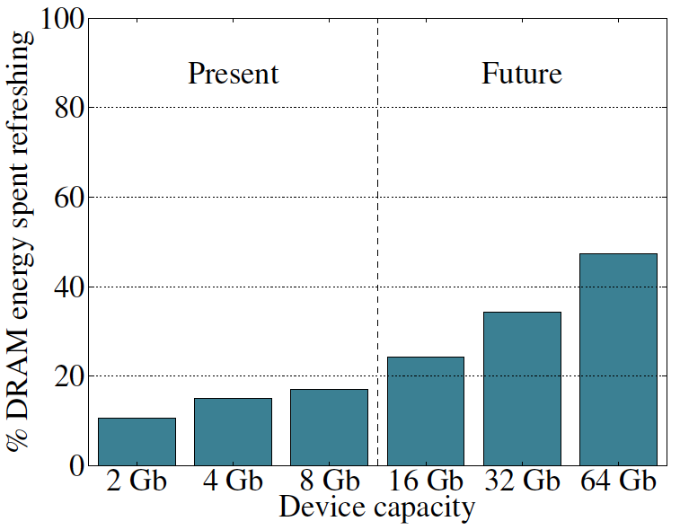
Refresh Overhead: Energy
47%
15%
Liu et al., “RAIDR: Retention-Aware Intelligent DRAM Refresh,” ISCA 2012.

Slide 50
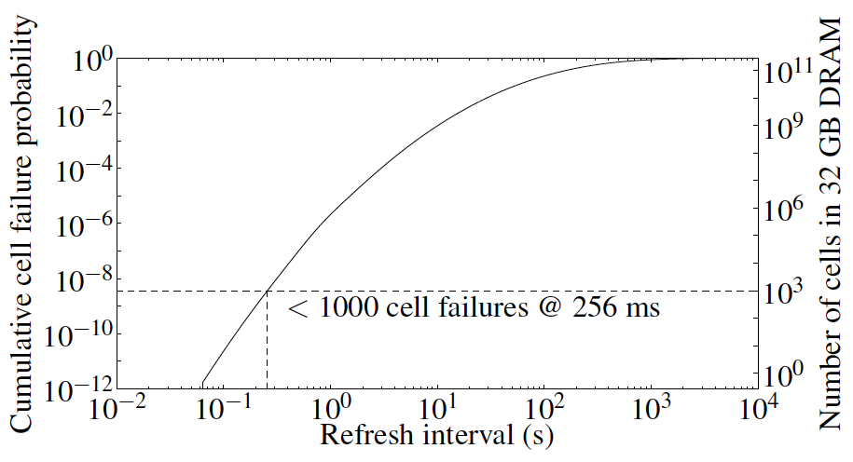
Problem with Conventional Refresh
Today: Every row is refreshed at the same rate
Observation: Most rows can be refreshed much less often without losing data [Kim+, EDL’09]
Problem: No support in DRAM for different refresh rates per row

Slide 51
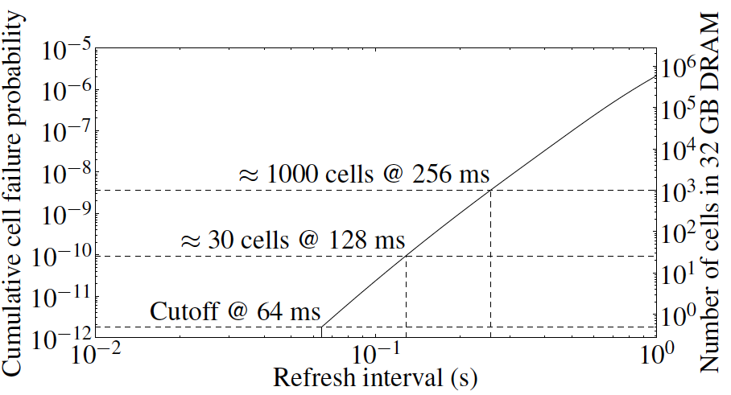
Retention Time of DRAM Rows
Observation: Only very few rows need to be refreshed at the worst-case rate
Can we exploit this to reduce refresh operations at low cost?

Slide 52
Reducing DRAM Refresh Operations
Idea: Identify the retention time of different rows and refresh each row at the frequency it needs to be refreshed
(Cost-conscious) Idea: Bin the rows according to their minimum retention times and refresh rows in each bin at the refresh rate specified for the bin
  e.g., a bin for 64-128ms, another for 128-256ms, …
Observation: Only very few rows need to be refreshed very frequently [64-128ms] → Have only a few bins → Low HW overhead to achieve large reductions in refresh operations
Liu et al., “RAIDR: Retention-Aware Intelligent DRAM Refresh,” ISCA 2012.

Slide 53
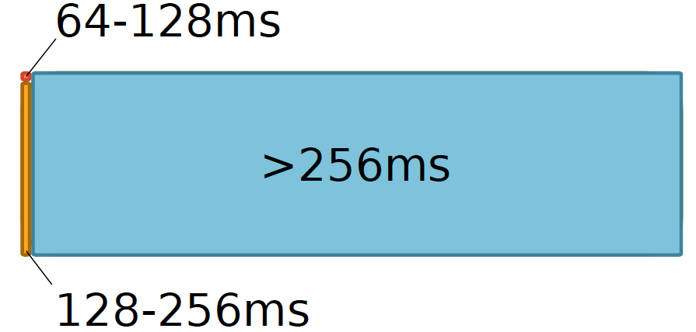

RAIDR: Mechanism
1. Profiling: Profile the retention time of all DRAM rows
→ can be done at DRAM design time or dynamically
2. Binning: Store rows into bins by retention time
→ use Bloom Filters for efficient and scalable storage
3. Refreshing: Memory controller refreshes rows in different bins at different rates
→ probe Bloom Filters to determine refresh rate of a row
1.25KB storage in controller for 32GB DRAM memory

Slide 54
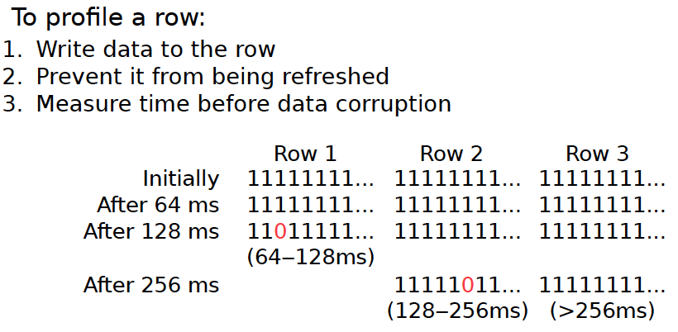
1. Profiling

Slide 55
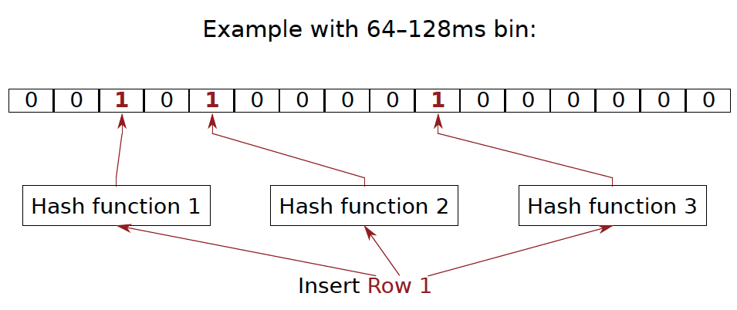
2. Binning
How to efficiently and scalably store rows into retention time bins?
  Use Hardware Bloom Filters [Bloom, CACM 1970]
Bloom, “Space/Time Trade-offs in Hash Coding with Allowable Errors”, CACM 1970.

Slide 56
Bloom Filter
[Bloom, CACM 1970]
Probabilistic data structure that compactly represents set membership (presence or absence of element in a set)
Non-approximate set membership: Use 1 bit per element to indicate absence/presence of each element from an element space of N elements
Approximate set membership: use a much smaller number of bits and indicate each element’s presence/absence with a subset of those bits
  Some elements map to the bits also mapped to other elements
Operations: 1) insert, 2) test, 3) remove all elements
Bloom, “Space/Time Trade-offs in Hash Coding with Allowable Errors”, CACM 1970.

Slide 57
Bloom Filter Operation Example
Bloom, “Space/Time Trade-offs in Hash Coding with Allowable Errors”, CACM 1970.

Slide 58
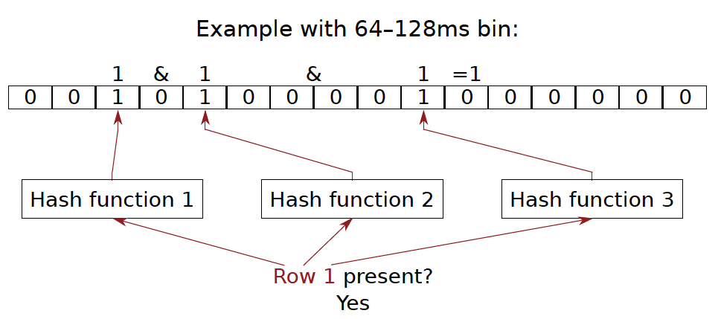
Bloom Filter Operation Example

Slide 59
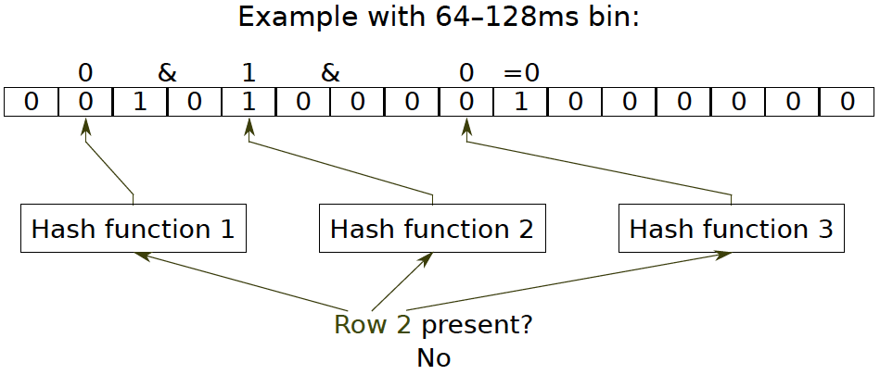
Bloom Filter Operation Example

Slide 60
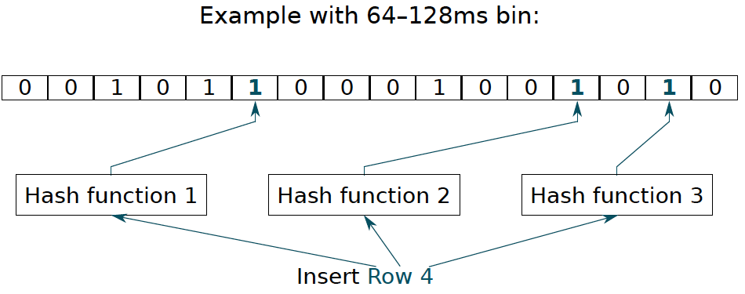
Bloom Filter Operation Example

Slide 61
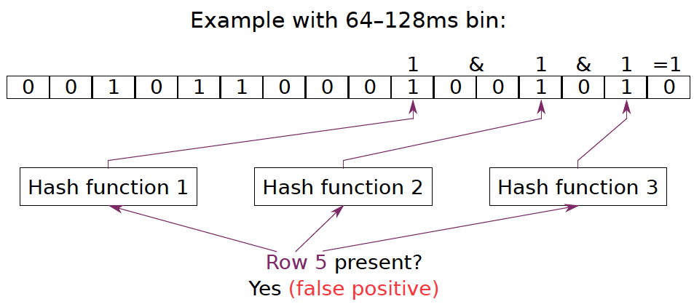
Bloom Filter Operation Example

Slide 62
Benefits of Bloom Filters as Bins
False positives: a row may be declared present in the Bloom filter even if it was never inserted
  Not a problem: Refresh some rows more frequently than needed
No false negatives: rows are never refreshed less frequently than needed (no correctness problems)
Scalable: a Bloom filter never overflows (unlike a fixed-size table)
Efficient: No need to store info on a per-row basis; simple hardware → 1.25 KB for 2 filters for 32 GB DRAM system

Slide 63
Use of Bloom Filters in Hardware
Useful when you can tolerate false positives in set membership tests
See the following recent examples for clear descriptions of how Bloom Filters are used
  Liu et al., “RAIDR: Retention-Aware Intelligent DRAM Refresh,” ISCA 2012.
  Seshadri et al., “The Evicted-Address Filter: A Unified Mechanism to Address Both Cache Pollution and Thrashing,” PACT 2012.

Slide 64
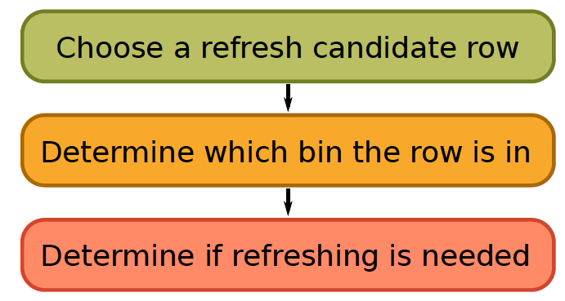
3. Refreshing (RAIDR Refresh Controller)

Slide 65
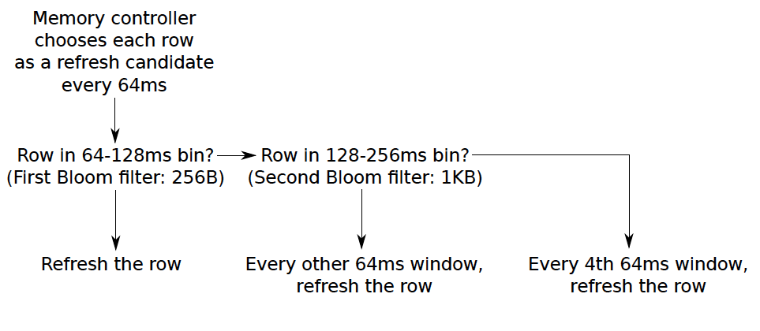
3. Refreshing (RAIDR Refresh Controller)
Liu et al., “RAIDR: Retention-Aware Intelligent DRAM Refresh,” ISCA 2012.

Slide 66
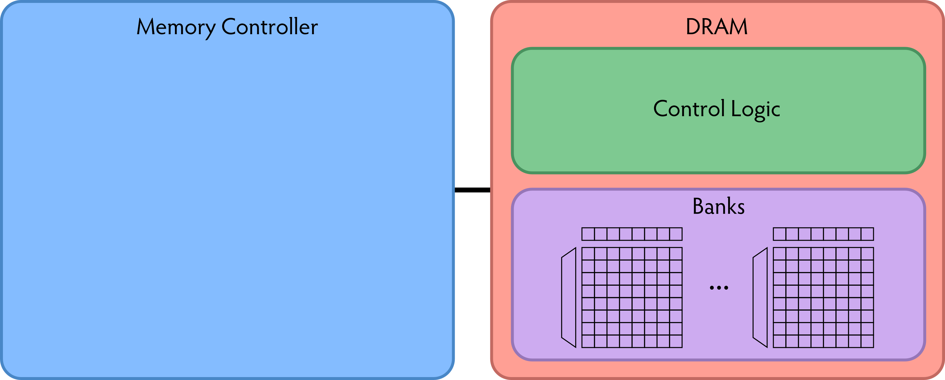
RAIDR: Baseline Design
Refresh control is in DRAM in today’s auto-refresh systems
RAIDR can be implemented in either the controller or DRAM

Slide 67
RAIDR in Memory Controller: Option 1
Overhead of RAIDR in DRAM controller:
1.25 KB Bloom Filters, 3 counters, additional commands issued for per-row refresh (all accounted for in evaluations)

Slide 68
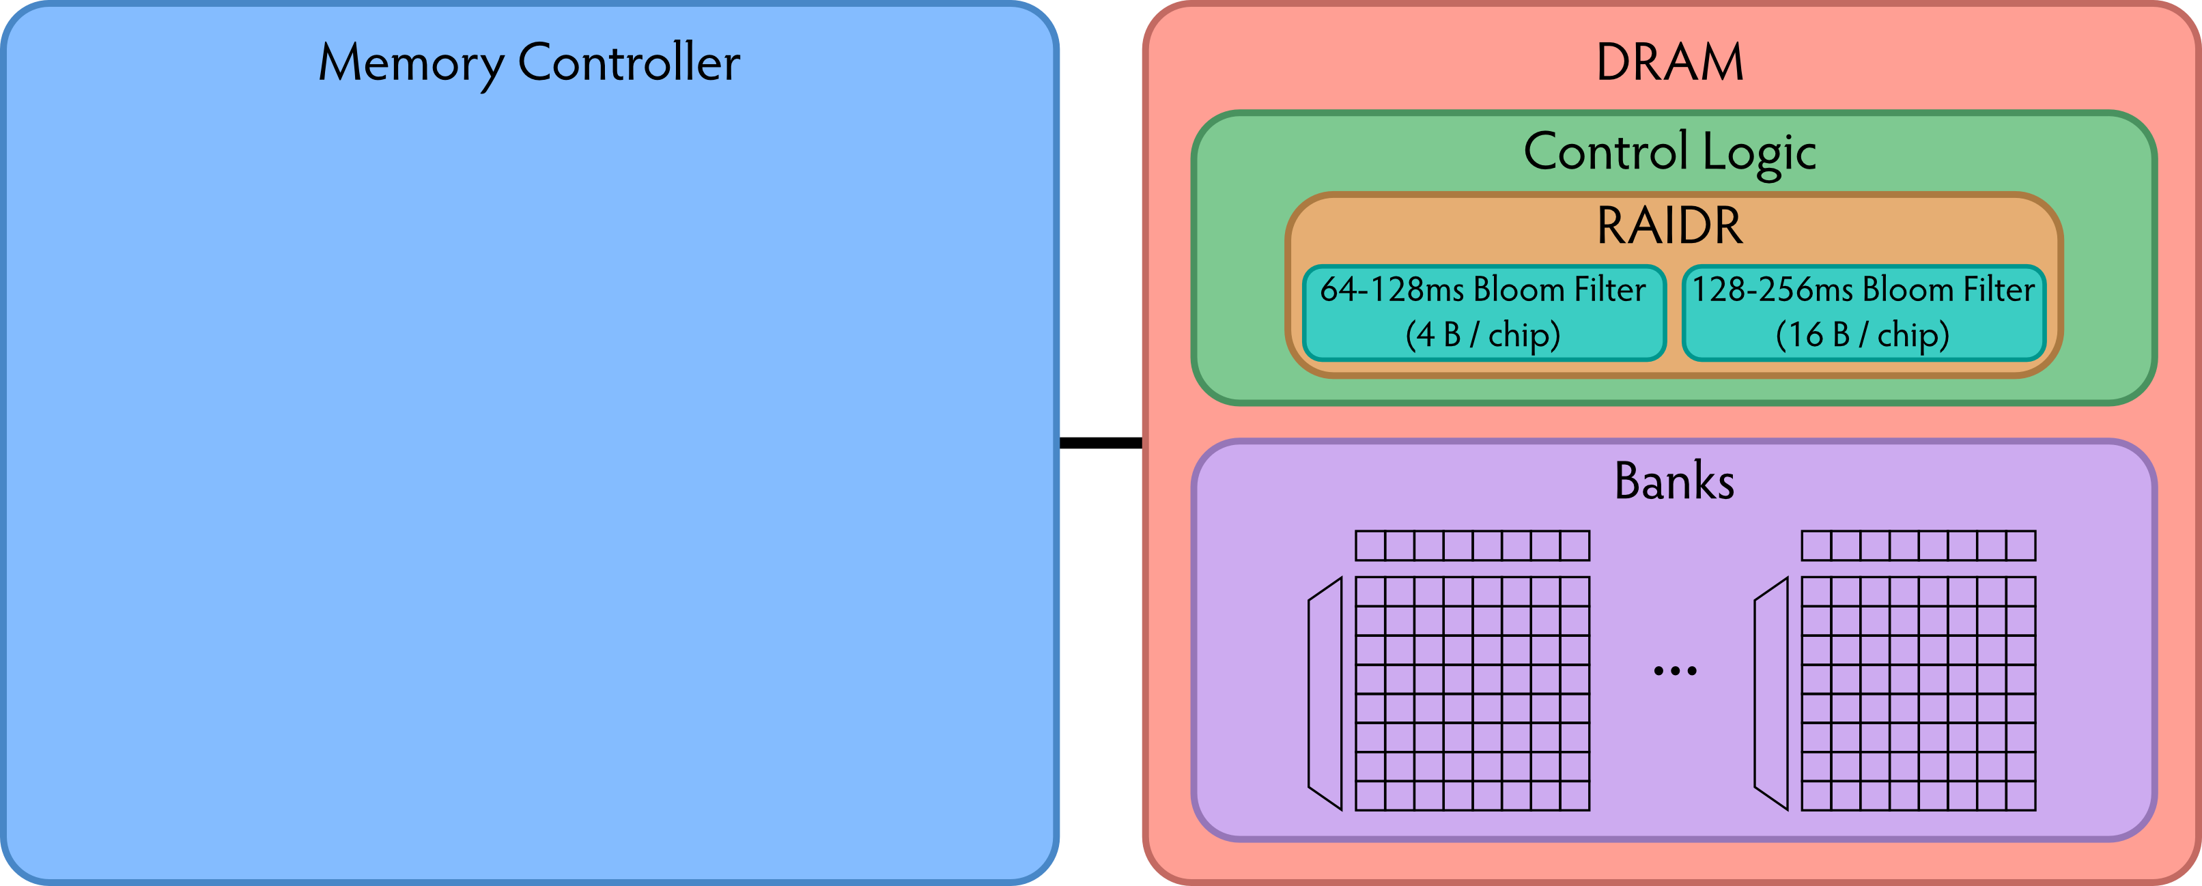
RAIDR in DRAM Chip: Option 2
Overhead of RAIDR in DRAM chip:
Per-chip overhead: 20B Bloom Filters, 1 counter (4 Gbit chip)
Total overhead: 1.25KB Bloom Filters, 64 counters (32 GB DRAM)

Slide 69
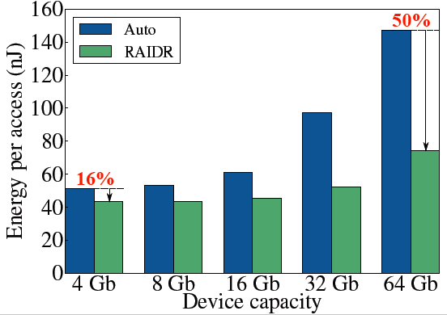
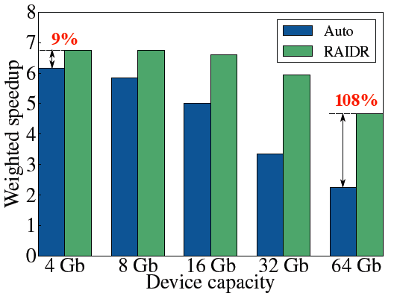
RAIDR: Results and Takeaways
System: 32GB DRAM, 8-core; SPEC, TPC-C, TPC-H workloads
RAIDR hardware cost: 1.25 kB (2 Bloom filters)
Refresh reduction: 74.6%
Dynamic DRAM energy reduction: 16%
Idle DRAM power reduction: 20%
Performance improvement: 9%
Benefits increase as DRAM scales in density

Slide 70
DRAM Refresh: More Questions
What else can you do to reduce the impact of refresh?
What else can you do if you know the retention times of rows?
How can you accurately measure the retention time of DRAM rows?
Recommended reading:
  Liu et al., “An Experimental Study of Data Retention Behavior in Modern DRAM Devices: Implications for Retention Time Profiling Mechanisms,” ISCA 2013.

Slide 71
We will likely not cover the following slides in lecture. These are for your benefit.

Slide 72
ATLAS Memory Scheduler
Yoongu Kim, Dongsu Han, Onur Mutlu, and Mor Harchol-Balter,
"ATLAS: A Scalable and High-Performance
Scheduling Algorithm for Multiple Memory Controllers"
16th International Symposium on High-Performance Computer Architecture (HPCA),
Bangalore, India, January 2010. Slides (pptx)
ATLAS HPCA 2010 Talk

Slide 73
Rethinking Memory Scheduling
A thread alternates between two states (episodes)
  Compute episode: Zero outstanding memory requests ➔ High IPC
  Memory episode: Non-zero outstanding memory requests ➔ Low IPC
Outstanding memory requests
Time
Memory episode
Compute episode
Goal: Minimize time spent in memory episodes

Slide 74

How to Minimize Memory Episode Time
Prioritize thread whose memory episode will end the soonest
Minimizes time spent in memory episodes across all threads
Supported by queueing theory:
  Shortest-Remaining-Processing-Time scheduling is optimal in single-server queue
Remaining length of a memory episode?
Outstanding
memory requests
How much longer?
Time

Slide 75
Predicting Memory Episode Lengths
We discovered: past is excellent predictor for future
Outstanding
memory requests
Time
Attained service
PAST
Remaining service
FUTURE
Large attained service ➔ Large expected remaining service
Q: Why?
A: Memory episode lengths are Pareto distributed…

Slide 76
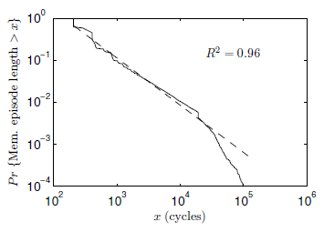
Pareto Distribution of Memory Episode Lengths
Memory episode lengths of
SPEC benchmarks
401.bzip2
Pareto distribution
Pr{Mem. episode > x}
The longer an episode has lasted ➔ The longer it will last further
x (cycles)
Attained service correlates with remaining service
Favoring least-attained-service memory episode
= Favoring memory episode which will end the soonest

Slide 77
Least Attained Service (LAS) Memory Scheduling
Our Approach
Queueing Theory
Prioritize the memory episode with least-remaining-service
Prioritize the job with
shortest-remaining-processing-time
Provably optimal
Remaining service: Correlates with attained service
Attained service: Tracked by per-thread counter
Prioritize the memory episode with least-attained-service
Least-attained-service (LAS) scheduling: Minimize memory episode time
However, LAS does not consider
long-term thread behavior

Slide 78
Long-Term Thread Behavior
Thread 1
Thread 2
Short memory episode
Long memory episode
Short-term
thread behavior
>
priority
Mem.
episode
Long-term
thread behavior
<
priority
Compute episode
Mem.
episode
Compute
episode
Prioritizing Thread 2 is more beneficial:
results in very long stretches of compute episodes

Slide 79
Quantum-Based Attained Service of a Thread
Short-term
thread behavior
Outstanding memory requests
Time
Attained service
Quantum (millions of cycles)
…
Long-term
thread behavior
Outstanding memory requests
Time
Attained service
We divide time into large, fixed-length intervals:
quanta (millions of cycles)

Slide 80
LAS Thread Ranking
During a quantum
Each thread’s attained service (AS) is tracked by MCs
AS_{i} = A thread’s AS during only the i-th quantum
End of a quantum
Each thread’s TotalAS computed as:
TotalAS_{i} = α · TotalAS_{i-1} + (1- α) · AS_{i}
High α ➔ More bias towards history
Threads are ranked, favoring threads with lower TotalAS
Next quantum
Threads are serviced according to their ranking

Slide 81
ATLAS Scheduling Algorithm
ATLAS
Adaptive per-Thread Least Attained Service
Request prioritization order
1. Prevent starvation: Over threshold request
2. Maximize performance: Higher LAS rank
3. Exploit locality: Row-hit request
4. Tie-breaker: Oldest request
How to coordinate MCs to agree upon a consistent ranking?

Slide 82
System Throughput: 24-Core System
System throughput = ∑ Speedup
3.5%
5.9%
8.4%
System throughput
9.8%
17.0%
# of memory controllers
ATLAS consistently provides higher system throughput than all previous scheduling algorithms

Slide 83
System Throughput: 4-MC System
10.8%
8.4%
4.0%
System throughput
3.5%
1.1%
# of cores
# of cores increases ➔ ATLAS performance benefit increases

Slide 84
ATLAS Pros and Cons
Upsides:
  Good at improving performance
  Low complexity
  Coordination among controllers happens infrequently
Downsides:
  Lowest ranked threads get delayed significantly → high unfairness

Slide 85
Emerging Non-Volatile Memory Technologies

Slide 86
Aside: Non-Volatile Memory
If memory were non-volatile…
  there would be no need for refresh…
  we would not lose data on power loss…
Problem: non-volatile has traditionally been much slower than DRAM
  Think hard disks… Even flash memory…
Opportunity: there are some emerging memory technologies that are relatively fast, and non-volatile.
  And, they seem more scalable than DRAM
Question: Can we have emerging technologies as part of main memory?

Slide 87
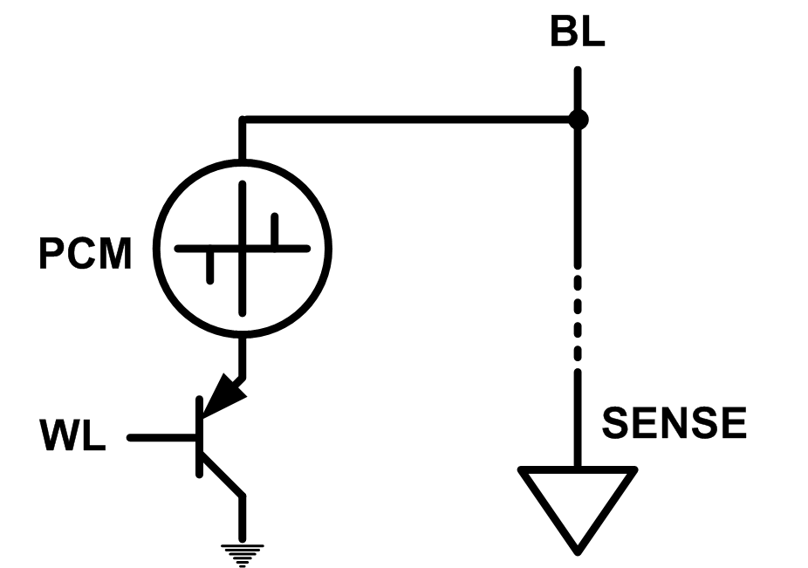
Emerging Memory Technologies
Some emerging resistive memory technologies seem more scalable than DRAM (and they are non-volatile)
Example: Phase Change Memory
  Data stored by changing phase of material
  Data read by detecting material’s resistance
  Expected to scale to 9nm (2022 [ITRS])
  Prototyped at 20nm (Raoux+, IBM JRD 2008)
  Expected to be denser than DRAM: can store multiple bits/cell
But, emerging technologies have (many) shortcomings
  Can they be enabled to replace/augment/surpass DRAM?
Notes:
Even if DRAM continues to scale there could be benefits to examining and enabling these new technologies.

Slide 88
Emerging Resistive Memory Technologies
PCM
  Inject current to change material phase
  Resistance determined by phase
STT-MRAM
  Inject current to change magnet polarity
  Resistance determined by polarity
Memristors
  Inject current to change atomic structure
  Resistance determined by atom distance

Slide 89
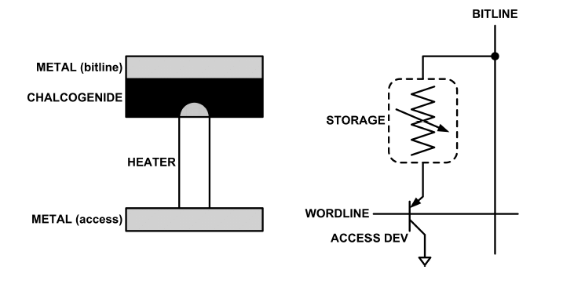
What is Phase Change Memory?
Phase change material (chalcogenide glass) exists in two states:
  Amorphous: Low optical reflexivity and high electrical resistivity
  Crystalline: High optical reflexivity and low electrical resistivity
PCM is resistive memory: High resistance (0), Low resistance (1)
PCM cell can be switched between states reliably and quickly

Slide 90
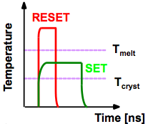
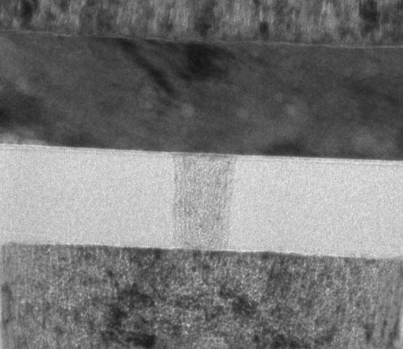
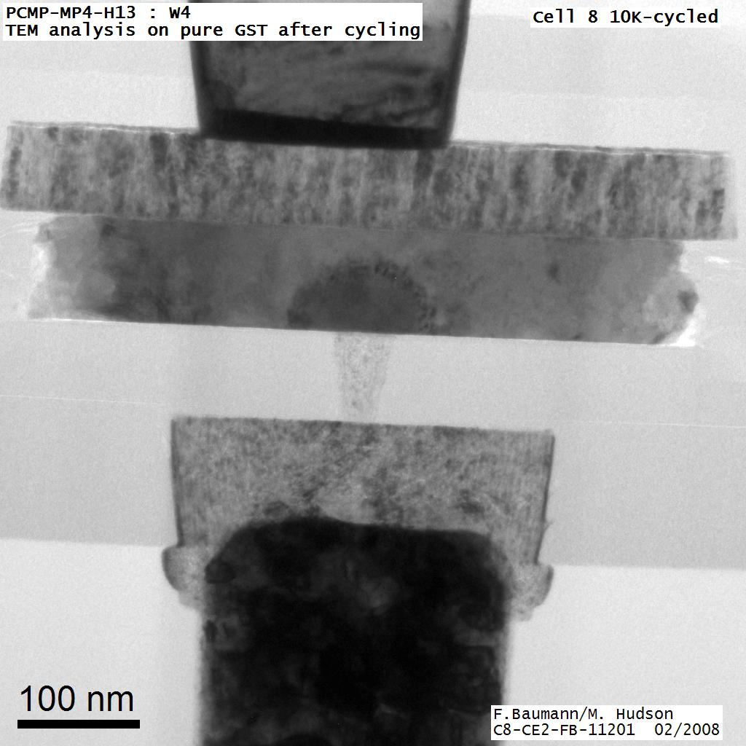
How Does PCM Work?
Write: change phase via current injection
  SET: sustained current to heat cell above Tcryst
  RESET: cell heated above Tmelt and quenched
Read: detect phase via material resistance
  amorphous/crystalline
Large
Current
Small
Current
Memory
Element
SET (cryst)
Low resistance
Access
Device
RESET (amorph)
High resistance
10³-10⁴ Ω
10⁶-10⁷ Ω
Photo Courtesy: Bipin Rajendran, IBM
Slide Courtesy: Moinuddin Qureshi, IBM

Slide 91
Phase Change Memory: Pros and Cons
Pros over DRAM
  Better technology scaling (capacity and cost)
  Non volatility
  Low idle power (no refresh)
Cons
  Higher latencies: ~4-15x DRAM (especially write)
  Higher active energy: ~2-50x DRAM (especially write)
  Lower endurance (a cell dies after ~10⁸ writes)
Challenges in enabling PCM as DRAM replacement/helper:
  Mitigate PCM shortcomings
  Find the right way to place PCM in the system

Slide 92
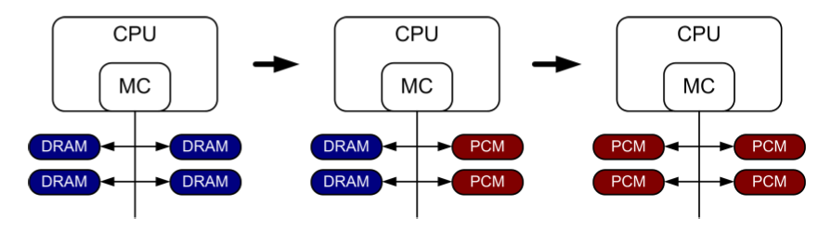
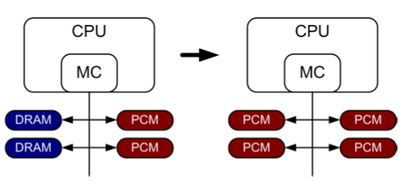
PCM-based Main Memory (I)
How should PCM-based (main) memory be organized?
Hybrid PCM+DRAM [Qureshi+ ISCA’09, Dhiman+ DAC’09]:
  How to partition/migrate data between PCM and DRAM

Slide 93
PCM-based Main Memory (II)
How should PCM-based (main) memory be organized?
Pure PCM main memory [Lee et al., ISCA’09, Top Picks’10]:
  How to redesign entire hierarchy (and cores) to overcome PCM shortcomings

Slide 94
PCM-Based Memory Systems: Research Challenges
Partitioning
  Should DRAM be a cache or main memory, or configurable?
  What fraction? How many controllers?
Data allocation/movement (energy, performance, lifetime)
  Who manages allocation/movement?
  What are good control algorithms?
  How do we prevent degradation of service due to wearout?
Design of cache hierarchy, memory controllers, OS
  Mitigate PCM shortcomings, exploit PCM advantages
Design of PCM/DRAM chips and modules
  Rethink the design of PCM/DRAM with new requirements

Slide 95
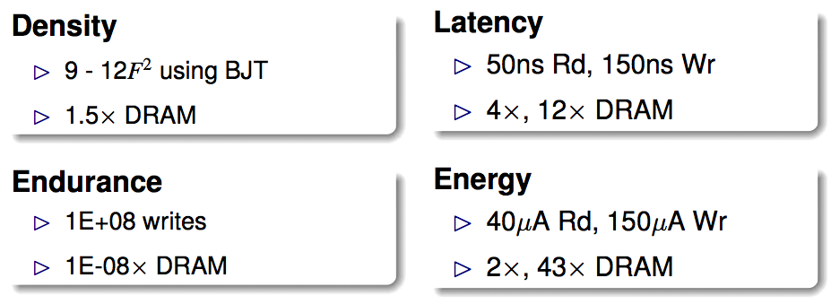
An Initial Study: Replace DRAM with PCM
Lee, Ipek, Mutlu, Burger, “Architecting Phase Change Memory as a Scalable DRAM Alternative,” ISCA 2009.
  Surveyed prototypes from 2003-2008 (e.g. IEDM, VLSI, ISSCC)
  Derived “average” PCM parameters for F=90nm

Slide 96
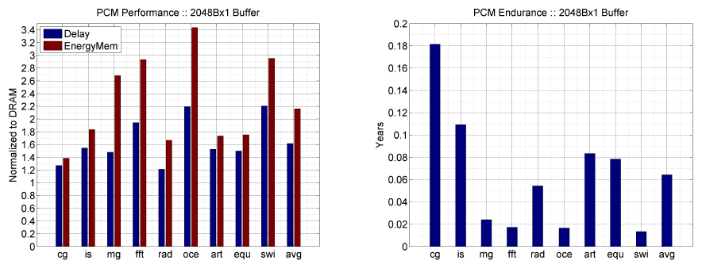
Results: Naïve Replacement of DRAM with PCM
Replace DRAM with PCM in a 4-core, 4MB L2 system
PCM organized the same as DRAM: row buffers, banks, peripherals
1.6x delay, 2.2x energy, 500-hour average lifetime
Lee, Ipek, Mutlu, Burger, “Architecting Phase Change Memory as a Scalable DRAM Alternative,” ISCA 2009.

Slide 97
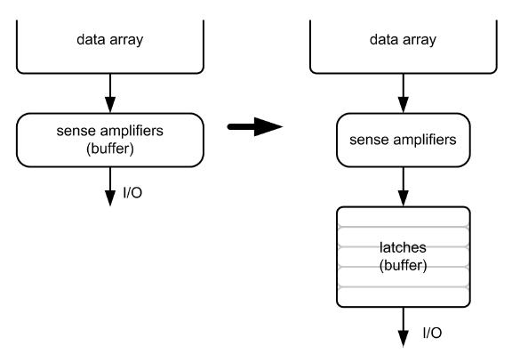
Architecting PCM to Mitigate Shortcomings
Idea 1: Use multiple narrow row buffers in each PCM chip
    → Reduces array reads/writes → better endurance, latency, energy
Idea 2: Write into array at
cache block or word
granularity
→ Reduces unnecessary wear
DRAM
PCM

Slide 98
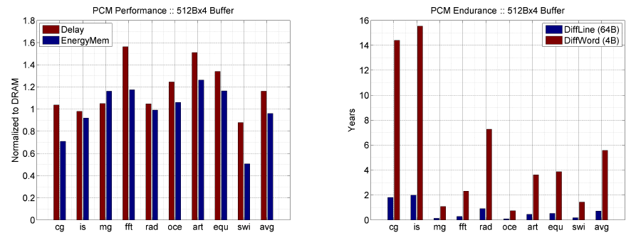
Results: Architected PCM as Main Memory
1.2x delay, 1.0x energy, 5.6-year average lifetime
Scaling improves energy, endurance, density
Caveat 1: Worst-case lifetime is much shorter (no guarantees)
Caveat 2: Intensive applications see large performance and energy hits
Caveat 3: Optimistic PCM parameters?

Slide 99
Hybrid Memory Systems
CPU
Meza+, “Enabling Efficient and Scalable Hybrid Memories,” IEEE Comp. Arch. Letters, 2012.
Yoon, Meza et al., “Row Buffer Locality Aware Caching Policies for Hybrid Memories,” ICCD 2012 Best Paper Award.
DRAMCtrl
PCM Ctrl
DRAM
Phase Change Memory (or Tech. X)
Fast, durable
Small,
leaky, volatile,
high-cost
Large, non-volatile, low-cost
Slow, wears out, high active energy
Hardware/software manage data allocation and movement
to achieve the best of multiple technologies

Slide 100
One Option: DRAM as a Cache for PCM
PCM is main memory; DRAM caches memory rows/blocks
  Benefits: Reduced latency on DRAM cache hit; write filtering
Memory controller hardware manages the DRAM cache
  Benefit: Eliminates system software overhead
Three issues:
  What data should be placed in DRAM versus kept in PCM?
  What is the granularity of data movement?
  How to design a low-cost hardware-managed DRAM cache?
Two idea directions:
  Locality-aware data placement [Yoon+ , ICCD 2012]
  Cheap tag stores and dynamic granularity [Meza+, IEEE CAL 2012]

