Slide 1

ECE Ph.D. Qualifying
Exam Overview
January 22nd, 2026
Prof. Rohit Negi,
Chair of
Graduate Studies Committee (GSC)

Slide 2
Qual timeline policy
Must ATTEMPT the Qual by 4th academic semester (or earlier)
Must PASS the Qual by 5th academic semester
  GSC Petition needed if this needs to be postponed for unusual reasons
Second FAIL will require student to exit Ph.D. program
  Perhaps by transitioning to M.S. program
Typical pass rates: 80% first attempt; 95% by second attempt
https://www.ece.cmu.edu/academics/phd-ece/qualifying-exam.html

Slide 3
Agenda for today
Discuss Ph.D. qualifying exam (“the Qual”) philosophy
Discuss details about the Qual
  Important phases
  Associated dates and deadlines
Q&A at the end
Caution: Besides these slides, you must also attend GSC chair presentation or watch its recorded video

Slide 4
Big Takeaways
You set the scope of your qual exam, as we will see
Students must take exam in-person and on campus
  However, one or more faculty MAY attend remotely, perhaps due to a last-minute conflict
  So, be ready for that possibility. Get a laptop, tablet and stylus, and headphones for exam
  (ECE may try to obtain a room with such facility – watch for future announcements)
Let Greta Ruperto know if you’re taking the Qual, for email reminders, announcements
Be sure to also study obvious undergraduate material clearly relevant to your exam
Involve your advisor at every step of the Qual process, as elaborated later
  If your Advisor or research group is not familiar with ECE quals, ask them to find an ECE post-qual student to talk to
<gruperto@andrew.cmu.edu>
(e.g., by them contacting other ECE faculty they know, or by them contacting the GSC)

Slide 5
Ph.D. Qualifying Exam Philosophy

Slide 6
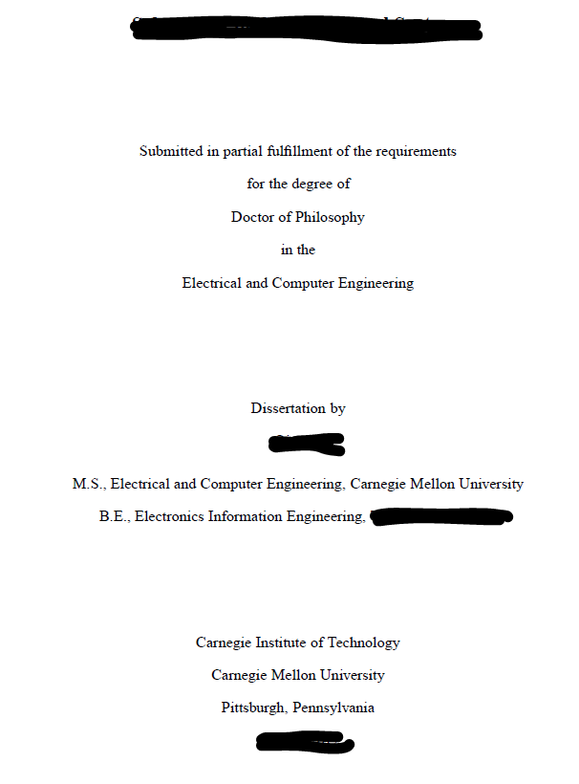
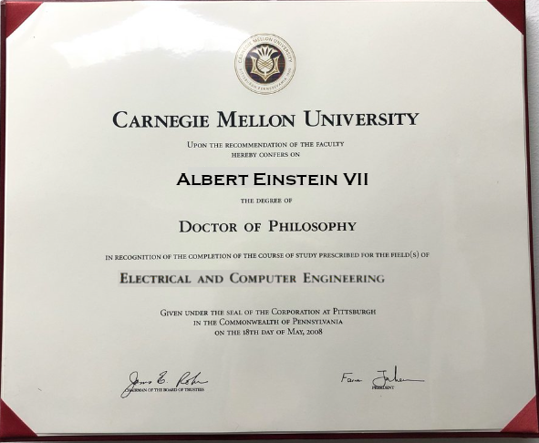
The Ph.D.
Ph.D. students work very closely with advisor(s) and complete
  A proposal, and then
  A thesis showing novel research
So, why is ECE department involved?
Because actual diploma mentions ECE, not your advisor

Slide 7
Ph.D. requirements in ECE
So, ECE department wants to ensure all Ph.D.s satisfy minimum requirements as below
So, how can ECE department guarantee satisfaction of these minimum requirements?
ECE or ECE-approved
courses
✓
You must take
graduate courses
Breadth & Depth
Ability to think
You must pass the
Ph.D. Qualifying Exam
(“the Qual”)
Ability to speak
Ph.D. proposal and thesis
But, Advisor, not
ECE department
controls this
Ability to write
Graduate progress
reports
every semester
Steady Progress
✓
ECE faculty review
these

Slide 8
What “the Qual” is NOT
NOT a test of Depth and Breadth that faculty feel “you ought to know”, simply because you are an ECE student
  You take courses to show that
NOT a test of knowledge about the latest research in your area
  Your thesis proposal shows that
NOT a test of your novel research contributions
  Your thesis defense shows that
Breadth & Depth
Ability to think
You must pass the
Ph.D. Qualifying Exam
(“the Qual”)
Ability to speak
Ability to write
Steady Progress

Slide 9
What “the Qual” IS
The Qual IS a test of your ability to Think / Speak / Write
All students who hope to work towards a Ph.D. (approximately 2nd year students) must demonstrate the above abilities
The Qual: This is how it works
You select 3 technical papers to limit the scope of your exam
You write a 4-page technical paper on that particular topic
You orally present that topic to a committee of three [3] faculty members
You answer questions about that topic and about whatever
undergraduate material underpins that topic
about a “research-like” topic
to a particular topic
Breadth & Depth
Ability to think
Ability to think
Ability to speak
Ability to speak
You must pass the
Ph.D. Qualifying Exam
(“the Qual”)
Ability to write
Ability to write
Steady Progress
https://www.ece.cmu.edu/academics/phd-ece/qualifying-exam.html

Slide 10
The Qual visualized
Research
topics
...
Cloud
computing
RF
circuits
Compilers
Nano-
devices
Network
protocols
Knowledge is vast!
Signal
processing
Machine
learning
Computer
architecture
How to narrow the scope
so faculty can test your
Ability to Think?
Undergraduate
under-pinnings
LTI
systems
Matrix
theory
Analog
circuits
Graph
theory
Programming
languages
TCP/IP
…

Slide 11
The Qual visualized
Research
topics
...
Cloud
computing
RF
circuits
Compilers
Nano-
devices
technical paper
Network
protocols
Selected Topic
technical paper
Clustering with Temporal
Neural Networks
Signal
processing
Review paper
and Qual talk
Machine
learning
Computer
architecture
technical paper
Most obviously
related undergraduate
material
You have
defined scope
of your exam
Undergraduate
under-pinnings
LTI
systems
Matrix
theory
Analog
circuits
Graph
theory
Programming
languages
TCP/IP
…

Slide 12
The Qual – details

Slide 13
Qual Phases
February 16th: Qual declaration deadline
February 17th: Accommodation requests deadline
March 20th: Review paper and technical Background papers submission deadline
April 10th: Exam committees and date/time/location announced to students
April 13th-23rd: Exams ― Oral presentation and Q&A with Qual exam committee
April 24th: ECE faculty meet to discuss all qual results
April 27th: Official results with feedback released
(GSC meets to select Qual exam faculty committee)
(GSC verifies appropriateness and figures out exam date/time/location)

Slide 14
Accommodations
Exam accommodation (if needed) must be requested through the Office of Disability Resources (ODR)
Already have approved accommodations? Coordinate with ODR to submit request to ECE
See Qual Phases slide for Deadline to submit accommodations to ECE
  ECE must formally approve requests
  Late requests will not allow ECE sufficient time to review the request

Slide 15

Qual declaration
Qual phases
Qual declaration
Review+Background papers
Exam committee
Oral presentation
ECE faculty meet
Official results
( $D$ ≈ Mid-February )
(See Qual Phases slide for exact deadline date $D$)

Slide 16
Qual declaration
In this 1st phase, you will submit via Qual Declaration app portal ...
Your name and Title of your proposed Qual talk
200-300 word description of talk (similar to conference abstract)
RANKED list of your faculty preferences (highest to lowest)
Three [3] preliminary technical Background papers of your choice
You should consult with your advisor on every aspect of your Qual declaration
Qual declaration
Review+Background papers
Exam committee
Oral presentation
ECE faculty meet
Official results
Caveat: Qual app software does not allow re-submissions. Submit once only
Caveat: Qual app software times out, if inactive too long

Slide 17
Ranked list of faculty
You MUST select 10 faculty in Ranked order of preference (Top to Bottom list)
  With #1 = Listed on the top in list, etc.
This is absolutely important because GSC assumes you
know which faculty can best examine you
Do select all 10, because, if you select only 3, say, you MAY get one
from your list, but two assigned randomly from outside list
Why? Because GSC ensures that no faculty is over-loaded
(and your advisor)
Qual declaration
Review+Background papers
Exam committee
Oral presentation
ECE faculty meet
Official results
Faculty
in Qual
app portal
F1
F2
F3
F4
F5
F6
F7
F8
Qual
students
S1
S2
S3
S4
S5
S6

Slide 18
Faculty unavailable in Spring 2026
Not all ECE faculty are available. Faculty unavailable in Spring 2026 are below
  This list MAY grow later (So, check the Qual declaration portal for latest list)
  So make sure your Ranked list does contain 10 faculty, not less
Caution: Courtesy faculty can be listed by you, but are often unavailable
  So, do NOT list many Courtesy faculty in your preferences
ECE Home Faculty
Courtesy Faculty (‘Other’)
Limited Availability Faculty
Bill Sanders
Larry Pileggi
Franz Franchetti
Akshitha Sriraman
Vijayakumar Bhagavatula
John Shen
Akshitha Sriraman
Greg Ganger
Farnam Jahanian
Srinivasa Narasimhan
Changliu Liu
Zico Kolter
Nicolas Christin
Virginia Smith
Rebecca Taylor
Jose Moura
Tom Zajdel
George Amvrosiadis
John Dolan
Giulia Fanti
Samuel Pagliarini
Andrea Zanette

Slide 19
Preliminary Background papers
We will later discuss 3 Background papers you must provide us in the next Phase
  See detailed criteria for these papers later
However, in the Qual declaration phase also, you must provide us
with a preliminary choice of these 3 Background papers
This will give the GSC a better idea of your proposed topic,
so it can check that your Ranked list of faculty makes sense
You ARE allowed to change this choice of 3 papers when you reach the next Phase
Caution: Even if you change these papers in the next phase, the Exam committee assigned to you cannot be changed
Qual declaration
Review+Background papers
Exam committee
Oral presentation
ECE faculty meet
Official results

Slide 20

Review and
Background papers
Qual phases
Qual declaration
Review+Background papers
Exam committee
Oral presentation
ECE faculty meet
Official results
( $≈ D +$ one month )
(See Qual Phases slide for exact deadline)

Slide 21
Review and Background papers
In this phase, you will submit
A Review paper and
Three [3] final technical Background papers of your choice
The 3 Background papers here may be the same as the ones
submitted during Qual declaration (typical case)
Or, they may be completely different
However, changing Background papers now will not change your assigned Exam committee
Qual declaration
Review+Background papers
Exam committee
Oral presentation
ECE faculty meet
Official results

Slide 22
Review and Background papers
Discuss the 3 technical Background papers first. Of these,
At least one paper’s co-authors must all be outside CMU
(i.e., no CMU affiliation listed anywhere on paper)
  To ensure some diversity of thought
At most one paper can have you (the student) as co-author
  To show you can read papers from others also
At least one paper should have been published within the last 10 years
  To show recency of topic, not ‘text-book’ type topic
Total length, counting all 3 papers, including references, should not exceed 50 pages
Qual declaration
Review+Background papers
Exam committee
Oral presentation
ECE faculty meet
Official results
NOTE: Qual portal will not allow submissions exceeding 50 pages

Slide 23
Background papers: Purpose
The 3 Background papers set boundaries of what you think is acceptable for Exam Q&A
So, you ARE expected to know all the details of what these 3 papers are talking about
  (But NOT required to know what papers cited in Background papers are talking about)
Exam committee does NOT expect you to know other research papers, except these 3
Broad latitude on what we accept as ‘papers’
  Conference, Journal, Book chapter, Thesis chapter, Technical report, Including your own
technical paper
You define scope
of your exam
technical paper
Selected Topic
technical paper

Slide 24
Background papers
The faculty committee assigned to you will (generally) NOT be experts in the topic you present
So, the 3 papers together should provide enough context for them to grasp the essence of the topic
Suggestion: Consider 1 ‘basic’ paper that is a tutorial or survey about the critical ideas in that topic

Slide 25
Review paper
Qual declaration
Review+Background papers
Exam committee
Oral presentation
ECE faculty meet
Official results
Your Review paper is center of your defined exam scope
  It should also be the focus of your Qual presentation
4-page, 2-column, 11 point conference format
Must be exactly 4 pages, including references
Must be completely written by you (advisor may make broad suggestions)
NOTE: Software will not allow you to re-submit review paper.
technical paper
You have
defined scope
of your exam
Topic: Clustering with Temporal Neural Networks
technical paper
Review paper
and Qual talk
technical paper

Slide 26
Review paper
Review paper does NOT need to contain any original research.
Must appear similar to a conference paper in that topic
  Contain Title, Abstract, Introduction, Prior work/background, Conclusions
Must cite the 3 background papers appropriately (in the correct context)
Must either contain preliminary research you did for Ph.D. or M.S., or
some preliminary simulations/calculations/etc. you did, or
a detailed discussion of the background papers that shows your Ability to Think
Remember: The Qual is NOT a thesis prospectus or defense
It is an exam to check that you can Talk / Write / Think about a “research-like” topic
However it,
most typical case

Slide 27
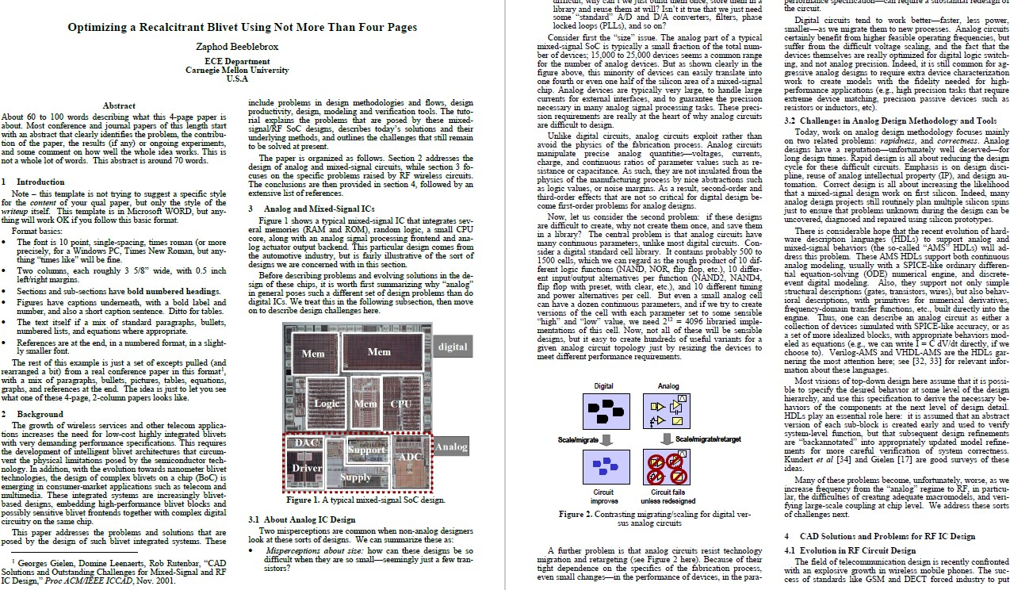
Sample review paper – Pages 1,2
Albert Einstein VII

Slide 28
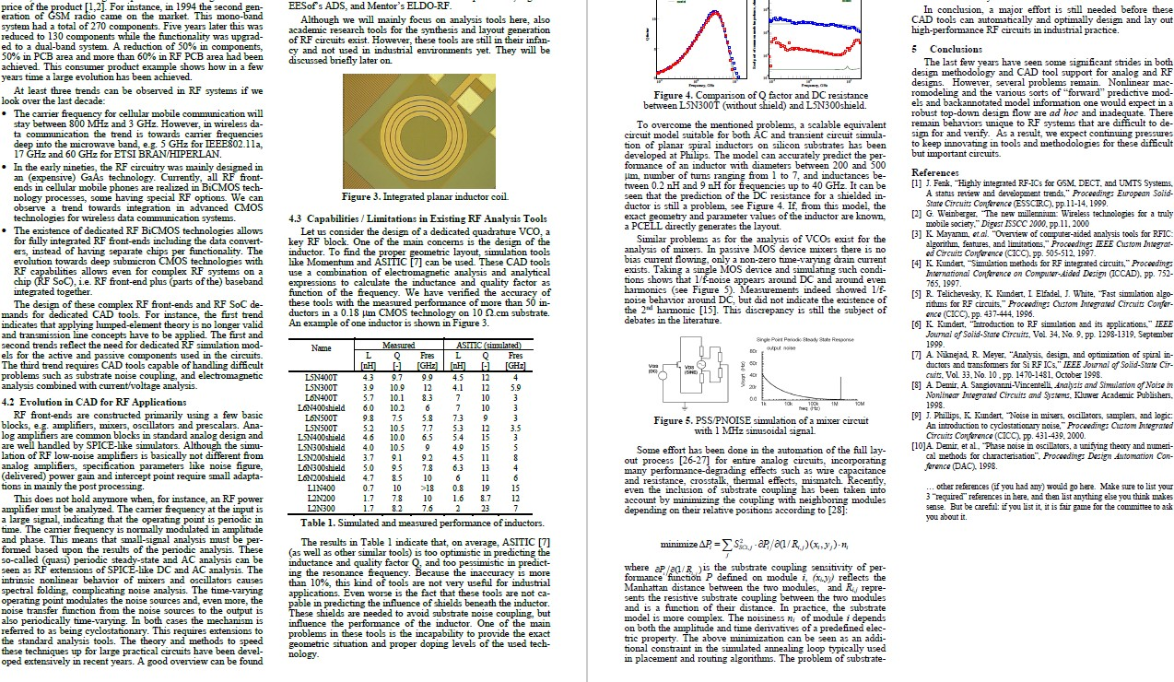
Sample review paper – Pages 3,4
Too many
references,
in my opinion

Slide 29

Exam committee
Qual phases
Qual declaration
Review+Background papers
Exam committee
Oral presentation
ECE faculty meet
Official results
( $≈ D +$ 8 weeks)
(See Qual Phases slide for exact dates)

Slide 30
Exam committee
Based on Ranked list you provided, GSC selects exactly three [3]
faculty for your Exam committee
Email will inform you of committee + date/time/location of your exam
GSC will try to provide you with your higher ranked choices,
but will balance that with fairness to other students,
while also avoiding over-loading individual faculty
  (GSC solves a ‘Graph matching problem’ based on all Qual declarations)
Qual declaration
Review+Background papers
Exam committee
Oral presentation
ECE faculty meet
Official results
3
3
1
3
3
1
1
3
Faculty
F1
F2
F3
F4
F5
F6
F7
F8
Students
S1
S2
S3
S4
S5
S6
3
3
3
3
3
3

Slide 31
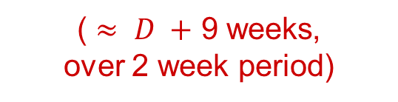
Exam: Oral presentation and Q&A
Qual phases
Qual declaration
Review+Background papers
Exam committee
Oral presentation
ECE faculty meet
Official results
( $≈ D +$ 9 weeks,
over 2 week period)
(See Qual Phases slide for exact dates)

Slide 32
Exam: Oral presentation and Q&A
Qual student MUST present talk from an in-campus conference room (we will find one)
  Medical or other serious issues will be accomodated
Some committee members MAY participate remotely via Zoom
Note: Remote participation of committee members is allowed,
so as to increase your chances of being matched to your top choices
  e.g., Faculty who are travelling cannot participate in-person, but could participate remotely
You MUST assume at least one member may be remote (say, due to a last-minute conflict)
  So, you need a laptop, tablet and stylus, and headphones. ECE will try to provide such a room
Qual declaration
Review+Background papers
Exam committee
Oral presentation
ECE faculty meet
Official results
Borrow from library? Advisor buys? Practice using this

Slide 33
Actual exam’s stages
Stage 1: You first Talk from prepared slides explaining your 4-page Review paper
  Slides must be completely prepared by you (advisor can make broad suggestions)
Stage 2: Committee asks Questions about Talk, Review paper, Background papers
  Committee should have read Background papers you provided (hopefully)
  However, the Background papers are really to prevent faculty going outside your scope
Stage 3: Committee asks Questions about any obvious undergraduate basic material
  “Obvious” = Clearly relevant to your talk
Stage 4: Extra time if committee remains undecided on score
  Or if they find the discussion fascinating
You can ask for a break any time, for any reason
  So can the committee, say, to discuss next questions
30
mins
60
mins
45
mins
45
mins
3 hour
Qual exam

Slide 34
Caution: Q&A
Committee will examine your ability to Talk / Write / Think
All three are important. But there is no “percentage distribution” among these
  Each committee member makes his/her own judgement call about what overall score to assign
Most students seem to do fine in Review paper (“Write”) and Presentation (“Talk”)
  Assuming they spent time writing and practicing the talk
The Q&A is hardest part usually (“Think”). Questions that may throw off students ...
  What would happen if I change ABC to XYZ?
  Why would you do ABC, if XYZ can obviously solve the problem?
  Write down a simple equation that predicts quantity ABC in your experiment
  Let’s simplify your set-up, so we can model it using this basic undergrad math
  What is a Fourier transform / State space model / Graph matching problem / L2 cache
About
Talk/review
paper
About
Basic
material

Slide 35
Caution: Undergraduate material
Often, students get tripped by Q&A about Undergraduate/Basic material
So, make sure you review/study/practice any obvious undergraduate material
  e.g., If you mention “harmonics” in your talk, then perhaps review Fourier transforms
  e.g., If you mention “cache misses” in your talk, you must know typical architecture of CPU
  e.g., If you mention “neural network” in your talk, perhaps you must know basic linear algebra
  ...
By “obvious”, we mean undergraduate material that is considered basic in your field of research, especially for your topic
  In fact, the committee may just ask you what you think is obvious undergraduate material
Warning:
you must do well in Q&A to Pass
  Because the committee cannot judge your precise contribution to those results/publications
Even if you already have many research results, and have published papers,

Slide 36
Grading criteria
After your exam, committee members fill out an evaluation sheet separately
Oral Communications Skills demonstrated
  (e.g., could the student present at a conference?)
Written Communication Skills demonstrated
  (e.g., can the student write a conference-style paper?)
Summary Comments about exam
  (Based on 1, 2 and also based on impressions from Q&A part)
A score is assigned by member (1,2,3,4) for exam based on that member’s overall judgement
Committee does NOT make Pass/Fail decision. So, committee cannot tell you outcome
  You WILL receive the written #1, #2, #3 evaluation in Official results, but not the scores
Qual declaration
Review+Background papers
Exam committee
Oral presentation
ECE faculty meet
Official results

Slide 37

ECE faculty meet and
Official results
Qual phases
Qual declaration
Review+Background papers
Exam committee
Oral presentation
ECE faculty meet
Official results
( $≈ D +$ 2 months )
(See Qual Phases slide for exact dates)

Slide 38
ECE faculty meet
Entire ECE faculty convene to discuss performance of all qual students
Scores and feedback from qual exam committee considered
  3 scores, 3 written feedback, with committee describing the exam
Advisor is permitted to give appropriate feedback at meeting
  Special circumstances, Personal views on student ability, etc.
Entire ECE faculty votes Pass/Fail for each student
Students are usually notified by advisor (unofficially) same night
Official notification comes from Academic Affairs office next Monday
Qual declaration
Review+Background papers
Exam committee
Oral presentation
ECE faculty meet
Official results

Slide 39
FAQs
Qual phases
Qual declaration
Review+Background papers
Exam committee
Oral presentation
ECE faculty meet
Official results
(See remaining slides at home)
Questions for now?
Greta Ruperto <gruperto@andrew.cmu.edu> can answer questions over email
Greta will forward me questions that need my input

Slide 40
FAQs
Question
Do I have to give the talk on my Ph.D. research?
Answer
No. Your work may be related to your Ph.D. research, your prior M.S. research, or another research theme where you can demonstrate your ability to Think to the committee.
However, your Ph.D. or M.S. research is the most likely choice, since that is the specific topic you would know the most about.

Slide 41
FAQs
Question
Do I need to complete any of the Ph.D. breadth course requirements before I do the qual exam?
Answer
No. However, you must be able to answer questions about your qual talk and paper, which may involve some breadth.

Slide 42
FAQs
Question
How do I ask questions about what’s on the qual if I don’t know who the committee is until just before the qual?
Answer
You are not allowed to discuss the qualifier with your committee before your scheduled exam.
You will be asked questions related to your talk, your paper, your technical background papers, and your general technical area. Prepare to answer such questions.

Slide 43
FAQs
Question
How much help can I ask of my advisor for the talk and paper?
Answer
It’s OK to ask for advice—that’s their job. However,
the talk, and the paper need to be substantially the product of your own individual efforts.
It is not permissible for your advisor to make your slides, or write your paper
You may ask your friends, and more senior PhD students, to critique/review.
You are not allowed to use text or figures directly
taken from other papers without the appropriate citation

Slide 44
FAQs
Question
Can I take the qual exam early, before my fourth semester?
Answer
Yes, with your advisor’s permission. You should take it as soon as you are ready so that you can move on to the next phase of your Ph.D. research.
However, the clock for Ph.D. proposal starts once you pass the qual; see ECE’s Ph.D. program description on the web for details

Slide 45
FAQs
Question
I changed my mind about the background papers. Can I change them after the deadline?
Answer
You may choose to submit different background papers in the ‘Review and Background papers phase’, compared to what you submitted in the ‘Qual declaration phase’.
However, once you submit these papers in the ‘Review and Background papers phase’, they cannot be changed.

Slide 46
FAQs
Question
I have some changes to my review paper. Can I resubmit after the deadline?
Answer
No.
However, you may point out mistakes in your submitted paper during your oral presentation, to give the committee a more accurate picture of your topic.

Slide 47
FAQs
Question
If other CMU people are authors on my technical papers, can they be on my committee?
Answer
Yes, but this does not guarantee that they will be on your committee. It also does not guarantee that they won’t be on your committee.

Slide 48
FAQs
Question
I have not been working on original research for very long— how can I give a good qual talk on incomplete work?
Answer
We do not expect the Qual to be like a PhD thesis defense or even a proposal.
We do expect you to be able to explain and to justify whatever you are working on—even if what are doing is mostly understanding the important prior work, and just implementing it, running some simulations, or slightly extending it.

Slide 49
FAQs
Question
Will the Qual Committee have expert knowledge of all of my technical background papers, and this technical area, and my own work?
Answer
Maybe yes, maybe no. They will be chosen to be in your general area, so they should generally be able to speak the same “technical language” as you do.
This assumes that you did indeed provide the GSC with a Ranked list of 10 faculty preferences.

Slide 50
FAQs
Question
Re: previous slide
What does “explain & justify” imply?
Answer
Explain… what are you doing? What technical decisions did you (or the background papers you reference) make? How is the work like previous work, or different from previous work?
Justify… why are you doing this? What technical goals do you have? There are alternative technical approaches for every problem—why are you (or the background papers you reference) attacking the problem in this particular way? What are the alternatives?

Slide 51
FAQs
Question
How ‘deep’ do I have to be about my 3 technical background papers? They have 100’s of their own references—must I know them all?
Answer
We expect you to understand the content of the 3 papers themselves thoroughly, and to have enough undergraduate knowledge in that topic to allow that understanding.
You are not expected to know details of the papers cited in your 3 papers.

Slide 52
FAQs
Question
What questions beyond the specific topics of the 3 tech background papers, and my own talk, might be asked in a qual?
Answer
Questions from basic undergrad material directly relevant to your area.
Example: If you refer to “harmonics” and are generally considered to be in the Signal processing area, it is OK for faculty to ask about Fourier Transforms, even if you don’t use them.
Example: If you refer to “harmonics” and are generally considered to be in the Signal processing area, it is not OK for faculty to ask you to compute the current through an inductor.

Slide 53
FAQs
Question
Cont’d from previous slide
What questions beyond the specific topics of the 3 tech background papers, and my own talk, might be asked in a qual?
Answer
Questions about assumptions and conventions common to your area
Example: If you are working on low-
power digital design, it is OK to ask
what “power” is, how it gets computed for basic circuits, etc.
Example: If you are working on
operating system resource
management, it is OK to ask what "response time" is, how to compute it.

Slide 54
FAQs
Question
I recently submitted/published a paper with my advisor that contains the material I wanted to write about for my qual paper. Can I use this Recent Paper (RP) as my qual paper?
Answer
The Qual review paper MUST be substantially your own work. The advisor can only offer broad suggestions, not edit that paper. Given that the RP has your advisor listed, showing substantial effort on the Advisor’s part, it is NOT suitable as Qual paper.
You could, of course, write a Qual paper afresh that uses similar ideas as the RP, but you cannot copy language directly from the RP, as this would obviously be considered plagiarism (for example, if the RP was written by someone else)

Slide 55
Addendum

Slide 56
Qual resources: Web-links
Qual declaration application portal
ECE qual exam webpage, includes important dates/deadlines
EGO qual webpage, includes mentoring sessions, practice talk signup, templates, etc.

