Slide 1





Ph.D. Qualifying Exam Overview
September 7th, 2023
Prof. Rick Carley,
Graduate Studies Committee, Chair

Slide 2
Agenda
Review Ph.D. qualifying exam philosophy and components
Review important dates and deadlines
Q&A session

Slide 3
Before we begin…
This presentation serves as an overview of the Qual Exam Process
To best prepare for exam, you must:
Watch the Fall 2023 recording and presentation slides available on the ECE Qual Exam webpage.
Reference Canvas Qual Exam course for deadlines, reminders, announcements, etc.
3

Slide 4
3 Big Takeaways
You have control over many aspects of the qual exam experience, including the topic, background papers to be discussed, and (to some degree) the committee.
Fall 2023 exams will be in-person, on campus for students. Under specific circumstances, faculty are allowed to attend qual exams remotely. Plan accordingly: arrange a laptop/desktop, tablet and stylus, headphones, etc.
Communication from Academic Affairs office sent via Canvas Qual Exam course
4

Slide 5
Ph.D. Qualifying Exam Philosophy

Slide 6
2nd year Ph.D. students should be able to:
Read and understand three [3] technical papers
Review these papers briefly, explain how they inform your research work
Talk for 30 minutes about your own work, even if it is very early or
preliminary
Answer detailed questions about:
  Your work
  The 3 selected Technical papers
  Obvious undergraduate-level technical background for this material

Slide 7
What the exam IS
In a word, focused by you. You provide the technical scope for the exam. We test you on your understanding within that scope.
Exam based on material in your talk, on the 3 Technical papers you selected and on the engineering underpinning of that material.
Exam stresses your ability to understand and communicate technical linkages to the topics you have chosen.
This requires some breadth and some depth.
It is a skill we expect all PhD students to master.

Slide 8
What the exam IS NOT
A comprehensive exam for all work on the leading edge of this particular field
An open-ended exam for anything the faculty feel “you ought to know”
A thesis proposal exam

Slide 9
Dates & Deadlines

Slide 10
Important dates and deadlines
October 6: Declaration application deadline
  Online application with faculty selections
  1-page abstract
  3 technical background papers
October 27: Review paper submission deadline
November 3: Exam committees announced to students
November 6-16: Oral presentation with faculty committee
November 20: Official results with feedback released
10
https://www.ece.cmu.edu/academics/phd-ece/qualifying-exam.html

Slide 11
Exam Components

Slide 12
Declaration Application, due OCT 6
Materials:
One-page abstract
Three [3] background papers of your choice
Online application submitted via Qual Declaration app portal
  Includes preferred faculty list, RANKED in order (top to bottom)
NOTE: You may submit your declaration application once.

Slide 13
Abstract (due 10/6)
Requirements:
1-page abstract as part of your qual exam declaration package:
  Your name
  Title of qualifying exam talk
  1-2 paragraph description of your planned talk

Slide 14
Background papers (due 10/6)
Requirements:
Three [3] technical background papers uploaded with application
No more than 2 papers may have authors currently at CMU
Only 1 paper can have you (the student) as an author
Total length, counting all 3 papers, should not exceed 50 pages
NOTE: Submissions exceeding 50 pages will be rejected.

Slide 15
Background papers (due 10/6)
Papers that provide context to GSC and exam committee about your work
  What is your work about? Why does it matter?
  Where did it come from? Why are you doing it like this?
Broad latitude on acceptable ‘papers’: conference, journal, book chapter, thesis chapter, your own papers, technical reports
https://www.ece.cmu.edu/academics/phd-ece/qualifying-exam.html

Slide 16
Background papers (due 10/6)
You should consult with your advisor(s) for paper recommendations.
Papers should provide a good foundation and explanation for the work you will describe in your paper and your talk
Consider 1 ‘basic’ paper that is a tutorial or survey about the critical ideas in the area, then 2 papers that relate more specifically to your own work
1 paper should have been published within the last 5 years so that faculty can see one example of recent work in the area
https://www.ece.cmu.edu/academics/phd-ece/qualifying-exam.html

Slide 17
Application: Faculty selections (due 10/6)
Recommended process:
Go to Qual Exam Declaration app to review list of available faculty
Consult your advisor(s) for guidance to select and rank preferred faculty for your committee
Return to Qual Exam Declaration app to select AND rank faculty, top (most preferred) to bottom
NOTE: Qual app includes tools to add, remove, and order faculty list.
17

Slide 18
ECE Qual Exam Fall 2023 Canvas Course
After submitting the Qual Exam Declaration Application, you will be added to the ECE Qual Exam Fall 2023 Canvas Course.
The Canvas Course will help you to prepare for the Ph.D. qualifying exam.

Slide 19
Review Paper

Slide 20
Review paper, due October 27
Focus and Purpose:
This paper defines the focus of your Qualifying Examination topic.
You should explain your technical area, your work and the relationship between your work to the background provided in the three background papers.

Slide 21
Review paper (due 10/27)
Requirements:
4-page, 2-column conference format
  Firm requirement; do not exceed 4 pages!
Keep it short; make it professional
Clear goals:
  Explain your own technical area
  Explain your own work
  Explain relevance of the three papers to your technical area
NOTE: You may submit your review paper once.

Slide 22
Suggested Review paper format (due 10/27)
Pages 1 & 2
Introduce the area
Summarize the problem(s)
Explain the history
Summarize key ideas and contributions of your 3 technical background papers
Pages 3 & 4
Introduce your own work
Summarize your own problem, goals
Explain what prior ideas you use.
Summarize what you have done:
Key technical decisions, results. What worked, what didn’t, why.
Conclusions

Slide 23
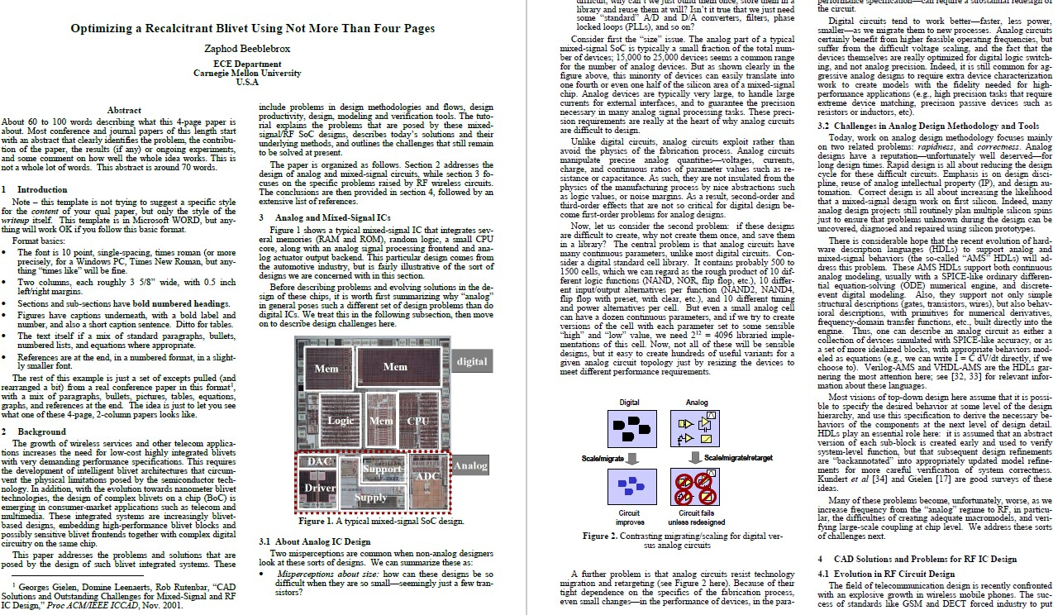

Slide 24
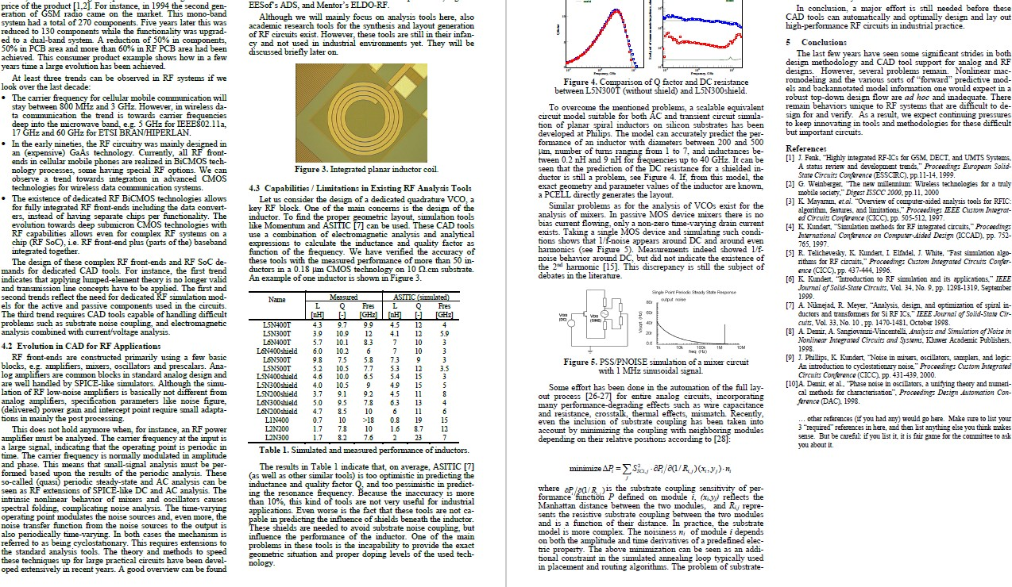

Slide 25
Exam Committee

Slide 26
Qual Exam committee
Requirements:
Select 7-10 preferred or ‘most relevant’ faculty members for your committee from list in your declaration application
  Strongly recommended to select 10 faculty for your application.
Advisor receives link to formally approve declaration, but should be discussed beforehand
GSC selects 3-person exam committee based on student declaration application, advisor input, and faculty availability

Slide 27
Known faculty unavailable for Fall 2023 quals
ECE Home Faculty
Franz Franchetti
Phil Koopman
Akshitha Sriraman
Gauri Joshi
Vanessa Chen
Brandon Lucia
Virgil Gligor
Pulkit Grover
Larry Pileggi
Bill Sanders
Courtesy Faculty (‘Other’)
Farnam Jahanian
Raj Reddy
NOTE: Updates to be added to Canvas course with accompanying announcement.

Slide 28
Oral Exam and Presentation

Slide 29
Exam modes
Student and 1-3 faculty committee members on-campus; perhaps some committee members participate remotely via Zoom.
Only in rare cases - Student on-campus with all committee members participating remotely via Zoom.
3. Fully virtual with student and faculty committee participating from off-campus locations. Contingency plan ONLY for campus posture change or health reasons (e.g., self-quarantining, medical accommodation)

Slide 30
Exam modes, cont’d
Default mode: Student conducts exam on-campus in conference room
Prepare to conduct exam with at least 1 faculty member participating remotely.
Virtual qual exams has increased scheduling flexibility with faculty to serve on exam committees, thereby increasing the odds of most- preferred faculty on application included on committee
Over 4 semesters of virtual quals, technology has not been cited as a major factor in exam outcome

Slide 31
Needed technology
Critical: A touchscreen device and functional stylus is required for the exam.
Any device/stylus combination will do. An iPad/Pencil combination works well with Zoom’s native Apple screen share feature.
Talk with your advisor if you need to purchase or borrow technology.
Recommended setup: laptop for camera and presentation, plus tablet for whiteboarding

Slide 32
Resources

Slide 33
Qual resources
Qual declaration application portal
ECE qual exam webpage, includes important dates/deadlines
EGO qual webpage, includes mentoring sessions, practice talk signup, templates, etc.
32

Slide 34
ADDENDUM

Slide 35
Exam format
Oral presentation: 30 minutes
  You talk first, about your work, from prepared slides
Committee questions: 90 minutes
  Questions from your 3 faculty members, about your area, the technical background papers, your review paper, basic background

Slide 36
Committee: composition
3 faculty chosen by GSC that understand (roughly) your area
Committee reads 3 background papers and review paper in advance of exam
NOTE: Exam is not about general breadth—it’s all about this area and these papers

Slide 37
Timeline policy
Must attempt exam by 4th academic semester, though possible to attempt earlier
Must pass exam by 5th academic semester
Failure after second attempt will require student to exit Ph.D. program or transition to the MS program
Recent pass rates (Fall 2018-Fall 2020):
  Total exams, n=62
  81% first attempt; 100% by second attempt (some retakes due F21)

Slide 38
Evaluation criteria on faculty grading sheet
Demonstrates Oral Communications Skills
(e.g. comfortable having student present at a conference in an understandable way?)
Demonstrates Written Communication Skills (communicates problem, approach and results in writing?)
Demonstrates Ability to Interpret Results (either their own or others)

Slide 39
Evaluation criteria on faculty grading sheet, cont’d
Demonstrates Breadth of Knowledge
(understands the bigger picture and concepts related to his/her work?)
Demonstrates Depth of Knowledge
(has deep understanding of concepts and details in his/her area?)
Demonstrates Critical Thinking and Problem-Solving Skills (applies principles and knowledge to probe deeper, understands trade-offs/fallacies/insights?
finds solutions applying scientific or engineering skills?)

Slide 40
Evaluation and decision meeting
Qual outcomes are not decided until all faculty convene to discuss performances
Scores and feedback from qual exam committee considered
Advisor is permitted to give appropriate feedback at the faculty meeting
Final decision by vote of faculty & students notified shortly thereafter by advisor (unofficially) and by the Academic Affairs office (officially)

Slide 41
Next Steps

Slide 42
Tips about declaration application
Submit declaration application ASAP after consulting faculty advisor. Do not need to wait until declaration deadline to submit.
Submit as soon as you’re ready and begin working on review paper ASAP.
Login to application portal when it opens to view available faculty. Come back later to make selections and submit.
DO NOT take too long to make selections in application. Time-out issues will happen if you do not submit application quickly enough.
42

Slide 43
FAQs

Slide 44
FAQs
Question
Do I have to give the talk on my Ph.D. research?
Answer
No. Your work may be related to your Ph.D. research, your prior M.S. research, or another research theme where you can demonstrate your depth and breadth to the committee.
However, your Ph.D. or M.S. research is the most likely choice.

Slide 45
FAQs
Question
Do I need to complete any of the Ph.D. breadth course requirements before I do the qual exam?
Answer
No. However, we strongly advise you
to complete at least one of the
graduate breadth courses in your own
technical area before attempting the qual exam.
Faculty may find it difficult to believe
that students have “mastered” a
technical area in which they have
never finished an ECE grad course in that area.

Slide 46
FAQs
Question
How do I ask questions about what’s on the qual if I don’t know who the committee is until just before the qual?
Answer
You may not discuss the qualifier with your committee before your scheduled exam.
You will be asked questions related to your talk, your paper, your technical background papers, and your general technical area. Prepare to answer such questions.

Slide 47
FAQs
Question
How much help can I ask of my advisor for the talk and paper?
Answer
It’s OK to ask for advice—that’s their job. However,
the talk, and the paper still need to be substantially the product of your own individual efforts.
It is not permissible for your advisor to make your slides, or write your paper
You may ask your friends, and more senior PhD students, to critique/review.
You are not allowed to use text or figures directly
taken from other papers (without quotation marks and a reference)

Slide 48
FAQs
Question
Can I take the qual exam early, before my fourth semester?
Answer
Yes, with your advisor’s permission. You should take it as soon as you are ready so that you can move on to the next phase of your Ph.D. research.
However, the clock for proposal starts once you pass the qual; you have 4 semesters (including summers) to do your proposal after passing the qual.

Slide 49
FAQs
Question
I changed my mind about the background papers. Can I change them after the deadline?
Answer
No. The GSC reviews your papers to assign your committee and cannot reconvene to review and reset your committee. Think carefully and work with your advisor in advance.

Slide 50
FAQs
Question
I have some changes to my review paper. Can I resubmit after the deadline?
Answer
No. Deadlines in paper submission are common. Learn to work with it. Whatever is in the system at the time of the deadline will be circulated to your exam committee for review.

Slide 51
Additional Questions

Slide 52
Additional questions
Additional informative FAQs in following slides
Reference at your convenience

Slide 53
FAQs
Question
Should my three reference papers be the only references in my qual paper?
Answer
Not necessarily, but they can be.
Good practice is to explicitly acknowledge 3
papers and why they are most significant sources in work
Other references should be included as appropriate
Knowledge of other reference papers can be
limited to whether they support the assertions
that they are cited to support.
i.e. normal burden on an author when they cite – that citation is correctly used

Slide 54
FAQs
Question
Why the rules about papers with CMU authors, and my papers?
Answer
We want to make sure you can read papers other than those written by you, or your advisor, or research colleagues inside CMU.

Slide 55
FAQs
Question
If other CMU people are authors on my technical papers, can they be on my committee?
Answer
Yes, but this does not guarantee that they will be on
your committee. Additionally, it does not guarantee that they won’t be on your committee.
GSC decides on the staffing of the qual committees. You do get to specify a list of “7 closest” ECE faculty
to be on your committee, based on their technical
areas. However, GSC does not guarantee that your committee will be drawn solely from this list.

Slide 56
FAQs
Question
When will I know who is on my qual exam committee?
Answer
Nov 4, 2022
Be aware that GSC reserves the right
to make substitutions on your
committee in order to be able to schedule all quals during Qual Days
However, GSC will always work to
ensure you have a committee who can
properly review and ask questions about your work

Slide 57
FAQs
Question
I have not been working on original research for very long— how can I give a good qual talk on incomplete work?
Answer
We do not expect the Qual to be like a PhD thesis defense, with a large amount of mature, original work.
We do expect you to be able to explain and to justify whatever you are working on—even if what are doing is mostly understanding the important prior work, and just implementing it or slightly extending it.

Slide 58
FAQs
Question
Will the Qual Committee have expert knowledge of all of my technical background papers, and this technical area, and my own work?
Answer
Maybe yes, maybe no. They will be chosen to be in your general area
In the real world, audiences have a mix of experts and not-so-experts.
During the exam, you should expect to be able to explain and to justify your work to an expert, and to someone who is not so close to the work.

Slide 59
FAQs
Question
Re: previous slide
What does “explain & justify” imply?
Answer
Explain… what are you doing? What technical decisions did you make? How is the work like previous work, or different from previous work?
Justify… why are you doing this? What technical goals do you have? There are alternative technical approaches for every problem—why are you attacking your problem in this particular way? What are the alternatives?

Slide 60
FAQs
Question
How ‘deep’ do I have to be about my 3 technical background papers? They have 100’s of their own references—must I know them all?
Answer
We expect you to understand the content of the 3 papers themselves and enough of the background to be comfortable in the area.
Of course, there will be papers in the area you have not read, and ideas you do not know yet. We expect this.
Your goal is to be very solid on the 3 technical background papers themselves, and on the relationship of your own research work to the ideas in these papers.

Slide 61
FAQs
Question
What questions beyond the specific topics of the 3 tech background papers, and my own talk, might be asked in a qual?
Answer
Questions from basic undergrad material directly relevant to your area.
Example: If you are working on streaming digital media, it is OK for faculty to ask about Fourier Transforms, even if you don’t use them.
Example: If you are working on streaming digital media, it is not OK for faculty to ask you to compute the current through an inductor.

Slide 62
FAQs
Question
Cont’d from previous slide
What questions beyond the specific topics of the 3 tech background papers, and my own talk, might be asked in a qual?
Answer
Questions about assumptions and conventions common to your area
Example: If you are working on low-
power digital design, it is OK to ask
what “power” is, how it gets computed for basic circuits, etc.
Example: If you are working on
operating system resource
management, it is OK to ask what "response time" is, how to compute it.

Slide 63
FAQs
Question
I recently submitted/published a paper with my advisor that contains the material I wanted to write about for my qual paper. Can I use this Recent Paper (RP) as my qual paper?
Answer
This is a gray area in which you should definitely DEFINITELY consult you advisor.
If RP is 15 pages, then cut down is likely to be your
own work. You can include the RP in your list of 3 or not (no problem either way)
If RP is 4 pages, and essentially your own words,
then use as qual paper and don’t include in list of 3. Maybe retool intro to bring out 3 ref papers
If RP is 4 pages, and essentially your advisor’s words,
then include RP in list of 3 and write qual paper in your own words to amplify and comment

Slide 64
FAQs
Question
Cont’d from previous slide
I recently submitted/published a paper with my advisor that contains the material I wanted to write about for my qual paper. Can I use this Recent Paper (RP) as my qual paper?
Answer
More tutorial; focuses on additional considerations; focuses on strengths and weaknesses of RP; focuses on what is next…
Figures in RP typically NOT in qual paper, but similar ones OK

