Slide 1
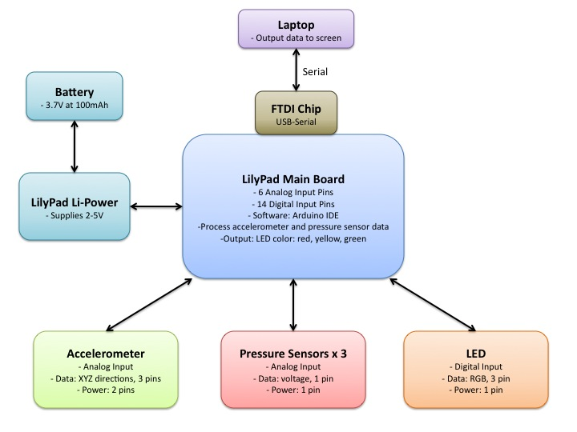
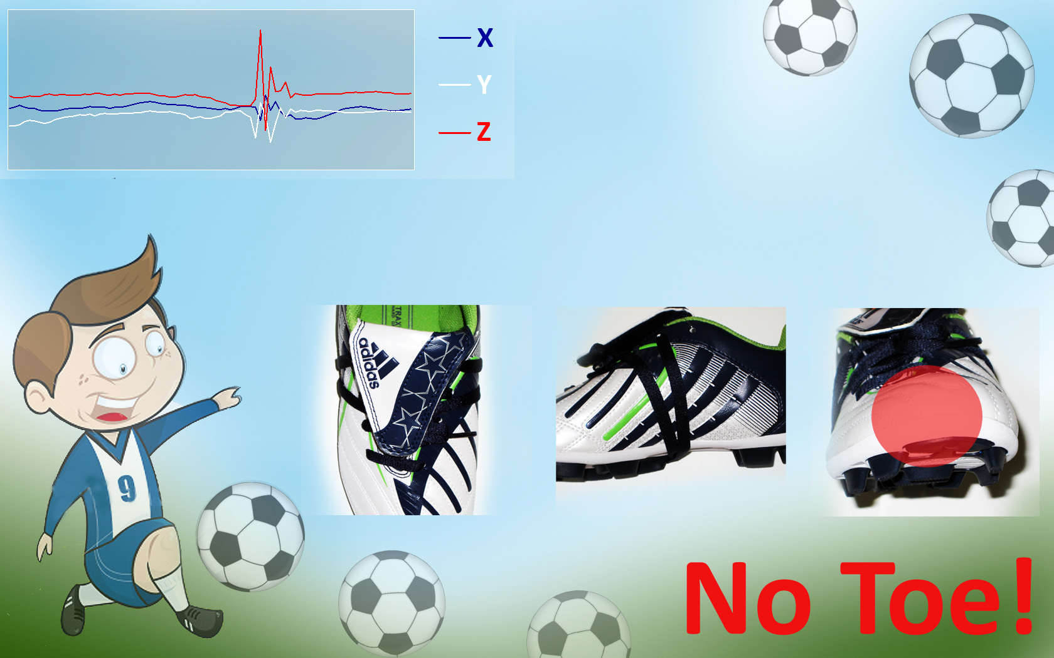
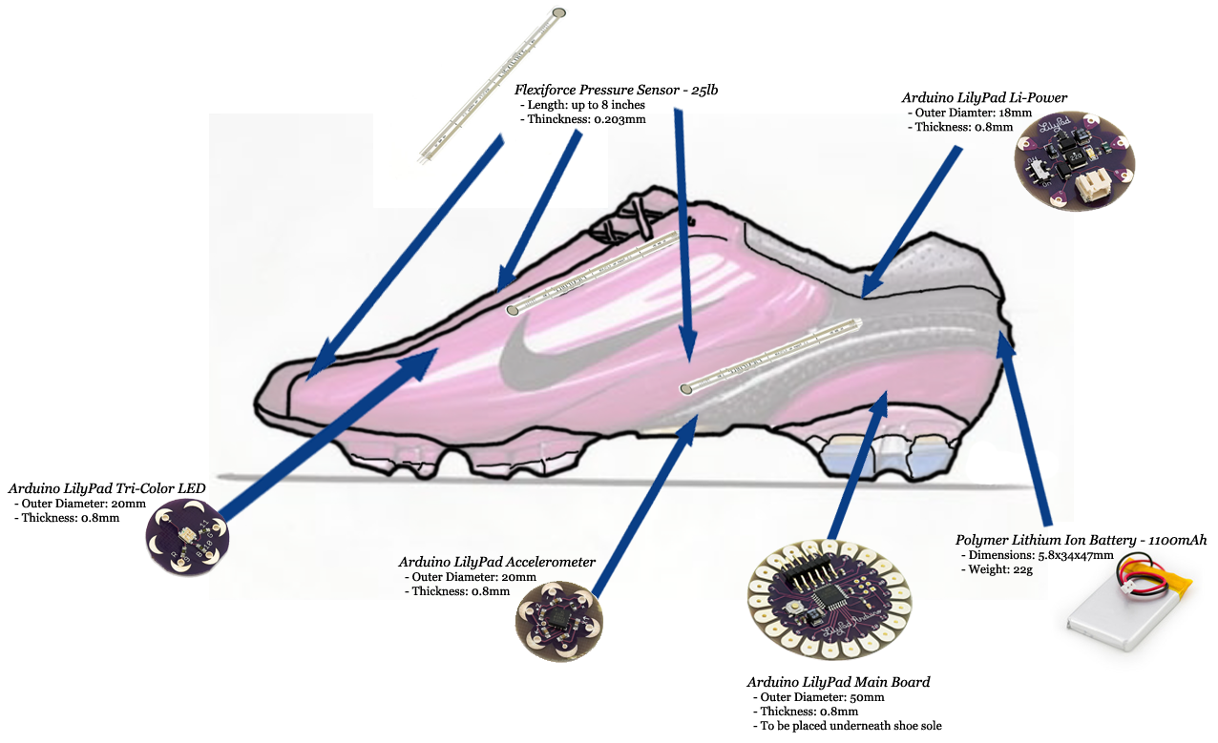
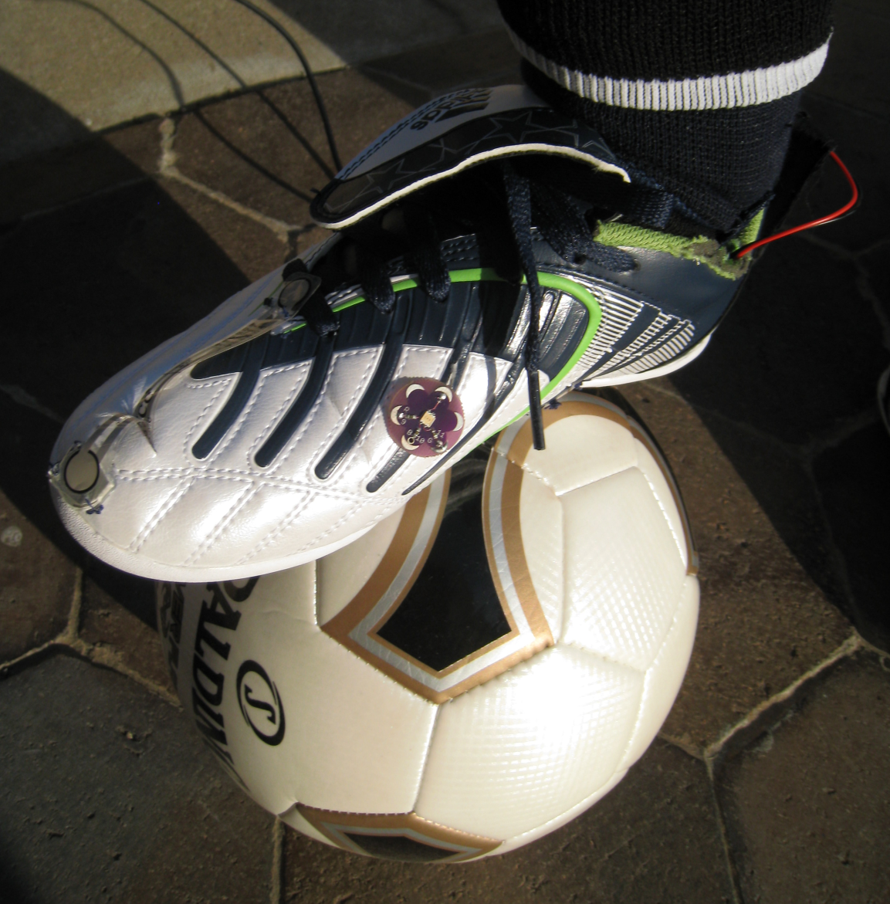
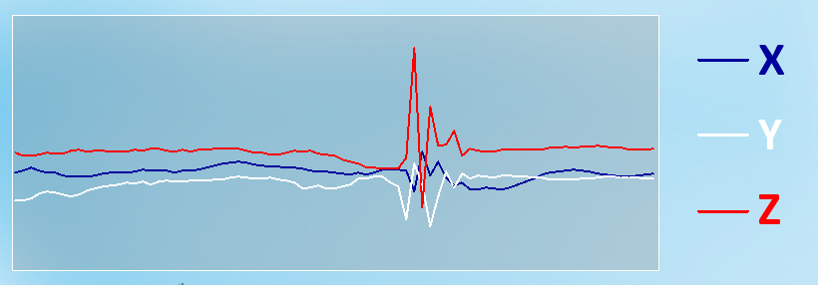
Super Sweet Kicks: Instructional Soccer Shoe Jessica Liao, Matt Wagner, Tom Cherry, Seth Rosenblum, Advisor: Priya Narasimhan
MOTIVATION
ARCHITECTURE
Learning how to properly kick a soccer ball is very challenging, especially for kids. Children have short attention spans and coaches can get easily frustrated and sometimes even yell at them. Rather than having a child experience the emotional anguish or discouragement after being screamed at by a coach, our smart shoe will provide colorful feedback in a fun and friendly way.
This project will help young children learn how to properly kick a soccer ball. This smart soccer shoe will provide kids feedback in a friendly, easy-to-understand way in order to allow them to improve.
Default mode / Home State
Continuous accelerometer reading
LED off and no pressure reading
User kicks soccer ball / Process
Valid pressure reading
Process kick data based on how hard and where ball was kicked
Interactive Color Feedback / Response
LED lights from gradients of red (bad), yellow (satisfactory), and green (sweet)
Objective
DEVELOPMENT ENVIRONMENT
RESULTS
Hardware
1 – LilyPad Arduino Main Board
3 – Flexiforce Pressure Sensors
1 – LilyPad Accelerometer
1 – LilyPad Tri-Color LED
1 – LilyPad LiPower
1 – Polymer Lithium Ion Battery
Software
Arduino IDE
Protocol
Serial
The shoe is able to detect three types of kicks: laces, instep, and toe and interactively respond with light feedback within 200ms. Pressure sensor and accelerometer data were used to detect kicks. We managed to fit everything in the shoe comfortably.
We also made a graphical user interface that shows where the soccer ball was kicked on the shoe, feedback, and acceleration of the shoe in real-time.
This is a graph of the acceleration in the X, Y and Z direction. The spike represents a kick.
Optional User Interface
Acceleration vs. Time
http://www.ece.cmu.edu/~ece549/spring09/team15/index.html

