Slide 1
Large Scale Studies of
Memory, Storage, and Network Failures in a Modern Data Center
Thesis Oral
Justin Meza
Committee
Prof. Onur Mutlu (Chair)
Prof. Greg Ganger
Prof. James Hoe
Dr. Kaushik Veeraraghavan (Facebook, Inc.)

Slide 2
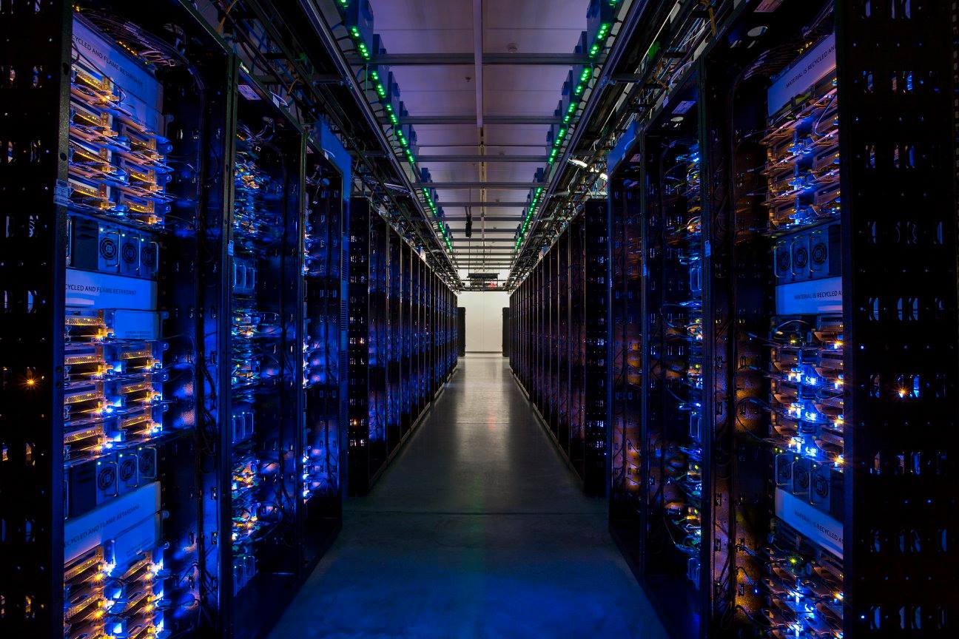
MODERN
DATA CENTERS
Notes:
Every day we interact with modern data centers. Modern data centers form the central nervous system for our society, powering how we communicate, shop, and entertain ourselves. But it's often a mystery what goes on inside of them. So let's start by taking a look at modern data centers by the numbers.

Slide 3
100's
SOFTWARE SYSTEMS
[Hahn LISA'18]

Slide 4
1,000,000's
CONTAINERS
[Hahn LISA'18]

Slide 5
1,000,000,000's
REQUESTS PER SECOND
[Hahn LISA'18]

Slide 6
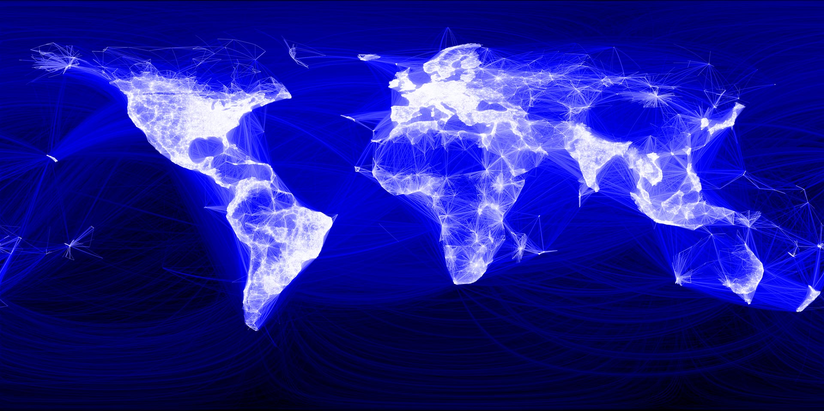
WANT HIGH RELIABILITY
Notes:
So, it's no wonder that with so much at stake, we want to ensure that modern data centers have high reliability.

Slide 7
PROBLEM
Device failures disrupt
data center workloads
Notes:
And I would like to argue today that three properties of the workloads running in modern data centers make them the perfect storm for device failures to reduce the reliability of workloads.

Slide 8
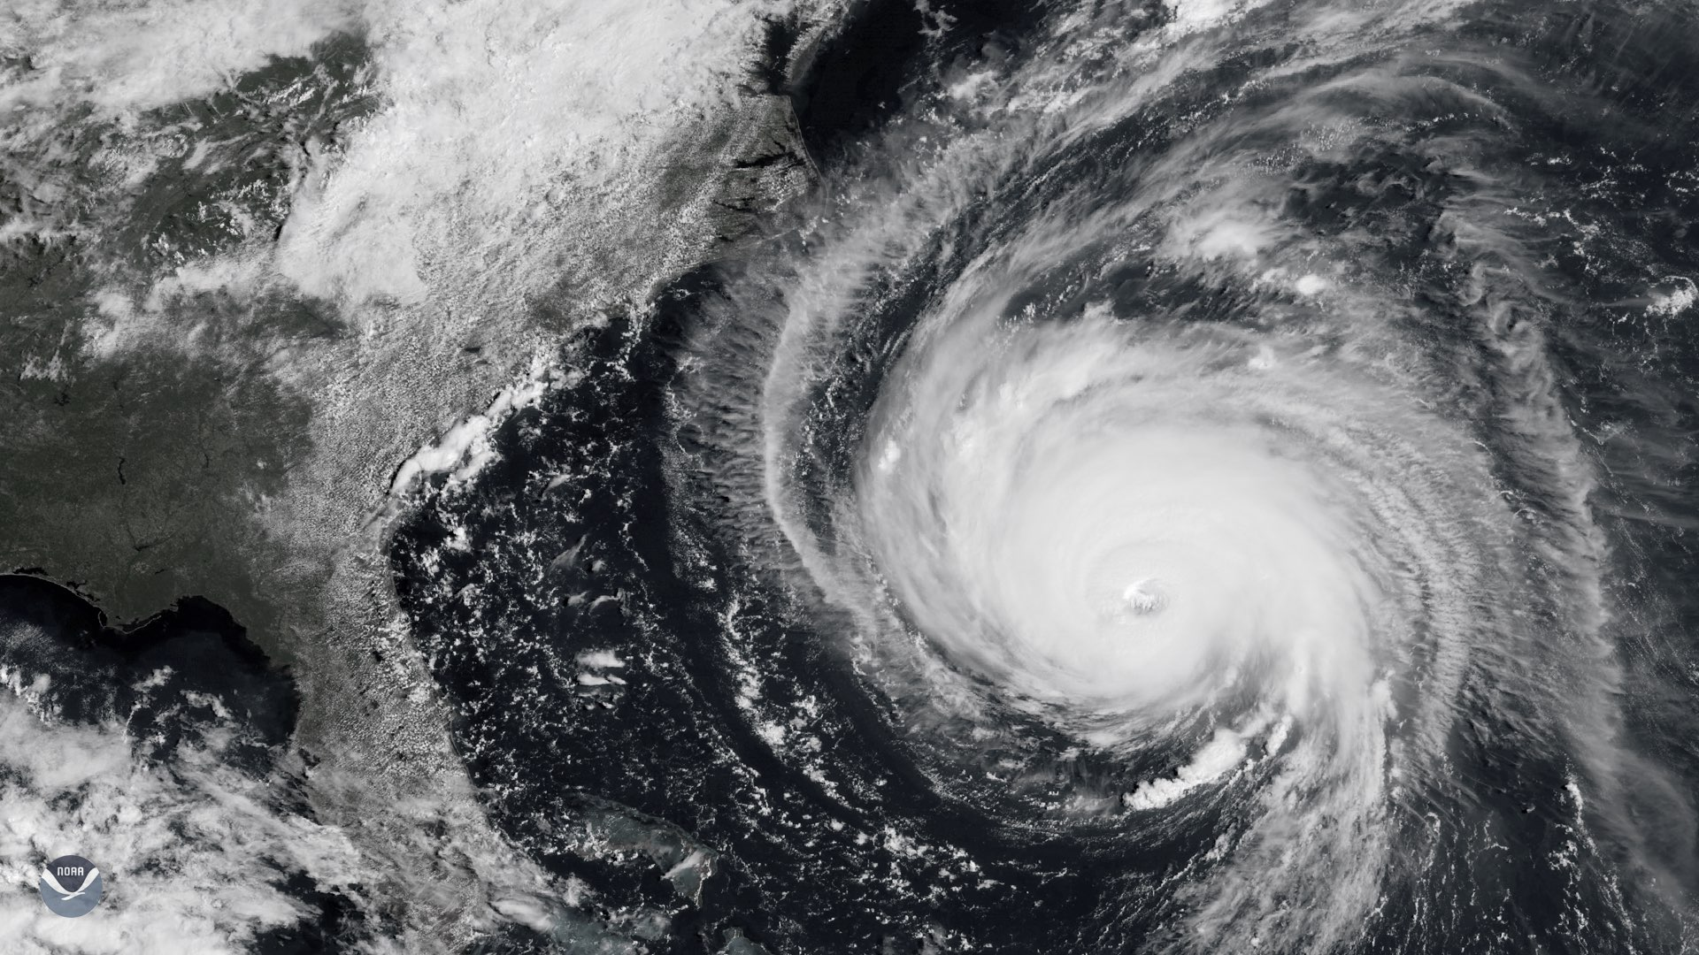
1. INTERDEPENDENCE
2. DISTRIBUTION
3. COMMODITY HW

Slide 9
PROBLEM 1: INTERDEPENDENCE
WEB
SERVER
CACHE
DATABASE
Program
Program
Program
The programs running in modern data centers
make up larger workloads.
Notes:
Failures in one can affect the others.

Slide 10
PROBLEM 1: INTERDEPENDENCE
Workload
WEB
SERVER
Request
Request
CACHE
DATABASE
Response
Response
Program
Program
Program
The programs running in modern data centers
make up larger workloads.
Notes:
Failures in one can affect the others.

Slide 11
PROBLEM 1: INTERDEPENDENCE
x
Workload
WEB
SERVER
Request
Request
CACHE
DATABASE
Response
Response
Program
Program
Program
The programs running in modern data centers
make up larger workloads.
Notes:
Failures in one can affect the others.

Slide 12
PROBLEM 1: INTERDEPENDENCE
x
x
Workload
x
WEB
SERVER
Request
Request
CACHE
DATABASE
Response
Response
Program
Program
Program
The programs running in modern data centers
make up larger workloads.
Notes:
Failures in one can affect the others.

Slide 13
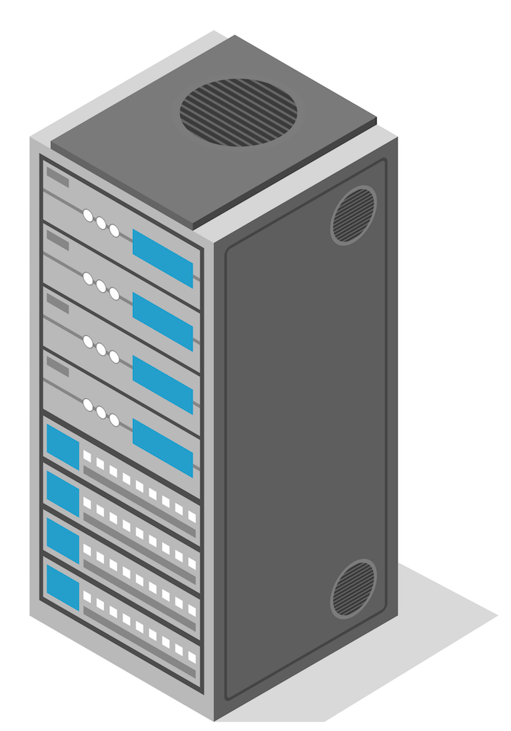
PROBLEM 2: DISTRIBUTION
WEB SERVER
CACHE
DATABASE
Request
Request
Response
Response
Workloads in modern data centers are distributed across many servers.
Notes:
Failures in one can affect the others.

Slide 14
PROBLEM 2: DISTRIBUTION
x
WEB SERVER
CACHE
DATABASE
Request
Request
Response
Response
Workloads in modern data centers are distributed across many servers.
Notes:
Failures in one can affect the others.

Slide 15
PROBLEM 2: DISTRIBUTION
x
x
WEB SERVER
x
CACHE
x
DATABASE
Request
Request
Response
Response
Workloads in modern data centers are distributed across many servers.
Notes:
Failures in one can affect the others.

Slide 16
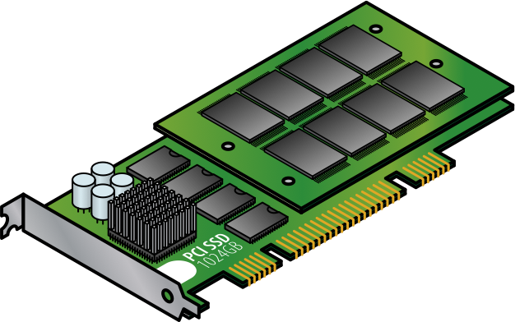
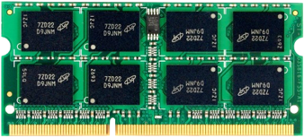
PROBLEM 3: COMMODITY HW
Modern data centers trade off reliability for
using simpler, commodity hardware.

Slide 17
PROBLEM 3: COMMODITY HW
Modern data centers trade off reliability for
using simpler, commodity hardware.

Slide 18
PROBLEM 3: COMMODITY HW
x
x
x
x
Modern data centers trade off reliability for
using simpler, commodity hardware.

Slide 19
Even a single device failure can have a widespread effect
on the workloads running in
modern data centers

Slide 20
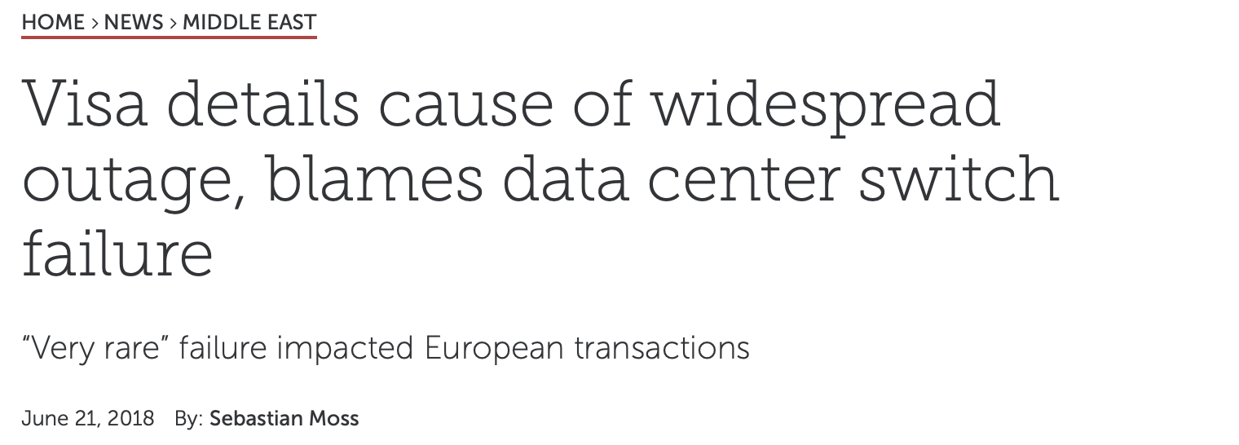
Notes:
We see these types of incidents all the time and you may have even been affected by them.

Slide 21
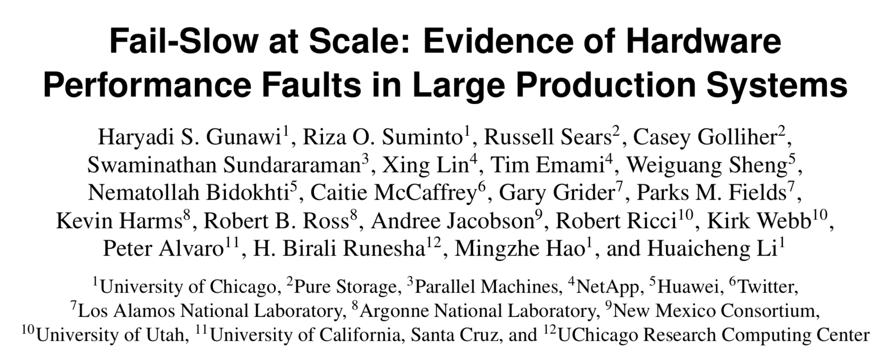
[FAST'18]
"A fail-slow hardware can collapse the entire cluster performance; for example, a degraded NIC made many jobs lock task slots/containers in healthy machines, hence new jobs cannot find enough free slots."
Notes:
In fact, a recent paper in FAST 2018 showed examples of slow hardware devices in industry, government, and academic data centers could cause cascading failures when they become unresponsive and load shifts to other machines. Device reliability is a real problem.

Slide 22
GOAL
Measure, model, and learn from device failures
to improve data center reliability

Slide 23
CHALLENGES
1. Most device reliability studies are small scale
2. Prior large scale studies hard to generalize
3. Limited evaluation of techniques in the wild
Notes:
Hard to ask "what-if" questions.

Slide 24
THESIS STATEMENT
If we measure the device failures in modern data centers,
then we can learn the reasons why devices fail,
develop models to predict device failures, and
learn from failure trends to make recommendations
to enable workloads to tolerate device failures.

Slide 25
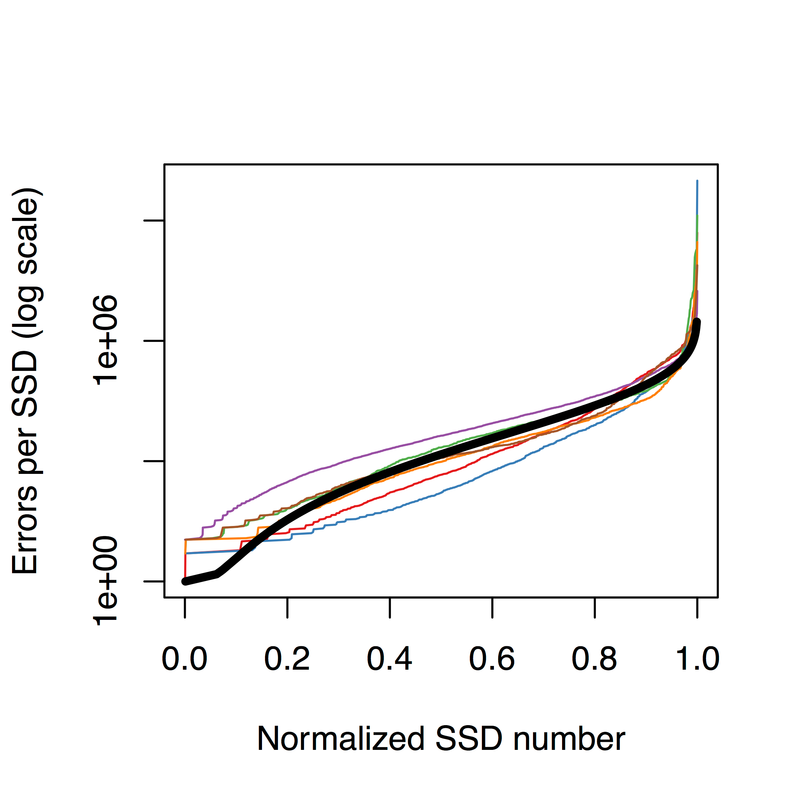
MEASURE
MODEL
EVALUATE
Notes:
If we break this thesis down, it consists of three areas of focus: measuring device failures, using them to develop statistical models, and then using those models to suggest improvements for data center reliability.

Slide 26
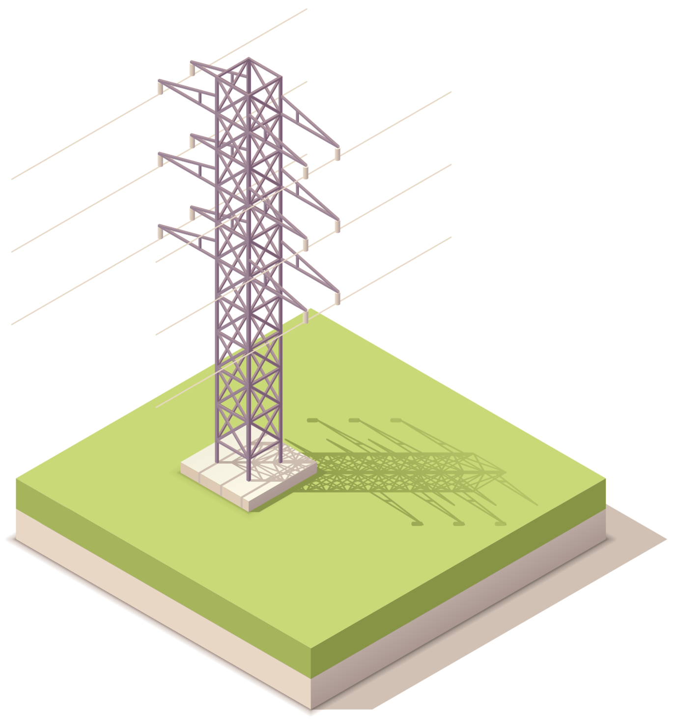
CONTRIBUTIONS
1. Large scale failure studies
DRAM
[DSN '15]
SSDs
[SIGMETRICS '15]
Networks
[IMC '18]
We shed new light on device trends from the field

Slide 27
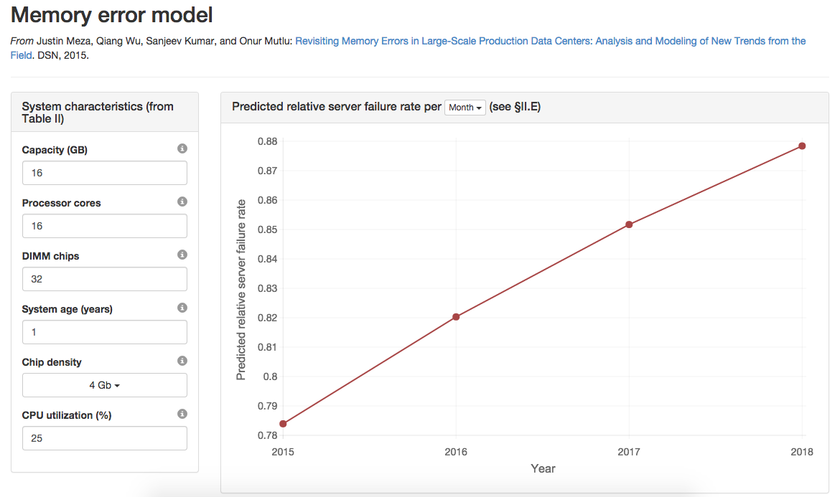
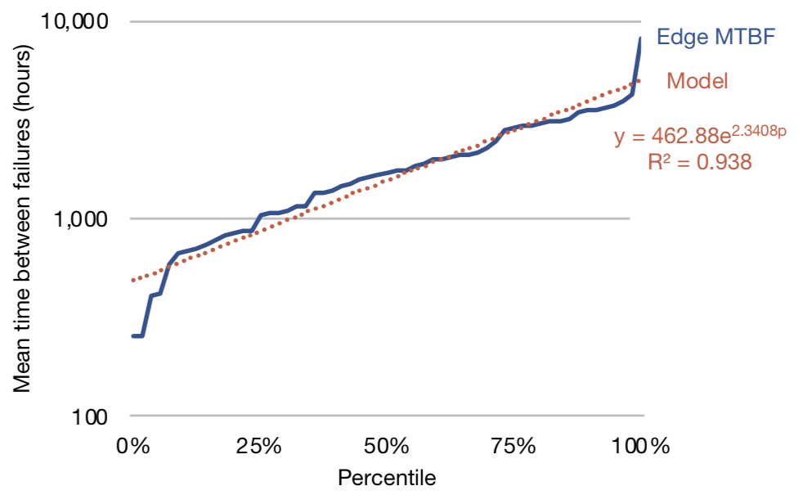
CONTRIBUTIONS
2. Statistical failure models
DRAM
[DSN '15]
SSDs
[SIGMETRICS '15]
Networks
[IMC '18]
We enable the community to apply what we learn

Slide 28
CONTRIBUTIONS
3. Evaluate best practices in the field
DRAM
Page offlining
SSDs
OS write buffering
Networks
Software-based
networks
We provide insight into how to tolerate failures

Slide 29
OUTLINE
1. Modern data center background
2. Large scale device failure studies
Memory: DRAM
Storage: SSDs
Network: Switches and WAN
3. Conclusion

Slide 30
Notes:
So let’s take a quick look at what happens I take out my mobile phone <CLICK> and open up an app. First, ... <CLICK>

Slide 31
Notes:
<CLICK>

Slide 32
Notes:
... a request is sent to a server in one of several datacenters around the world. To get to the data center, ... <CLICK>

Slide 33
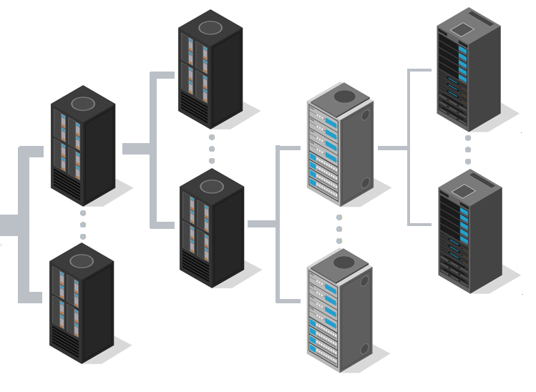
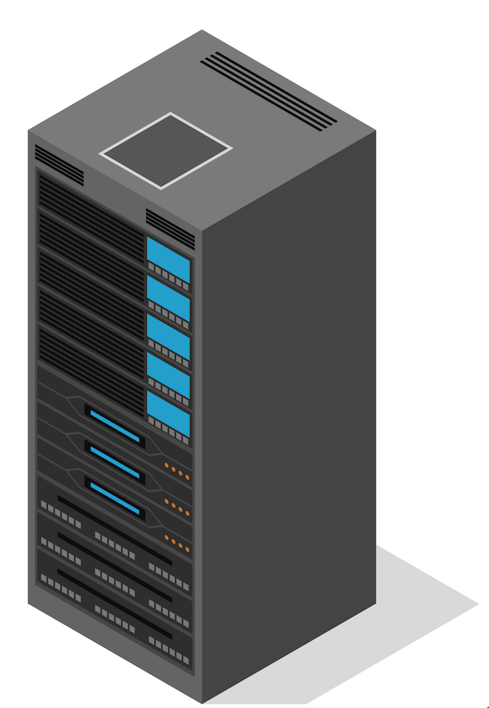
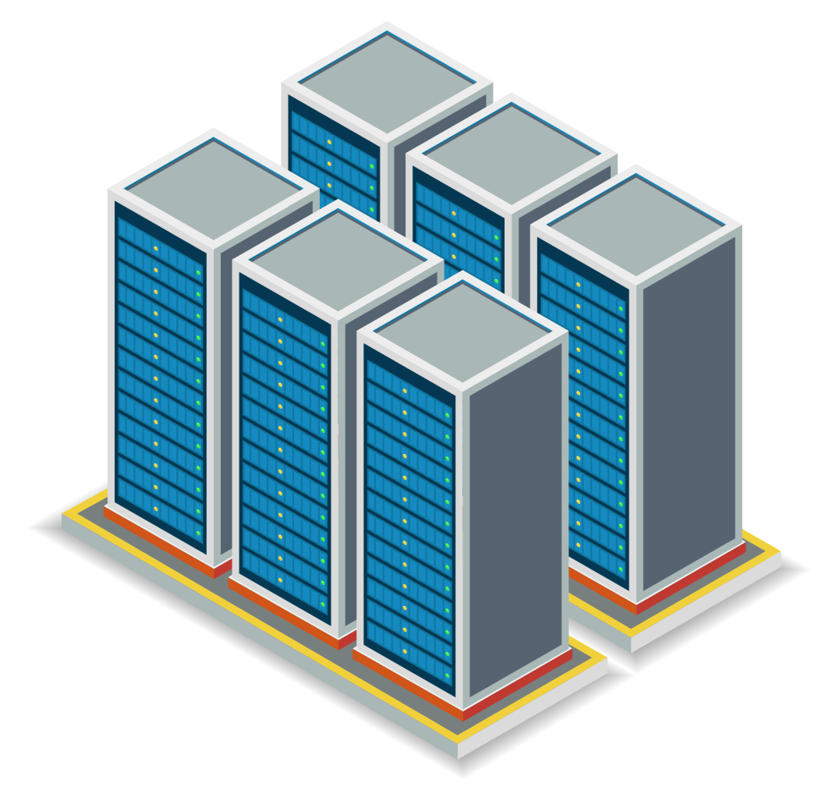
WAN
Internet
ISP
Edge Node
Core Switches
Data Center Fabric
Top of Rack Switch
Notes:
... the request travels over the Internet, to an Internet Service Provider that peers with a Wide Area Network backbone. The request traverses the WAN backbone to get to an Edge Node that runs network load balancing software, typically located in ISPs or colation facilities, and then... <CLICK>

Slide 34
WAN
Internet
ISP
Edge Node
Core Switches
Data Center Fabric
Top of Rack Switch
Notes:
... the request is routed to a data center. The request first arrives at a set of Core switches that provide cross data center connectivity, and, in modern data centers, traverses through a mesh of switches that form a software-based fabric. The data center fabric is a software-managed hierarchy of switches that provides reliable connectivity within a data center. The edge of the fabric connects to top of rack switches, which then forward the request to a server running the rack. <CLICK>

Slide 35
Server Rack
Server Sleds
Devices

Slide 36
MEMORY
Dynamic Random Access Memory (DRAM)

Slide 37
STORAGE
Solid State Drives (SSDs)

Slide 38
NETWORK
Switches and Wide Area Network (WAN) Backbone

Slide 39
WHY DO DEVICES FAIL?
DRAM
SSDs
Networks
Retention
Disturbance
Endurance
Endurance
Disturbance
Temperature
Bugs
Faulty hardware
Human error
Notes:
There's a wealth of controlled experimental data from the field, which we detail in our work. But to summarize...

Slide 40
DATA CENTER DIVERSITY
Different system configurations
Diverse workloads (Web, Database, Cache, Media)
Diverse CPU/memory/storage requirements
Different device organizations
Capacity, frequency, vendors, ...
Across various stages of lifecycle
Notes:
Modern data centers are diverse.

Slide 41
KEY OBSERVATIONS
Large scale data centers have diverse device populations
Large sample sizes mean we can build accurate models
We can observe infrequent failure types at large scale
Notes:
17 m

Slide 42
RELIABILITY EVENTS
ERROR
How failures manifest in software using a device
FAULT
The underlying reason why a device fails
Permanent: the fault appears every time
Transient: the appears only sometimes

Slide 43
LARGE SCALE STUDIES
DRAM
[DSN '15]
SSDs
[SIGMETRICS '15]
Networks
[IMC '18]
Notes:
This study was interesting to perform as the next-most-recent similar study was performed several years prior on much older devices and technologies.

Slide 44
Socket

Slide 45
Memory channels

Slide 46
Dual
In-line Memory
Module
(DIMM) slots

Slide 47
DIMM

Slide 48
Chip

Slide 49
Banks

Slide 50
Rows and columns

Slide 51
Cell

Slide 52
Memory data
Error Correcting Code (ECC) metadata

Slide 53
MEASURING DRAM ERRORS
Measured every logged error
Across Facebook's fleet
For 14 months
Metadata associated with each error
Parallelized Map-Reduce to process
Used R for further analysis

Slide 54
ANALYTICAL METHODOLOGY
Measure server characteristics
Examined all servers with errors (error group)
Sampled servers without errors (control group)
Bucket devices based on characteristics
Measure relative failure rate
Of error group vs. control group
Within each bucket

Slide 55
KEY DRAM CONTRIBUTIONS
Errors follow a power-law distribution
Denial of service due to socket/channel
Higher density = more failures
DIMM architectural effects on reliability
Workload influence on failures
Model, page-offlining, page randomization
Notes:
We provided several novel contributions in this study.

Slide 56
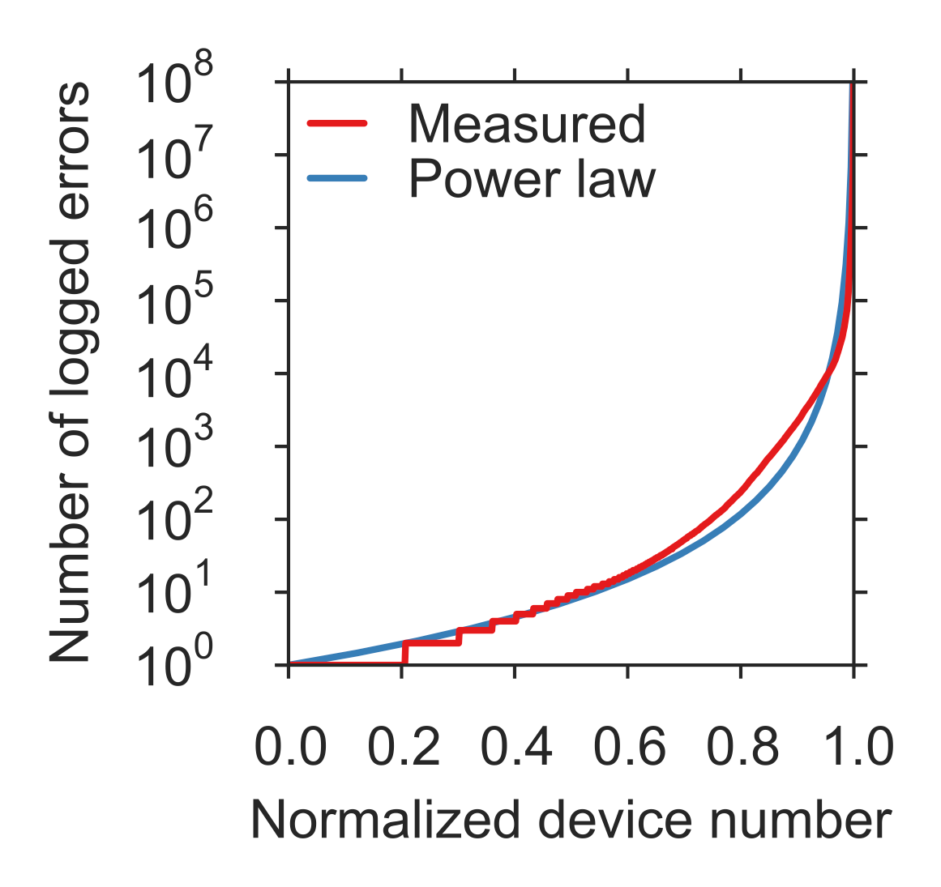
POWER-LAW DISTRIBUTION
1% of servers = 97.8% errors

Slide 57
POWER-LAW DISTRIBUTION
1% of servers = 97.8% errors
Average is 55X median

Slide 58
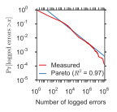
POWER-LAW DISTRIBUTION
1% of servers = 97.8% errors
Average is 55X median
Pareto distribution fits
Devices without errors tend to stay without errors

Slide 59
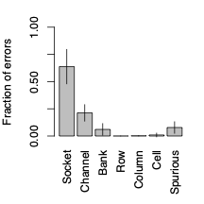
SOCKET/CHANNEL ERRORS
Contribute majority of errors

Slide 60
SOCKET/CHANNEL ERRORS
Contribute majority of errors
Concentrated on a few hosts
Symptoms ≈ server DoS

Slide 61
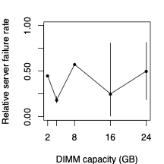
HIGHER DENSITY TRENDS
?
Capacity, NO! Density, YES!
Notes:
Need to add info on relative server failure rate

Slide 62
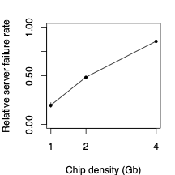
HIGHER DENSITY TRENDS
Capacity, NO! Density, YES!
Higher density, more failure
Due to smaller feature sizes

Slide 63
DIMM architecture
Chips per DIMM, transfer width
8 to 48 chips
x4, x8 = 4 or 8 bits per cycle
Electrical implications

Slide 64
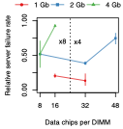
ARCHITECTURAL EFFECTS
For the same transfer width:
More chips = more failures

Slide 65
ARCHITECTURAL EFFECTS
For the same transfer width:
More chips = more failures
For different transfer widths:
More bits = more failures
Likely related to electrical noise

Slide 66
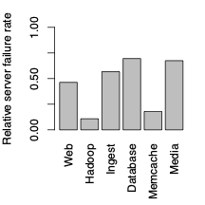
WORKLOAD INFLUENCE
No consistent trends across CPU and memory utilization
But workload varies by ~6X
May be due to distribution for read/write behavior

Slide 67
MODELING MEMORY FAILURES
Use statistical regression model
Compare control group versus error group
Logistic (linear) regression in R
Trained using data from analysis
Enable exploratory analysis

Slide 68
MODELING MEMORY FAILURES
Density
Memory
error
model
Relative server failure rate
Chips
Age
...

Slide 69
MODELING MEMORY FAILURES
Density
Memory
error
model
Relative server failure rate
Chips
Age
...

Slide 70
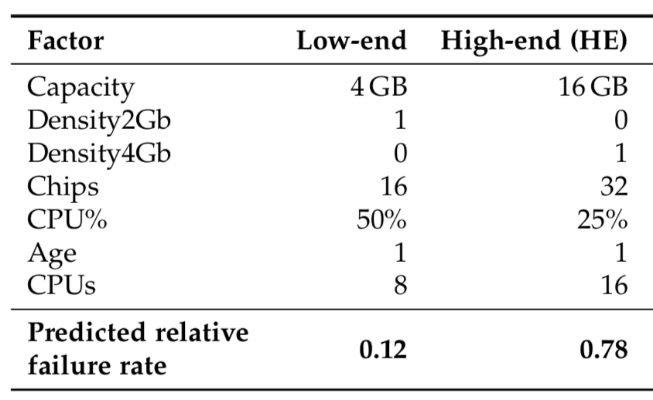
EXPLORATORY ANALYSIS
Inputs
Output
6.5X difference in yearly failures

Slide 71
TOOL AVAILABLE ONLINE
http://www.ece.cmu.edu/~safari/tools/memerr/

Slide 72
Page offlining
System-level technique to reduce errors
When a page has an error, take the page offline
Copy its contents to a new location
Poison the page to prevent allocation

Slide 73
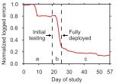
PAGE OFFLINING AT SCALE
First study at large scale
Cluster of 12,276 servers

Slide 74
PAGE OFFLINING AT SCALE
First study at large scale
Cluster of 12,276 servers
Reduced error rate by 67%

Slide 75
PAGE OFFLINING AT SCALE
First study at large scale
Cluster of 12,276 servers
Reduced error rate by 67%
Prior simulations: 86 to 94%
Did not account for OS failures to lock page

Slide 76
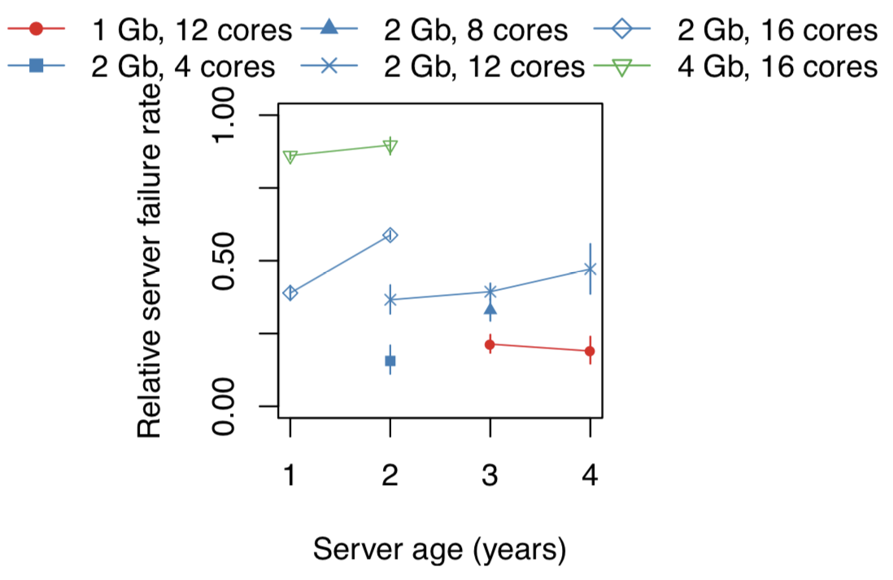
DRAM WEAROUT IN THE FIELD
DRAM shows signs of wear
Idea: What if we performed wear leveling in DRAM?
Can be done in OS without modifying hardware
Notes:
- Add this conclusion to the thesis and add as a limitation of the study.

Slide 77
PAGE RANDOMIZATION
Prototype implemented in Debian 6.0.7 kernel

Slide 78
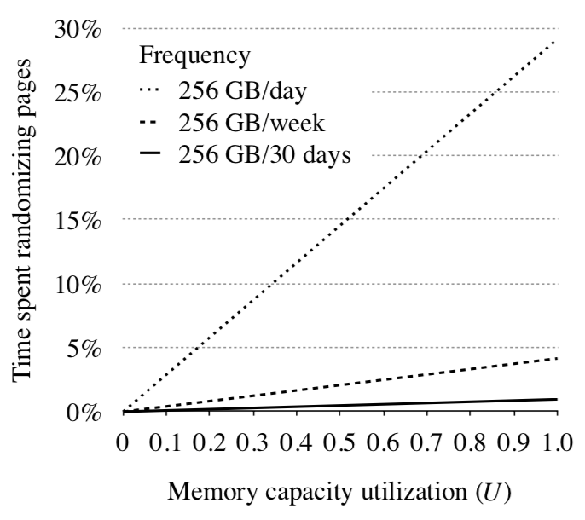
PAGE RANDOMIZATION
Can perform with low overhead (< 5%)
Can fine-tune desired rate of randomization

Slide 79
KEY DRAM CONTRIBUTIONS
Errors follow a power-law distribution
Denial of service due to socket/channel
Higher density = more failures
Architectural effects on reliability
Workload influence on failures
Model, page-offlining, page randomization
Notes:
38 m

Slide 80
RELATED WORK
DRAM errors at Google [Schroeder+ SIGMETRICS'09]
Component failures + simulated page offlining [Hwang+ ASPLOS'12]
Error correction, location, multi-DIMM errors [Sridharan+ SC'12, SC'13; DeBardeleben+ SELSE'14]

Slide 81
LARGE SCALE STUDIES
DRAM
[DSN '15]
SSDs
[SIGMETRICS '15]
Networks
[IMC '18]
Notes:
This study was exciting to perform because it was a very early work in the field to examine SSD failures at a large scale.

Slide 82
Notes:
Here is a schematic of a server SSD. Unlike the SSD in your computer, server SSDs are connected over PCIe to enable high bandwidth.

Slide 83
PCIe

Slide 84
Flash chips

Slide 85
SSD controller
translates addresses
schedules accesses
performs wear leveling

Slide 86
10011111 11001111 11000011 00001101
10101110 11100101 11111001 01111011
00011001 11011101 11100011 11111000
11011111 01001101 11110000 10111111
00000001 11011110 00000101 01010110
00001011 10000010 11111110 00011100
...
Stored data
01001100 01001101 11010010 01000000
10011100 10111111 10101111 11000101
ECC metadata
Notes:
Because bit flips are common in flash memory, the SSD controller stores error correcting code metadata alongside user data on the flash chips.

Slide 87
TYPES OF SSD FAILURES
Ones that cause SMALL ERRORS
10's of flipped bits per KB
Silently corrected by SSD controller
Ones that cause LARGE ERRORS
100's of flipped bits per KB
Corrected by host using driver
Referred to as SSD failure

Slide 88
MEASURING SSD FAILURES
Examined lifetime hardware counters
Across Facebook's fleet
Devices deployed between 6 months and 4 years
15 TB to 50 TB read and written
Planar, Multi-Level Cell (MLC)
Snapshot-based analysis

Slide 90
Errors | 54,326 | 0 | 2 | 10
Data written | 10TB | 2TB | 5TB | 6TB

Slide 91
Errors | 54,326 | 0 | 2 | 10
Data written | 10TB | 2TB | 5TB | 6TB
2018-12-3

Slide 92
Errors | 54,326 | 0 | 2 | 10
Data written | 10TB | 2TB | 5TB | 6TB
2018-12-3
Errors
Data written

Slide 93
Errors | 54,326 | 0 | 2 | 10
Data written | 10TB | 2TB | 5TB | 6TB
2018-12-3
Buckets
Errors
Data written

Slide 94
Errors | 54,326 | 0 | 2 | 10
Data written | 10TB | 2TB | 5TB | 6TB
2018-12-3
Errors
Data written

Slide 95
Errors | 54,326 | 0 | 2 | 10
Data written | 10TB | 2TB | 5TB | 6TB
2018-12-3
Errors
Data written

Slide 96
KEY SSD CONTRIBUTIONS
Distinct lifecycle periods
Read disturbance not prevalent in the field
Higher temperatures cause more failures
Amount of data written by OS is misleading
Write amplification trends from the field

Slide 97
FAILURE MODELING
Built a model across 6 SSD server configurations
Weibull (0.3, 5e3)
Most errors are from a small set of SSDs

Slide 98
Storage lifecycle background:
the
bathtub curve
for disk drives
Failure
rate
Usage
[Schroeder+,FAST'07]

Slide 99
Storage lifecycle background:
the
bathtub curve
for disk drives
Early failure period
Wearout period
Failure
rate
Useful life period
Usage
[Schroeder+,FAST'07]

Slide 100
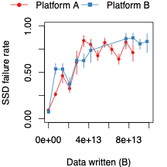
SSD LIFECYCLE PERIODS
720GB, 1 SSD
720GB, 2 SSDs
0
40
80
Data written (TB)

Slide 101
SSD LIFECYCLE PERIODS
0
40
80
Data written (TB)

Slide 102
SSD LIFECYCLE PERIODS
0
40
80
Data written (TB)
Notes:
Call out limitation of bath SSD; limitations andopportunities for further study
- Questions: Wearout period may just be different; could be a completely new finding
- Firmware issues
- System provisioning could play a factor -> fewer devices

Slide 103
SSD LIFECYCLE PERIODS
We believe there are two distinct pools of flash cells
The "weak" pool fails first, during early detection
The "strong" pool follows the bathtub curve
Burn-in testing is important to help the SSD identify the weak pool of cells

Slide 104
Read disturbance errors
Charge drift from reads to neighboring cells
Documented in prior controlled studies on chips

Slide 105
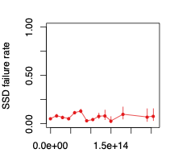
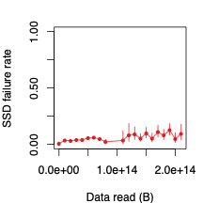
READ DISTURBANCE ERRORS
SSDs with the most reads
3.2TB, 1 SSD
(R/W = 2.14)
1.2TB, 1 SSD
(R/W = 1.15)

Slide 106
READ DISTURBANCE ERRORS
SSDs with the most reads
No statistically significant difference at low data read versus high data read
3.2TB, 1 SSD
(R/W = 2.14)
1.2TB, 1 SSD
(R/W = 1.15)

Slide 107
TEMPERATURE DEPENDENCE

Slide 108
TEMPERATURE DEPENDENCE
Temperature sensor

Slide 109
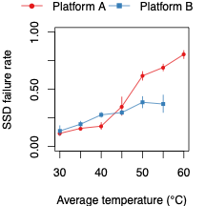
TEMPERATURE DEPENDENCE
Higher temperature = more failures
720GB, 1 SSD
720GB, 2 SSDs

Slide 110
TEMPERATURE DEPENDENCE
On some devices, high temperature
may throttle or
shut down SSD

Slide 111
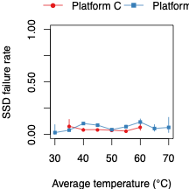
TEMPERATURE DEPENDENCE
Throttling is an effective technique to reduce failures
Potentially decreases device performance, however
1.2TB, 1 SSD
3.2TB, 1 SSD

Slide 112
Access patterns and SSD writes
System buffering
Data served from OS caches
Decreases SSD usage
Write amplification
Updates to small amounts of data
Increases erasing and copying

Slide 113
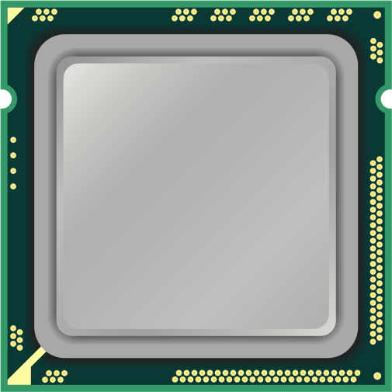
System caching reduces
the impact of SSD writes
OS
Page cache

Slide 114
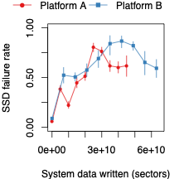
OS WRITES MISLEADING
No statistically significant correlation with failures at high write volume
1.2TB, 2 SSDs
3.2TB, 2 SSDs
0
15
30
Data written to OS (TB)

Slide 115
OS WRITES MISLEADING
No statistically significant correlation with failures at high write volume
Data written to OS versus SSD is not correlated for high write volume
60
Data written to flash cells (TB)
20
720GB, 2 SSDs
0
15
30
Data written to OS (TB)

Slide 116
Flash devices use a
translation layer
to locate data
OS

Slide 117
Translation layer
Logical
address
space
Physical
address
space
<offset1, size1>
OS
<offset2, size2>
...

Slide 118
Sparse data layout
more translation metadata
potential for higher write amplification
Notes:
Example: reading/writing a large number of small files.

Slide 119
Dense data layout
less translation metadata
potential for lower write amplification
Notes:
Example: reading/writing a large file.

Slide 120
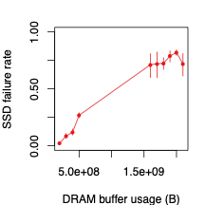
WRITE AMPLIFICATION
Sparse data shows signs of higher failure rates
Likely due to write amplification
720GB, 1 SSD
0
1
2
Denser
Sparser
Translation data (GB)

Slide 121
KEY SSD CONTRIBUTIONS
Distinct lifecycle periods
Read disturbance not prevalent in the field
Higher temperatures cause more failures
Amount of data written by OS is misleading
Write amplification trends from the field
Notes:
51 m

Slide 122
RELATED WORK
Examined chip-level failures E.g., [Cai+ DATE'12, ICCD'12, DATE'13, ICCD'13, DSN'15, HPCA'17]
Examined a simulated SSD controller with 45 flash chips [Grupp+ FAST'12]
Reliability of SSD controllers (NOT chips) [Ouyang+ ASPLOS'14]
Microsoft and Google SSDs over multiple years [Narayanan+ SYSTOR'16, Schroeder+ FAST'16]

Slide 123
LARGE SCALE STUDIES
DRAM
[DSN '15]
SSDs
[SIGMETRICS '15]
Networks
[IMC '18]
Notes:
This study was interesting in that it was the first to study the entire network hierarchy, from the devices within data centers all the way to the devices that connect data centers around the world.

Slide 124
WAN
Internet
ISP
Edge Node
Core Switches
Data Center Fabric
Rack Switch
Notes:
Just a reminder of the network architecture in modern data centers.
(Show which parts are intra versus inter.)
Understanding and managing the reliability of large scale networks -- both between data centers and within data centers -- can be challenging. Especially because failure in a portion of the network in one place can affect software systems running on the other side of the globe. In a large scale web service, for example, we'd like to answer questions such as, "Which devices and links pose the biggest risk to reliability?" "How severe are network failures to site reliablity when they occur?", and "How can we plan our network to minimize reliability risk?" <CLICK>

Slide 125
SOFTWARE-AIDED NETWORKS
Simple, custom switches
Software-based fabric networks
Automated repair of common failures
Notes:
In the last few years there has been a shift from using big vendor devices with priopriatary firmware and software toward using simple switches built from commodity network chips and connecting those simple switches into a software-based fabric of devices. Devices in the fabric are fungible, meaning that when they go away, software orchestration kicks in to replace them. On top of that, software-based automated repair systems handle the most common failure modes. <CLICK>

Slide 126
MEASURING NETWORK FAILURE
DATA CENTER NETWORK
WIDE AREA NETWORK
Incident reports
Across Facebook's fleet
Over 7 years
Details on faulty device, severity, ...
Vendor repair tickets
Across Facebook's fleet
Over 14 months
Details on location, timing, ...

Slide 127
INCIDENT REPORTS
Switch Failures
cause
Software Failures
that result in
Incidents (with reports)
Notes:
It's important that I introduce some terminology, as our work differs from some prior large scale data center network studies. At Facebook, network issues are a common occurrence, but not all network issues affect software systems. In our paper, we say that a Network Incident is any event in the network that causes software to fail. A network incident might be an unresponsive port or a bad configuration change, for example. Software failures result in Site Events, or SEVs for short. SEVs can range from small events that impact user experience only briefly, to widespread site outages. I'll refer to network incidents and SEVs interchangeably throughout this talk. <CLICK>

Slide 128
KEY NETWORK CONTRIBUTIONS
Software-aided networks greatly reduce errors
High bandwidth switches cause more incidents
Rack switches are a bottleneck for reliability
Data center WAN reliability models
Notes:
Quantifying how...

Slide 129
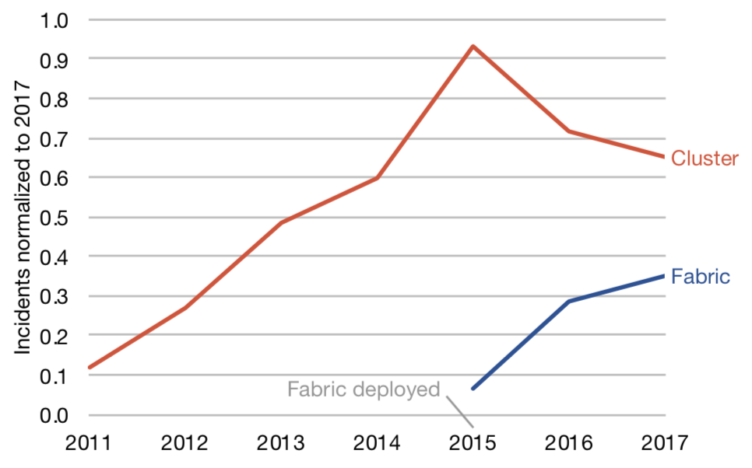
NETWORK DESIGN TRENDS
Older hard-wired networks
9X incident increase over 4 years
Hard-wired network

Slide 130
NETWORK DESIGN TRENDS
Older hard-wired networks
9X incident increase over 4 years
Newer software-aided designs
2X fewer incidents
2.8X on a per-device basis
Hard-wired network
Software-aided network
Notes:
2.8 = 2 / 0.6

Slide 131
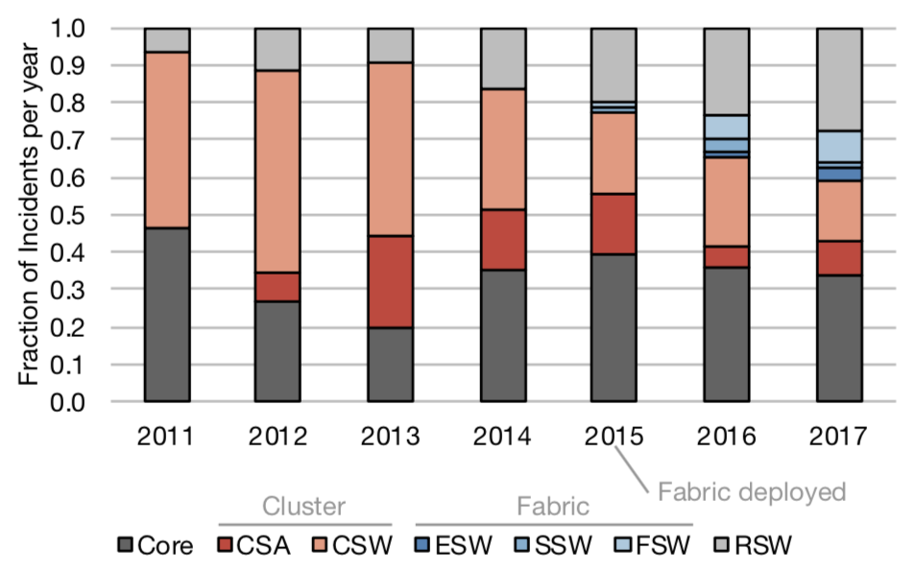
SWITCH TYPE TRENDS
Hard-wired
Software-aided
Highest bandwidth
Lowest bandwidth
Moderate bandwidth
Notes:
Since the adoption of fabric networks in 2015, the predominant source of SEVs has shifted from switches that make up the middle layers of the data center network, shown in red and blue on this graph, to the switches that perform the first and last hop in the data center network: the core switches and the rack switches, shown in gray.

Slide 132
SWITCH TYPE TRENDS
Hard-wired
Software-aided
Highest bandwidth
Lowest bandwidth
Moderate bandwidth
Notes:
The core devices are still built based on vendor hardware, making them challenging to maintain and customize. Compared to software, humans perform slow repairs, and slow repairs mean fewer switches to route requests, more traffic on the remaining switches, and more congestion in the network. <CLICK>

Slide 133
SWITCH TYPE TRENDS
Hard-wired
Software-aided
Highest bandwidth
Lowest bandwidth
Moderate bandwidth
Notes:
On the other hand, rack switches run Facebook's fully customized hardware and software. So what makes them so error prone? <CLICK>

Slide 134
Rack switches make up
82%
of network devices
Notes:
The answer is their sheer volume. At Facebook, nearly 82% of network devices are rack switches, and rack switch incident rates are increasing over time. So how problematic are core switches and rack switches when they fail? Well, throughout 2017... <CLICK>

Slide 135
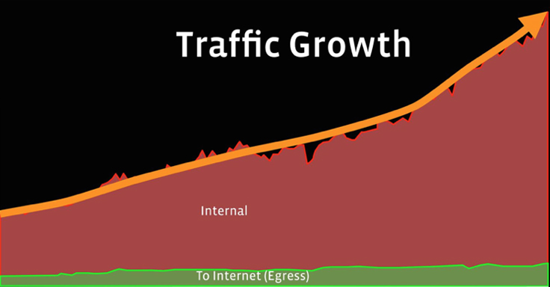
WAN traffic growth
Backbone
Notes:
Take a look at this normalized graph, which compares, over the last few years, the amount of traffic on Facebook's backbone coming from "Internal" server-to-server communication across data centers, in red, versus the amount of "Egress" that goes back into the Internet and to users, in green. You can see that Internal traffic is growing at a much faster rate than Egress. So what does this imply for how we manage our backbone? <CLICK>

Slide 136
WAN architecture
Edge nodes
Route requests across different network paths
Connected by multiple links
Links
Optical fiber cables that connect edges

Slide 137
MODELING WAN RELIABILITY
Failure rate
Repair rate
Edge
Link

Slide 138
MODELING WAN RELIABILITY
Failure rate
Repair rate
O(months)
Edge
O(hours)
Link
O(months)
O(days)

Slide 139
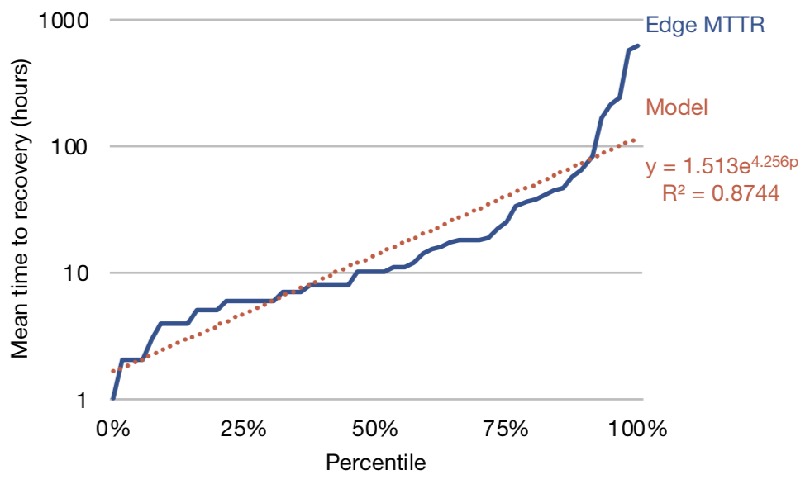
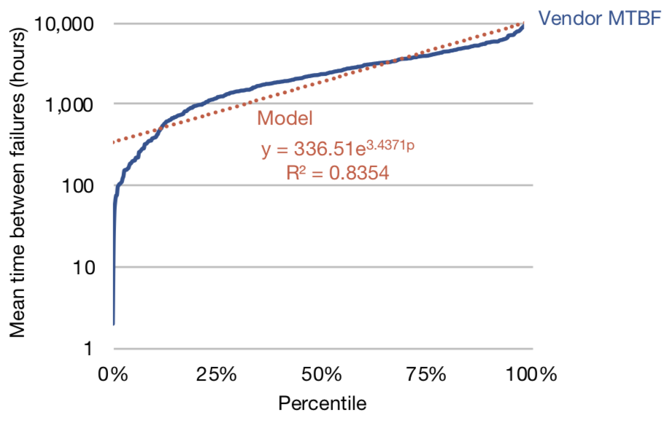
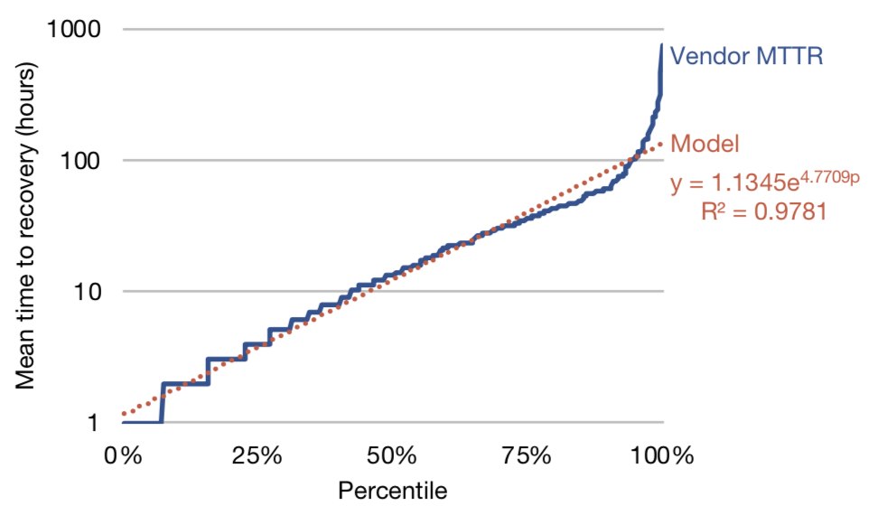
MODELING WAN RELIABILITY
Failure rate
Repair rate
Edge
We provide open models
Link

Slide 140
KEY NETWORK CONTRIBUTIONS
Software-aided networks greatly reduce errors
High bandwidth switches cause more incidents
Rack switches are a bottleneck for reliability
Data center WAN reliability models
Notes:
Focus on software-level effects
1:01

Slide 141
RELATED WORK
Identify network incidents as leading cause [Barroso+ DCaaC, Gunawi+ SoCC'6, Oppenheimer+ USITS'03, Brewer Google Tech. Rep. '17, Wang+ DSN'17]
Hard-wired network studies [Zhuo+ SIGCOMM'17, Gill+ SIGCOMM'11, Potharaju+ IMC'13]
Complementary large scale works focused on device trends [Potharaju+ SoCC'13, Turner+ SIGCOMM'10, Govindan+ SIGCOMM'16]

Slide 142
LARGE SCALE STUDIES
DRAM
[DSN '15]
SSDs
[SIGMETRICS '15]
Networks
[IMC '18]

Slide 143
THESIS STATEMENT
If we measure the device failures in modern data centers,
then we can learn the reasons why devices fail,
develop models to predict device failures, and
learn from failure trends to make recommendations
to enable workloads to tolerate device failures.

Slide 144
CONCLUSION
The problem of understanding why data center devices fail
can be solved by using the scale of modern data centers
to observe failures and by building robust statistical models
to understand the implications of the failure trends.

Slide 145
CONTRIBUTIONS
1. Large scale failure studies
We shed new light on device trends from the field
2. Statistical failure models
We enable the community to apply what we learn
3. Evaluate best practices in the field
We provide insight into how to tolerate failures

Slide 146
LIMITATIONS
Only examined one company's data centers
Do not consider combination of device effects
Do not consider silent data corruption

Slide 147
FUTURE RESEARCH
Further field study based analysis
Other devices, statistical techniques, environments
HW/SW cooperative techniques
Use learnings to inform design decisions
Introspective fault monitoring and reduction
Systems that can identify and adapt their behavior

Slide 148
THESIS PUBLICATIONS
Large scale reliability studies
DRAM [Meza+ DSN'15]
SSDs [Meza+ SIGMETRICS'15]
Network [Meza+ IMC'18]

Slide 149
OTHER PhD PUBLICATIONS
Non-volatile memory
Datacenter Energy
DRAM + NVM [Meza+ CAL'12]
Persistent Memory [Meza+ WEED'13]
Multi-Level Cell [Yoon+ TACO'14]
Row Buffers Locality [Yoon+ ICCD'15]
Row Buffer Sizes [Meza+ ICCD'12]
Sustainable DC Design [Chang+ ASPLOS'12]
Main memory architecture
Bit Flips [Luo+ DSN'14]
Overview [Mutlu+ KIISE'15]

Slide 150
EARLIER PUBLICATIONS
Energy efficiency studies
JouleSort [Rivoire+ Computer'07]
DB Energy [Harizopoulos+ CIDR'09]
OLTP Energy [Meza+ ISLPED'09]
Sustainable DC Design [Meza+ IMCE'10]
Sustainable Server Design [Chang+ HotPower'10]

Slide 151
FACEBOOK PUBLICATIONS
Systems architecture + reliability
Power Management [Wu+ ISCA'16]
Time Series DBs [Pelkonen+ VLDB'15]
Load Testing [Veeraraghavan+ OSDI'16]
Disaster Recovery [Veeraraghavan+ OSDI'18]

Slide 152
ACKNOWLEDGEMENTS
My advisor, Onur, who had confidence in me even when I didn't
My committee – Greg, James, Kaushik – who were always there to listen and guide me
The SAFARI group at CMU for lifelong friendships
Family, friends, and colleagues (too many to list!) who kept me going (Partha, Kim, Yee Jiun ...)

Slide 153
Large Scale Studies of
Memory, Storage, and Network Failures in a Modern Data Center
Thesis Oral
Justin Meza
Committee
Prof. Onur Mutlu (Chair)
Prof. Greg Ganger
Prof. James Hoe
Dr. Kaushik Veeraraghavan (Facebook, Inc.)
Notes:
1:08

Slide 154
BACKUP SLIDES

Slide 155
More Techniques?
We believe our DRAM work provides a promising direction
Analyze failures, build models, design techniques
At the same time, we wanted to focus on:
Instrumentation + analysis of new devices (SSDs)
Going more in depth in software-level effects (networks)
We sketch how to extend our methodology in the thesis

Slide 156
Other Data Centers
We tie our results to fundamental device properties
We build models that control for data center specifics
E.g., DRAM: Workload has an effect, but our models can factor that in to other features (e.g., CPU util)
We do see evidence of similarities to other data centers
E.g., Networks: Data center networks ≈ B4, WAN ≈ B2 in [Jain+SIGCOMM'13, Govindan+SIGCOMM'16]

Slide 157
How Widespread is the Impact?
For DRAM and SSDs we observe fail-slow behavior
Slow devices can cause cascading failures [FAST'18]
For Network devices, failure domain is large leading to widespread effects

Slide 158
DRAM Failure Details
Retention
Cells must be refreshed
Variable retention time complicates matters
Disturbance
Bit flips due to charged particles
Data pattern disturbance & RowHammer effect
Endurance
Wear out due to physical phemonena

Slide 159
SSD Failure Details
Endurance
Cells wear out after many program-erase cycles
Floating gate loses ability to adequately store charge
Temperature
Shrinks and expands boards and components
Arrhenius effect ages cells at accelerated rate
Disturbance
Pass through voltage causes neighboring cell disturbance
Program failures, retention failures

Slide 160
Network Failure Details
Hardware (see DRAM and SSD failure details)
Unplanned fiber cuts
Everything from anchors dragging to backhoes
Bugs
Switches run a variety of software, can be buggy
Operational mistakes
Attempting to repair a switch without turning it off

Slide 161
Exploratory analysis

Slide 162
WRITE AMPLIFICATION
Graph search
Key-value store
0.25
0.45
0.25
0.45
Translation data (GB)
Translation data (GB)

Slide 163
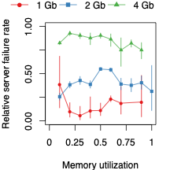

Slide 164
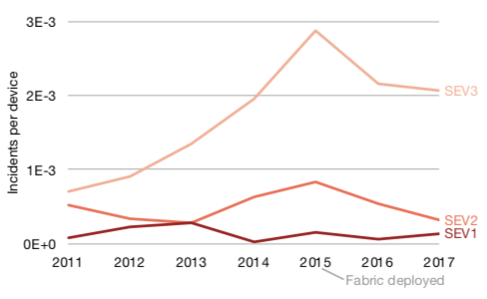
DC fabric has fewer incidents
Reversing the negative software-level reliability trend
Notes:
What's also interesting is that if we look at the top-line reliability of the site, measured using the number of SEVs over time, we can see a corresponding inflecton point in incidents corresponding to when we deployed our fabric design, effectively reversing the negative software-level reliability trend of cluster networks. Here, we're showing the number of SEVs of different severity levels, from the least severe SEVs, at the top, to the most severe SEVs at the bottom. So, with fabric networks being deployed, you might be asking yourself, as my team did, what network events still cause SEVs in Facebook data centers? Well... <CLICK>

Slide 165
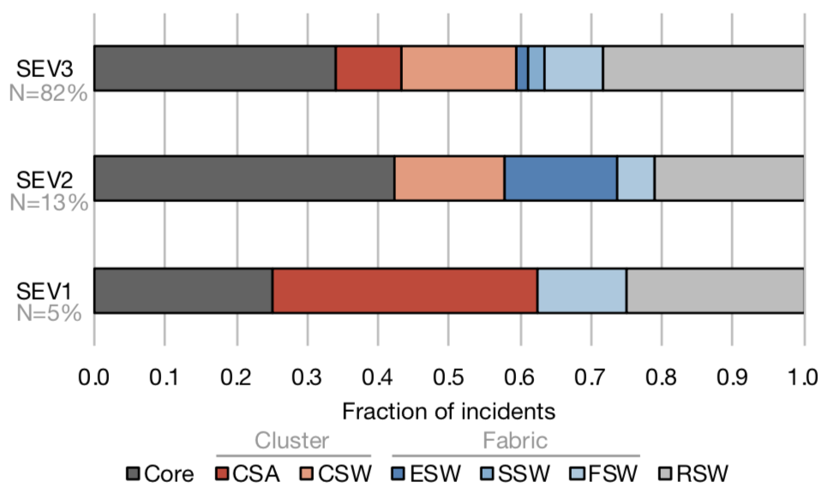
Main cause across all severities
Notes:
Core switch and rack switch failure rates dominated nearly all categories of software incident severity, from small failures, shown at the top, all the way to widespread service outages, shown at the bottom. <CLICK>

Slide 166
Edge node MTBF distribution
Typical edge node failure rate is on the order of months
Notes:
For example, this graph shows the distribution of mean time between failures, in hours, for all of Facebook's edge nodes. Note that the y axis is in log scale. You can see that typical edge node failure rate is on the order of months. We also build models from this data, shown in red. And we can do the same thing for mean time to repair... <CLICK>

Slide 167
Edge node MTTR distribution
Edge node mean time to repair is on the order of hours
Notes:
Here you can see the distribution for mean times to repair for edge nodes, which are typically on the order of hours. Again, we can model this distribution. We can look at the data in other ways, too, for example... <CLICK>

Slide 168
Fiber vendor MTBF distribution
Typical vendor link failure rate is on the order of months
Notes:
We can slice the data by the vendors that supply fiber links, again showing MTBF in log scale. The first thing to notice here is that most links supplied by vendors fail on the order of months. We also noticed some vendors with very high MTBFs. What was going on here? Upon closer inspection, we found that these vendors tend to operate in large metropolitan areas, which reflects how fiber in densely populated areas is easier to maintain than in more rural other areas. <CLICK>

Slide 169
Fiber vendor MTTR distribution
Notes:
We can also study the mean time to recovery for links supplied by vendors. Most links recover relatively quickly, in hours, but we now see a trend emerge: Across all the vendors, we find multiple orders of magnitude between the vendors with the most reliable links and vendors with the least reliable links. This illustrates the significant, yet not well studied in the literature, role fiber vendors play in backbone reliability. <CLICK>

Slide 170
Minimizing backbone outages
Simulation
objective = six 9's yearly reliability
Capacity plan
Model 2
Node1: Links A, B Node 2: Links X, Y
Model 3
...
Notes:
Once we have models to describe backbone reliability, we can begin to simulate the reliability of the network. The simulation takes into account similar models to what we present in the paper, in addition to forecasts of backbone network demand. <CLICK>

