Slide 1
Project Smart Sleeper
Mid-Semester Check-In
Team 9
Kero,Eric,Patrick,Doowon

Slide 3
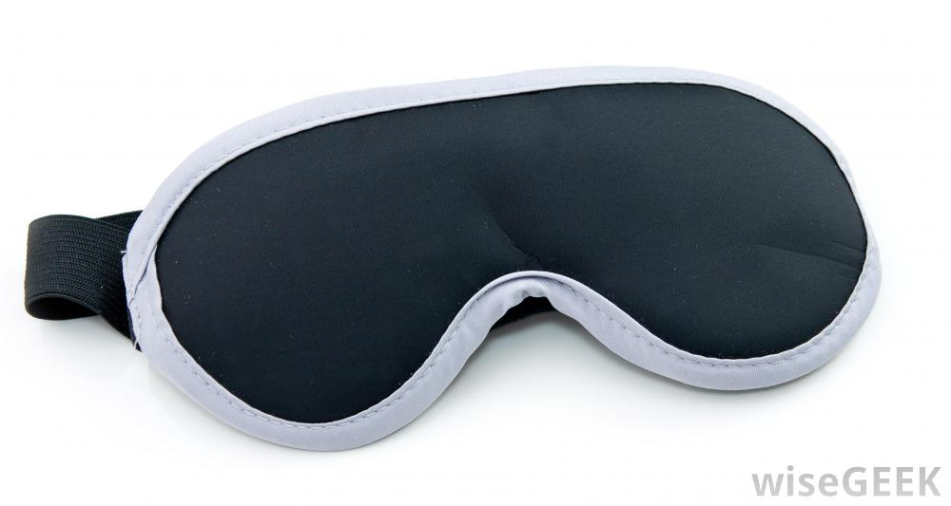
Project Concept & Motivation
You right now
You after Smart Sleeper

Slide 4
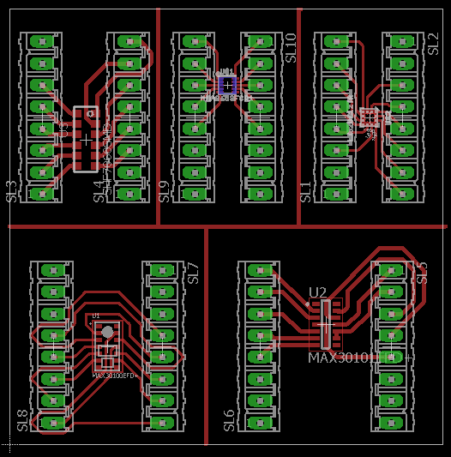
Hardware Progress
Peripheral Sensors Schematic
Current Status:
TI CC2650 setup and running with a test peripheral sensor
BLE connection setup
Peripheral sensor PCBs made
Future Plans:
Connecting heart rate sensor
Transmitting/Receiving data via BLE to/from phone
Adding LED illumination

Slide 5
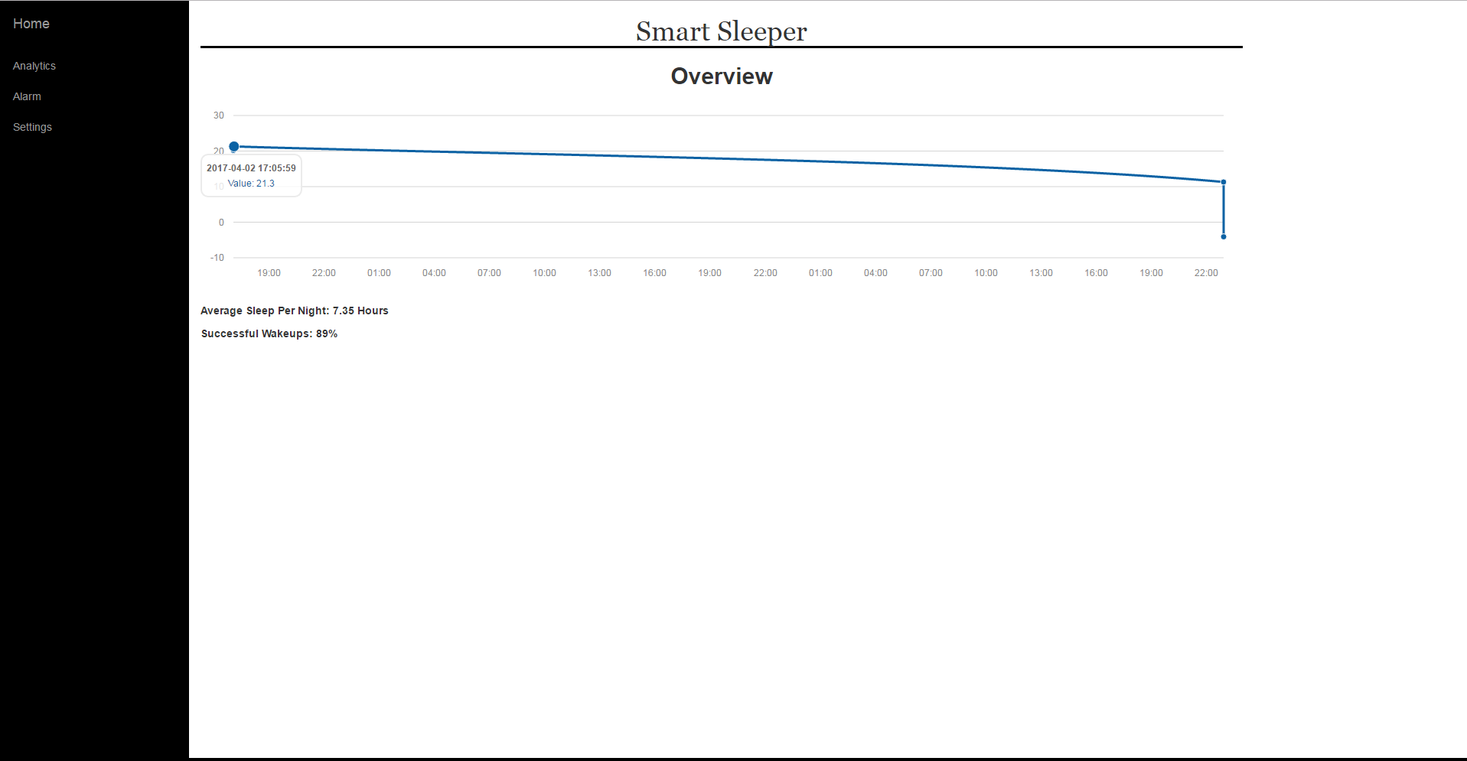
Software Progress
Web App
Machine Learning
44, 000 SHHS Observations
Heart Rate + Elapsed Sleep Time
65%
Within 1 Cycle
85%
Within 2 Cycle

Slide 6
AWS Phone Transmission Demo

Slide 7
DEMO
Users will be able to:
Wear our product
See real-time monitoring via the Web Application
Experience alarm light illumination

