Slide 1
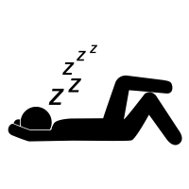
Project Smart Sleeper
Team 9
Kero,Eric,Patrick,Doowon

Slide 2
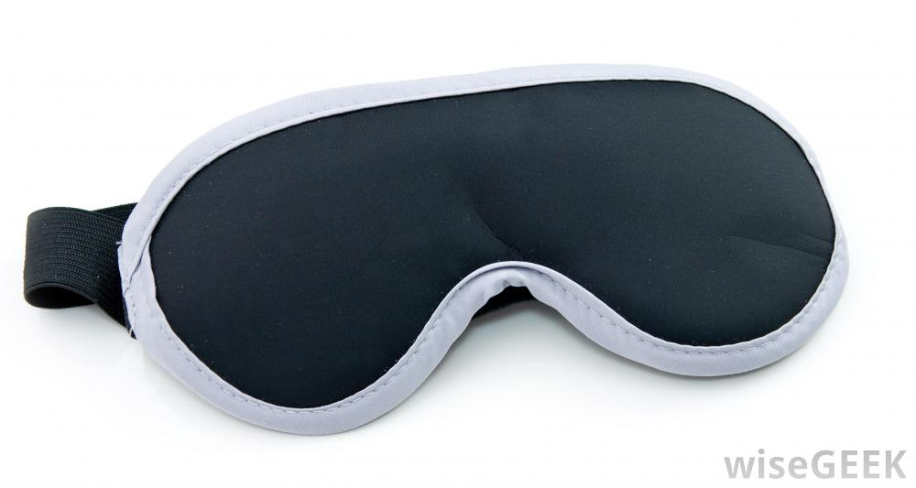
Project Concept & Motivation
You right now
You after Smart Sleeper

Slide 3
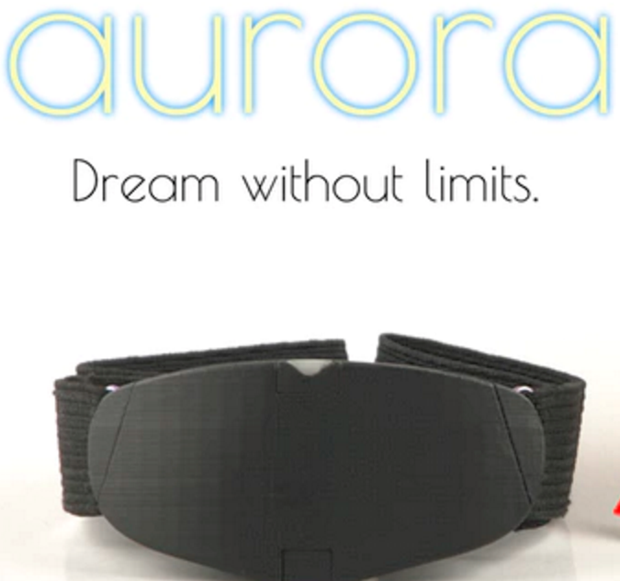
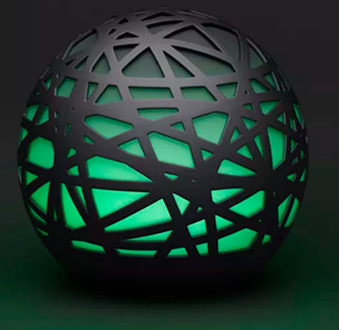
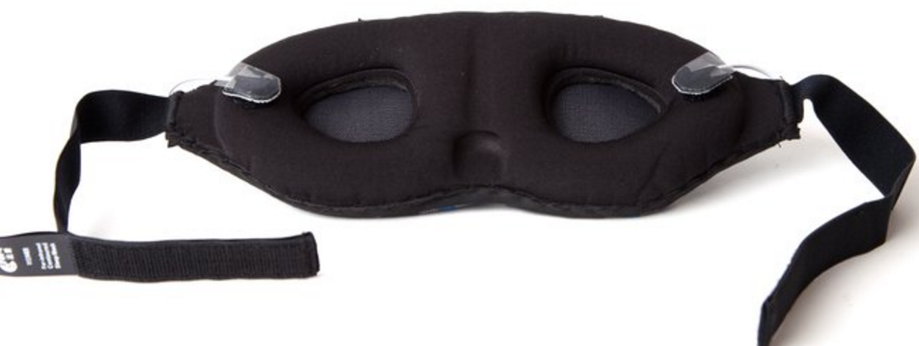
Competitive Analysis
Aurora
Sense
REMzen
$200+
Lucid Dreaming
$150
Fitbit for sleep
$300+
No easy data analytics

Slide 4
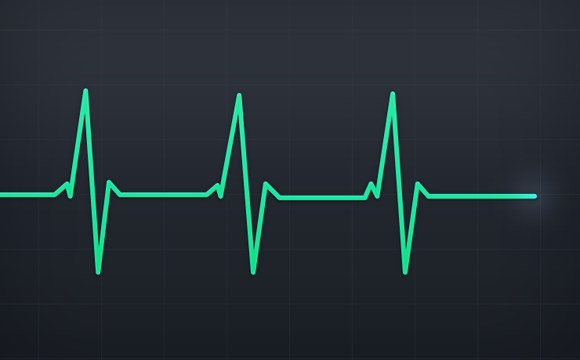
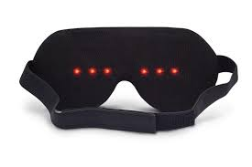
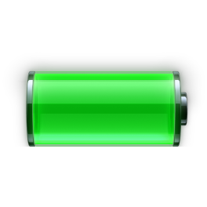
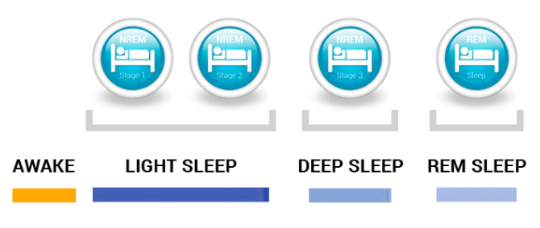
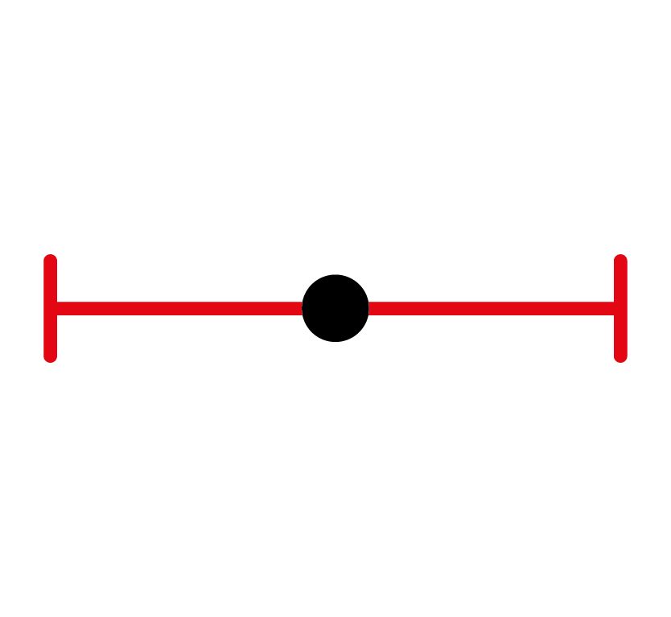
Requirements
Measure Heartbeat filtering any noise
Wake user with LED illuminate at proper time
Remember a user specified alarm time
Battery life minimum of 24 hours
Map heartbeat to REM Cycle
Wake user within a specified window of time at closest exit of REM
Not disrupt sleep cycle of user

Slide 5
Technical Specification

Slide 6
Questions?

