Slide 1
Project Smart Sleeper
Team 9

Slide 2
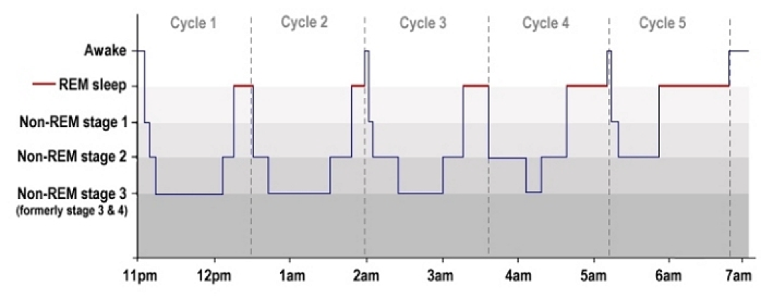
Motivation

Slide 3
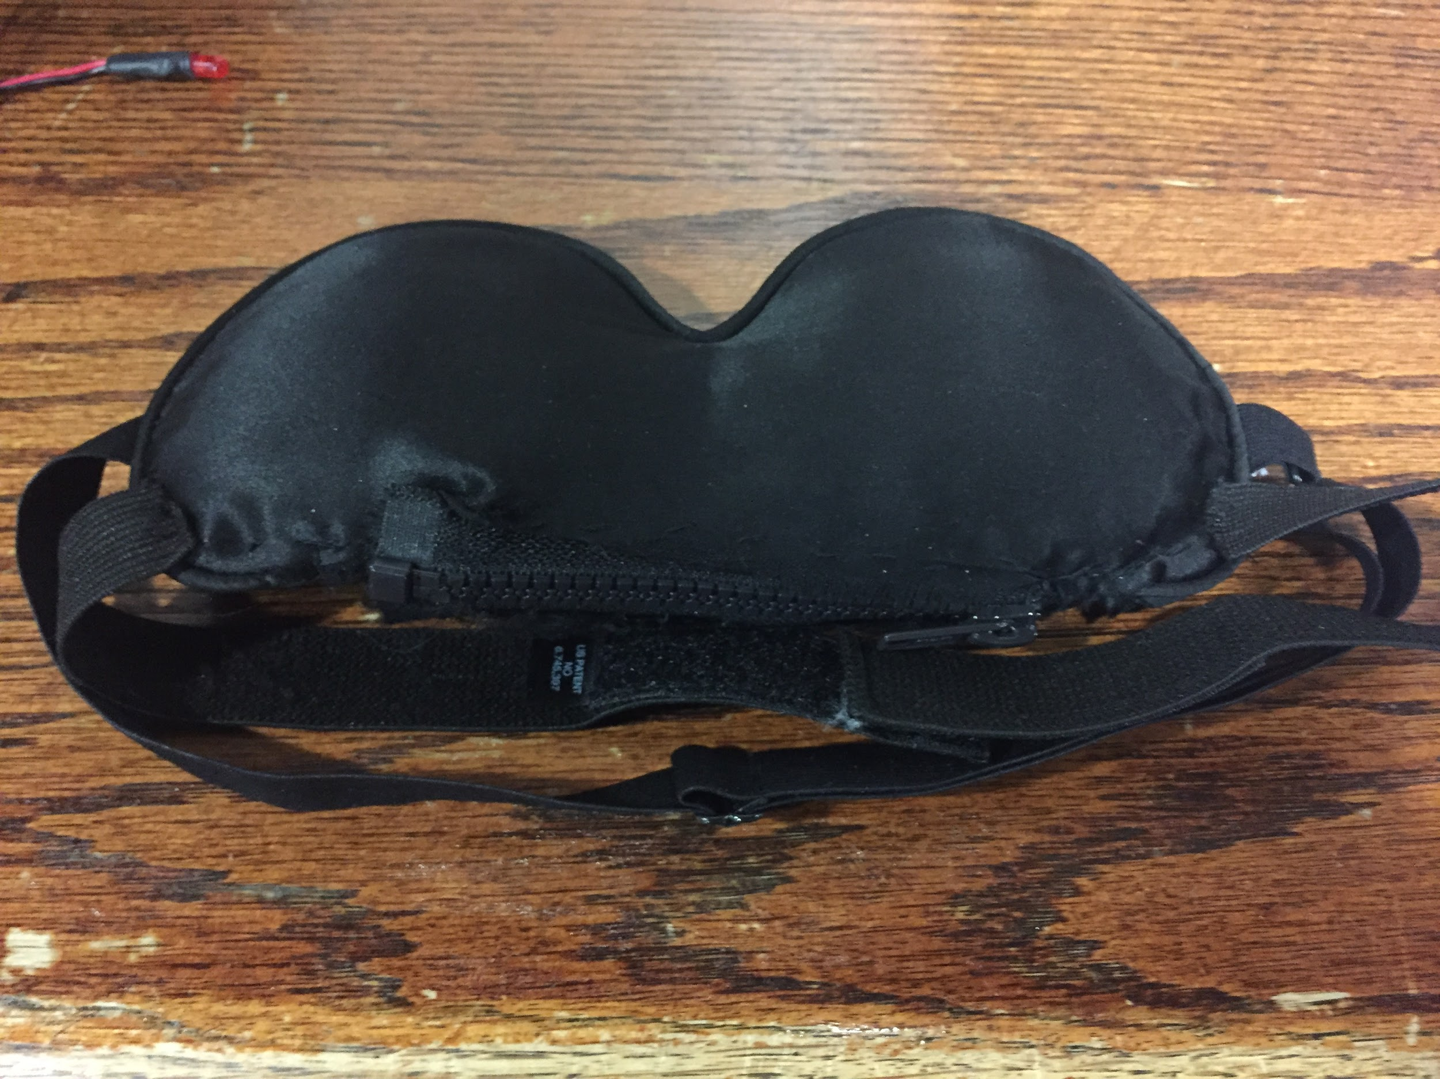
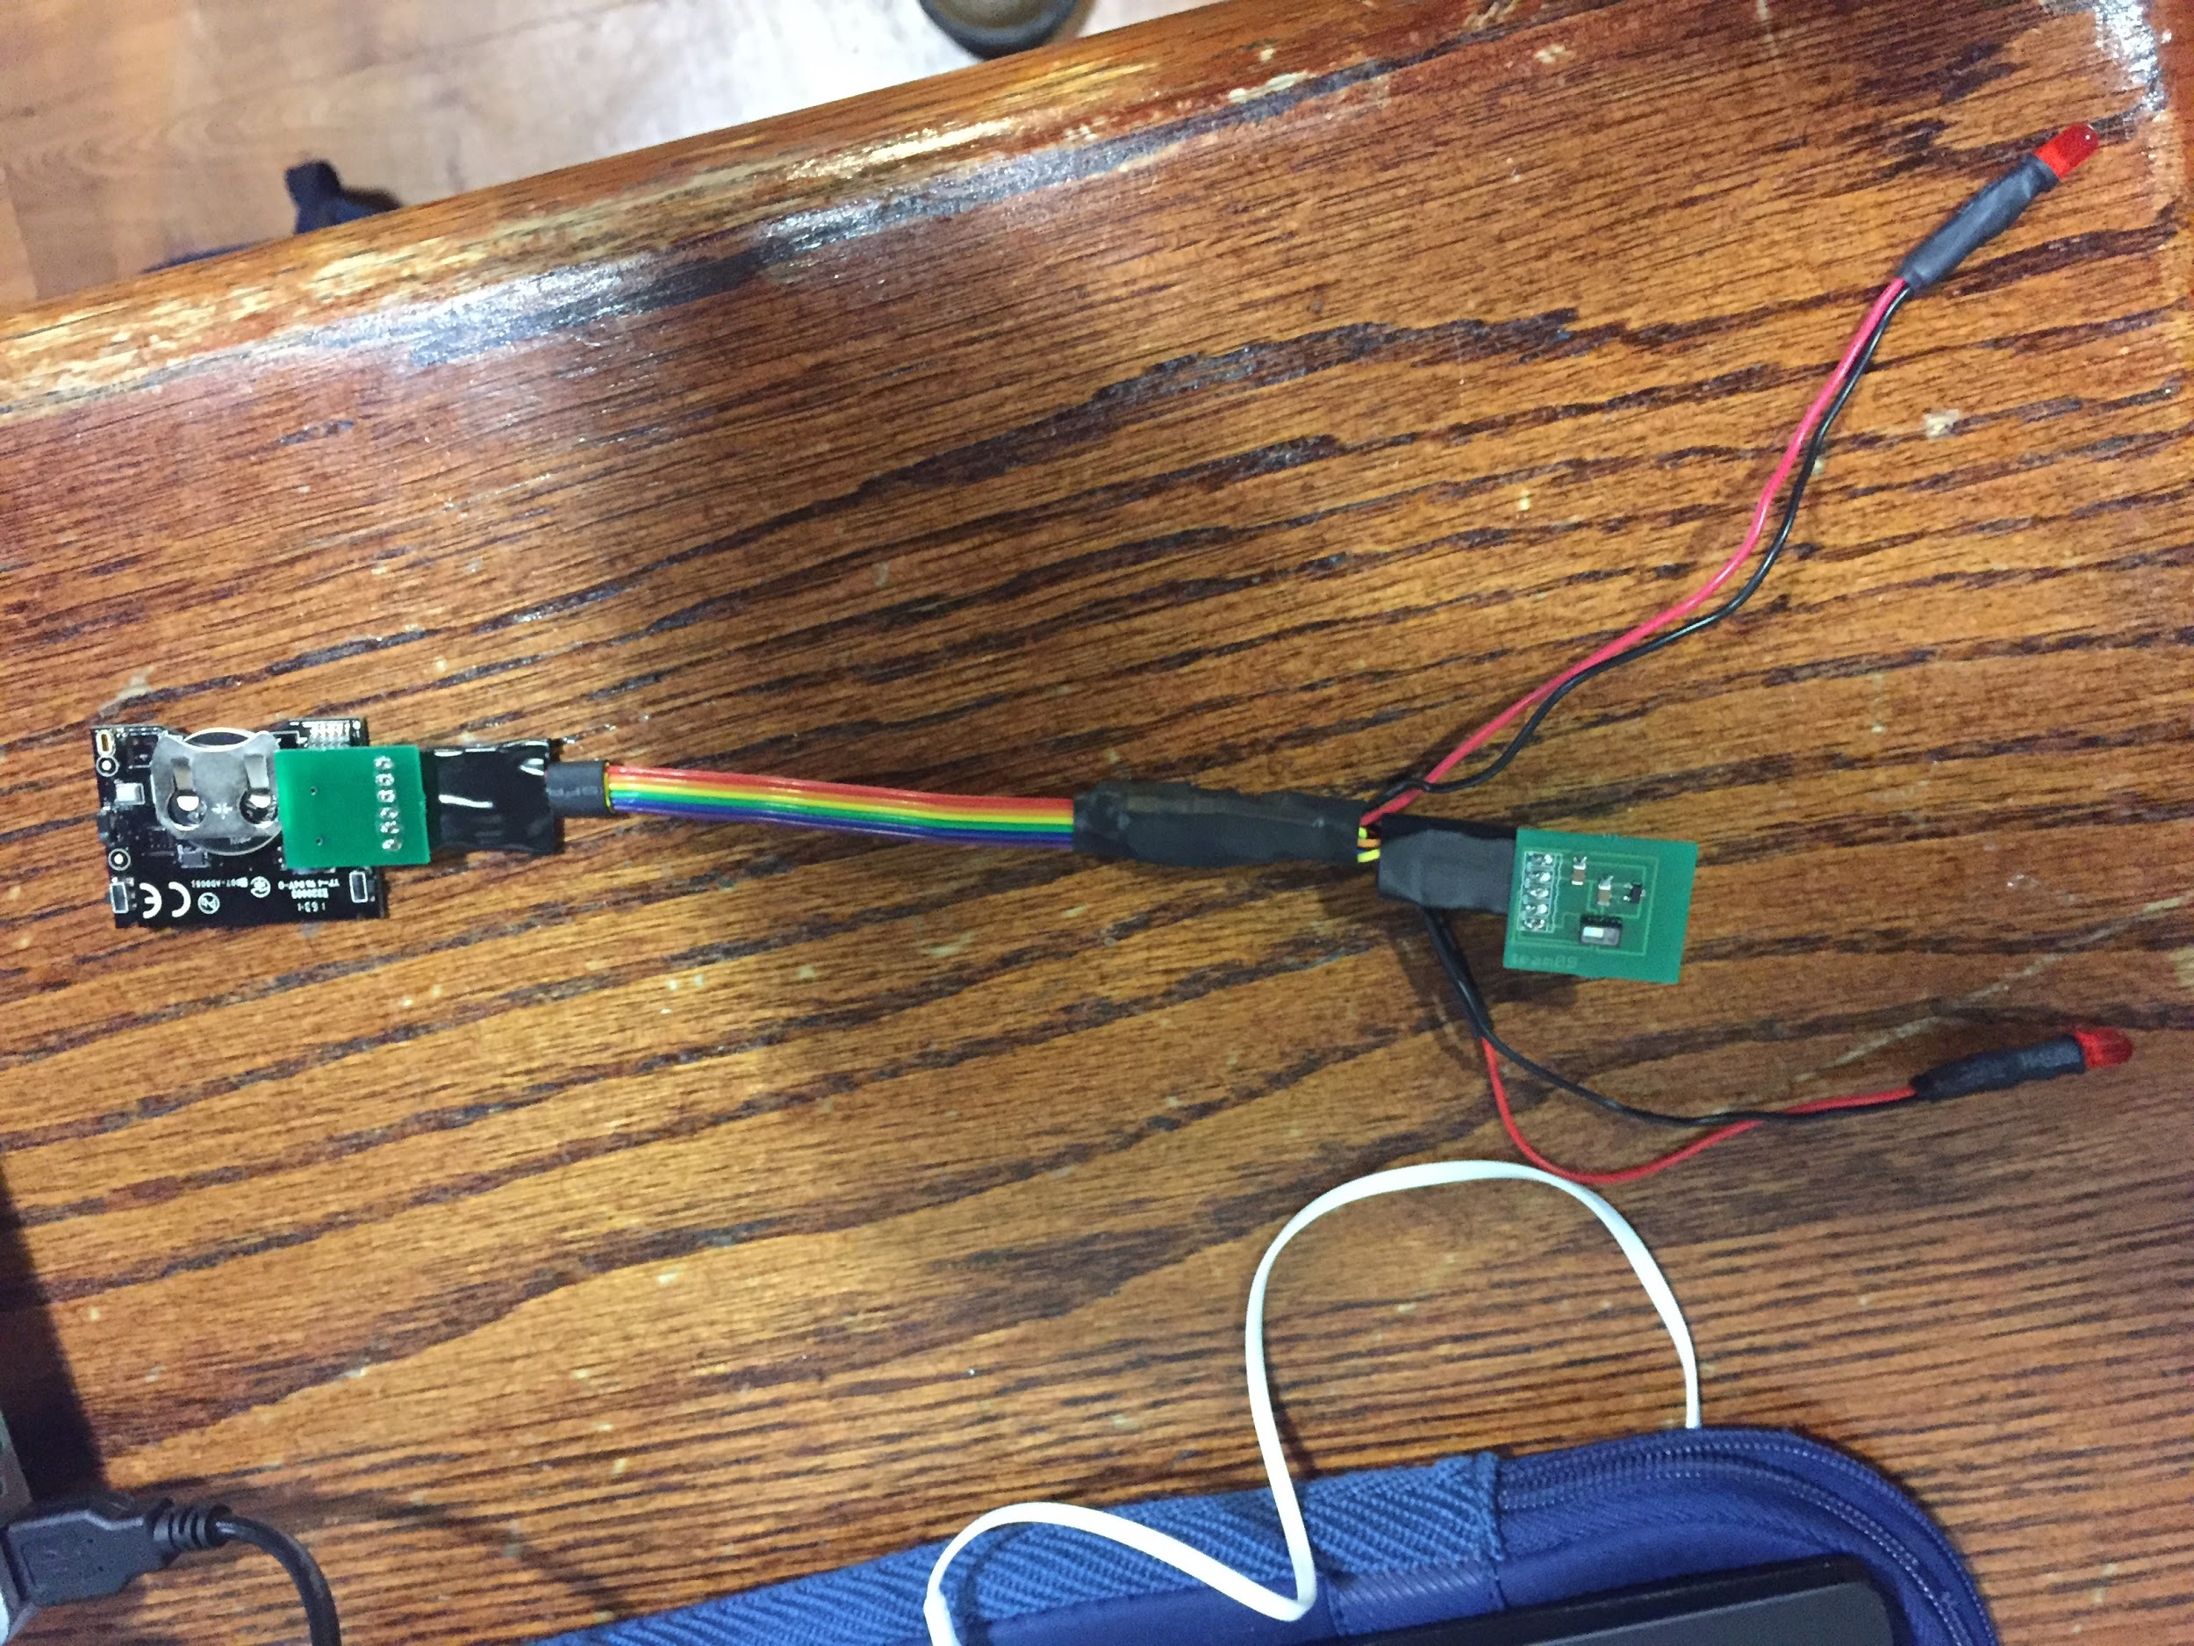
3 Core Components
Sensing: Oximeter
Communication: BLE
Learning: Sleep Stage Calculation

Slide 4
Demo Agenda
1.Sleep Teaser Video
2.Sleep Demonstration Video
3.Machine Learning Discussion
4.Heartbeat On Mask -> Web App
5.LED Illumination with Alarm
6.Recommended Sleep Time & Other Metrics
7.Power Consumption

Slide 5
Sleep Teaser Video

Slide 6
Sleep Demonstration Video

Slide 7
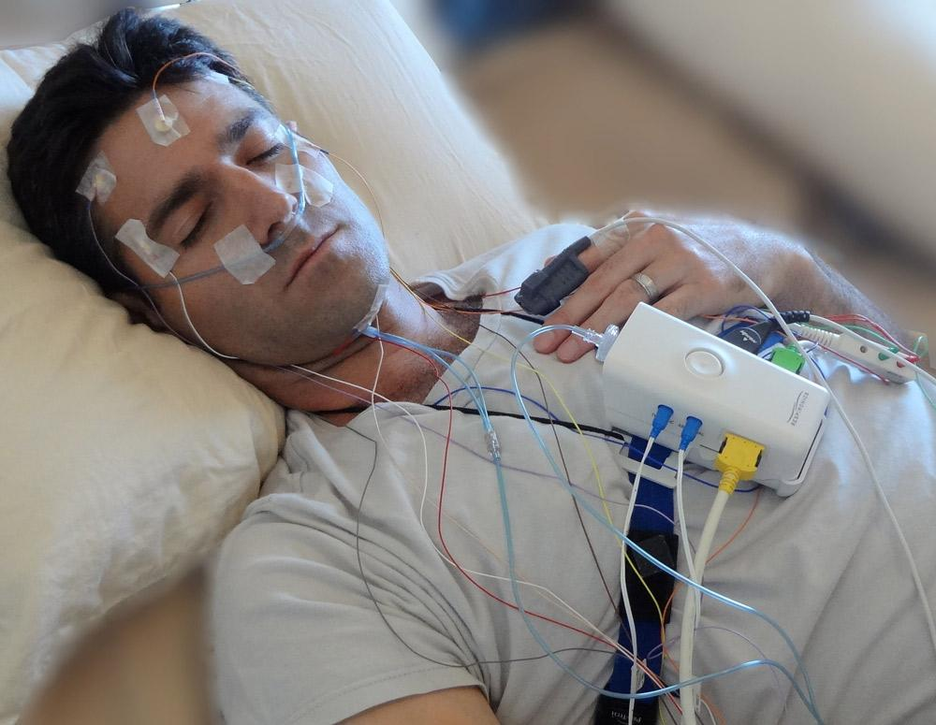
Sleep Cycle Study (Ground Truth)
Source: Sleep Heart Health Study
400+ Patients
Heart Rate & Sleep Cycle
30 Second Polysomnography Recordings

Slide 8
Machine Learning Methodology
30,000
Train Data Set
44,000 Recordings
14,000
Test Data Set

Slide 9
For, 14,000 tests the model is 75% accurate within 2 sleep cycles.
Sleep Cycle Difference (Actual - Prediction) | Negative Difference Percentage | Positive Difference Percentage | Amount of Data Represented
Zero | - | 37% | 37%
One | 8% | 10% | 18%
Two | 12% | 8% | 20%
Three | 8% | 13% | 21%
Four | 1% | 0% | 1%
Five | 2% | 2% | 4%
Total | 30% | 70% | 100%

Slide 10
Live Demo
http://ec2-34-207-105-69.compute-1.amazonaws.com:8000/
Heartbeat On Mask -> Web App
LED Illumination with Alarm
Recommended Sleep Time & Other Metrics

Slide 11
Backup System Demo

Slide 12
Power Consumption
Device | Current | Maximum Voltage | Consumption | Time Active (8 hours of Sleep) | Total Consumption (Per Day)
CC2650 Advertising | 1.45 mA | 3.8 V | .0055 W | 80% (6.4 hours) | .0352 Wh
CC2650 Transmission | 6.1 mA | 3.8 V | .02318 W | 20% (1.6 hours) | .0370 Wh
Oximeter | 20 mA | 3.7 V | .074 W | 20% (1.6 hours) | .1184 Wh
LED | 20 mA | 2.4 V | .048 W | .05% (.004 hours) | .0002 Wh
Total |  |  |  |  | .1908 Wh

Slide 13
Power Consumption
3V - 240mAh Coin Cell Supply: .72Wh
Total Consumption : .19 Wh
Supply Time: ~30 Hours of Usage or 3-4 Days

Slide 14
QUESTIONS

