Slide 1
18-549 Testing Plan:
3/26/2014
Rapid Ocular Sideline Concussion Diagnostics
Team 8
Brandon Lee--Andrew Pfeifer--Thomas Phillips--Ryan Quinn
1

Slide 2
Status Update
Restructuring the eye-set
Fixing the camera to be adjustable
Allows for tests to include both eyes; will require additional trainer intervention, at least for now
Exchanging the display screen for several LED’s around rim of glasses
Enables us to implement additional concussion tests
OpenCV implementation
RasPi will be sending each video to a laptop to do the analysis after video recording; “send data-process data-receive results loop” ~90 seconds,
Web App set up
Enables us to persistently store each test of each athlete
Can do server-side analysis on many test subjects (in the future)
2

Slide 3
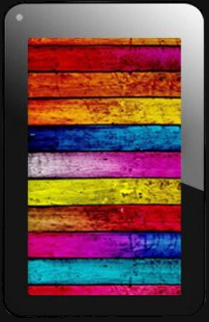
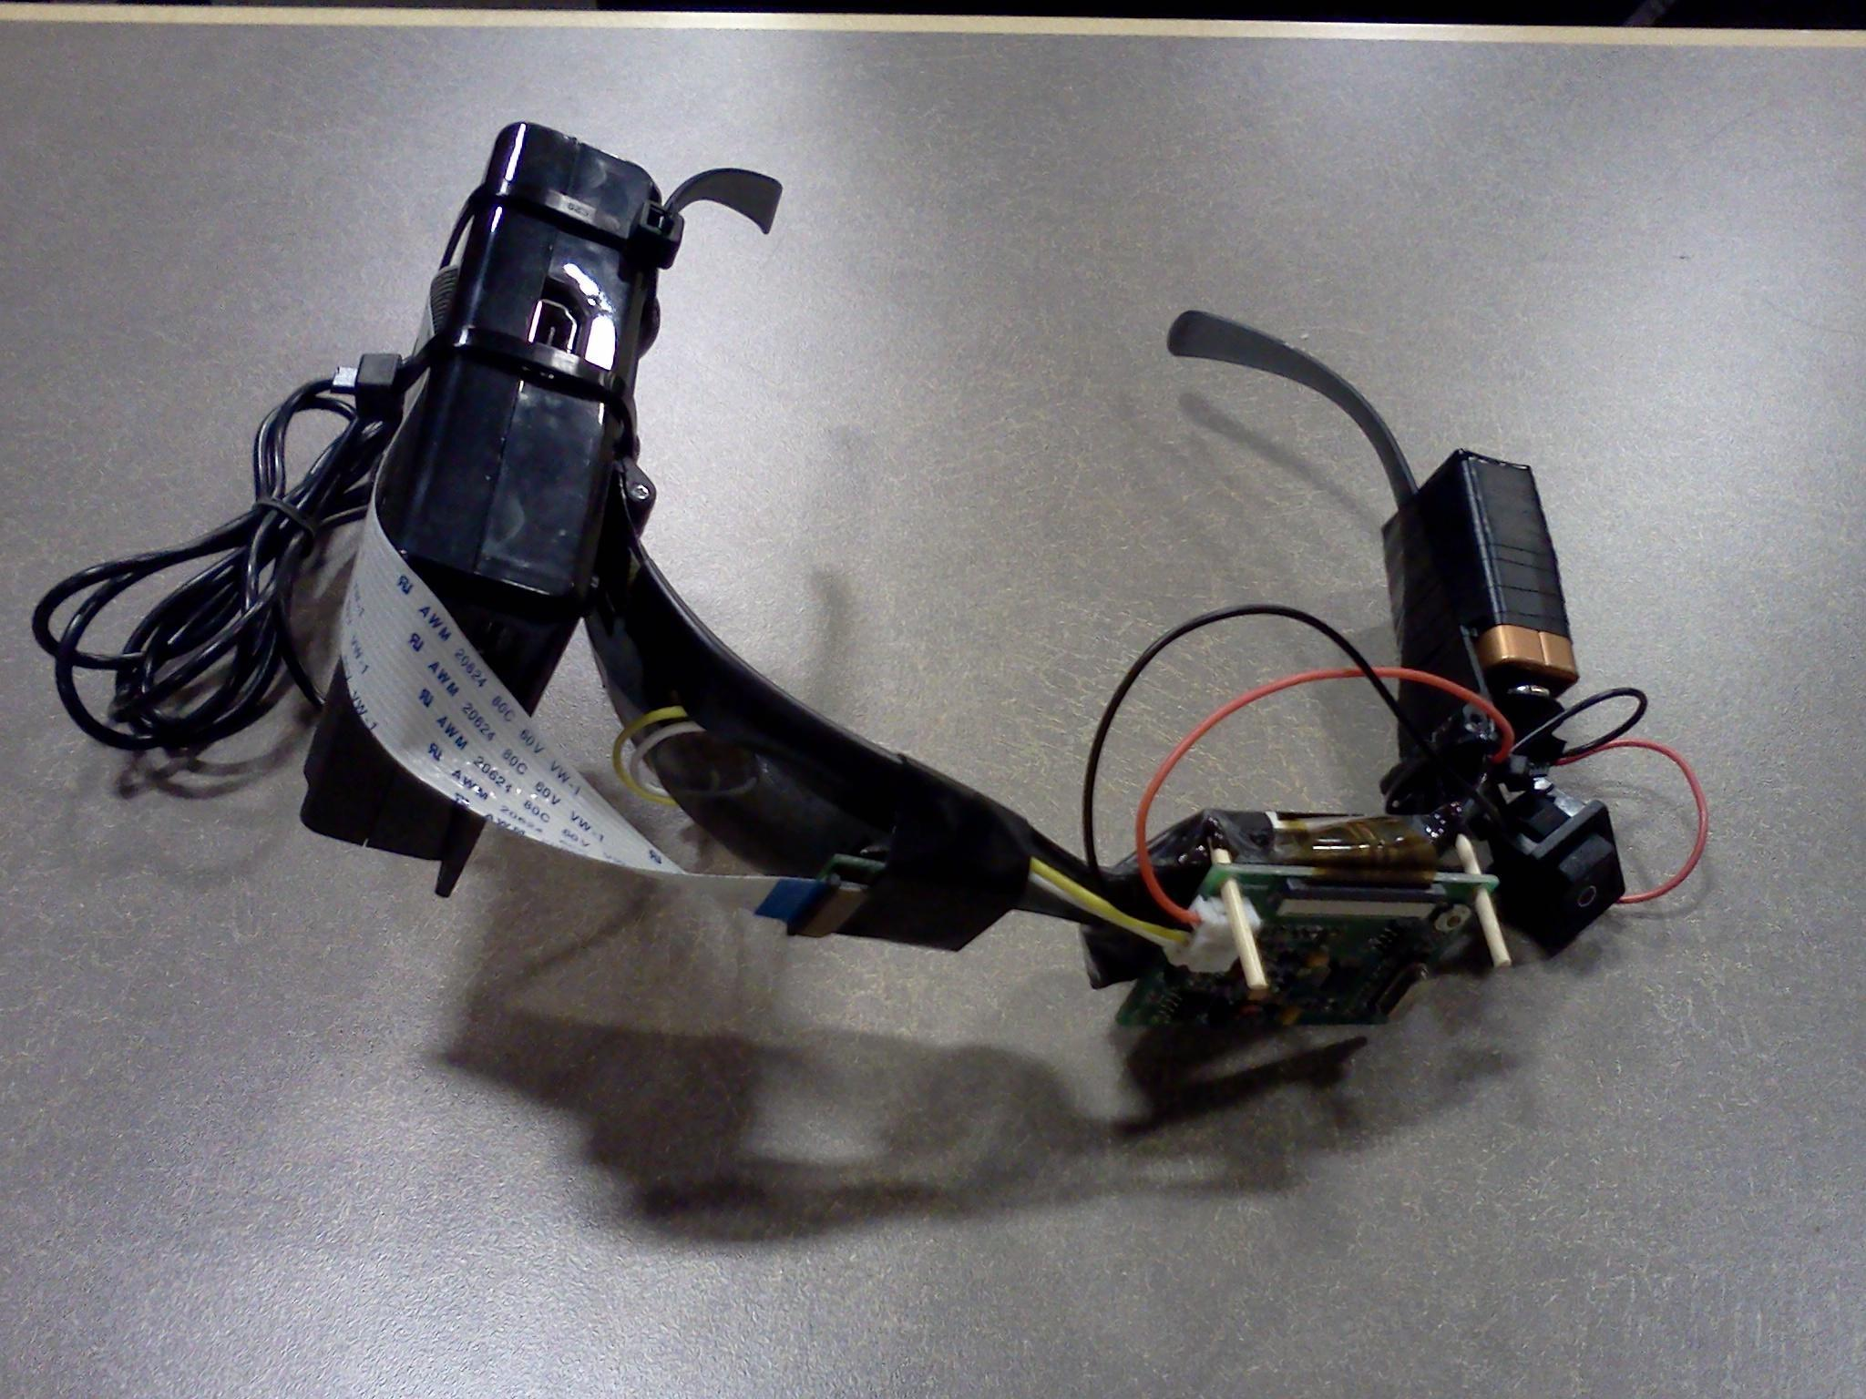
Updated Architecture
Concussion-Testing Eye set
Base Station (Laptop)
Android Tablet
RasPi
1
3
OpenCV Kernel
App
2
Camera
4
6
5
7
Trainer begins test
Glasses performs test*
Video sent to laptop*
OpenCV analysis
Results sent back to glasses
All results sent to tablet
All results pushed to web app
*Done for each individual concussion test
Web App
Database
3

Slide 4
Component Requirements
Glasses
Needs to correctly time LED sequence with camera recording
Ensure that each video is successfully sent to base station
If unsuccessful, need to alert user!
Flow of PiUi app must be smooth
Main interface for instructions/alerts back to training staff
Base Station
Analyze the correct metric for each test
Area of pupil vs location of pupil
Package & transmit results properly back to glasses & server
Server
Store all test results as well as metadata about each test
Web interface must be intuitive and informative

Slide 5
Testing Plan
Glasses
Unit test each LED sequence to ensure it provides the correct stimulus to athlete
Will need to play with brightness of the LED’s
Many iterations of each test to ensure we capture only the video we need
Too much video => unneeded processing & time
Too little video => inaccurate results
Rigorous PiUi user testing
Base Station
Many iterations of OpenCV application to ensure:
Same inputs => same outputs, different inputs => different outputs
No issues analyzing different eyes (eye colors, right vs left)
Awareness of what metric each test is measuring

Slide 6
Testing Plan (Cont)
Web App
Unit tests for all database models
Unit tests for controllers to ensure HTTP requests are routed and handled properly
Overall System
Communication between each component is critical. We will be testing the system by simulating failures of each node.
System should remain stable if a node has an unexpected restart

