Slide 1
LiquiFire
Xinwu Yang
Solomon Sia
Akash Katipaly
Nick Gullapalli

Slide 2
Idea Recap
3 Layer Painting: LEDs, Paint, Water
Themes (Contrast):
Hot vs Cold
Light vs Dark
Features:
Touch/Sound responsive animations
Elements (Colorful things):
Cherry Blossoms
Waterfalls
Stars
Pagodas

Slide 3
To Do List
We have the parts !!!
Arduino, LEDs, microphones…
By this week:
Final Design/ Composition of Painting
Starter Codes for Animations
Water Pump Assembly
Basic LED Tests
Painting Test
Censor Test
Microcontroller Test

Slide 4
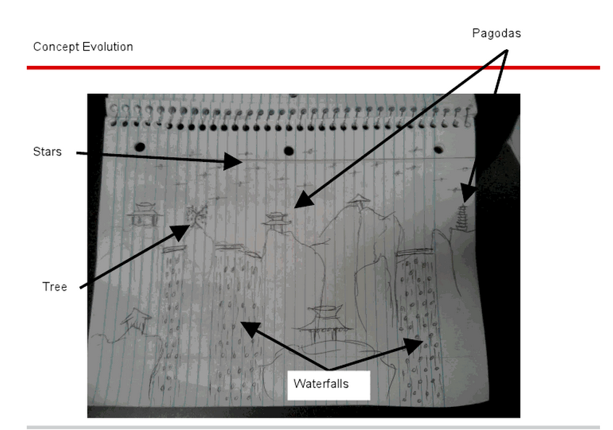
Concept Evolution

Slide 5
Concept Evolution

Slide 6
Microphone
Light Sensor
Touch Sensors
Behind the
Painting, Parts
Bucket of Water
Send Analog Input
Sending Digital Signal
Gravity pulling back water to bucket
Amplifier
Pump
Analog to Digital Converter
Lifting water up
5 Volt Power from Wall Outlet
Microprocessor
Microprocessor
PWM Signal
PWM Signal
Outlet of Water
LED Clusters
LED Clusters
Painting

Slide 7
Task Allocation
ALL GROUP MEMBERS FOCUS ON THE LED LAYOUT DESIGNS
Xinwu (FIRE):
Pagodas, Lanterns
Nick (WOOD):
Cherry Blossom ,Framing
Solomon (WATER):
Waterfalls ,Pond
Akash (AIR):
Stars ,Microcontrollers

Slide 8
Solomon: WATER
Parts: 4 waterfalls, each containing:
1 servo, 1 pump, 1 transistor, 10 blue LEDs, 10 amber LEDs, 1 ATmega.
9 outputs: water flow control, 4 blue LED clusters, 4 amber LED clusters
2 inputs: hot/cold (heat sensor), day/night (light sensor)
Hot animation (when room is cold): Water flow reduced by half, LEDs are amber.
Cold animation(when room is hot): Water flow constant, LEDs are blue.
Interactivity: None
Challenges:
waterproofing (painting & circuits)
water collection and distribution
water cleanliness
wiring, wiring, wiring...

Slide 9
Nick: CHERRY BLOSSOM
Parts:
4 trees, each containing:
1 microphone, 10 green LEDs (2 clusters), 5 pink/red LEDs
1 input: day/night (light sensor)
3 outputs: 2 green LED cluster & 1 pink LED cluster
Day animation:
2 clusters of green LEDs ON, on a loop; microphone will activate all red LEDs (Blowing away cherry blossoms)
Night animation:
1 cluster of green LEDs ON, on a slower loop; microphone will activate some red LEDs (Blowing away cherry blossoms)
Interactivity: Microphone
Challenges:
Making the trees look realistic with green LEDs
Connecting the microphone to activate red LEDs
WIRING!!!!!

Slide 10
Akash: STARS
Parts:
Arduino Mega, 5-7 Microprocessors, 25 White LEDS, 20 Blue LEDS, 5 Red LEDS
1 input: Light Sensor (Light/Dark)
2 outputs: Dark LED Clusters, Bright LED Clusters
Dark Animation:
Both LED Clusters will shine beautiful
(Achieved by a magical loop yet to be discovered)
Interactivity: None
Challenges:
Finding the magical loop
And of course, wiring…

Slide 11
Xinwu: FIRE
Parts:
3 pagodas, each containing:
7 lines of orange LEDs (for candles), 1 cluster of yellow LEDs (for roof)
2 lantern strips, each containing:
1 touch sensor, 5 red LEDs
2 inputs: day/night (light sensor), user stroke (touch sensor)
10 outputs: 7 orange LED clusters, 1 yellow LED cluster, 2 red LED cluster
Night animation:
roof lights up simultaneously, candles lights up layer by layer according to brightness.
lantern strips light up when stroke
Interactivity: Stroke
Challenges:
wiring, wiring,wiring…
lighting up the candles layer by layer

Slide 12
RISKs | MITIGATION
1. Large scale design, heavy wiring 2. Several discrete elements for the final design 3. Unfamiliarity with large scale and structural design | Focus on modularity. Rather than a single microcontroller working all LEDs, each distinct element will have its own standalone command module that handles the LED cluster. Therefore failures, if any, will be isolated and easily identified on the module level. Tasks are allocated with separate ICs dedicated to troubleshooting the various components. Project will be built from bottom up with most critical/basic elements completed first, and complex elements added on in subsequent weeks. IC for structure/water components do research and complete proof of concept models before it is incorporated into the final design.

