Slide 1
RADAGAST power of the worlds
Team Members:
Chanin Laohaphan
Mian Luo
Andrew Noh
Brian Pfiffner
Jonathan Wu

Slide 2
Collaborative Digital Canvas
Concept: This project will allow children to enjoy painting in real time on a collaborative digital canvas regardless of physical location. This project will integrate smart phones, wands with off-the-shelf embedded components and the display system.
Motivation: Existing remote collaborative painting systems are usually web based and the modes of input required are used unsuitable for children. With our system, children will be able to collaborate using a simpler pointing mechanic to paint.

Slide 3
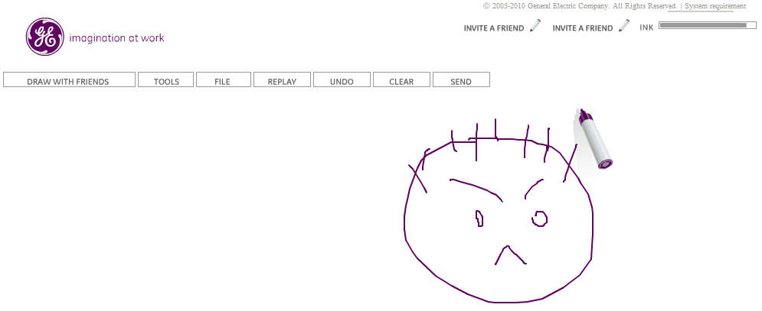
Competitive Analysis
Imagination cubed: an online collaborative whiteboard http://www.imaginationcubed.com/ Our project supports a wider variety of input methods that are suitable for children to use and supports more simultaneous users.
Wii: A potential competitor to our system. All that is required is a software component. http://www.wii.com/ Our project has remote modes of input via cell phone side applications.

Slide 4
Requirements
Functional requirements: Accepts user and sensor (accelerometers and magnetometers) inputs and converts data to positions and effects on the canvas.
The system will have a defined network protocol to allow for interoperability between multiple client (wand, cell phone) and server (local projector / system) devices.
Timing requirements: Any changes on canvas will take less than half a second to take effect.
Reliability requirements: The system will degrade gracefully from connection loss
Security requirements: The server will support an authentication and connection limiting systems for remote users (smart phones, other servers)

Slide 5
Technical Specification
X86 computer
Projector
Smart phones equipped with accelerometers and magnetometers
ADX 1345: three-axis accelerometer with high resolution (13-bit) measurement up to ±16g
HMC6352: 0.5 degree heading resolution1 to 20Hz selectable update rate
AVR 28 Pin 20MHz 32K 6A/D - ATMega328:23 I/O lines, 6 of which are channels for the 10-bit ADC, runs up to 20MHz
XBee 1mW Chip Antenna: 300ft (100m) range, 250kbps Max data rate, 3.3V @ 50mA

