Slide 1

Providing High and Predictable Performance in Multicore Systems
Through Shared Resource Management
Lavanya Subramanian

Slide 2
Shared Resource Interference
Core
Core
Core
Core
Core
Core
Core
Core
Shared
Cache
Main Memory
Core
Core
Core
Core
Core
Core
Core
Core

Slide 3
High and Unpredictable
Application Slowdowns
1. High application slowdowns due to shared resource interference
2. An application’s performance depends on which application it is running with
Notes:
This graph shows two applications from the SPEC CPU 2006 suite, leslie3d and gcc. These applications are run on either core of a two core system and share main memory. The y-axis shows each application’s slowdown as compared to when the application is run standalone on the same system.
Now, let’s look at leslie3d. It slows down by 2x when run with gcc.
Let’s look at another case when leslie3d is run with another application, mcf. Leslie now slows down by 5.5x, while it slowed down by 2x when run with gcc. Leslie experiences different slowdowns when run with different applications.
More generally, an application’s performance depends on which applications it is running with. Such performance unpredictability is undesirable….

Slide 4
Outline
Goals:
High performance
Predictable performance
Goals:
High performance
Predictable performance
Goals:
High performance
Predictable performance
Blacklisting memory scheduler
Predictability with memory interference

Slide 5
Outline
Goals:
High performance
Predictable performance
Blacklisting memory scheduler
Predictability with memory interference

Slide 6
Background: Main Memory
Columns
Bank 0
Bank 0
Bank 1
Bank 1
Bank 2
Bank 2
Bank 3
Bank 3
Row-buffer hit
Rows
Row-buffer miss
Row Buffer
Row Buffer
Row Buffer
Row Buffer
Row Buffer
Memory Controller
Channel
FR-FCFS Memory Scheduler [Zuravleff and Robinson, US Patent ‘97; Rixner et al., ISCA ‘00]
  Row-buffer hit first
  Older request first
Unaware of inter-application interference

Slide 7
Tackling Inter-Application Interference:
Memory Request Scheduling
Monitor application memory access characteristics
Rank applications based on memory access characteristics
Prioritize requests at the memory controller, based on ranking

Slide 8
An Example:
Thread Cluster Memory Scheduling
higher
priority
Non-intensive
cluster
Memory-non-intensive
thread
Throughput
thread
thread
thread
thread
thread
Prioritized
higher
priority
thread
thread
thread
thread
Threads in the system
Memory-intensive
Intensive cluster
Fairness
Figure: Kim et al., MICRO 2010

Slide 9
Problems with Previous
Application-aware Memory Schedulers
Hardware Complexity
  Ranking incurs high hardware cost
Unfair slowdowns of some applications
  Ranking causes unfairness

Slide 10
High Hardware Complexity
Ranking incurs high hardware cost
  Rank computation incurs logic/storage cost
  Rank enforcement requires comparison logic
1.8x
8x
Avoid ranking to achieve low hardware cost
Synthesized with a 32nm standard cell library

Slide 11
Ranking Causes
Unfair Application Slowdowns
astar
soplex
Lower-rank applications experience significant slowdowns
  Low memory service causes slowdown
  Periodic rank shuffling not sufficient
Grouping offers lower unfairness than ranking

Slide 12
Problems with Previous
Application-Aware Memory Schedulers
Hardware Complexity
  Ranking incurs high hardware cost
Unfair slowdowns of some applications
  Ranking causes unfairness
Our Goal: Design a memory scheduler with
Low Complexity, High Performance, and Fairness

Slide 13
Towards a New Scheduler Design
Monitor applications that have a number of consecutive requests served
Blacklist such applications
1. Simple Grouping Mechanism
Prioritize requests of non-blacklisted applications
Periodically clear blacklists
2. Enforcing Priorities Based On Grouping

Slide 14
Methodology
Configuration of our simulated system
  24 cores
  4 channels, 8 banks/channel
  DDR3 1066 DRAM
  512 KB private cache/core
Workloads
  SPEC CPU2006, TPCC, Matlab
  80 multi programmed workloads

Slide 15
Metrics
System Performance:
Fairness:

Slide 16
Previous Memory Schedulers
FR-FCFS [Zuravleff and Robinson, US Patent 1997, Rixner et al., ISCA 2000]
  Prioritizes row-buffer hits and older requests
  Application-unaware
PARBS [Mutlu and Moscibroda, ISCA 2008]
  Batches oldest requests from each application; prioritizes batch
  Employs ranking within a batch
ATLAS [Kim et al., HPCA 2010]
  Prioritizes applications with low memory-intensity
TCM [Kim et al., MICRO 2010]
  Always prioritizes low memory-intensity applications
  Shuffles request priorities of high memory-intensity applications

Slide 17
Performance Results
Approaches fairness of PARBS and FRFCFS-Cap achieving better performance than TCM
5% higher system performance and 25% lower maximum slowdown than TCM

Slide 18
Complexity Results
Blacklisting achieves
43% lower area than TCM
Blacklisting achieves
70% lower latency than TCM

Slide 19
Outline
Goals:
High performance
Predictable performance
Blacklisting memory scheduler
Predictability with memory interference

Slide 20
Need for Predictable Performance
There is a need for predictable performance
  When multiple applications share resources
  Especially if some applications require performance guarantees
Example 1: In server systems
  Different users’ jobs consolidated onto the same server
  Need to provide bounded slowdowns to critical jobs
Example 2: In mobile systems
  Interactive applications run with non-interactive applications
  Need to guarantee performance for interactive applications
As a first step: Predictable performance
in the presence of memory interference
Notes:
…because there is a need for predictable performance
When multiple applications share resources and
Especially when some applications require guarantees on performance.
For example, in mobile systems, interactive applications are run with non-interactive ones.
And there is a need to provide guarantees on performance to the interactive applications.
In server systems, different users’ jobs are heavily consolidated onto the same server.
In such a scenario, there is a need to achieve bounded slowdowns for critical jobs of users.
These are a couple of examples of systems that need predictable performance.
There are many other systems (such as …) in which performance predictability is necessary.
Therefore, our goal in this work is to provide predictable performance in the presence of memory interference.

Slide 21
Outline
Goals:
High performance
Predictable performance
Blacklisting memory scheduler
Predictability with memory interference

Slide 22
Predictability in the Presence of Memory Interference
1. Estimate Slowdown
  Key Observations
  MISE Operation: Putting it All Together
  Evaluating the Model
2. Control Slowdown
  Providing Soft Slowdown Guarantees
  Minimizing Maximum Slowdown
Notes:
First, let me describe the key observations that enable us to estimate application slowdowns.

Slide 23
Predictability in the Presence of Memory Interference
1. Estimate Slowdown
  Key Observations
  MISE Operation: Putting it All Together
  Evaluating the Model
2. Control Slowdown
  Providing Soft Slowdown Guarantees
  Minimizing Maximum Slowdown
Notes:
First, let me describe the key observations that enable us to estimate application slowdowns.

Slide 24
Slowdown: Definition
Notes:
Slowdown of an application is its performance when it is run stand alone on a system to its performance when it is sharing the system with other applications.
An application’s performance when it is sharing the system with other applications can be measured in a straightforward manner. However, measuring an application’s alone performance, without actually running it alone is harder.
This is where are first observation comes in.

Slide 25
Key Observation 1
For a memory bound application,
Performance ∝ Memory request service rate
Difficult
Intel Core i7, 4 cores
Mem. Bandwidth: 8.5 GB/s
Easy
Notes:
We observe that for a memory bound application, its performance is roughly proportional to the rate at which its memory requests are serviced.
This plot shows the results of our experiment on an Intel, 4-core system. We run omnetpp, a SPEC CPU 2006 benchmark along with another memory hog, whose memory intensity can be varied. This, in turn, lets us vary the rate at which the memory requests of omnetpp are serviced.
The x-axis shows the normalized request service rate of omnetpp, normalized to when it is run alone.
The y-axis shows the performance of omnetpp, normalized to when it is run alone.
As can be seen, there is a very strong, y=x like correlation between request service rate and performance.
We observe the same trend for various memory bound applications. Here are a couple of more examples.
Therefore, memory request service rate can be used as a proxy for performance.
Now, going back to the slowdown equation. We can replace performance by request service rate, based on our first observation, enabling us to express slowdown as the ratio of alone to shared request service rates.
Shared request service rate can be measured in a relatively straightforward manner when an application is run along with other applications.
Measuring alone request service rate, without actually running an application alone is harder. This is where our second observation comes into play.

Slide 26
Key Observation 2
Request Service Rate _{Alone} (RSR_{Alone}) of an application can be estimated by giving the application highest priority in accessing memory
Highest priority → Little interference
(almost as if the application were run alone)
Notes:
We observe that an application’s alone request service rate can be estimated by giving the application highest priority in accessing memory.
Because, when an application has highest priority, it receives little interference from other applications, almost as though the application were run alone.

Slide 27
Key Observation 2
1. Run alone
Time units
Service order
Request Buffer State
Main Memory
3
2
1
Main Memory
2. Run with another application
Time units
Service order
Request Buffer State
Main Memory
3
2
1
Main Memory
3. Run with another application: highest priority
Time units
Service order
Request Buffer State
Main Memory
3
2
1
Main Memory
Notes:
Here is an example.
An application, let’s call it the red application, is run by itself on a system. Two of its requests are queued at the memory controller request buffers. Since these are the only two requests queued up for main memory at this point, the memory controller schedules them back to back and they are serviced in two time units.
Now, the red application is run with another application, the blue application. The blue application’s request makes its way between two of the red application’s requests. A naïve memory scheduler could potentially schedule the requests in the order in which they arrived, delaying the red application’s second request by one time unit, as compared to when the application was run alone.
Next, let’s consider running the red and blue applications together, but give the red application highest priority. In this case, the memory scheduler schedules the two requests of the red application back to back, servicing them in two time units. Therefore, when the red application is given highest priority, its requests are serviced as though the application were run alone.

Slide 28
Memory Interference-induced Slowdown Estimation (MISE) model for memory bound applications
Notes:
Based on these two observations, our memory interference induced slowdown estimation (MISE) model for memory bound applications is as follows. Now, let’s analyze why this request service rate ratio based model holds for memory bound applications

Slide 29
Key Observation 3
Compute Phase
Memory-bound application
Memory Phase
No
interference
Req
Req
Req
time
With interference
Req
Req
Req
time
Memory phase slowdown dominates overall slowdown
Notes:
A memory-bound application spends significant fraction of its execution time waiting for memory.
Let’s first look at the case when a memory-bound application is not receiving any interference.
The application does a small amount of compute at the core and then sends out a bunch of memory requests. The application cannot do any more compute until these requests are serviced.
Now, when this application experiences interference, the length of its compute phase does not change. However, the time taken to service the memory requests increases. In essence, since the application spends most of its time in the memory phase, the memory induced slowdown of the application dominates the overall slowdown of the application.

Slide 30
Key Observation 3
Compute Phase
Non-memory-bound application
Memory Phase
Memory Interference-induced Slowdown Estimation (MISE) model for non-memory bound applications
No
interference
time
With interference
time
Only memory fraction ( ) slows down with interference
Notes:
However, this is not the case for a non-memory-bound application.
A non-memory-bound application spends a sizeable fraction of its time doing compute at the core and a smaller fraction of time waiting for memory. When the application experiences interference, the length of the compute phase does not change, whereas the memory phase slows down with interference.
Specifically, if alpha is the fraction of time the application spends in the memory phase, then 1 – alpha is the fraction of time it spends in the compute phase. The 1 – alpha fraction does not change with memory interference, however the alpha fraction slows down as the ratio of request service rate alone to request service rate shared.
We augment the MISE model to take this into account. Slowdown for non-memory-bound applications can be expressed as the sum of two quantities - 1 – alpha, the compute fraction that does not change with interference and the memory induced slowdown.

Slide 31
Predictability in the Presence of Memory Interference
1. Estimate Slowdown
  Key Observations
  MISE Operation: Putting it All Together
  Evaluating the Model
2. Control Slowdown
  Providing Soft Slowdown Guarantees
  Minimizing Maximum Slowdown
Notes:
First, let me describe the key observations that enable us to estimate application slowdowns.

Slide 32
MISE Operation: Putting it All Together
Interval
Interval
time
Measure RSR_{Shared},
Estimate RSR_{Alone}
Measure RSR_{Shared},
Estimate RSR_{Alone}
Estimate
slowdown
Estimate
slowdown
Notes:
MISE operates on an interval basis.
Execution time is divided into intervals. During an interval, each application’s shared request service rate and alpha are measured.
And alone request service rate is estimated.
At the end of the interval, slowdown is estimated as a function of these three quantities.
This repeats during every interval.
Now, let us look at how each of these quantities is measured/estimated.

Slide 33
Predictability in the Presence of Memory Interference
1. Estimate Slowdown
  Key Observations
  MISE Operation: Putting it All Together
  Evaluating the Model
2. Control Slowdown
  Providing Soft Slowdown Guarantees
  Minimizing Maximum Slowdown
Notes:
First, let me describe the key observations that enable us to estimate application slowdowns.

Slide 34
Previous Work on Slowdown Estimation
Previous work on slowdown estimation
  STFM (Stall Time Fair Memory) Scheduling [Mutlu et al., MICRO ‘07]
  FST (Fairness via Source Throttling) [Ebrahimi et al., ASPLOS ‘10]
Basic Idea:
Difficult
Easy
Count number of cycles application receives interference
Notes:
The most relevant previous works on slowdown estimation are STFM, stall time fair memory scheduling and FST, fairness via source throttling.
FST employs similar mechanisms as STFM for memory-induced slowdown estimation, therefore, I will focus on STFM for the rest of the evaluation.
STFM estimates slowdown as the ratio of alone to shared stall times.
Stall time shared is easy to measure, analogous to shared request service rate
Stall time alone is harder and STFM estimates it by counting the number of cycles an application receives interference from other applications.

Slide 35
Two Major Advantages of MISE Over STFM
Advantage 1:
  STFM estimates alone performance while an application is receiving interference → Difficult
  MISE estimates alone performance while giving an application the highest priority → Easier
Advantage 2:
  STFM does not take into account compute phase for non-memory-bound applications
  MISE accounts for compute phase → Better accuracy
Notes:
Let me now present the two major advantages of MISE over STFM, qualitatively.
First, STFM estimates alone performance of an application while it is receiving interference. This is hard because of BLP effects.
MISE addresses this difficulty by giving an application highest priority and then estimating its alone performance.
Second, STFM does not take into account compute phase for non-mem-bound applications. MISE accounts for compute phase and hence achieves better accuracy.

Slide 36
Methodology
Configuration of our simulated system
  4 cores
  1 channel, 8 banks/channel
  DDR3 1066 DRAM
  512 KB private cache/core
Workloads
  SPEC CPU2006
  300 multi programmed workloads
Notes:
Next, I will quantitatively compare MISE and STFM. Before that, let me present our methodology.
We carry out our evaluations on a 4-core, 1-channel DDR3 1066 DRAM system.
Our workloads are composed of SPEC CPU 2006 applications. We build 300 multiprogrammed workloads from these applications.

Slide 37
Quantitative Comparison
SPEC CPU 2006 application
leslie3d
Notes:
This graph shows the actual slowdown of leslie3d, a memory-bound application, with time (in million cycles).
Here are slowdown estimates from STFM and here are slowdown estimates from MISE. As can be seen, MISE’s slowdown estimates are much closer to the actual slowdowns. This is because MISE estimates leslie’s alone performance while giving it highest priority, whereas STFM tries to estimate it while leslie receives interference from other applications.

Slide 38
Comparison to STFM
Average error of MISE: 8.2%
Average error of STFM: 29.4%
(across 300 workloads)
cactusADM
GemsFDTD
soplex
wrf
calculix
povray
Notes:
Several more applications. For most applications, MISE’s slowdown estimates are more accurate.
On average, MISE’s error is 8.2%, while STFM’s error is 29.4%, across our 300 workloads.

Slide 39
Predictability in the Presence of Memory Interference
1. Estimate Slowdown
  Key Observations
  MISE Operation: Putting it All Together
  Evaluating the Model
2. Control Slowdown
  Providing Soft Slowdown Guarantees
  Minimizing Maximum Slowdown
Notes:
First, let me describe the key observations that enable us to estimate application slowdowns.

Slide 40
MISE-QoS: Providing
“Soft” Slowdown Guarantees
Goal
  1. Ensure QoS-critical applications meet a prescribed slowdown bound
  2. Maximize system performance for other applications
Basic Idea
  Allocate just enough bandwidth to QoS-critical application
  Assign remaining bandwidth to other applications
Notes:
The goal of this mechanism is to .. <read off slide>.
The basic idea is to allocate just enough bandwidth the QoS-critical application, while assigning the remaining bandwidth among the other applications.

Slide 41
Outline
Goals:
High performance
Predictable performance
Blacklisting memory scheduler
Predictability with memory interference

Slide 42
A Recap
Problem: Shared resource interference causes high and unpredictable application slowdowns
Approach:
  Simple mechanisms to mitigate interference
  Slowdown estimation models
  Slowdown control mechanisms
Future Work:
  Extending to shared caches

Slide 43
Shared Cache Interference
Core
Core
Core
Core
Core
Core
Core
Core
Shared
Cache
Main Memory
Core
Core
Core
Core
Core
Core
Core
Core

Slide 44
Impact of Cache Capacity Contention
Shared Main Memory
Shared Main Memory and Caches
Cache capacity interference causes high application slowdowns

Slide 45
Backup Slides

Slide 46
Outline
Goals:
High performance
Predictable performance
Blacklisting memory scheduler
Predictability with memory interference
Coordinated cache/memory management for performance
Cache slowdown estimation
Coordinated cache/memory management for predictability

Slide 47
Outline
Goals:
High performance
Predictable performance
Blacklisting memory scheduler
Predictability with memory interference
Coordinated cache/memory management for performance
Cache slowdown estimation
Coordinated cache/memory management for predictability

Slide 48
Request Service vs. Memory Access
Memory Access Rate
Core
Core
Core
Core
Core
Core
Core
Core
Shared
Cache
Main Memory
Core
Core
Core
Core
Request Service Rate
Core
Core
Core
Core
Request service and access rates tightly coupled

Slide 49
Estimating Cache and Memory Slowdowns
Through Cache Access Rates
Cache
Access Rate
Core
Core
Core
Core
Core
Core
Core
Core
Shared
Cache
Main Memory
Core
Core
Core
Core
Core
Core
Core
Core

Slide 50
Cache Access Rate vs. Slowdown
bzip2
xalancbmk

Slide 51
Challenge
How to estimate alone cache access rate?
Cache
Access Rate
Core
Core
Core
Core
Core
Core
Core
Core
Shared
Cache
Main Memory
Core
Core
Core
Core
Priority
Core
Core
Core
Core
Auxiliary Tags

Slide 52
Outline
Goals:
High performance
Predictable performance
Blacklisting memory scheduler
Predictability with memory interference
Coordinated cache/memory management for performance
Cache slowdown estimation
Coordinated cache/memory management for predictability

Slide 53
Leveraging Slowdown Estimates for Performance Optimization
How do we leverage slowdown estimates to achieve high performance by allocating
  Memory bandwidth?
  Cache capacity?
Leverage other metrics along with slowdowns
  Memory intensity
  Cache miss rates

Slide 54
Coordinated Resource
Allocation Schemes
Cache capacity-aware
bandwidth allocation
Core
Core
Core
Core
Core
Core
Core
Core
Shared
Cache
Main Memory
Core
Core
Core
Core
Core
Core
Core
Core
Bandwidth-aware
cache capacity allocation

Slide 55
Outline
Goals:
High performance
Predictable performance
Blacklisting memory scheduler
Predictability with memory interference
Coordinated cache/memory management for performance
Cache slowdown estimation
Coordinated cache/memory management for predictability

Slide 56
Coordinated Resource Management Schemes for Predictable Performance
Goal: Cache capacity and memory bandwidth allocation for an application to meet a bound
Challenges:
  Large search space of potential cache capacity and memory bandwidth allocations
  Multiple possible combinations of cache/memory allocations for each application

Slide 57
Outline
Goals:
High performance
Predictable performance
Blacklisting memory scheduler
Predictability with memory interference
Coordinated cache/memory management for performance
Cache slowdown estimation
Coordinated cache/memory management for predictability

Slide 58
Timeline

Slide 59
Summary
Problem: Shared resource interference causes high and unpredictable application slowdowns
Goals: High and predictable performance
Our Approach:
  Simple mechanisms to mitigate interference
  Slowdown estimation models
  Coordinated cache/memory management

Slide 60
Thank You!

Slide 61
Backup Slides

Slide 62
Prior Work: Cache and Memory QoS
Resource QoS (SIGMETRICS 2007, ICS 2009, TACO 2010)
Bubble up (MICRO 2011)
Cache capacity QoS (ASPLOS 2014)
Provide QoS on resource allocations
Complementary to our slowdown-based mechanisms

Slide 63
Prior Work: Memory Interference Mitigation
Source throttling (ASPLOS 2010)
  Throttle interfering applications at the core
Memory interleaving (MICRO 2011)
  Map data to banks to exploit parallelism and row locality
Complementary to our proposals

Slide 64
Prior Work: Shared Cache Management
Cache replacement policies (PACT 2008, ISCA 2010)
Insertion policies (ACSAC 2007, MICRO 2011)
Partitioning (ICS 2004, MICRO 2006, ASPLOS 2014)
Focused on a single resource: shared cache
Goal of these policies: Improve performance Complementary to our slowdown-based mechanisms

Slide 65
Prior Work: DRAM Optimizations

Slide 66
Related Work
Main memory interference mitigation
Slowdown estimation
Shared cache capacity management
Cache and memory QoS

Slide 67
Main Memory Interference Mitigation
Source throttling (Ebrahimi et al., ASPLOS 2010)
  Throttle interfering applications at the core
Memory interleaving (Kaseridis et al., MICRO 2011)
  Map data to banks to exploit parallelism and row locality

Slide 68
Blacklisting

Slide 69
Blacklisting Scheduler Mechanism
At each channel,
  Count the number of consecutive requests served from an application
The counter is cleared
  when a request belongs to a different application than the previous one is served
When count equals N
  clear the counter
  blacklist the application
Periodically clear blacklists

Slide 70
Complexity Results
DDR3-800
DDR3-1333
DDR4-3200

Slide 71
Understanding Why Blacklisting Works
libquantum
(High memory-intensity application)
calculix
(Low memory-intensity application)
Blacklisting shifts the request distribution towards the right
Blacklisting shifts the request distribution towards the left

Slide 72
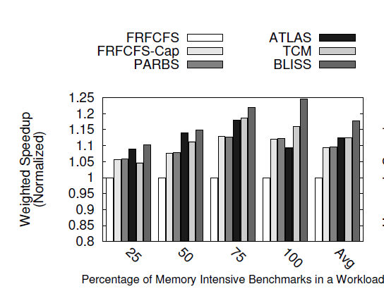
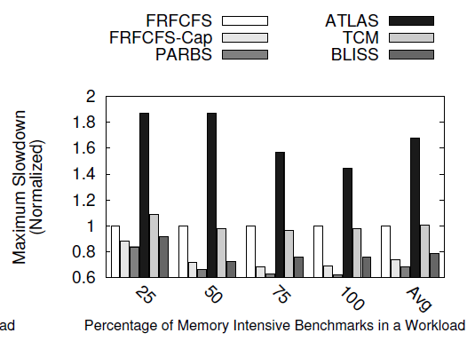
Effect of Workload Memory Intensity

Slide 73
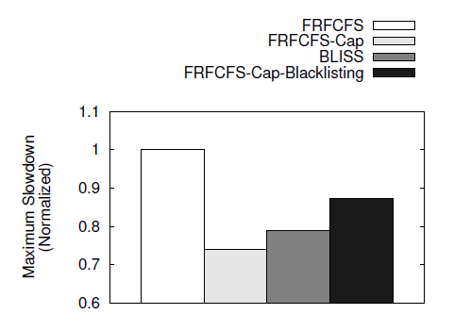
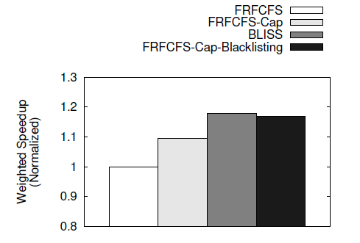
Combining FRFCFS-Cap and Blacklisting

Slide 74
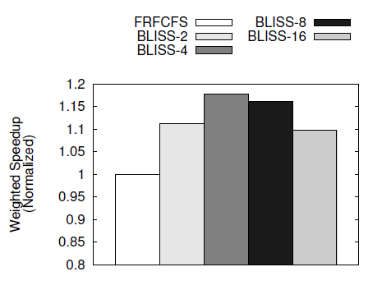
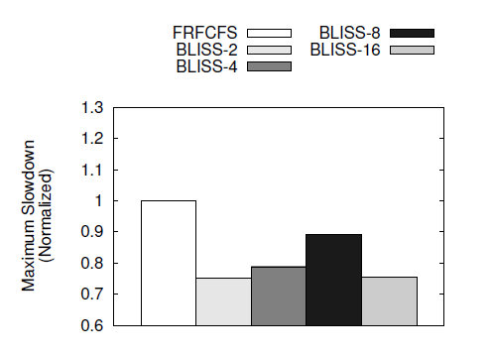
Sensitivity to Blacklisting Threshold

Slide 75
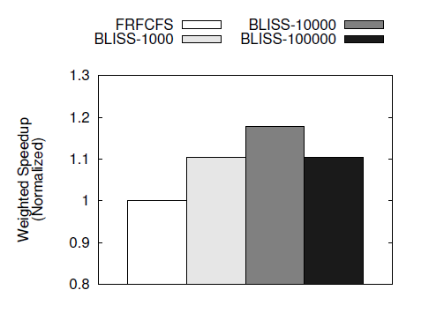
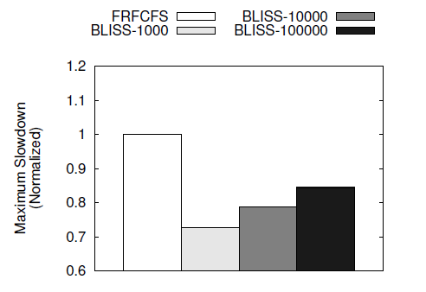
Sensitivity to Clearing Interval

Slide 76
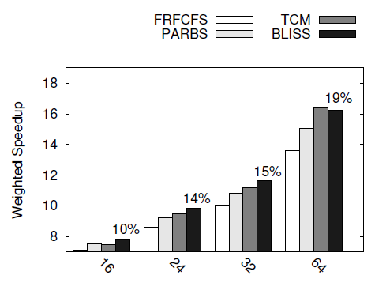
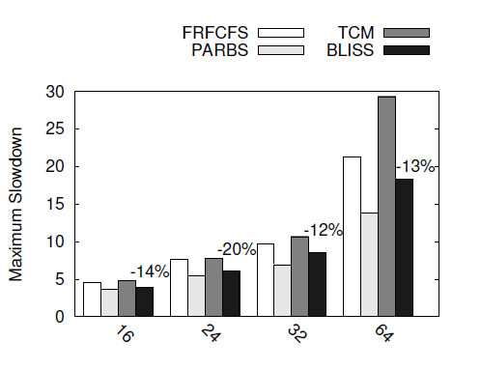
Sensitivity to Core Count

Slide 77
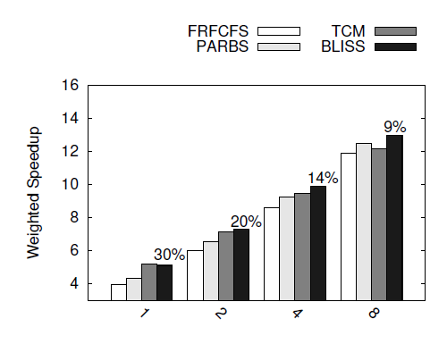
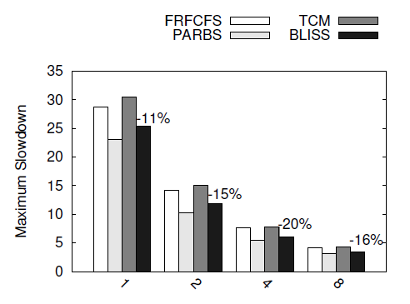
Sensitivity to Channel Count

Slide 78
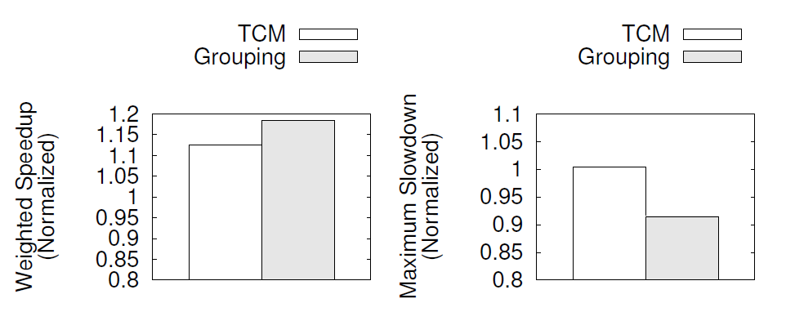
TCM vs. Grouping

Slide 79
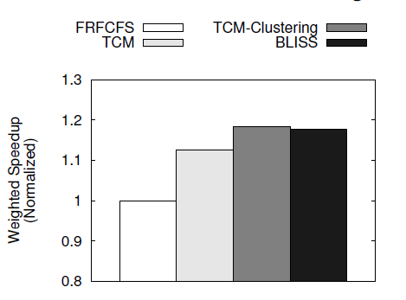
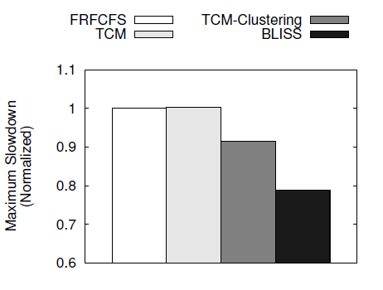
Comparison with TCM-like Clustering

Slide 80
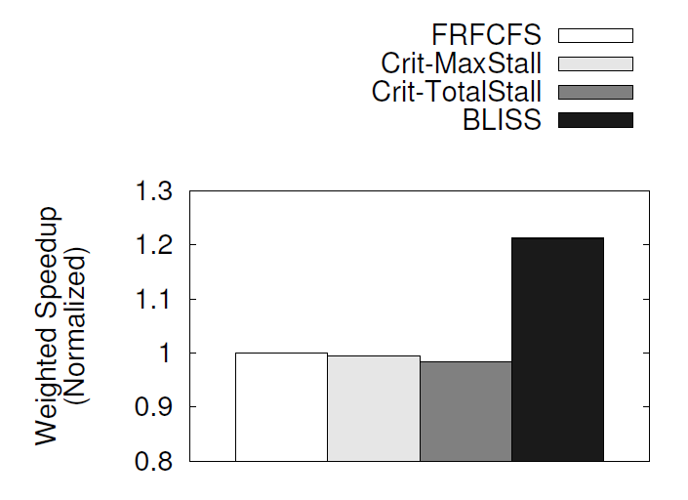
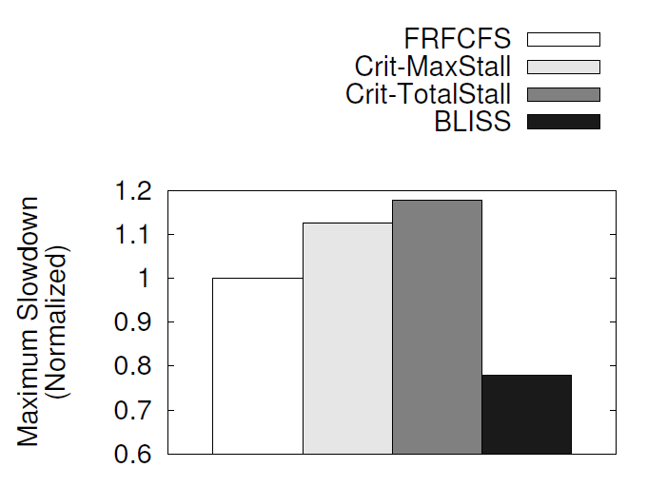
BLISS vs. Criticality-aware Scheduling

Slide 81
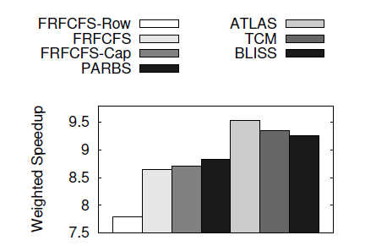
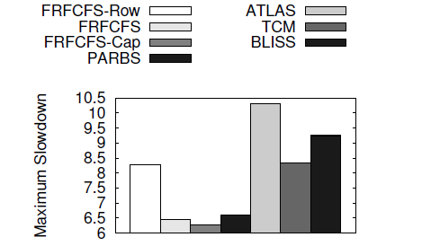
Sub-row Interleaving

Slide 82
MISE

Slide 83
Measuring RSR_{Shared} and α
Request Service Rate _{Shared} (RSR_{Shared})
  Per-core counter to track number of requests serviced
  At the end of each interval, measure
Memory Phase Fraction ( )
  Count number of stall cycles at the core
  Compute fraction of cycles stalled for memory
Notes:
Shared request service rate can be measured using per-core counters to track the number of requests serviced during each interval.
At the end of the interval, SRSR can be computed as the number of requests serviced divided by the length of the interval.
Memory phase fraction of each application can be computed by counting the number of cycles the core stalls waiting for memory and then computing what fraction are these cycles of the interval length.
Measuring SRSR and alpha is the straightforward part. Now, for the more interesting part, estimating alone request service rate.

Slide 84
Estimating Request Service Rate _{Alone}
(RSR_{Alone})
Goal: Estimate RSR_{Alone}
How: Periodically give each application highest priority in accessing memory
Divide each interval into shorter epochs
At the beginning of each epoch
  Memory controller randomly picks an application as the highest priority application
At the end of an interval, for each application, estimate
Notes:
Our goal is to estimate alone request service rate. To do this, we periodically give each application the highest priority in accessing memory, based on observation 2.
How exactly do we do this. First, each interval is divided into shorter epochs. At the beginning of each epoch, the memory controller picks one application at random and designates it the highest priority application. This way each application is given highest priority at different epochs during the interval.
At the end of the interval, ARSR is estimated for each application as the ratio of the number of requests of the application serviced during the high priority epochs to the number of cycles the application was given highest priority.
Now, is this an accurate way of estimating ARSR. It turns out not. We have been ignoring an inaccuracy all along.

Slide 85
Inaccuracy in Estimating RSR_{Alone}
When an application has highest priority
  Still experiences some interference
Request Buffer
State
Time units
Service order
High Priority
Main Memory
3
2
1
Main Memory
Request Buffer
State
Time units
Service order
Main Memory
3
2
1
Main Memory
Request Buffer
State
Time units
Service order
Main Memory
3
2
1
Main Memory
Time units
Service order
3
2
1
Main Memory
Interference Cycles
Notes:
That is, even when an application has highest priority, it still experiences some interference from other applications.
Here is an example showing why.
The red application has highest priority and is run along with another application, the blue application. First, there is just one request in the request buffer and it is from the red application. Since this is the only request, it is scheduled by the memory controller and completes in one time unit.
While this request is being serviced, there comes another request from the blue application. Our memory controller is work conserving and schedules another application’s request, if there is no request from the red application. So, it schedules the blue application’s request next.
However, just as the blue application’s request is being scheduled comes another request from the red application. Ideally, we would like to pre-empt the blue application’s request. However, because of the way DRAM operates, preempting the blue application’s request incurs overhead. Therefore, the red application’s request would have to wait until the blue application’s request completes and only then is it serviced. These extra cycles that the red application spent waiting for the blue application’s request to complete are interference cycles that it would not have experienced had it been running alone.

Slide 86
Accounting for Interference in RSR_{Alone} Estimation
Solution: Determine and remove interference cycles from RSR_{Alone} calculation
A cycle is an interference cycle if
  a request from the highest priority application is waiting in the request buffer and
  another application’s request was issued previously
Notes:
The solution to account for this interference is to determine and remove such interference cycles from the ARSR computation.
How we do this is to subtract these cycles from the number of high priority epoch cycles.
Now, the question is how do we determine which cycles are interference cycles.
We deem a cycle an interference cycle if …. (read from slide)

Slide 87
Other Results in the Paper
Sensitivity to model parameters
  Robust across different values of model parameters
Comparison of STFM and MISE models in enforcing soft slowdown guarantees
  MISE significantly more effective in enforcing guarantees
Minimizing maximum slowdown
  MISE improves fairness across several system configurations

Slide 88
Quantitative Comparison
SPEC CPU 2006 application
hmmer

Slide 89
MISE-QoS: Mechanism to Provide Soft QoS
Assign an initial bandwidth allocation to QoS-critical application
Estimate slowdown of QoS-critical application using the MISE model
After every N intervals
  If slowdown > bound B +/- ε, increase bandwidth allocation
  If slowdown < bound B +/- ε, decrease bandwidth allocation
When slowdown bound not met for N intervals
  Notify the OS so it can migrate/de-schedule jobs
Notes:
SLIDE NEEDS WORK

Slide 90
A Look at One Workload
Slowdown Bound = 10
Slowdown Bound = 3.33
Slowdown Bound = 2
MISE is effective in
meeting the slowdown bound for the QoS-critical application
improving performance of non-QoS-critical applications
QoS-critical
non-QoS-critical

Slide 91
Performance of Non-QoS-Critical Applications
When slowdown bound is 10/3
MISE-QoS improves system performance by 10%
Higher performance when bound is loose

Slide 92
Case Study with Two QoS-Critical Applications
Two comparison points
  Always prioritize both applications
  Prioritize each application 50% of time
MISE-QoS can achieve a lower slowdown bound for both applications
MISE-QoS provides much lower slowdowns for non-QoS-critical applications

Slide 93
Minimizing Maximum Slowdown
Goal
  Minimize the maximum slowdown experienced by any application
Basic Idea
  Assign more memory bandwidth to the more slowed down application

Slide 94
Mechanism
Memory controller tracks
  Slowdown bound B
  Bandwidth allocation of all applications
Different components of mechanism
  Bandwidth redistribution policy
  Modifying target bound
  Communicating target bound to OS periodically

Slide 95
Bandwidth Redistribution
At the end of each interval,
  Group applications into two clusters
  Cluster 1: applications that meet bound
  Cluster 2: applications that don’t meet bound
  Steal small amount of bandwidth from each application in cluster 1 and allocate to applications in cluster 2

Slide 96
Modifying Target Bound
If bound B is met for past N intervals
  Bound can be made more aggressive
  Set bound higher than the slowdown of most slowed down application
If bound B not met for past N intervals by more than half the applications
  Bound should be more relaxed
  Set bound to slowdown of most slowed down application

Slide 97
Results: Harmonic Speedup

Slide 98
Results: Maximum Slowdown

Slide 99
Sensitivity to Memory Intensity
(16 cores)

Slide 100
MISE: Per-Application Error
Benchmark | STFM | MISE | Benchmark | STFM | MISE
453.povray | 56.3 | 0.1 | 473.astar | 12.3 | 8.1
454.calculix | 43.5 | 1.3 | 456.hmmer | 17.9 | 8.1
400.perlbench | 26.8 | 1.6 | 464.h264ref | 13.7 | 8.3
447.dealII | 37.5 | 2.4 | 401.bzip2 | 28.3 | 8.5
436.cactusADM | 18.4 | 2.6 | 458.sjeng | 21.3 | 8.8
450.soplex | 29.8 | 3.5 | 433.milc | 26.4 | 9.5
444.namd | 43.6 | 3.7 | 481.wrf | 33.6 | 11.1
437.leslie3d | 26.4 | 4.3 | 429.mcf | 83.74 | 11.5
403.gcc | 25.4 | 4.5 | 445.gobmk | 23.1 | 12.5
462.libquantum | 48.9 | 5.3 | 483.xalancbmk | 18 | 13.6
459.GemsFDTD | 21.6 | 5.5 | 435.gromacs | 31.4 | 15.6
470.lbm | 6.9 | 6.3 | 482.sphinx3 | 21 | 16.8
473.astar | 12.3 | 8.1 | 471.omnetpp | 26.2 | 17.5
456.hmmer | 17.9 | 8.1 | 465.tonto | 32.7 | 19.5

Slide 101
Sensitivity to Epoch and Interval Lengths
Interval
Length
 | 1 mil. | 5 mil. | 10 mil. | 25 mil. | 50 mil.
1000 | 65.1% | 9.1% | 11.5% | 10.7% | 8.2%
10000 | 64.1% | 8.1% | 9.6% | 8.6% | 8.5%
100000 | 64.3% | 11.2% | 9.1% | 8.9% | 9%
1000000 | 64.5% | 31.3% | 14.8% | 14.9% | 11.7%
Epoch
Length

Slide 102
Workload Mixes
Mix No. | Benchmark 1 | Benchmark 2 | Benchmark 3
1 | sphinx3 | leslie3d | milc
2 | sjeng | gcc | perlbench
3 | tonto | povray | wrf
4 | perlbench | gcc | povray
5 | gcc | povray | leslie3d
6 | perlbench | namd | lbm
7 | h264ref | bzip2 | libquantum
8 | hmmer | lbm | omnetpp
9 | sjeng | libquantum | cactusADM
10 | namd | libquantum | mcf
11 | xalancbmk | mcf | astar
12 | mcf | libquantum | leslie3d

Slide 103
STFM’s Effectiveness in Enforcing QoS
Across 3000 data points
 | Predicted Met | Predicted Not Met
QoS Bound Met | 63.7% | 16%
QoS Bound Not Met | 2.4% | 17.9%

Slide 104
STFM vs. MISE’s System Performance

Slide 105
MISE’s Implementation Cost
1. Per-core counters worth 20 bytes
Request Service Rate Shared
Request Service Rate Alone
  1 counter for number of high priority epoch requests
  1 counter for number of high priority epoch cycles
  1 counter for interference cycles
Memory phase fraction ( )
2. Register for current bandwidth allocation – 4 bytes
3. Logic for prioritizing an application in each epoch

Slide 106
MISE Accuracy w/o Interference Cycles
Average error – 23%

Slide 107
MISE Average Error by Workload Category
Workload Category (Number of memory intensive applications) | Average Error
0 | 4.3%
1 | 8.9%
2 | 21.2%
3 | 18.4%

Slide 108
Initial Ideas
Separate slowdown into cache and memory slowdowns
Determine resource allocations based on cache, memory and overall slowdowns

Slide 109
QoS in Heterogeneous Systems
Staged memory scheduling
  In collaboration with Rachata Ausavarungnirun, Kevin Chang and Gabriel Lob
  Goal: High performance in CPU-GPU systems
Memory scheduling in heterogeneous systems
  In collaboration with Hiroukui Usui
  Goal: Meet deadlines for accelerators while improving performance

Slide 110
Publications

