Slide 1
18-447
Computer Architecture
Lecture 24: Memory Scheduling
Prof. Onur Mutlu
Carnegie Mellon University
Spring 2014, 3/31/2014

Slide 2
Last Two Lectures
Main Memory
  Organization and DRAM Operation
  Memory Controllers
DRAM Design and Enhancements
  More Detailed DRAM Design: Subarrays
  RowClone and In-DRAM Computation
  Tiered-Latency DRAM
Memory Access Scheduling
  FR-FCFS – row-hit-first scheduling

Slide 3
Today
Row Buffer Management Policies
Memory Interference (and Techniques to Manage It)
  With a focus on Memory Request Scheduling

Slide 4
Review: DRAM Scheduling Policies (I)
FCFS (first come first served)
  Oldest request first
FR-FCFS (first ready, first come first served)
  1. Row-hit first
  2. Oldest first
  Goal: Maximize row buffer hit rate → maximize DRAM throughput
  Actually, scheduling is done at the command level
    Column commands (read/write) prioritized over row commands (activate/precharge)
    Within each group, older commands prioritized over younger ones

Slide 5
Review: DRAM Scheduling Policies (II)
A scheduling policy is essentially a prioritization order
Prioritization can be based on
  Request age
  Row buffer hit/miss status
  Request type (prefetch, read, write)
  Requestor type (load miss or store miss)
  Request criticality
    Oldest miss in the core?
    How many instructions in core are dependent on it?

Slide 6
Row Buffer Management Policies
Open row
  Keep the row open after an access
  + Next access might need the same row → row hit
  -- Next access might need a different row → row conflict, wasted energy
Closed row
  Close the row after an access (if no other requests already in the request buffer need the same row)
  + Next access might need a different row → avoid a row conflict
  -- Next access might need the same row → extra activate latency
Adaptive policies
  Predict whether or not the next access to the bank will be to the same row

Slide 7
Open vs. Closed Row Policies
Policy | First access | Next access | Commands needed for next access
Open row | Row 0 | Row 0 (row hit) | Read
Open row | Row 0 | Row 1 (row conflict) | Precharge + Activate Row 1 + Read
Closed row | Row 0 | Row 0 – access in request buffer (row hit) | Read
Closed row | Row 0 | Row 0 – access not in request buffer (row closed) | Activate Row 0 + Read + Precharge
Closed row | Row 0 | Row 1 (row closed) | Activate Row 1 + Read + Precharge

Slide 8
Memory Interference and Scheduling in Multi-Core Systems

Slide 9
Review: A Modern DRAM Controller

Slide 10
Review: DRAM Bank Operation
Access Address:
(Row 0, Column 0)
Columns
(Row 0, Column 1)
(Row 0, Column 85)
(Row 1, Column 0)
Row address 0
Row address 1
Row decoder
Rows
Row Buffer
CONFLICT !
HIT
Row 1
HIT
Row 0
Empty
Column address 0
Column mux
Column address 0
Column address 1
Column address 85
Data

Slide 11
Scheduling Policy for Single-Core Systems
A row-conflict memory access takes significantly longer than a row-hit access
Current controllers take advantage of the row buffer
FR-FCFS (first ready, first come first served) scheduling policy
  1. Row-hit first
  2. Oldest first
  Goal 1: Maximize row buffer hit rate → maximize DRAM throughput
  Goal 2: Prioritize older requests → ensure forward progress
Is this a good policy in a multi-core system?

Slide 12
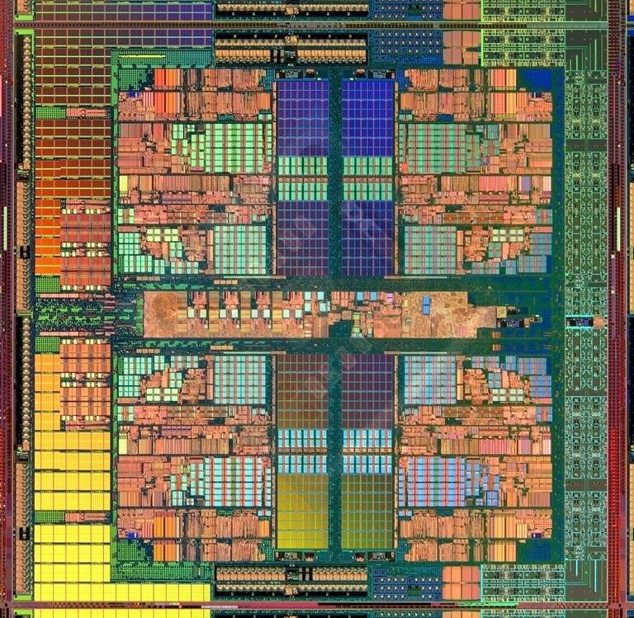
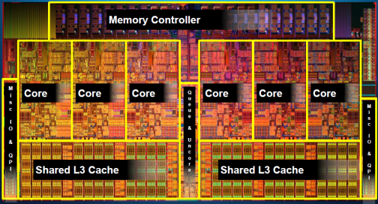
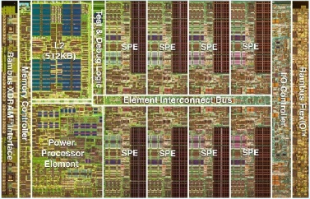
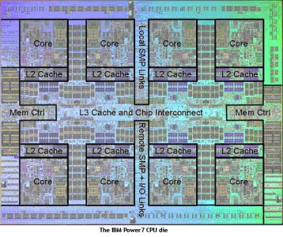
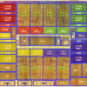
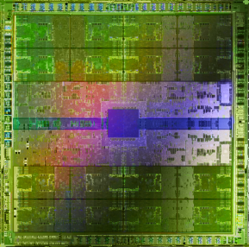
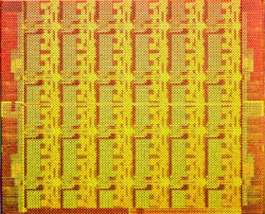
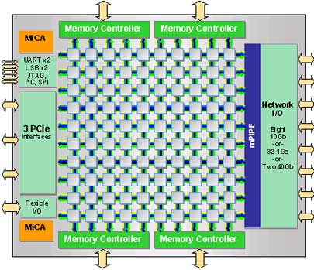
Trend: Many Cores on Chip
Simpler and lower power than a single large core
Large scale parallelism on chip
Intel Core i7
8 cores
IBM Cell BE
8+1 cores
IBM POWER7
8 cores
AMD Barcelona
4 cores
Nvidia Fermi
448 “cores”
Intel SCC
48 cores, networked
Tilera TILE Gx
100 cores, networked
Sun Niagara II
8 cores

Slide 13
Many Cores on Chip
What we want:
  N times the system performance with N times the cores
What do we get today?

Slide 14
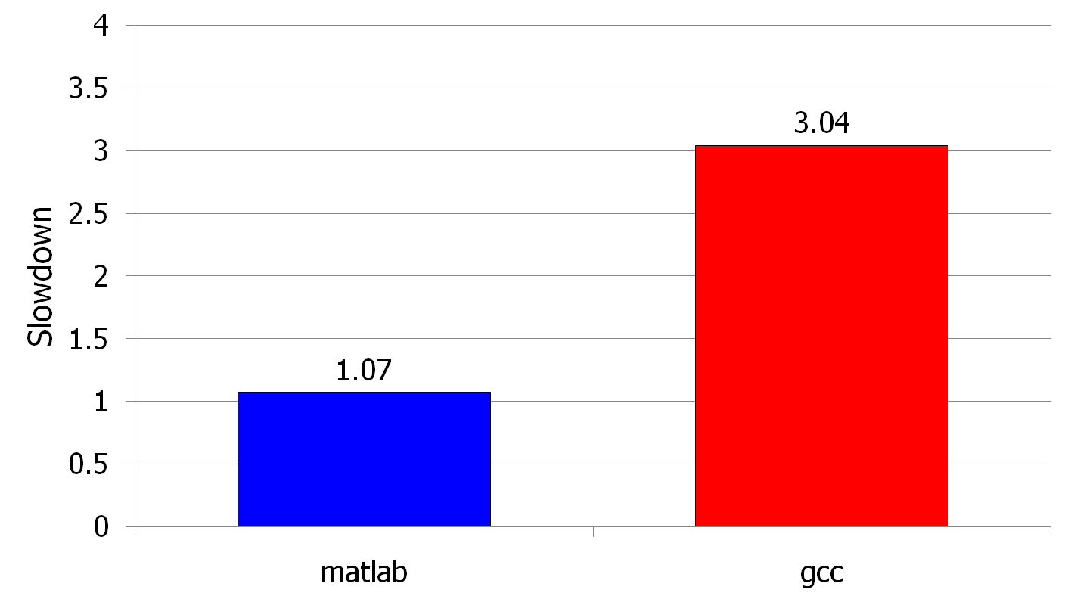
(Un)expected Slowdowns in Multi-Core
High priority
Low priority
(Core 0)
(Core 1)
Moscibroda and Mutlu, “Memory performance attacks: Denial of memory service
in multi-core systems,” USENIX Security 2007.
Notes:
What kind of performance do we expect when we run two applications on a multi-core system? To answer this question, we performed an experiment. We took two applications we cared about, ran them together on different cores in a dual-core system, and measured their slowdown compared to when each is run alone on the same system. This graph shows the slowdown each app experienced. (DATA explanation…)
Why do we get such a large disparity in the slowdowns?
Is it the priorities? No. We went back and gave high priority to gcc and low priority to matlab. The slowdowns did not change at all. Neither the software or the hardware enforced the priorities.
Is it the contention in the disk? We checked for this possibility, but found that these applications did not have any disk accesses in the steady state. They both fit in the physical memory and therefore did not interfere in the disk.
What is it then? Why do we get such large disparity in slowdowns in a dual core system?
I will call such an application a “memory performance hog”
Now, let me tell you why this disparity in slowdowns happens.
Is it that there are other applications or the OS interfering with gcc, stealing its time quantums? No.

Slide 15
Uncontrolled Interference: An Example
CORE 1
random
Multi-Core
Chip
stream
CORE 2
L2
CACHE
L2
CACHE
unfairness
INTERCONNECT
Shared DRAM
Memory System
DRAM MEMORY CONTROLLER
DRAM
Bank 0
DRAM
Bank 1
DRAM
Bank 2
DRAM
Bank 3
Notes:
-In a multi-core chip, different cores share some hardware resources. In particular, they share the DRAM memory system. The shared memory system consists of this and that.
When we run matlab on one core, and gcc on another core, both cores generate memory requests to access the DRAM banks. When these requests arrive at the DRAM controller, the controller favors matlab’s requests over gcc’s requests. As a result, matlab can make progress and continues generating memory requests. These requests are again favored by the DRAM controller over gcc’s requests. Therefore, gcc starves waiting for its requests to be serviced in DRAM whereas matlab makes very quick progress as if it were running alone.
Why does this happen? This is because the algorithms employed by the DRAM controller are unfair.
But, why are these algorithms unfair? Why do they unfairly prioritize matlab accesses?
To understand this, we need to understand how a DRAM bank operates.
Almost all systems today contain multi-core chips
Multi-core systems consist of multiple on-chip cores and caches
Cores share the DRAM memory system
DRAM memory system consists of
DRAM banks that store data (multiple banks to allow parallel accesses)
DRAM memory controller that mediates between cores and DRAM memory
It schedules memory operations generated by cores to DRAM
This talk is about exploiting the unfair algorithms in the memory controllers to perform denial of service to running threads
To understand how this happens, we need to know about how each DRAM bank operates

Slide 16
A Memory Performance Hog
// initialize large arrays A, B
for (j=0; j<N; j++) {
index = j*linesize;
A[index] = B[index];
…
}
// initialize large arrays A, B
for (j=0; j<N; j++) {
index = rand();
A[index] = B[index];
…
}
streaming
random
STREAM
RANDOM
Sequential memory access
Very high row buffer locality (96% hit rate)
Memory intensive
Random memory access
Very low row buffer locality (3% hit rate)
Similarly memory intensive
Moscibroda and Mutlu, “Memory Performance Attacks,” USENIX Security 2007.
Notes:
Streaming through memory by performing operations on two 1D arrays.
Sequential memory access
Each access is a cache miss (elements of array larger than a cache line size) → hence, very memory intensive
Link to the real code…

Slide 17
What Does the Memory Hog Do?
Row decoder
T0: Row 0
T0: Row 0
T0: Row 0
T0: Row 0
T0: Row 0
T0: Row 0
T0: Row 0
T1: Row 5
T1: Row 111
T0: Row 0
T1: Row 16
T0: Row 0
Memory Request Buffer
Row 0
Row Buffer
Row 0
Column mux
Row size: 8KB, cache block size: 64B
128 (8KB/64B) requests of T0 serviced before T1
T0: STREAM
T1: RANDOM
Data
Moscibroda and Mutlu, “Memory Performance Attacks,” USENIX Security 2007.
Notes:
Pictorially demonstrate how stream denies memory service to rdarray
Stream continuously accesses columns in row 0 in a streaming manner (streams through a row after opening it)
In other words almost all its requests are row-hits
RDarray’s requests are row-conflicts (no locality)
The DRAM controller reorders streams requests to the open row over other requests (even older ones) to maximize DRAM throughput
Hence, rdarray’s requests do not get serviced as long as stream is issuing requests at a fast-enough rate
In this example, the red thread’s request to another row will not get serviced until stream stops issuing a request to row 0
With those parameters, 128 requests of stream would be serviced before 1 from rdarray
As row-buffer size increases, which is the industry trend, this problem will become more severe
This is not the worst case, but it is easy to construct and understand
Stream falls off the row buffer at some point
I leave it to the listeners to construct a case worse than this (it is possible)

Slide 18
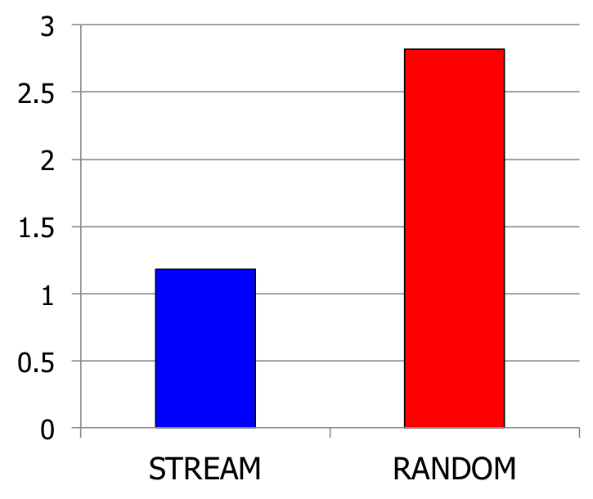
Effect of the Memory Performance Hog
2.82X slowdown
Slowdown
1.18X slowdown
Results on Intel Pentium D running Windows XP
(Similar results for Intel Core Duo and AMD Turion, and on Fedora Linux)
Moscibroda and Mutlu, “Memory Performance Attacks,” USENIX Security 2007.
Notes:
RANDOM was given higher OS priority in the experiments

Slide 19
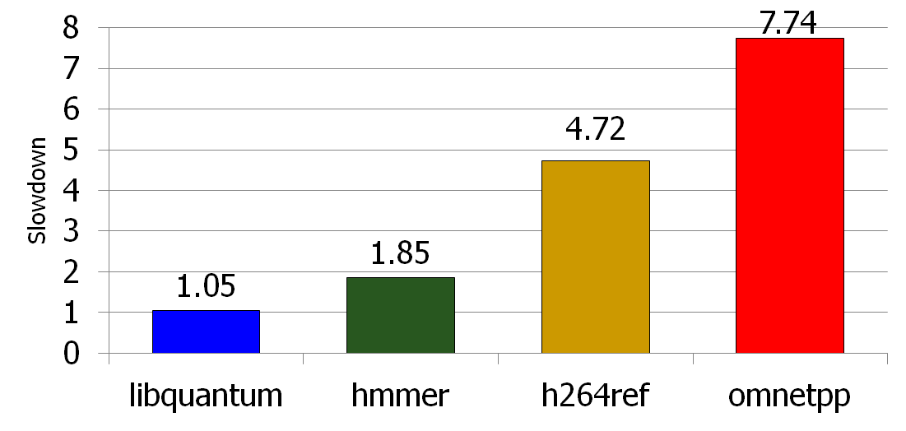
Problems due to Uncontrolled Interference
Main memory is the only shared resource
High priority
Memory performance hog
Low priority
Slowdown
Cores make
very slow
progress
Unfair slowdown of different threads
Low system performance
Vulnerability to denial of service
Priority inversion: unable to enforce priorities/SLAs

Slide 20
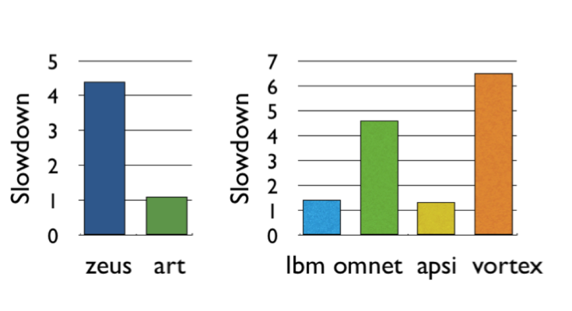
Problems due to Uncontrolled Interference
Unfair slowdown of different threads
Low system performance
Vulnerability to denial of service
Priority inversion: unable to enforce priorities/SLAs
Poor performance predictability (no performance isolation)
Uncontrollable, unpredictable system

Slide 21
Inter-Thread Interference in Memory
Memory controllers, pins, and memory banks are shared
Pin bandwidth is not increasing as fast as number of cores
  Bandwidth per core reducing
Different threads executing on different cores interfere with each other in the main memory system
Threads delay each other by causing resource contention:
  Bank, bus, row-buffer conflicts → reduced DRAM throughput
Threads can also destroy each other’s DRAM bank parallelism
  Otherwise parallel requests can become serialized

Slide 22
Effects of Inter-Thread Interference in DRAM
Queueing/contention delays
  Bank conflict, bus conflict, channel conflict, …
Additional delays due to DRAM constraints
  Called “protocol overhead”
  Examples
    Row conflicts
    Read-to-write and write-to-read delays
Loss of intra-thread parallelism
  A thread’s concurrent requests are serviced serially instead of in parallel

Slide 23
Problem: QoS-Unaware Memory Control
Existing DRAM controllers are unaware of inter-thread interference in DRAM system
They simply aim to maximize DRAM throughput
  Thread-unaware and thread-unfair
  No intent to service each thread’s requests in parallel
  FR-FCFS policy: 1) row-hit first, 2) oldest first
    Unfairly prioritizes threads with high row-buffer locality
    Unfairly prioritizes threads that are memory intensive (many outstanding memory accesses)

Slide 24
Solution: QoS-Aware Memory Request Scheduling
Resolves memory contention by scheduling requests
How to schedule requests to provide
  High system performance
  High fairness to applications
  Configurability to system software
Memory controller needs to be aware of threads
Core
Core
Memory Controller
Memory
Core
Core

Slide 25
Stall-Time Fair Memory Scheduling
Onur Mutlu and Thomas Moscibroda,
"Stall-Time Fair Memory Access Scheduling for Chip Multiprocessors"
40th International Symposium on Microarchitecture (MICRO),
pages 146-158, Chicago, IL, December 2007. Slides (ppt)
STFM Micro 2007 Talk

Slide 26
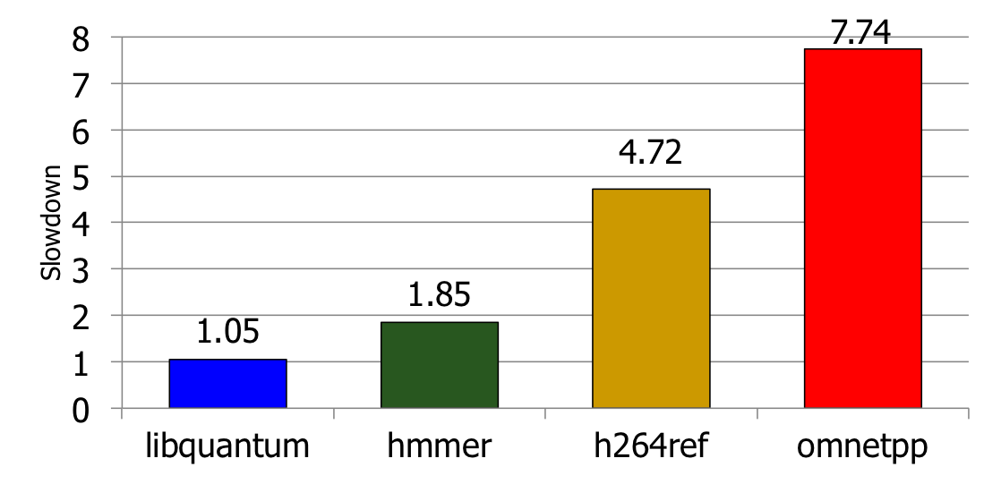
The Problem: Unfairness
Vulnerable to denial of service
Unable to enforce priorities or service-level agreements
Low system performance
Uncontrollable, unpredictable system

Slide 27
How Do We Solve the Problem?
Stall-time fair memory scheduling [Mutlu+ MICRO’07]
Goal: Threads sharing main memory should experience similar slowdowns compared to when they are run alone → fair scheduling
  Also improves overall system performance by ensuring cores make “proportional” progress
Idea: Memory controller estimates each thread’s slowdown due to interference and schedules requests in a way to balance the slowdowns
Mutlu and Moscibroda, “Stall-Time Fair Memory Access Scheduling for Chip Multiprocessors,” MICRO 2007.

Slide 28
Stall-Time Fairness in Shared DRAM Systems
A DRAM system is fair if it equalizes the slowdown of equal-priority threads relative to when each thread is run alone on the same system
DRAM-related stall-time: The time a thread spends waiting for DRAM memory
ST_{shared}: DRAM-related stall-time when the thread runs with other threads
ST_{alone}: DRAM-related stall-time when the thread runs alone
Memory-slowdown = ST_{shared}/ST_{alone}
  Relative increase in stall-time
Stall-Time Fair Memory scheduler (STFM) aims to equalize Memory-slowdown for interfering threads, without sacrificing performance
  Considers inherent DRAM performance of each thread
  Aims to allow proportional progress of threads
Notes:
Memory-slowdown is the relative increase in the DRAM-related stall-time due to interference from other threads
For example, if a thread’s DRAM related stall time is 1 hour when running alone, and its stall-time is 2 hours when it runs together with other threads,
Its memory-slowdown is said to be 2.
Give an example at the end: If a thread waits for DRAM 1 hour running by itself and this increases to 2 hours (its slowdown is 2), then a thread that waits for DRAM 2 hours, should now wait for DRAM 4 hours.
Each thread experiences the same slowdown compared to its baseline DRAM performance
The amount of time a thread spends waiting for DRAM memory
Extra time a thread requires to run because DRAM access is not instant
PROPORTIONALITY: Each thread makes the same amount of progress relative to its baseline performance. This is consistent with priority based scheduling mechanisms that allocate the same time quantum for equal-priority threads.
We define two values to compute slowdown.
Proportional slowdown (proportionate progress)
Fairness notion similar to SMT [Cazorla, IEEE Micro’04][Luo, ISPASS’01], SoEMT [Gabor, Micro’06], and shared caches [Kim, PACT’04]

Slide 29
STFM Scheduling Algorithm [MICRO’07]
For each thread, the DRAM controller
  Tracks ST_{shared}
  Estimates ST_{alone}
Each cycle, the DRAM controller
  Computes Slowdown = ST_{shared}/ST_{alone} for threads with legal requests
  Computes unfairness = MAX Slowdown / MIN Slowdown
If unfairness < α
  Use DRAM throughput oriented scheduling policy
If unfairness ≥ α
  Use fairness-oriented scheduling policy
    (1) requests from thread with MAX Slowdown first
    (2) row-hit first , (3) oldest-first
Notes:
Except for pathological cases, best achievable unfairness value is 1
Maximizes DRAM throughput if it cannot improve fairness
WORK CONSERVING: Does not waste useful bandwidth to improve fairness
If a request does not interfere with any other, it is scheduled

Slide 30
How Does STFM Prevent Unfairness?
T0: Row 0
T1: Row 5
T0: Row 0
T0: Row 0
T1: Row 111
T0: Row 0
T0: Row 0
T0: Row 0
T0: Row 0
T1: Row 16
Row 16
Row Buffer
Row 111
Row 0
Row 0
T0 Slowdown
1.00
1.04
1.04
1.07
1.10
1.03
T1 Slowdown
1.03
1.06
1.08
1.14
1.06
1.11
1.00
Unfairness
1.03
1.06
1.03
1.04
1.06
1.04
1.03
1.00
Data
α
1.05
Notes:
A pictorial example of how our solution prevents stream from being a memory performance hog
Our technique requires the DRAM controller to keep track of slowdowns for each thread and the unfairness value based on these slowdowns
Alpha parameter (maximum tolerable unfairness until the fairness-oriented scheduling policy kicks in) is set to 1.05 in this example
As stream’s requests are prioritized over rdarray’s, rdarray’s slowdown increases and hence unfairness increases
Once unfairness crosses the alpha value, our algorithm kicks in and uses the fairness-oriented scheduling policy
This policy prioritizes requests from the thread with the maximum slowdown (rdarray – thread 1)
Hence, rdarray’s requests do not indefinitely starve
Servicing rdarray’s request increases stream’s slowdown and keeps in check rdarray’s slowdown (thus reduces unfairness)
Therefore, when unfairness becomes tolerable again, our algorithm switches back to the baseline scheduling policy to maximize throughput (i.e. it schedules stream’s row hit requests first, and then the oldest requests)

Slide 31
STFM Pros and Cons
Upsides:
  First algorithm for fair multi-core memory scheduling
  Provides a mechanism to estimate memory slowdown of a thread
  Good at providing fairness
  Being fair can improve performance
Downsides:
  Does not handle all types of interference
  (Somewhat) complex to implement
  Slowdown estimations can be incorrect

Slide 32
Parallelism-Aware Batch Scheduling
Onur Mutlu and Thomas Moscibroda,
"Parallelism-Aware Batch Scheduling: Enhancing both
Performance and Fairness of Shared DRAM Systems”
35th International Symposium on Computer Architecture (ISCA),
pages 63-74, Beijing, China, June 2008. Slides (ppt)
PAR-BS ISCA 2008 Talk

Slide 33
Another Problem due to Interference
Processors try to tolerate the latency of DRAM requests by generating multiple outstanding requests
  Memory-Level Parallelism (MLP)
  Out-of-order execution, non-blocking caches, runahead execution
Effective only if the DRAM controller actually services the multiple requests in parallel in DRAM banks
Multiple threads share the DRAM controller
DRAM controllers are not aware of a thread’s MLP
  Can service each thread’s outstanding requests serially, not in parallel
Notes:
Modern processors try to amortize the latency of DRAM requests by generating multiple outstanding requests
This concept is called memory-level parallelism.
Many techniques, such as OOO, non-blocking caches and runahead execution, are designed or used to tolerate long memory latencies by exploiting memory-level parallelism
These latency tolerance techniques are effective only if the DRAM controller actually services the multiple requests of a thread in parallel in DRAM banks
This is true in a single-threaded system since only one thread has exclusive access to all DRAM banks.
However, in a multi-core system, multiple threads share the DRAM controller.
Unfortunately, existing DRAM controllers are not aware of each thread’s memory level parallelism
As a result they can service each thread’s outstanding requests serially, not in parallel
Let’s take a look at why this happens.
-----------------------------------------
Assuming requests are to different banks
In a single core system this is fine because only one thread has exclusive access to all DRAM banks.
However, in a multi-core system, multiple threads shared the DRAM controller.
Unfortunately, DRAM controllers are unaware of a thread’s MLP. As a result, because threads can interfere with each other in the DRAM system, they can service each thread’s requests serially instead of in parallel.
Let’s take a look at why this happens.

Slide 34
Bank Parallelism of a Thread
2 DRAM Requests
Bank 0
Bank 1
Single Thread:
Thread A :
Compute
Stall
Compute
Bank 0
Bank 1
Thread A: Bank 0, Row 1
Thread A: Bank 1, Row 1
Bank access latencies of the two requests overlapped
Thread stalls for ~ONE bank access latency
Notes:
I will demonstrate this pictorially with an example.
Let’s say a thread A executes until it encounters 2 DRAM requests caused by two of its load instructions. These requests are sent to the DRAM controller. And, the controller services them by first scheduling the request to Bank 0 and then scheduling the request to Bank 1. While the requests are being serviced in parallel in the banks, the thread stalls (waiting for the data). Once the servicing of the requests completes, the thread can continue execution.
Since the requests were serviced in parallel in the two banks, bank access latencies of the two requests are overlapped. As a result, the thread stalls for approximately one bank access latency, instead of two bank access latencies.

Slide 35
Bank Parallelism Interference in DRAM
Baseline Scheduler:
Bank 0
Bank 1
2 DRAM Requests
A :
Compute
Stall
Stall
Compute
Bank 0
Bank 1
Thread A: Bank 0, Row 1
2 DRAM Requests
B:
Compute
Stall
Stall
Compute
Thread B: Bank 1, Row 99
Bank 1
Thread B: Bank 0, Row 99
Bank 0
Thread A: Bank 1, Row 1
Bank access latencies of each thread serialized
Each thread stalls for ~TWO bank access latencies
Notes:
What happens when we run two of these threads together in a dual-core system? Again, both threads execute until each encounters 2 DRAM requests. These requests are sent to the DRAM controller. Assume they arrive in the order shown. And the controller services them in the order they arrive.
The controller first takes Thread A’s request to Bank 0 and schedules it. It then schedules Thread B’s request to Bank 1. While these two requests are serviced in parallel, both threads stall.
Once the first request to Bank 0 is done, the controller takes Thread B’s request to bank 0 and schedules it. And it takes Thread A’s request to Bank 1 and schedules it. While these two requests are serviced in parallel, both threads stall.
Once the requests are complete, the threads continue computation.
In this case, because the threads’ requests interfered with each other in the DRAM system, the bank access latencies of each thread were serialized because the requests were serialized. As a result both threads stall for two bank access latencies instead of 1, which is what each thread experienced when running alone.
This is because the DRAM controller did not try to preserve the bank parallelism of each thread.

Slide 36
Parallelism-Aware Scheduler
Baseline Scheduler:
Bank 0
Bank 1
2 DRAM Requests
A :
Compute
Stall
Stall
Compute
Bank 0
Bank 1
2 DRAM Requests
Thread A: Bank 0, Row 1
B:
Compute
Stall
Stall
Compute
Thread B: Bank 1, Row 99
Bank 1
Thread B: Bank 0, Row 99
Bank 0
Parallelism-aware Scheduler:
Thread A: Bank 1, Row 1
2 DRAM Requests
A :
Compute
Stall
Compute
Saved Cycles
Average stall-time: ~1.5 bank access latencies
Bank 0
Bank 1
2 DRAM Requests
B:
Compute
Stall
Stall
Compute
Bank 0
Bank 1
Notes:
Can we do better than this? Let me describe what a parallelism aware scheduler would do.
This is the same example. The two threads compute until they each generate 2 DRAM requests, which arrive at the controller in the same order as before. The controller first takes Thread A’s request to Bank 0 and schedules it. But then, instead of servicing the requests in their arrival order, it realizes there is another request from Thread A to Bank 1 and if it schedules that one back to back with Thread A’s previous request, thread A’s request latencies would be overlapped.
Therefore, the controller takes Thread A’s request to Bank 1 and schedules it. While these two requests are serviced in parallel in the banks, both threads stall.
Once the request to Bank 0 is complete, the controller takes Thread B’s request to Bank 0 and schedules it. Later, it schedules Thread B’s request to Bank 1. While these two requests are being serviced, Thread B stalls (because it does not have the data it needs), but thread A can do useful computation! This is because its requests were serviced in parallel in the banks, instead of serially, and the thread has all the data it needs to do useful computation. As a result, the execution time of Thread A reduces compared to the baseline scheduler that was not aware of the threads’ bank parallelism.
Overall system throughput also improves because the average stall-time of the threads is 1.5 bank access latencies instead of 2. Instead of stalling, cores can make progress executing their instruction streams.

Slide 37
Parallelism-Aware Batch Scheduling (PAR-BS)
Principle 1: Parallelism-awareness
  Schedule requests from a thread (to different banks) back to back
  Preserves each thread’s bank parallelism
  But, this can cause starvation…
Principle 2: Request Batching
  Group a fixed number of oldest requests from each thread into a “batch”
  Service the batch before all other requests
  Form a new batch when the current one is done
  Eliminates starvation, provides fairness
  Allows parallelism-awareness within a batch
T1
T1
T2
T0
T2
T2
T3
T2
Batch
T0
T3
T2
T1
T1
T0
Bank 0
Bank 1
  Mutlu and Moscibroda, “Parallelism-Aware Batch Scheduling,” ISCA 2008.
Notes:
Parallelism aware batch scheduling uses two key principles. The first principle is parallelism awareness. As I showed you before, a thread’s bank parallelism is improved by scheduling requests from a thread to different banks back to back. Unfortunately, doing this greedily can cause starvation because a thread whose requests are continuously scheduled back to back can keep on generating more requests and therefore deny service to other threads that are waiting to access the same bank.
To avoid this, we use a second principle, called request batching. With this, the controller groups a fixed number of oldest requests from each thread into a “batch”. And, it services the batch before all other requests. It forms a new batch when the current one is done.
Batching eliminates starvation of requests and threads, and provides fairness. It also allows parallelism of each thread to be optimized for within a batch.
Let’s take a look at how this works pictorially.
Multiple threads send requests to the DRAM controller. The controller groups these requests into a batch. Once a batch is formed any newly arriving requests are not included in the batch. Within the batch, the controller schedules each thread’s requests in parallel. It first takes TX’s requests and schedules them in parallel. Then it takes TY’s requests and schedules them in parallel. Note that incoming requests from T3 that are outside the batch are not serviced. Once all requests in the batch are serviced in a parallelism-aware manner, the controller forms a new batch with the requests in the memory request buffer.

Slide 38
PAR-BS Components
Request batching
Within-batch scheduling
  Parallelism aware
Notes:
PAR-BS has two components, which I will describe in more detail. The first is request batching. Aside from guaranteeing starvation freedom and providing fairness, a batch provides a flexible substrate that enables aggressive scheduling optimizations (within the batch).
The second component is the within-batch scheduling component. Within a batch, any DRAM scheduling policy can be employed. And, this policy can be very aggressive and possibly unfair in the global sense. Because the overlying batching scheme ensures forward progress in each thread. In fact, we use a globally unfair shortest job first scheduling policy within a batch, to optimize each thread’s bank parallelism.

Slide 39
Request Batching
Each memory request has a bit (marked) associated with it
Batch formation:
  Mark up to Marking-Cap oldest requests per bank for each thread
  Marked requests constitute the batch
  Form a new batch when no marked requests are left
Marked requests are prioritized over unmarked ones
  No reordering of requests across batches: no starvation, high fairness
How to prioritize requests within a batch?
Notes:
To implement batching, Each memory request has a bit (called the marked bit) associated with it
When a batch is formed, the controller marks up to a Marking-Cap pending requests per bank for each thread. Marked requests constitute the batch. A new batch is formed when no marked requests are left.
The key idea is that marked requests are always prioritized over unmarked ones. Hence, there is no reordering of requests across batches: As a result, there is no starvation, and a high degree of fairness.
But how does the controller prioritize requests within a batch?

Slide 40
Within-Batch Scheduling
Can use any existing DRAM scheduling policy
  FR-FCFS (row-hit first, then oldest-first) exploits row-buffer locality
But, we also want to preserve intra-thread bank parallelism
  Service each thread’s requests back to back
Scheduler computes a ranking of threads when the batch is formed
  Higher-ranked threads are prioritized over lower-ranked ones
  Improves the likelihood that requests from a thread are serviced in parallel by different banks
    Different threads prioritized in the same order across ALL banks
HOW?
Notes:
Within a batch, the controller can use any existing DRAM scheduling policy. For example, the baseline FR-FCFS policy is very good at exploiting row buffer locality.
However, in addition to exploiting row-buffer locality, we also want to preserve intra-thread bank parallelism. As I showed you before, this can be accomplished by servicing each thread’s requests back to back
To do so, the DRAM scheduler computes a ranking of threads when the batch is formed
And it prioritizes requests that belong to higher-ranked threads over those that belong to lower ranked ones
This Improves the likelihood that requests from a thread are serviced in parallel by different banks
Because Different threads prioritized in the same order (the RANK ORDER) across ALL banks
But how does the scheduler compute this ranking?

Slide 41
How to Rank Threads within a Batch
Ranking scheme affects system throughput and fairness
Maximize system throughput
  Minimize average stall-time of threads within the batch
Minimize unfairness (Equalize the slowdown of threads)
  Service threads with inherently low stall-time early in the batch
  Insight: delaying memory non-intensive threads results in high slowdown
Shortest stall-time first (shortest job first) ranking
  Provides optimal system throughput [Smith, 1956]*
  Controller estimates each thread’s stall-time within the batch
  Ranks threads with shorter stall-time higher
* W.E. Smith, “Various optimizers for single stage production,” Naval Research Logistics Quarterly, 1956.
Notes:
The thread ranking scheme affects system throughput and fairness
A good ranking scheme should achieve two objectives.
First, it should maximize system throughput
Second, it should minimize unfairness; in other words it should balance the slowdown of the threads compared to when each is run alone.
These two objectives call for the same ranking scheme, as I will show soon.
Maximizing system throughput is achieved by minimizing the average stall-time of the threads within the batch (as I showed in the earlier example). By minimizing the average stall time, we maximize the amount of time the system spends on computation rather than waiting for DRAM accesses.
Minimizing unfairness is achieved by servicing threads with inherently low stall-time early in the batch, The insight is that if a thread has low stall time to begin with (if it is not intensive) delaying that thread would result in very high slowdown compared to delaying a memory-intensive thread.
To achieve both objectives, we use the “shortest job first” principle. Shortest job first scheduling has been proven to provide the optimal throughput in generalized machine scheduling theory. The controller estimates each thread’s stall-time within the batch (assuming the thread is run alone). And, it ranks a thread higher if the thread has a short stall time.

Slide 42
Shortest Stall-Time First Ranking
Maximum number of marked requests to any bank (max-bank-load)
  Rank thread with lower max-bank-load higher (~ low stall-time)
Total number of marked requests (total-load)
  Breaks ties: rank thread with lower total-load higher
T3
 | max-bank-load | total-load
T0 | 1 | 3
T1 | 2 | 4
T2 | 2 | 6
T3 | 5 | 9
T3
T3
T2
T3
T3
T1
T0
T2
T0
T2
T2
T1
T2
T3
T1
T0
T3
T1
T3
T2
T3
Bank 0
Bank 1
Bank 2
Bank 3
Ranking:
T0 > T1 > T2 > T3
Notes:
How is this exactly done? The controller keeps track of two values for each thread. First, the maximum number of marked requests from the thread to any bank. This is called max-bank-load. A lower value of this correlates with low stall time (and less memory intensiveness). As a result the scheduler ranks a thread with lower max-bank-load higher than a thread with higher max-bank load.
If the max-bank-load of the two threads are equal, the scheduler uses another value it keeps track of to break the ties. It keeps the total number of requests in the batch from each thread. This is called total-load. If a thread has lower total-load it is less intensive, therefore it is ranked higher.
Let’s take a look at these concepts with an example. Assume these are the requests within the batch.
T0 has at most 1 request to any bank, so its max-bank-load is 1. Its total-load is 3 since it has total 3 marked requests.
T1 has at most 2 requests to any bank so its max-bank-load is 2. Its total load is 6.
T2 similarly has a max-bank-load of 2, but its total load is higher.
Finally, T3 has a maximum of 5 requests to Bank 3. Therefore, its max-bank load is 5.
Because T1 has the smallest max-bank-load, it is ranked highest. The scheduler ranks T1 higher than T2 because T1 has fewer total requests. The most memory intensive thread, T2 is ranked the lowest.
----------------------------
Insight: Memory-intensive threads can be delayed more within a batch since their baseline stall-time is high
How do you break the ties? A thread with lower total-load is ranked higher
Goal: Finish non-intensive threads first and fill in the gaps in parallelism as much as possible
Shortest job first within a batch might seem unfair, but remember the batch boundaries. Less intensive threads will be penalized across batches because if their requests are not marked, they cannot be serviced. Shortest job first balances this delay caused to the less intensive threads
Thread 0 has at most one request to any bank
Thread 1 has at most 2: it has two requests to Bank 0.
Thread 2 has at most 2 as well.
Thread 3 has max number of requests to Bank 3 (5 reqs)

Slide 43
Example Within-Batch Scheduling Order
Baseline Scheduling
Order (Arrival order)
T3
7
PAR-BS Scheduling
Order
T3
7
T3
6
T3
6
T3
T2
T3
T3
5
T3
T3
T3
T3
5
4
4
T1
T0
T2
T0
Time
T3
T2
T2
T3
Time
T2
T2
T1
T2
3
T2
T2
T2
T3
3
T3
T1
T0
T3
2
T1
T1
T1
T2
2
T1
T3
T2
T3
1
T1
T0
T0
T0
1
Bank 0
Bank 1
Bank 2
Bank 3
Bank 0
Bank 1
Bank 2
Bank 3
Ranking: T0 > T1 > T2 > T3
T0 | T1 | T2 | T3
4 | 4 | 5 | 7
T0 | T1 | T2 | T3
1 | 2 | 4 | 7
Stall times
Stall times
AVG: 5 bank access latencies
AVG: 3.5 bank access latencies
Notes:
How does this ranking affect the scheduling order? Let’s take a look at this pictorially.
First, let’s look at the baseline scheduler. I will show the time at which the requests are serviced, where time is expressed abstractly in terms of bank access latency. In the baseline scheduler, the batched requests are serviced in their arrival order. As a result, the last request of T0 is serviced after 4 bank access latencies, the last request of T1 is also serviced after 4 bank access latencies. Consequently, the average stall time of the threads is approximately 5 bank access latencies within this batch of requests.
If we use PAR-BS to rank the threads, the scheduler will prioritize requests based on their thread-rank order, which I showed before. It prioritizes T0’s requests first (as shown in the ranking order). As a result, T0’s requests complete after 1 bank access latency. T1’s requests are serviced after 2 bank access latencies. T2’s requests are serviced after 4 bank access latencies.
Note that the bank parallelism of each thread is preserved as much as possible. Because of this, the average stall time reduces by 30%. Thus, system throughput improves.
Also note that, to keep this example simple, I assumed there are no row-buffer hits. A more complicated example with row-buffer hits is provided in the paper, and I encourage you to look at it.
--------------------------------------
Time is in bank access latencies (note that this is an approximation to demonstrate the idea… real DRAM system is much more complex than this…)
Last request from a thread is scheduled at TIME

Slide 44
Putting It Together: PAR-BS Scheduling Policy
PAR-BS Scheduling Policy
  (1) Marked requests first
  (2) Row-hit requests first
  (3) Higher-rank thread first (shortest stall-time first)
  (4) Oldest first
Three properties:
  Exploits row-buffer locality and intra-thread bank parallelism
  Work-conserving
    Services unmarked requests to banks without marked requests
  Marking-Cap is important
    Too small cap: destroys row-buffer locality
    Too large cap: penalizes memory non-intensive threads
Mutlu and Moscibroda, “Parallelism-Aware Batch Scheduling,” ISCA 2008.
Batching
Parallelism-aware
within-batch
scheduling
Notes:
The resulting scheduling policy of our mechanism is based on four simple prioritization rules.
Marked requests are prioritized over others. This is the batching component.
Within a batch, row-hit requests are prioritized over others to exploit row-buffer locality (as in FR-FCFS). Then, higher-ranked threads’ requests are prioritized over lower ranked threads’ requests (to preserve each thread’s bank parallelism). Finally all else being equal, older requests are prioritized over others.
This scheduling policy has three properties.
First, it exploits both row-buffer locality and intra-thread bank parallelism. I assumed no row buffer hits in the previous example, to keep it simple, but this is taken into account in our scheduling algorithm. There is a balance between exploiting row buffer locality and bank parallelism, and our scheduling algorithm tries to achieve this balance. An example with row hits is provided in the paper.
Second, it is work conserving. It services unmarked requests in banks without marked requests.
Third, and I will not go into much detail on this, Marking-Cap is the most important parameter. Remember that the Marking-Cap determines how many requests from each thread to each bank can be admitted into a batch. If the cap is too small, too few requests from each thread are admitted into the batch. As a result, a thread’s row buffer locality cannot be exploited. If the cap is too large too many requests from intensive threads enter the batch, which slows down non-intensive threads.
Many other similar trade-offs are analyzed in the paper and I encourage you to read it.

Slide 45
Hardware Cost
<1.5KB storage cost for
  8-core system with 128-entry memory request buffer
No complex operations (e.g., divisions)
Not on the critical path
  Scheduler makes a decision only every DRAM cycle
Notes:
The implementation of PAR-BS is relatively simple. It requires three pieces of logic. Marking logic and thread ranking logic are utilized only when a new batch is formed. Extensions to request prioritization logic are needed to take into account the marked status and the thread-rank of each request.
There are no complex operations and the logic is not on the critical path of execution.
Our implementation requires less than 1.5KB storage cost within a reasonably large system with 8 cores.
More details are provided in the paper.

Slide 46
Unfairness on 4-, 8-, 16-core Systems
Unfairness = MAX Memory Slowdown / MIN Memory Slowdown [MICRO 2007]
Notes:
This graph compares the five schedulers in terms of unfairness averaged over all workloads run on the 4, 8, and 16 core systems. Unfairness is computed as the max memory slowdown in the system divided by the minimum memory slowdown in the system. PAR-BS reduces unfairness significantly compared to the best previous scheduler, STFM, on all systems.
We conclude that the combination of batching and shortest stall-time first within batch scheduling provides good fairness without the need to explicitly estimate each thread’s slowdown and adjust scheduling policy based on that.

Slide 47
System Performance
Notes:
This graph compares the system performance provided by the five schedulers. Performance is normalized to that of the baseline FR-FCFS scheduler. PAR-BS also improves system performance compared to the best previous scheduler, STFM, on all systems. In the 4-core system, PAR-BS provides an 8.3% performance improvement. The main reason is that PAR-BS improves each thread’s bank level parallelism: as a result, it reduces the average stall time per each request by 7.1% in the four core system (from 301 cycles to 281 cycles)

Slide 48
PAR-BS Pros and Cons
Upsides:
  First scheduler to address bank parallelism destruction across multiple threads
  Simple mechanism (vs. STFM)
  Batching provides fairness
  Ranking enables parallelism awareness
Downsides:
  Implementation in multiple controllers needs coordination for best performance → too frequent coordination since batching is done frequently
  Does not always prioritize the latency-sensitive applications

Slide 49
TCM:
Thread Cluster Memory Scheduling
Yoongu Kim, Michael Papamichael, Onur Mutlu, and Mor Harchol-Balter,
"Thread Cluster Memory Scheduling:
Exploiting Differences in Memory Access Behavior"
43rd International Symposium on Microarchitecture (MICRO),
pages 65-76, Atlanta, GA, December 2010. Slides (pptx) (pdf)
TCM Micro 2010 Talk

Slide 50
Throughput vs. Fairness
24 cores, 4 memory controllers, 96 workloads
Better fairness
System throughput bias
Better system throughput
Ideal
Fairness bias
No previous memory scheduling algorithm provides both the best fairness and system throughput
Notes:
The problem is that previously proposed scheduling algorithms are biased.
Shown here is a plot, where the x-axis is weighted speedup, a metric of system throughput and system throughput increases as you move towards the right on the x-axis.
The y-axis is maximum slowdown, which is the slowdown of the most unfairly treated thread within a workload. Correspondingly, fairness increases as you move downwards on the y-axis.
Ideally, a memory scheduling algorithm would be situated towards the lower right part of the graph where fairness and system throughput are both high.
However, some previous algorithms are biased towards system throughput, whereas some are biased towards fairness, while others are optimized for neither.
The takeaway is that no previous memory scheduling algorithm provides both the best fairness and system throughput.

Slide 51
Throughput vs. Fairness
Throughput biased approach
Fairness biased approach
  Prioritize less memory-intensive threads
  Take turns accessing memory
  Good for throughput
  Does not starve
thread A
less memory
intensive
thread B
higher
priority
thread C
thread A
thread B
thread C
not prioritized ➔
reduced throughput
starvation ➔ unfairness
Single policy for all threads is insufficient
Notes:
So why do previous algorithms fail?
On the one hand there is the throughput biased approach that prioritizes less memory-intensive threads.
Servicing memory requests from such threads allow them to make progress in the processor, increasing throughput.
However, the most memory-intensive thread, thread C, remains persistently deprioritized and and becomes prone to starvation causing large slowdowns and, ultimately, unfairness.
On the other hand there is the fairness biased approach where threads take turns accessing the memory.
In this case, the most memory-intensive thread does not starve.
However, the least memory-intensive thread, thread A, is not prioritized, leading to reduced throughput.
As you can see, a single policy applied to all threads is insufficient since different threads have different memory access needs.

Slide 52

Achieving the Best of Both Worlds
higher
priority
For Throughput
  Prioritize memory-non-intensive threads
thread
thread
thread
For Fairness
thread
  Unfairness caused by memory-intensive being prioritized over each other
    Shuffle thread ranking
  Memory-intensive threads have
  different vulnerability to interference
    Shuffle asymmetrically
thread
thread
thread
thread
thread
thread
thread
thread
Notes:
So how do we achieve the best of both worlds? Our algorithm is based on the following insights:
First, we would like to prioritize the memory-non-intensive threads to increase system throughput.
Doing so does not degrade unfairness, since memory-non-intensive threads are inherently “light” and rarely cause interference for the memory-intensive threads.
For fairness, we discovered that unfairness is usually caused when one memory-intensive thread is prioritized over another.
As we’ve seen, the most deprioritized thread can starve.
To address this problem, we would like to shuffle their priority so that no single thread is persistently prioritized over another thread.
However, memory-intensive threads are not created equal.
They have different vulnerability to memory interference.
To address their differences, shuffling should be performed in an asymmetric manner.

Slide 53
Thread Cluster Memory Scheduling [Kim+ MICRO’10]
Group threads into two clusters
Prioritize non-intensive cluster
Different policies for each cluster
higher
priority
Memory-non-intensive
Non-intensive
cluster
thread
Throughput
thread
thread
thread
thread
thread
Prioritized
higher
priority
thread
thread
thread
thread
Threads in the system
Memory-intensive
Intensive cluster
Fairness
Notes:
Our algorithm, Thread Cluster Memory Scheduling, first groups threads into two clusters.
Among the threads executing in the system, some are memory-non-intensive whereas some are memory-intensive.
We isolate the memory-non-intensive threads into the non-intensive cluster and the memory-intensive threads into the intensive cluster.
This is so that we can apply different policies for different threads.
Subsequently, we prioritize the non-intensive cluster over the intensive cluster since the non-intensive threads have greater potential for making progress IN THEIR CORES [ONUR].
Finally, we apply different policies within each cluster, one optimized for throughput and the other for fairness.

Slide 54
Clustering Threads
Step1 Sort threads by MPKI (misses per kiloinstruction)
higher
MPKI
thread
thread
thread
thread
thread
thread
Non-intensive
cluster
Intensive
cluster
αT
T
α < 10% ClusterThreshold
T = Total memory bandwidth usage
Step2 Memory bandwidth usage αT divides clusters
Notes:
To group threads into two clusters, we first sort threads according to their MPKI, which stands for last-level cache-misses per kiloinstruction and is a metric of memory intensity.
After sorting, the leftmost thread is the thread with the lowest MPKI.
We then define a quantity called T, which is the total memory bandwidth usage across all threads.
Second, we form the non-intensive cluster by including threads whose bandwidth usage sums up to a certain fraction of the memory bandwidth usage.
That fraction is defined by a parameter called the ClusterThreshold. I will show later in the presentation how adjusting this parameter we can trade off between throughput and fairness.
Lastly, the remaining threads become the intensive cluster.

Slide 55
TCM: Quantum-Based Operation
Previous quantum (~1M cycles)
Current quantum
(~1M cycles)
Time
Shuffle interval
(~1K cycles)
During quantum:
Monitor thread behavior
Memory intensity
Bank-level parallelism
Row-buffer locality
Beginning of quantum:
Perform clustering
Compute niceness of intensive threads
Notes:
Clustering is performed at regular time intervals called quanta.
THIS IS DONE [ONUR] to account for phase changes in threads’ memory access behavior.
During A [ONUR] quantum, TCM monitors each thread’s memory access behavior:
memory intensity, bank-level parallelism, and row-buffer locality.
At the beginning of the next quantum, TCM is invoked to perform clustering and calculate niceness for the intensive threads.
Throughout the quantum, shuffling of the intensive threads is performed periodically.

Slide 56
TCM: Scheduling Algorithm
Highest-rank: Requests from higher ranked threads prioritized
    Non-Intensive cluster > Intensive cluster
    Non-Intensive cluster: lower intensity ➔ higher rank
    Intensive cluster: rank shuffling
Row-hit: Row-buffer hit requests are prioritized
Oldest: Older requests are prioritized
Notes:
To bring it all together, TCM comprises three simple request prioritization rules.
The first is the highest-rank rule, where requests from higher ranked threads are prioritized.
The intensive cluster is prioritized over the non-intensive cluster TO IMPROVE SYSTEM [ONUR] throughput.
Within the intensive cluster, threads are assigned higher rank in the order of decreasing intensity. This, again, is to increase SYSTEM [ONUR] throughput.
Within the non-intensive cluster, the rank of threads are periodically shuffled and does not stay constant, TO ACHIEVE FAIRNESS [ONUR].
As a tie-breaker, the second rule is row-hit where row-buffer hitting requests are prioritized.
Lastly, all else being the same, we prioritize the oldest request.

Slide 57
TCM: Throughput and Fairness
24 cores, 4 memory controllers, 96 workloads
Better fairness
Better system throughput
TCM, a heterogeneous scheduling policy,
provides best fairness and system throughput
Notes:
This figure shows the performance of the four previous scheduling algorithms in addition to TCM, averaged over 96 workloads.
FRFCFS has low system throughput and fairness.
STFM and PAR-BS is biased towards fairness, while ATLAS is biased towards system throughput.
TCM lies towards the lower right part of the figure and provides the best fairness and system throughput.
Compared to ATLAS, TCM provides approx 5% better throughput and 39% better fairness.
Compared to PAR-BS, TCM provides approx 5% better fairness and 8% better throughput.

Slide 58
TCM: Fairness-Throughput Tradeoff
When configuration parameter is varied…
Better fairness
FRFCFS
STFM
Better system throughput
ATLAS
PAR-BS
TCM
Adjusting ClusterThreshold
TCM allows robust fairness-throughput tradeoff

Slide 59
TCM Pros and Cons
Upsides:
  Provides both high fairness and high performance
  Caters to the needs for different types of threads (latency vs. bandwidth sensitive)
  (Relatively) simple
Downsides:
  Scalability to large buffer sizes?
  Robustness of clustering and shuffling algorithms?

Slide 60
Other Ways of Handling Interference

Slide 61
Fundamental Interference Control Techniques
Goal: to reduce/control interference
1. Prioritization or request scheduling
2. Data mapping to banks/channels/ranks
3. Core/source throttling
4. Application/thread scheduling

Slide 62
Memory Channel Partitioning
Memory Channel Partitioning
  Idea: Map badly-interfering applications’ pages to different channels [Muralidhara+, MICRO’11]
Separate data of low/high intensity and low/high row-locality applications
Especially effective in reducing interference of threads with “medium” and “heavy” memory intensity
Time Units
Time Units
Channel 0
Channel 0
5
4
3
2
1
5
4
3
2
1
Bank 0
Bank 0
Core 0
App A
Core 0
App A
Bank 1
Bank 1
Bank 0
Core 1
App B
Bank 0
Core 1
App B
Bank 1
Bank 1
Channel 1
Channel 1
Conventional Page Mapping
Channel Partitioning
Muralidhara et al., “Memory Channel Partitioning,” MICRO’11.

Slide 63
Memory Channel Partitioning (MCP) Mechanism
Hardware
1. Profile applications
2. Classify applications into groups
3. Partition channels between application groups
4. Assign a preferred channel to each application
5. Allocate application pages to preferred channel
System Software

Slide 64
Observations
Applications with very low memory-intensity rarely access memory → Dedicating channels to them results in precious memory bandwidth waste
They have the most potential to keep their cores busy → We would really like to prioritize them
They interfere minimally with other applications → Prioritizing them does not hurt others

Slide 65
Integrated Memory Partitioning and Scheduling (IMPS)
Always prioritize very low memory-intensity applications in the memory scheduler
Use memory channel partitioning to mitigate interference between other applications
Muralidhara et al., “Memory Channel Partitioning,” MICRO’11.

Slide 66
Fundamental Interference Control Techniques
Goal: to reduce/control interference
1. Prioritization or request scheduling
2. Data mapping to banks/channels/ranks
3. Core/source throttling
4. Application/thread scheduling

Slide 67
An Alternative Approach: Source Throttling
Manage inter-thread interference at the cores (sources), not at the shared resources
Dynamically estimate unfairness in the memory system
Feed back this information into a controller
Throttle cores’ memory access rates accordingly
  Whom to throttle and by how much depends on performance target (throughput, fairness, per-thread QoS, etc)
  E.g., if unfairness > system-software-specified target then
  throttle down core causing unfairness &
  throttle up core that was unfairly treated
Ebrahimi et al., “Fairness via Source Throttling,” ASPLOS’10, TOCS’12.

Slide 68
Fairness via Source Throttling (FST) [ASPLOS’10]
Interval 1
Interval 2
Interval 3
Time
⎩
⎪
⎨
⎪
⎧
Slowdown Estimation
FST
Unfairness Estimate
Runtime Unfairness
Evaluation
Runtime Unfairness
Evaluation
Dynamic
Request Throttling
Dynamic
Request Throttling
App-slowest
App-interfering
1- Estimating system unfairness
2- Find app. with the highest slowdown (App-slowest)
3- Find app. causing most interference for App-slowest
(App-interfering)
if (Unfairness Estimate >Target)
{
1-Throttle down App-interfering
(limit injection rate and parallelism)
2-Throttle up App-slowest
}
68

Slide 69
Core (Source) Throttling
Idea: Estimate the slowdown due to (DRAM) interference and throttle down threads that slow down others
  Ebrahimi et al., “Fairness via Source Throttling: A Configurable and High-Performance Fairness Substrate for Multi-Core Memory Systems,” ASPLOS 2010.
Advantages
  + Core/request throttling is easy to implement: no need to change the memory scheduling algorithm
  + Can be a general way of handling shared resource contention
Disadvantages
  - Requires interference/slowdown estimations
  - Thresholds can become difficult to optimize → throughput loss

Slide 70
Fundamental Interference Control Techniques
Goal: to reduce/control interference
1. Prioritization or request scheduling
2. Data mapping to banks/channels/ranks
3. Core/source throttling
4. Application/thread scheduling
Idea: Pick threads that do not badly interfere with each other to be scheduled together on cores sharing the memory system

Slide 71
Handling Interference in Parallel Applications
Threads in a multithreaded application are inter-dependent
Some threads can be on the critical path of execution due to synchronization; some threads are not
How do we schedule requests of inter-dependent threads to maximize multithreaded application performance?
  Idea: Estimate limiter threads likely to be on the critical path and prioritize their requests; shuffle priorities of non-limiter threads to reduce memory interference among them [Ebrahimi+, MICRO’11]
  Hardware/software cooperative limiter thread estimation:
    Thread executing the most contended critical section
    Thread that is falling behind the most in a parallel for loop

Slide 72
Summary: Fundamental Interference Control Techniques
Goal: to reduce/control interference
1. Prioritization or request scheduling
2. Data mapping to banks/channels/ranks
3. Core/source throttling
4. Application/thread scheduling
Best is to combine all. How would you do that?

Slide 73
We will likely not cover the following slides in lecture. These are for your benefit.

Slide 74
ATLAS Memory Scheduler
Yoongu Kim, Dongsu Han, Onur Mutlu, and Mor Harchol-Balter,
"ATLAS: A Scalable and High-Performance
Scheduling Algorithm for Multiple Memory Controllers"
16th International Symposium on High-Performance Computer Architecture (HPCA),
Bangalore, India, January 2010. Slides (pptx)
ATLAS HPCA 2010 Talk

Slide 75
Rethinking Memory Scheduling
A thread alternates between two states (episodes)
  Compute episode: Zero outstanding memory requests ➔ High IPC
  Memory episode: Non-zero outstanding memory requests ➔ Low IPC
Outstanding memory requests
Time
Memory episode
Compute episode
Goal: Minimize time spent in memory episodes

Slide 76

How to Minimize Memory Episode Time
Prioritize thread whose memory episode will end the soonest
Minimizes time spent in memory episodes across all threads
Supported by queueing theory:
  Shortest-Remaining-Processing-Time scheduling is optimal in single-server queue
Remaining length of a memory episode?
Outstanding
memory requests
How much longer?
Time

Slide 77
Predicting Memory Episode Lengths
We discovered: past is excellent predictor for future
Outstanding
memory requests
Time
Attained service
PAST
Remaining service
FUTURE
Large attained service ➔ Large expected remaining service
Q: Why?
A: Memory episode lengths are Pareto distributed…

Slide 78
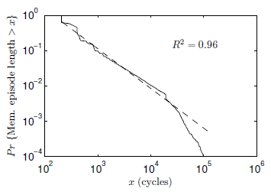
Pareto Distribution of Memory Episode Lengths
Memory episode lengths of
SPEC benchmarks
401.bzip2
Pareto distribution
Pr{Mem. episode > x}
The longer an episode has lasted ➔ The longer it will last further
x (cycles)
Attained service correlates with remaining service
Favoring least-attained-service memory episode
= Favoring memory episode which will end the soonest

Slide 79
Least Attained Service (LAS) Memory Scheduling
Our Approach
Queueing Theory
Prioritize the memory episode with least-remaining-service
Prioritize the job with
shortest-remaining-processing-time
Provably optimal
Remaining service: Correlates with attained service
Attained service: Tracked by per-thread counter
Prioritize the memory episode with least-attained-service
Least-attained-service (LAS) scheduling: Minimize memory episode time
However, LAS does not consider
long-term thread behavior

Slide 80
Long-Term Thread Behavior
Thread 1
Thread 2
Short memory episode
Long memory episode
Short-term
thread behavior
>
priority
Mem.
episode
Long-term
thread behavior
<
priority
Compute episode
Mem.
episode
Compute
episode
Prioritizing Thread 2 is more beneficial:
results in very long stretches of compute episodes

Slide 81
Quantum-Based Attained Service of a Thread
Short-term
thread behavior
Outstanding memory requests
Time
Attained service
Quantum (millions of cycles)
…
Long-term
thread behavior
Outstanding memory requests
Time
Attained service
We divide time into large, fixed-length intervals:
quanta (millions of cycles)

Slide 82
LAS Thread Ranking
During a quantum
Each thread’s attained service (AS) is tracked by MCs
AS_{i} = A thread’s AS during only the i-th quantum
End of a quantum
Each thread’s TotalAS computed as:
TotalAS_{i} = α · TotalAS_{i-1} + (1- α) · AS_{i}
High α ➔ More bias towards history
Threads are ranked, favoring threads with lower TotalAS
Next quantum
Threads are serviced according to their ranking

Slide 83
ATLAS Scheduling Algorithm
ATLAS
Adaptive per-Thread Least Attained Service
Request prioritization order
1. Prevent starvation: Over threshold request
2. Maximize performance: Higher LAS rank
3. Exploit locality: Row-hit request
4. Tie-breaker: Oldest request
How to coordinate MCs to agree upon a consistent ranking?

Slide 84
System Throughput: 24-Core System
System throughput = ∑ Speedup
3.5%
5.9%
8.4%
System throughput
9.8%
17.0%
# of memory controllers
ATLAS consistently provides higher system throughput than all previous scheduling algorithms

Slide 85
System Throughput: 4-MC System
10.8%
8.4%
4.0%
System throughput
3.5%
1.1%
# of cores
# of cores increases ➔ ATLAS performance benefit increases

Slide 86
ATLAS Pros and Cons
Upsides:
  Good at improving performance
  Low complexity
  Coordination among controllers happens infrequently
Downsides:
  Lowest ranked threads get delayed significantly → high unfairness

Slide 87
Emerging Non-Volatile Memory Technologies

Slide 88
Aside: Non-Volatile Memory
If memory were non-volatile…
  there would be no need for refresh…
  we would not lose data on power loss…
Problem: non-volatile has traditionally been much slower than DRAM
  Think hard disks… Even flash memory…
Opportunity: there are some emerging memory technologies that are relatively fast, and non-volatile.
  And, they seem more scalable than DRAM
Question: Can we have emerging technologies as part of main memory?

Slide 89
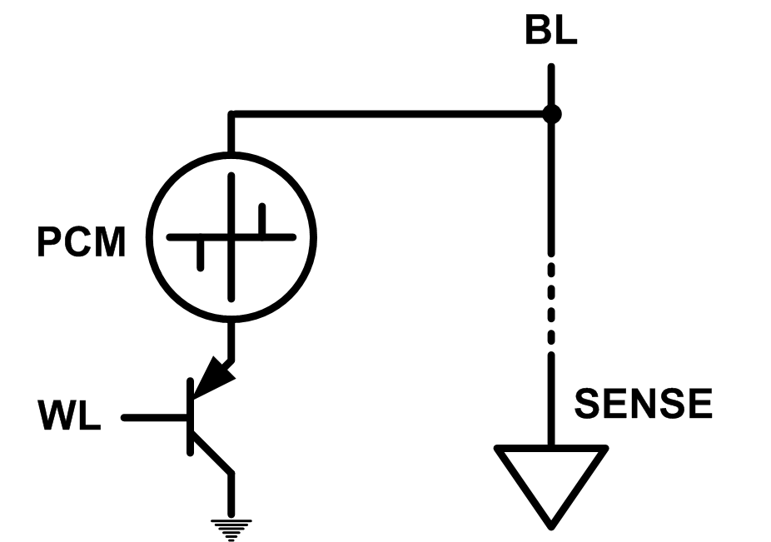
Emerging Memory Technologies
Some emerging resistive memory technologies seem more scalable than DRAM (and they are non-volatile)
Example: Phase Change Memory
  Data stored by changing phase of material
  Data read by detecting material’s resistance
  Expected to scale to 9nm (2022 [ITRS])
  Prototyped at 20nm (Raoux+, IBM JRD 2008)
  Expected to be denser than DRAM: can store multiple bits/cell
But, emerging technologies have (many) shortcomings
  Can they be enabled to replace/augment/surpass DRAM?
Notes:
Even if DRAM continues to scale there could be benefits to examining and enabling these new technologies.

Slide 90
Emerging Resistive Memory Technologies
PCM
  Inject current to change material phase
  Resistance determined by phase
STT-MRAM
  Inject current to change magnet polarity
  Resistance determined by polarity
Memristors
  Inject current to change atomic structure
  Resistance determined by atom distance

Slide 91
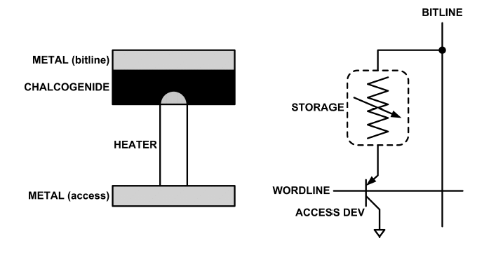
What is Phase Change Memory?
Phase change material (chalcogenide glass) exists in two states:
  Amorphous: Low optical reflexivity and high electrical resistivity
  Crystalline: High optical reflexivity and low electrical resistivity
PCM is resistive memory: High resistance (0), Low resistance (1)
PCM cell can be switched between states reliably and quickly

Slide 92
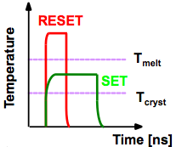
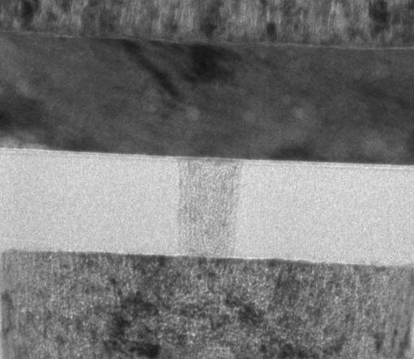
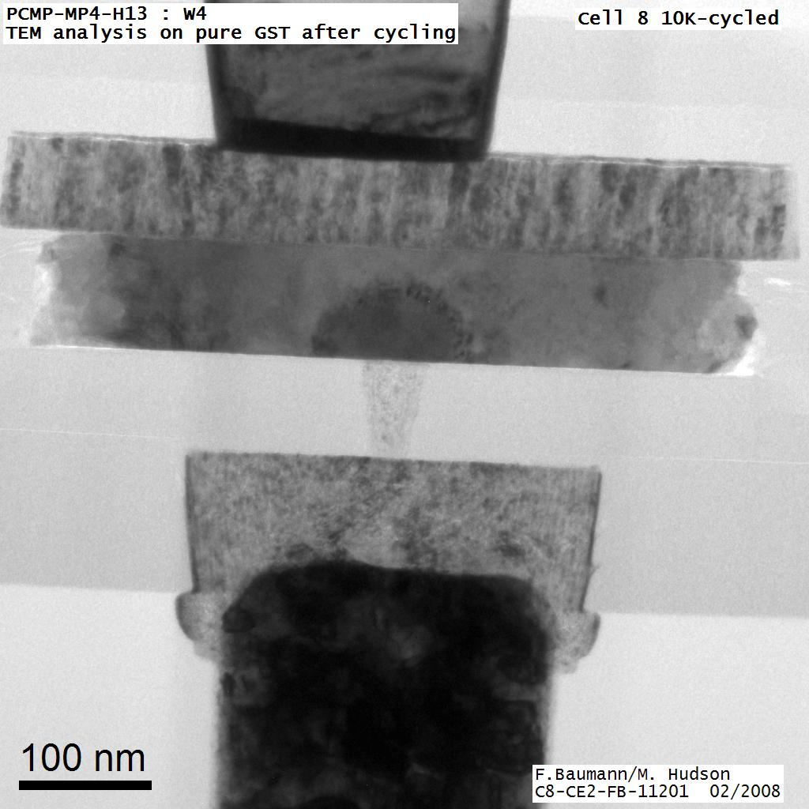
How Does PCM Work?
Write: change phase via current injection
  SET: sustained current to heat cell above Tcryst
  RESET: cell heated above Tmelt and quenched
Read: detect phase via material resistance
  amorphous/crystalline
Large
Current
Small
Current
Memory
Element
SET (cryst)
Low resistance
Access
Device
RESET (amorph)
High resistance
10³-10⁴ Ω
10⁶-10⁷ Ω
Photo Courtesy: Bipin Rajendran, IBM
Slide Courtesy: Moinuddin Qureshi, IBM

Slide 93
Phase Change Memory: Pros and Cons
Pros over DRAM
  Better technology scaling (capacity and cost)
  Non volatility
  Low idle power (no refresh)
Cons
  Higher latencies: ~4-15x DRAM (especially write)
  Higher active energy: ~2-50x DRAM (especially write)
  Lower endurance (a cell dies after ~10⁸ writes)
Challenges in enabling PCM as DRAM replacement/helper:
  Mitigate PCM shortcomings
  Find the right way to place PCM in the system

Slide 94
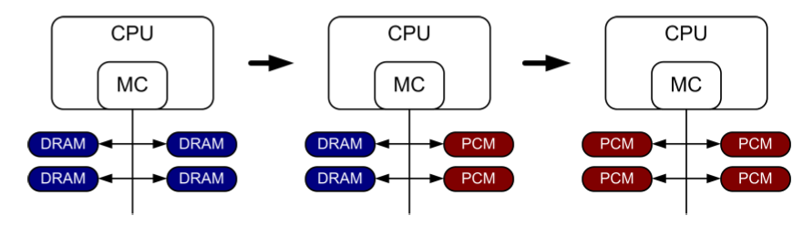
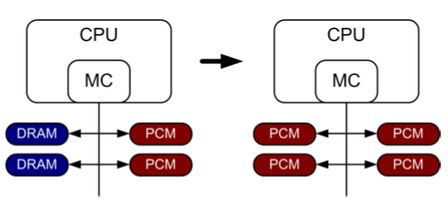
PCM-based Main Memory (I)
How should PCM-based (main) memory be organized?
Hybrid PCM+DRAM [Qureshi+ ISCA’09, Dhiman+ DAC’09]:
  How to partition/migrate data between PCM and DRAM

Slide 95
PCM-based Main Memory (II)
How should PCM-based (main) memory be organized?
Pure PCM main memory [Lee et al., ISCA’09, Top Picks’10]:
  How to redesign entire hierarchy (and cores) to overcome PCM shortcomings

Slide 96
PCM-Based Memory Systems: Research Challenges
Partitioning
  Should DRAM be a cache or main memory, or configurable?
  What fraction? How many controllers?
Data allocation/movement (energy, performance, lifetime)
  Who manages allocation/movement?
  What are good control algorithms?
  How do we prevent degradation of service due to wearout?
Design of cache hierarchy, memory controllers, OS
  Mitigate PCM shortcomings, exploit PCM advantages
Design of PCM/DRAM chips and modules
  Rethink the design of PCM/DRAM with new requirements

Slide 97
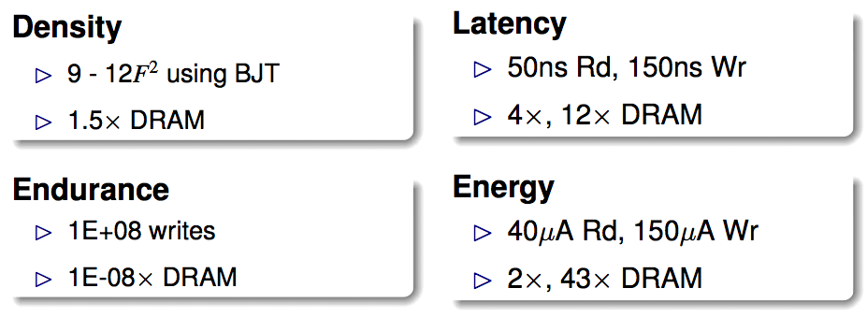
An Initial Study: Replace DRAM with PCM
Lee, Ipek, Mutlu, Burger, “Architecting Phase Change Memory as a Scalable DRAM Alternative,” ISCA 2009.
  Surveyed prototypes from 2003-2008 (e.g. IEDM, VLSI, ISSCC)
  Derived “average” PCM parameters for F=90nm

Slide 98
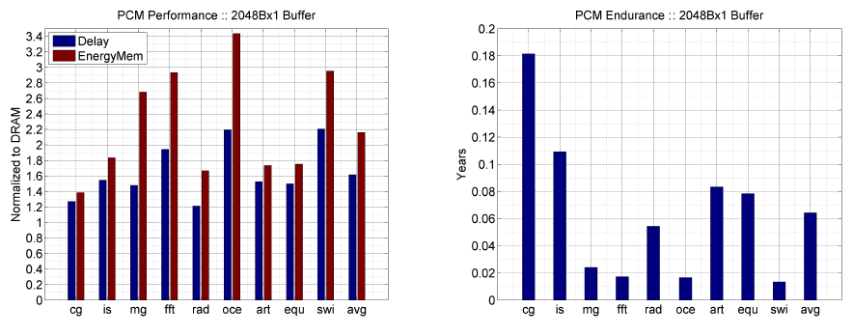
Results: Naïve Replacement of DRAM with PCM
Replace DRAM with PCM in a 4-core, 4MB L2 system
PCM organized the same as DRAM: row buffers, banks, peripherals
1.6x delay, 2.2x energy, 500-hour average lifetime
Lee, Ipek, Mutlu, Burger, “Architecting Phase Change Memory as a Scalable DRAM Alternative,” ISCA 2009.

Slide 99
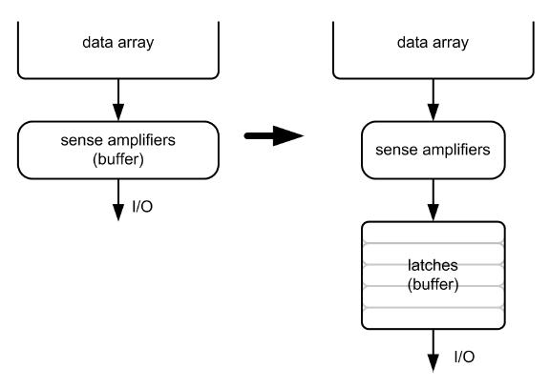
Architecting PCM to Mitigate Shortcomings
Idea 1: Use multiple narrow row buffers in each PCM chip
    → Reduces array reads/writes → better endurance, latency, energy
Idea 2: Write into array at
cache block or word
granularity
→ Reduces unnecessary wear
DRAM
PCM

Slide 100
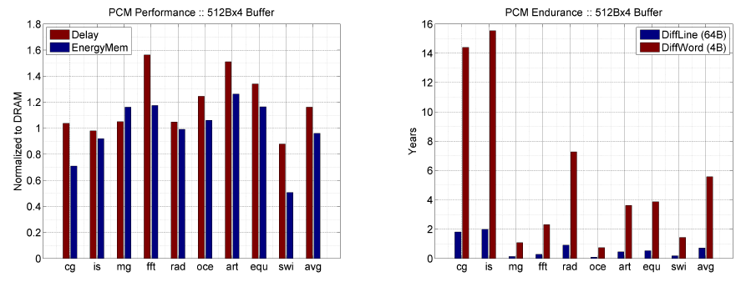
Results: Architected PCM as Main Memory
1.2x delay, 1.0x energy, 5.6-year average lifetime
Scaling improves energy, endurance, density
Caveat 1: Worst-case lifetime is much shorter (no guarantees)
Caveat 2: Intensive applications see large performance and energy hits
Caveat 3: Optimistic PCM parameters?

Slide 101
Hybrid Memory Systems
CPU
Meza+, “Enabling Efficient and Scalable Hybrid Memories,” IEEE Comp. Arch. Letters, 2012.
Yoon, Meza et al., “Row Buffer Locality Aware Caching Policies for Hybrid Memories,” ICCD 2012 Best Paper Award.
DRAMCtrl
PCM Ctrl
DRAM
Phase Change Memory (or Tech. X)
Fast, durable
Small,
leaky, volatile,
high-cost
Large, non-volatile, low-cost
Slow, wears out, high active energy
Hardware/software manage data allocation and movement
to achieve the best of multiple technologies

Slide 102
One Option: DRAM as a Cache for PCM
PCM is main memory; DRAM caches memory rows/blocks
  Benefits: Reduced latency on DRAM cache hit; write filtering
Memory controller hardware manages the DRAM cache
  Benefit: Eliminates system software overhead
Three issues:
  What data should be placed in DRAM versus kept in PCM?
  What is the granularity of data movement?
  How to design a low-cost hardware-managed DRAM cache?
Two idea directions:
  Locality-aware data placement [Yoon+ , ICCD 2012]
  Cheap tag stores and dynamic granularity [Meza+, IEEE CAL 2012]

