Slide 1
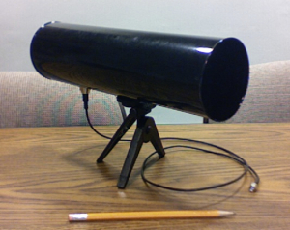
The Directional Attack on Wireless Localization - or - How to Spoof Your Location with a Tin Can
Kevin Bauer, Damon McCoy, Eric Anderson, Markus Breitenbach,
Greg Grudic, Dirk Grunwald, and Douglas Sicker
University of Colorado
IEEE GLOBECOM 2009 December 3, 2009

Slide 2
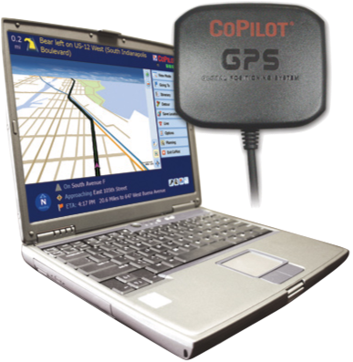
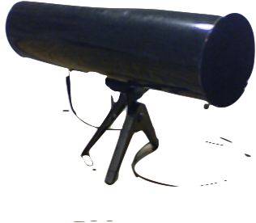
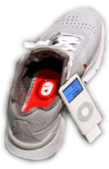
Our Wireless World
Our Wireless World
Our wireless signals can implicitly reveal our locations
Location-aware services: - Rogue device detection
- Location-based access control
Malicious users have incentive to precisely spoof their locations

Slide 3
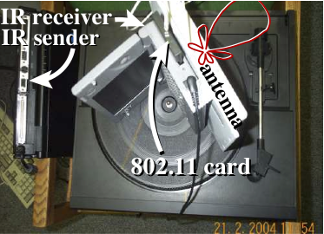
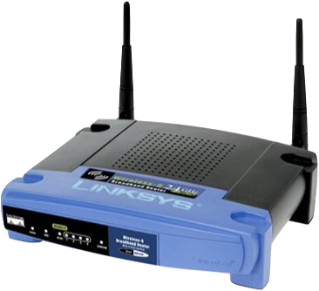
802.11 Localization Background
Many localization techniques have been proposed
Angle of arrival (AoA) [Elnahrawy et al., ‘07; Niculescu and Nath, ’04]
Time of arrival (ToA) [GPS; Chan et al., ‘06]
Time difference of arrival (TDoA) [Priyantha et al., ’00]
Received signal strength (RSS) [Bahl and Padmanabhan, ‘00; Haeberlen et al., ‘04; Tao et al., ’03; Ladd et al., ’02; King et al. ‘06]
Requires non-commodity hardware
Uses existing 802.11 AP infrastructure

Slide 4
RSS Localization is a Supervised Learning Problem
RSSI = -45 dB (x, y) = (4, 6)
RSSI = -80 dB (x, y) = (4, 6)
RSSI = -60 dB (x, y) = (4, 6)
Real location
(x, y) = (4, 6)
RSSI = -65 dB (x, y) = (4, 6)
Part 1: Training phase
1. Deploy 802.11 sensors in a target environment (or use existing APs)
2. Broadcast wireless frames from several positions within the environment labeled with the transmitter’s real location
3. Record the frames’ received signal strength (RSSI) values and locations
Feature vector i: {(x, y), RSSI_{i1}, RSSI_{i2}, RSSI_{i3}, RSSI_{i4}} = {(4, 6), -45, -60, -65, -80}
Notes:
Problem: Need to learn the mapping between signal space and physical space

Slide 5
RSS Localization is a Supervised Learning Problem
RSSI = -85 dB (x, y) = (?, ?)
RSSI = -40 dB (x, y) = (?, ?)
RSSI = -55 dB (x, y) = (?, ?)
(x, y) = (10, 7)
Part 2: Localization phase
Given a wireless frame, we want to determine the transmitter’s location
RSSI = -49 dB (x, y) = (?, ?)
Observed RSSI
feature vector
{-85, -55, -49, -40}
(x, y) = (10, 7)
RSSI training data
Learning algorithm
(k-nearest neighbors, Naïve Bayes, etc.)
Notes:
Problem: Need to learn the mapping between signal space and physical space

Slide 6
Prior Attacks on RSS Localization
RSSI = -80 dB (x, y) = (?, ?)
RSSI = -75 dB (x, y) = (?, ?)
RSSI = -55 dB (x, y) = (?, ?)
Estimated
location
Real
location
RSSI = -65 dB (x, y) = (?, ?)
Localization error
Attack: During localization phase, use transmit power control to
manipulate RSSI values [Tao et al., ‘03; Haeberlen et al., ’04; Chen et al., ’07; Chen et al., ‘09]
Result: Attacker appears at a different location far away
Limitation: Limited (or no) control over the location estimate
Notes:
Amplification effect not really accurately shown, but it should give the intuition
Attack can use this to gain access to location based services, but cannot reliably appear at a position of their choosing

Slide 7
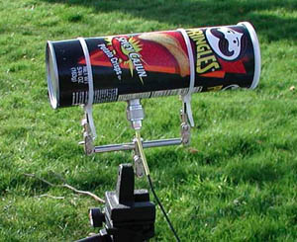
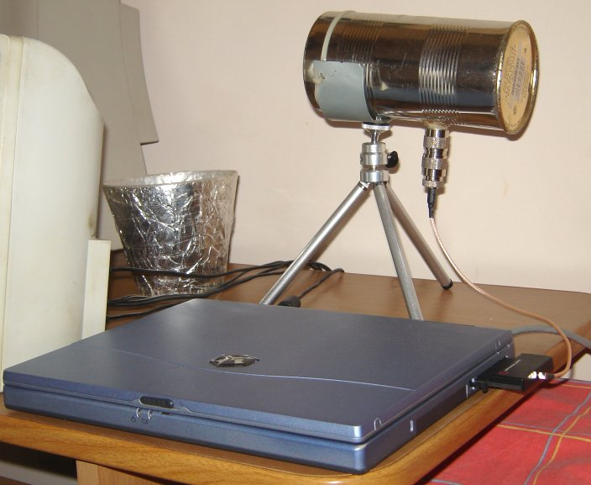
The Directional Attack
Intuition: Give the attacker the ability to influence their estimated location by focusing transmissions using an inexpensive directional antenna, a.k.a. a “cantenna”
Attack goals:
1. Introduce localization errors focused in a direction of the attacker’s choice
2. Introduce more error into predictions than can be achieved with transmit power attacks alone

Slide 8
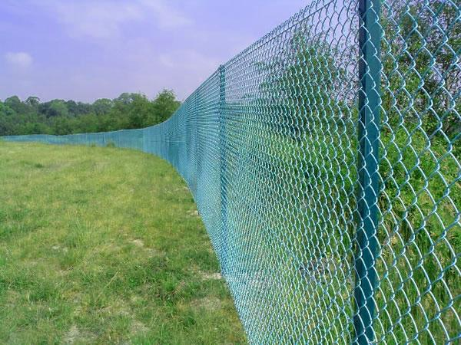
The Directional Attack
RSSI = -50 dB (x, y) = (?, ?)
RSSI = -85 dB (x, y) = (?, ?)
RSSI = -65 dB (x, y) = (?, ?)
Location-based
access control
RSSI = -80 dB (x, y) = (?, ?)
Estimated
location
Real
location
By pointing the directional antenna down long corridors or through open spaces, the attacker can appear in the direction of the antenna’s focus with a high probability
Could allow an attacker to gain access to location-based services or location-based access controlled resources

Slide 9
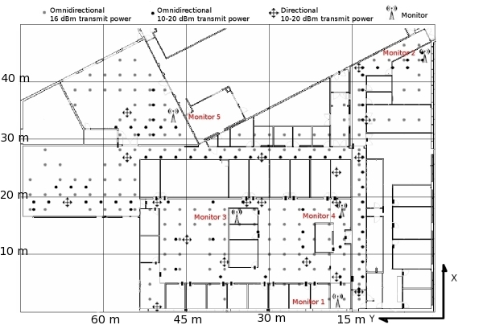
Experimental Setup
We collect three data sets:
Omni-directional training data
tx fixed at 16 dBm
Omni-directional testing data
tx varies between 10-20 dBm
Directional testing data
tx fixed at 16 dBm
tx varies between 10-20 dBm
Office building environment (50 x 75 meters)
5 802.11 monitors, 179 training locations, 70 omni-directional testing locations, and 18 directional testing locations (4 directions)
CRAWDAD: http://crawdad.cs.dartmouth.edu/cu/rssi
Notes:
We collect RSSI data from within a large office building.

Slide 10
Localization Algorithms Evaluated
k-nearest neighbors (“RADAR”) [Bahl and Padmanabhan, ‘00]
Find the k closest training instances using Euclidean distance and average their (x, y) coordinates
k-nearest neighbors-median [Trappe et al., ‘05]
Like above, but minimize the median of the distances in each dimension
Naïve Bayes [Ladd et al., ‘02; Haeberlen et al., ‘04]
Direct application of Bayes’ rule
Naïve Bayes-difference [Tao et al., ‘03]
Use Bayes’ rule with pair-wise differences in average signal strengths between each monitor

Slide 11
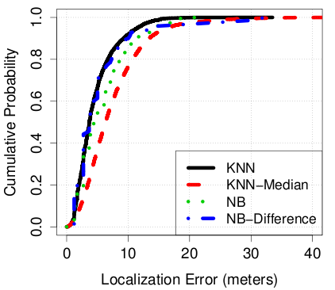
Experimental Evaluation: No Attack
We first establish a baseline
Compute CDF of localization
error without any attack
Median localization errors:
k-nearest neighbors: 3.6 m
k-nearest neighbors-med: 6.7 m
Naïve Bayes: 4.3 m
Naïve Bayes-diff: 3.7 m
Consistent with prior work
Notes:
Same omni-directional antenna used for testing as in the training phase. Same transmit power level used (16dBm). Perfect localization algorithm would be a vertical line along the y-axis.

Slide 12
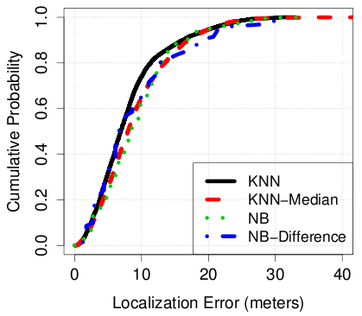
Experimental Evaluation: Transmit Power Control Attacks
We found that reducing transmit
power level produced increased
localization errors
Attacker transmits at 10 dBm
Median localization errors:
k-nearest neighbors: 6.8 m
k-nearest neighbors-med: 7.9 m
Naïve Bayes: 8.1 m
Naïve Bayes-diff: 6.7 m
Consistent with prior work
Notes:
Same omni-directional antenna used for testing as in the training phase. Same transmit power level used (16dBm).

Slide 13
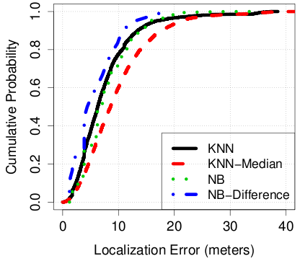
Experimental Evaluation: Directional Attacks
Directional attack, 16 dBm
transmit power level
Attacker points directional antenna
in the four cardinal directions
Median localization errors:
k-nearest neighbors: 6.2 m
k-nearest neighbors-med: 8.5 m
Naïve Bayes: 6.2 m
Naïve Bayes-diff: 4.7 m
Produces similar localization
errors as transmit power attacks
Notes:
Same omni-directional antenna used for testing as in the training phase. Same transmit power level used (16dBm).

Slide 14
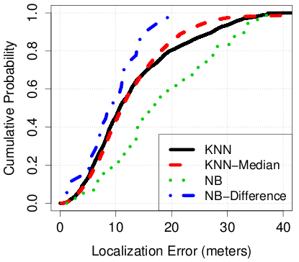
Experimental Evaluation: Transmit Power Control + Directional Attacks
Directional attack, 10 dBm
transmit power level
Attacker points directional antenna
in the four cardinal directions
Median localization errors:
k-nearest neighbors: 10.6 m
k-nearest neighbors-med: 11.0 m
Naïve Bayes: 16.9 m
Naïve Bayes-diff: 9.5 m
Produces greatest localization errors
Notes:
Same omni-directional antenna used for testing as in the training phase. Same transmit power level used (16dBm).
200% improvement over transmit power attacks alone.

Slide 15
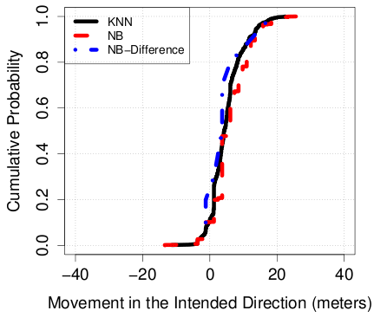
Experimental Evaluation: Movement in the Desired Direction
Directional attack, 16 dBm
transmit power level
Attacker points directional antenna
down long hallways and open
spaces
75% of the time: The attacker
appears in their desired direction
50% of the time: The attacker
appears at least 3 meters in that
direction
“Backscatter”
Notes:
Attacker points antenna in directions where there’s at least 10 meter of open space

Slide 16
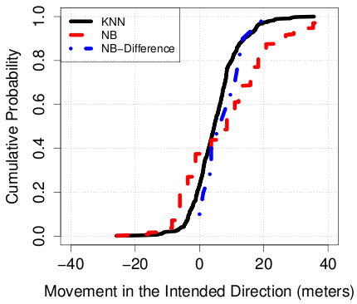
Experimental Evaluation: Movement in the Desired Direction
Directional attack, 10 dBm
transmit power level
Attacker points directional antenna
down long hallways and open
spaces and uses transmit power
control
60-80% of the time: The attacker
appears in their desired direction
50% of the time: The attacker
appears at least 6 meters in that
direction
“Backscatter”
Notes:
Attacker points antenna in directions where there’s at least 10 meter of open space

Slide 17
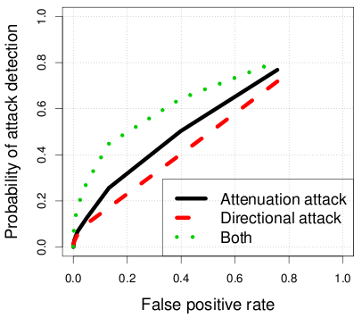
Prior Attack Detection Scheme
Goal: Detect transmit power/directional attackers
Prior detection scheme: Examine distance between potential attack data and the training data [Chen et al., ’07]:
Classify as attack if
ROC curves
Signal space distance generates too many false positives for transmit power, directional, and combination attacks

Slide 18
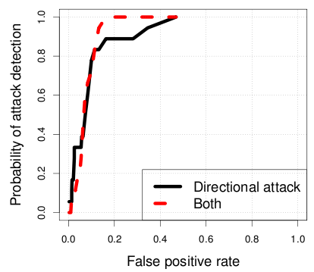
Attack Detection: Minimize Variance
Intuition: Directional attackers who point the antenna in different directions exhibit higher variances in received signal strength values
For each observation window j,
calculate variance in observed RSS
across each of the n monitors:
Classify as attack if
ROC curves
Offers 90+% detection rate with < 10% false positives

Slide 19
Summary and Conclusion
The directional attack is a powerful new way for malicious users to precisely spoof their locations
Through experiments, we show that directional attackers can reliably appear in a direction of their choice 75% of the time
We also show that directional attacks achieve an increase in localization error of up to 200% relative to transmit power attacks
Supported by NSF Awards ITR-0430593 and CRI-0454404

Slide 20
Backup Slides

Slide 21
Detecting General Case of Attack
Apply standard outlier detection and/or data smoothing techniques (future work)
For example, single exponential smoothing
Previous location prediction
Current smoothed location prediction
Previous smoothed location prediction
Smoothing constant, determines how fast
smoothed values change

Slide 22
k-Nearest Neighbors
Find the k closest training examples to a given test instance using a distance metric (i.e., Euclidean distance)
Average the (x, y) coordinates of the k training examples to get the location prediction

Slide 23
k-Nearest Neighbors – Median
Like normal k-nearest neighbors, except we minimize the median of the RSSI squared differences:
Proposed as a more secure variant of k-nearest neighbors

Slide 24
Simple Naïve Bayes Classifier
Estimate the probability of observing a received signal strength vector at a given location
For an unlabeled received signal strength vector, find the location that maximizes the a posteriori probability

Slide 25
Naïve Bayes – Difference
Input the pair-wise differences in observed average received signal strengths between all monitors into Bayes’ rule
Proposed as a more secure variant of Naïve Bayes

Slide 26
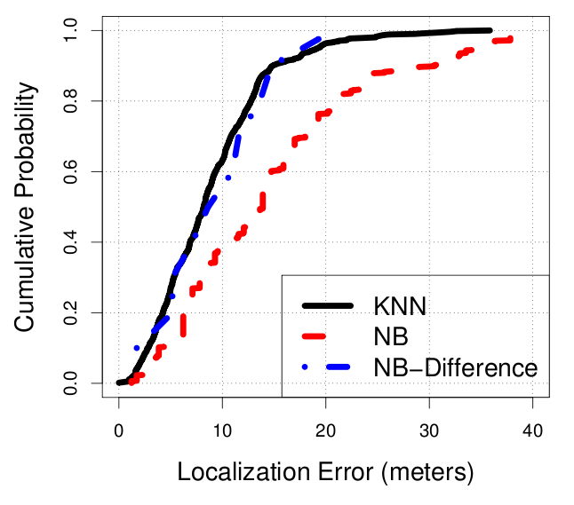
“Smart” vs. “Naïve” Attacker Localization Error
The smart directional attacker achieves similar total localization error
Smart Attacker CDF
Naïve Attacker CDF

Slide 27
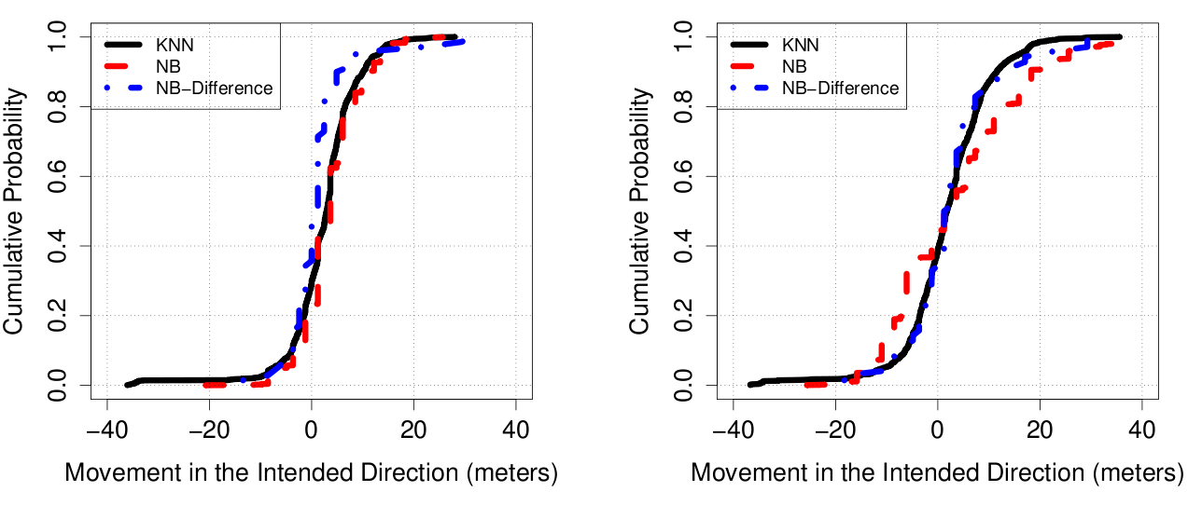
“Naïve” Attacker Teleportation
Naïve directional attacker achieves less movement in their intended direction than the intelligent attacker
With transmit power control

Slide 28
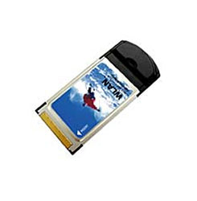
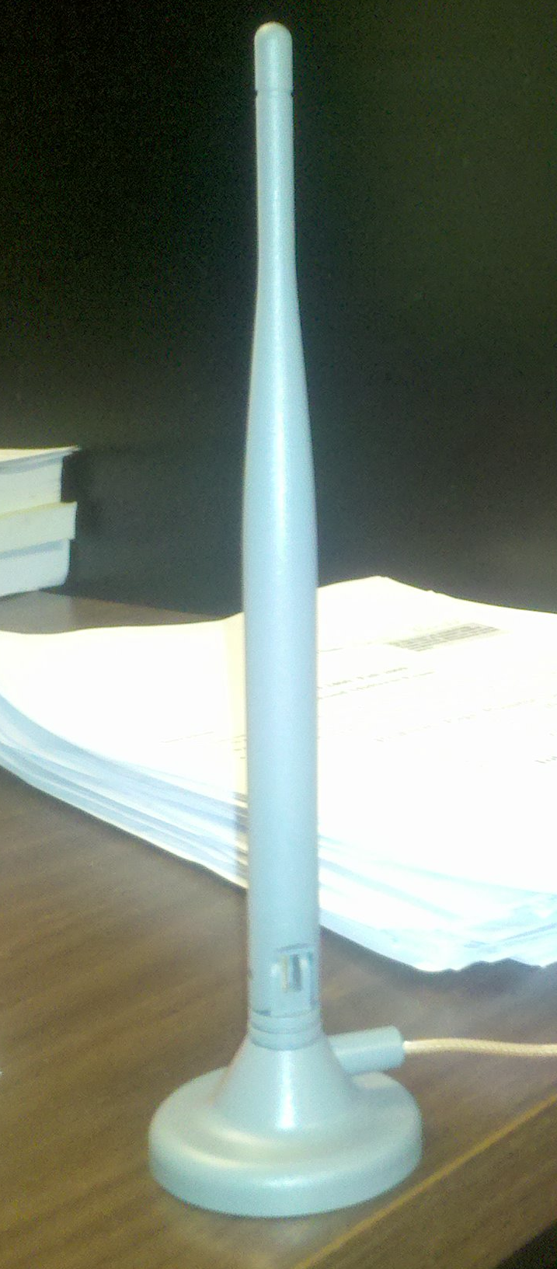
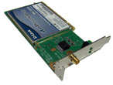
Hardware Used in Experiments
Omni-directional
antenna
802.11 cards
“Super Cantenna”

Slide 29
Please Download Our Data
Available to the public as part of the CRAWDAD wireless data repository:
Raw PCAP traces (w/ prism headers) and processed ASCII files available for download
Additional information is available here:
http://crawdad.cs.dartmouth.edu/cu/rssi
http://tinyurl.com/cu-globecom

