Slide 1
Corflow Online Tutorial
Eric Chung
http://www.ece.cmu.edu/~coram

Slide 2
Prerequisites
Are you familiar with CoRAM concepts?
watch the “Concepts” video
or check out the papers
will NOT cover in detail in this tutorial
Where to get materials
www.ece.cmu.edu/~coram

Slide 3
CoRAM and Corflow
CoRAM is a research concept
standard architecture that separates application from FPGA platform
Corflow is an implementation of CoRAM
prototype SW tool developed at CMU in 2011
emulates CoRAM features on existing FPGAs

Slide 4
How Corflow Works
Control Thread
Application
A
B
FPGA
A
B₀
B₁
Control FSM
DMA Clusters
On-Chip Network
DRAM Interfaces
Mem
Mem
Mem

Slide 5
How Corflow Works
Identify RAMs
Instantiate Clusters
Network-on-Chip Generator
Platform Libraries
Verilog
C-based Control Threads
LLVM C Frontend
BBlocks + Control Actions
Verilog Writer
Standard EDA Tools
Portable Application
CoRAM Control Compiler (CORCC)
Bitstream

Slide 6
Agenda
Prequisites
Corflow Overview
FPGA Design Example: Matrix-Vector Multiply
Online Web Demo
Simulation to Bitstream
Debug and Output
General Design Principles

Slide 7
Matrix-Vector Multiply
A
y
x
=
y = Ax
“A” matrix too large to fit in FPGA memory
Assume “x” and “y” vectors can fit on-chip
All data stored in DRAM contiguously (row-order)

Slide 8
Multiple vectors
A
y₀
y₁
x₀
x₁
=
Assume multiple ‘x’ and ‘y’ vectors
Allows re-use of ‘A’ values

Slide 9
Memory Blocking
Because A matrix too large, we will only bring in sub-blocks of A one at a time
A₀
y₀
y₁
x₀
x₁
A₁
=
A_{N-1}

Slide 10
Simple FPGA Design
Hardware
Single 32-bit multiply-accumulator
3 CoRAMs to store matrix state
Single control thread to manage data transfers
Procedure
Data from matrices ‘A’, ‘x’ are streamed in
Multiply-accumulator computes multiple dot products and stores in ‘y’ buffer
‘y’ buffer written back to DRAM

Slide 11
FPGA Core Logic for MVM
A coram
32
32-bit Integer Multiply-Adder
Y coram
32
X coram
32
MvM FSM
Checksum
Software Control Thread
Start Compute / Get Checksum

Slide 12
Agenda
Prequisites
Corflow Overview
FPGA Design Example: Matrix-Vector Multiply
Online Web Demo
Simulation to Bitstream
Debug and Output
General Design Principles

Slide 13
CoRAM Online Tool
Try out Corflow through the browser
visit www.ece.cmu.edu/~coram
click on “Online Demo”
Disclaimers
tool still in beta, expect bugs
send bug reports/comments/suggestions to coram-dev@ece.cmu.edu

Slide 14
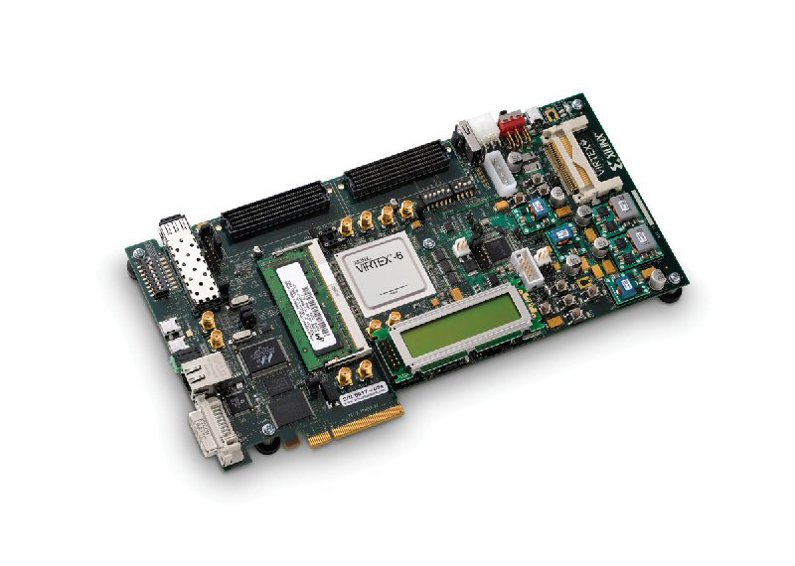
Corflow Output
Xilinx ML605 Board
I/O Devices (e.g., RS232)
I/O Subsystem and Drivers
100MHz
200MHz
100MHz
100MHz
Application Compute Elements
Xilinx Platform Adapter
Arbiter
Cache Bank
128b
Router
Router
Control Unit
Control Unit
Control Unit
Memory Controller
(Xilinx MIG)
Cache Bank
128b
Router
CoRAM
Cluster
x
Control
Router
x
+
+
x
+
512b
Cache Bank
128b
Router
Router
CoRAM
Cluster
Control Unit
Control Unit
Control Unit
Cache Bank
128b
Router
Router
CoRAM
Cluster
x
Control
x
+
+
x
+
DRAM Interfaces
DRAM Caches
NoC and Clusters

Slide 15
Requirements
Windows or Linux Machine
Windows 7, 64-bit
Ubuntu 10.04, 64-bit
4GB of RAM or more
Minimum software
Xilinx ISE 13
Icarus Verilog 0.95
ML605 Board from Xilinx

Slide 16
Simulation
Corflow includes testbench & scripts
corproj-ml605/run_icarus.sh // Icarus Verilog
corproj-ml605/run_vsim.sh // Modelsim
Rename script extension to “.cmd” for Windows
Tested Simulators
Icarus Verilog 0.95 (Linux + Windows)
QuestaSim 6.4f (Windows)
Synopsys VCS D-2009.12 (Linux)

Slide 17
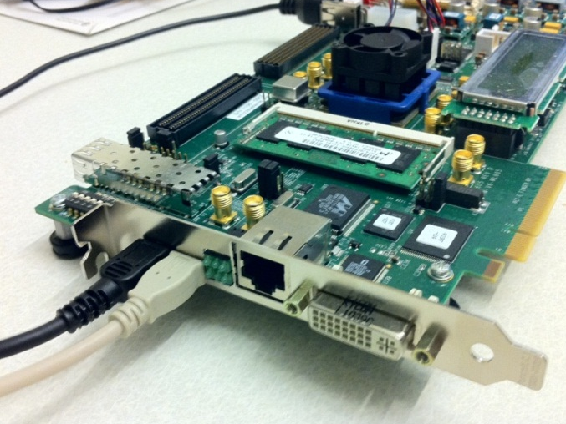
Bitstream Generation
Corflow includes “push-button” ISE scripts
corproj-ml605/par/iseflow.sh // Xilinx ISE scripts
Rename script extension to “.cmd” for Windows
Current platform support
Available: ML605
Pending: BEE3, Altera boards

Slide 18
Debugging Your System
Simulation-only Primitives for Control Threads
cpi_printf()
cpi_dumpram()
cpi_finish()
Board-Level Debugging
RS232 printing from control threads
Chipscope/LEDs for User Logic

Slide 19
Agenda
Prequisites
Corflow Overview
FPGA Design Example: Matrix-Vector Multiply
Online Web Demo
Simulation to Bitstream
Debug and Output
General Design Principles

Slide 20
Control Thread Restrictions
Think of control thread as a state machine
this is NOT software in traditional sense
subset of ANSI-C to describe FSMs
Ground rules
No pointers
No floating point
No structs (might be added in future)
No syscalls or memory management (e.g., alloc)
No recursion

Slide 21
Complete Definitions
Complete List of Control Actions
defined in “cpi.h”
CoRAM Black-Box Verilog Primitives
defined in “coprims.v”
Both available on demo page

Slide 22
ML605 Address Spaces
Control threads can initiate transfers to memory and I/O address spaces
Memory address range (ML605 512MB DRAM)
Lo address: 0x00000000
Hi address: 0x20000000
I/O Devices (RS232)
Lo address: 0x80000000
Hi address: 0x8FFFFFFFF

Slide 23
Current Tool Limitations
Verilog preprocessor needs work
No CoRAMs allowed within “generate” statements
CoRAM object parameters must be fixed constants
Hardware restrictions
Don’t allow CoRAMs configured as non-multiples of 4B wide
No multi-FPGA support (yet)
Web interface limited
limited number of allowed CoRAMs (under 4)
fixed NoC and platform
come talk to us for source code (no limitations)

Slide 24
Thank you!
If you are interested in source code, contact us at coram-dev@ece.cmu.edu
If you need help with the tools or would like to leave feedback: coram-support@ece.cmu.edu

