Slide 1


Algebraic Signal Processing Theory
Markus Püschel
Computer Science
Collaboration with:
José Moura
and
Jelena Kovacevic
Martin Rötteler
Aliaksei Sandryhaila

Slide 2

Theory
Picture: http://www.christianch.ch/images/andere_gefahren.png

Slide 3
Preliminaries
ASP = algebraic signal processing theory
Algebra: theory of groups, rings, and fields
Scope of ASP: linear signal processing
This talk: Focus on the discrete case

Slide 4

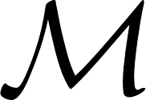

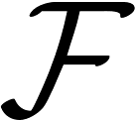
Signal processing concepts | Infinite time | Finite time | Infinite space | Finite space | ASP: Generic case | Other/new models
 | z-transform | Finite z-transform | C-transform | Finite C-transform
Set of signals | Laurent series in z^{-n} | Polynomials in z^{-n} | Series in C_{n} | Polynomials in C_{n}
Set of filters | Laurent series in z^{-n} | Polynomials in z^{-n} | Series in T_{n} | Polynomials in T_{n}
Fourier transform | DTFT | DFT | DSFT | DCTs/DSTs
Convolution Spectrum Frequency response Fast algorithms Filter banks <many others>
Derivation

Slide 5
Signal processing concepts | Infinite time | Finite time | Infinite space | Finite space | ASP: Generic case | Other/new models
 | z-transform | Finite z-transform | C-transform | Finite C-transform
Set of signals | Laurent series in z^{-n} | Polynomials in z^{-n} | Series in C_{n} | Polynomials in C_{n}
Set of filters | Laurent series in z^{-n} | Polynomials in z^{-n} | Series in T_{n} | Polynomials in T_{n}
Fourier transform | DTFT | DFT | DSFT | DCTs/DSTs
Convolution Spectrum Frequency response Fast algorithms Filter banks <many others>
Derivation

Slide 6
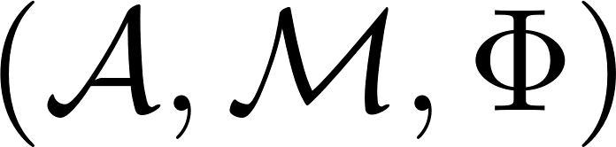
Big Picture
Key concept in ASP:
Examples: Infinite and finite time or space, many others
Signal model defined: all other concepts follow
Signal model:
algebra of filters
signal module
associated “z-transform”
Signal
Filter
“z-transform”
Spectrum
Fourier transform
Frequency response
Fast algorithms
… many other concepts
Signal model

Slide 7
Big Picture
Key concept in ASP:
Examples: Infinite and finite time or space, many others
Signal model defined: all other concepts follow
Signal model:
algebra of filters
signal module
associated “z-transform”
Element of module
Element of algebra
Mapping into module
Irreducible submodules
Decomposition into irred. submodules
Irreducible representation
Stepwise induction
… many other concepts
Signal model

Slide 8
Organization
The algebraic structure underlying linear signal processing
From shift to signal model: Time and space
From infinite to finite signal models
Fast algorithms
Conclusions

Slide 9
Algebraic Structure of Signal and Filter Space
Signal space, available operations:
  α • signal = signal
  signal + signal = signal
Filter space, available operations:
  α • filter = filter
  filter + filter = filter
  filter • filter = filter
Filters operate on signals:
  filter • signal = signal
vector space
α
filter
filter
vector space
filter
ring
filter
filter
signal
filter
signal
Set of filters = an algebra
Set of signals = an -module

Slide 10
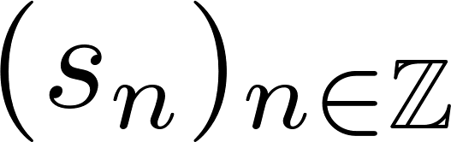
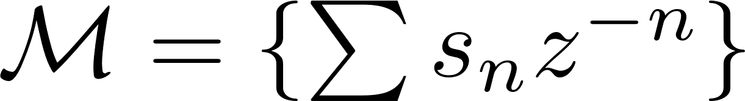
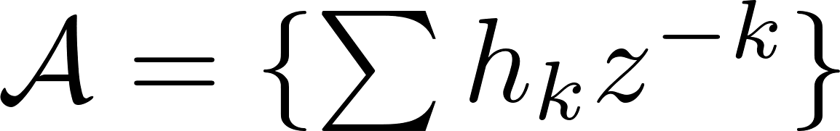

(Algebraic) Signal Model
Signals arise as sequences of numbers
Need to assign module and algebra
Example infinite discrete time:
Signal model (definition):
z-transform:
algebra of filters
an -module of signals
linear mapping

Slide 11
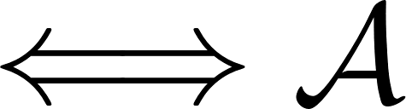
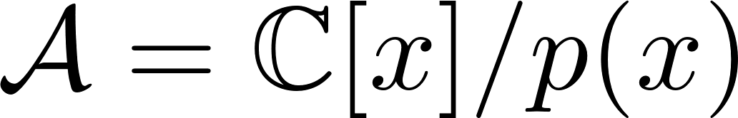
Algebras Occurring in SP: Shift-Invariance
What is the shift?
  A special filter x (=z⁻¹) = an element of
  Filters expressible as polynomials/series in x
Shift-invariance:
Shift-invariant + finite-dimensional (+ one shift only):
shift(s) = generator(s) of
signal model is shift-invariant is commutative
is a polynomial algebra

Slide 12
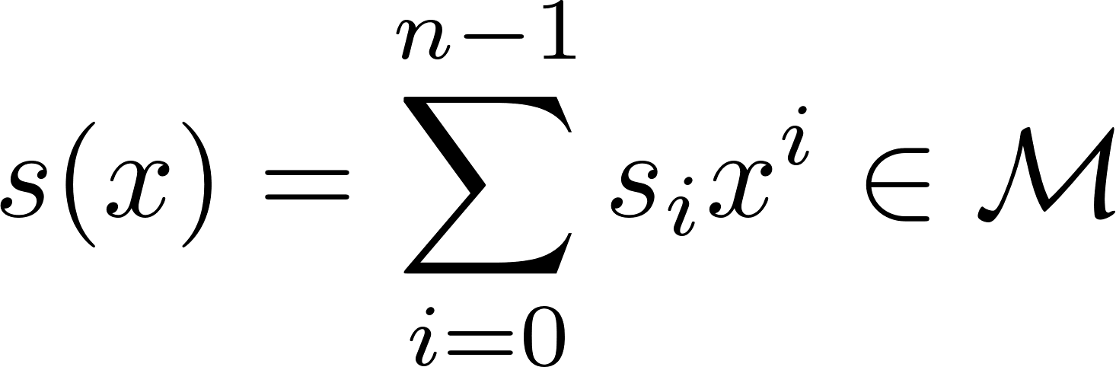
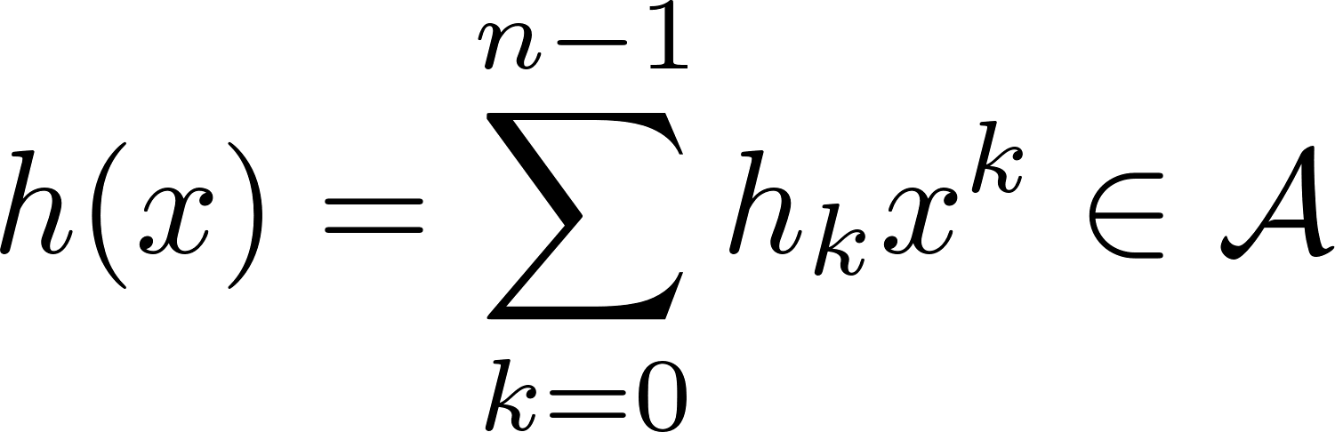
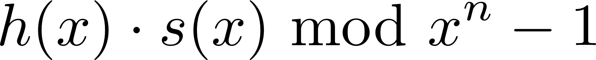
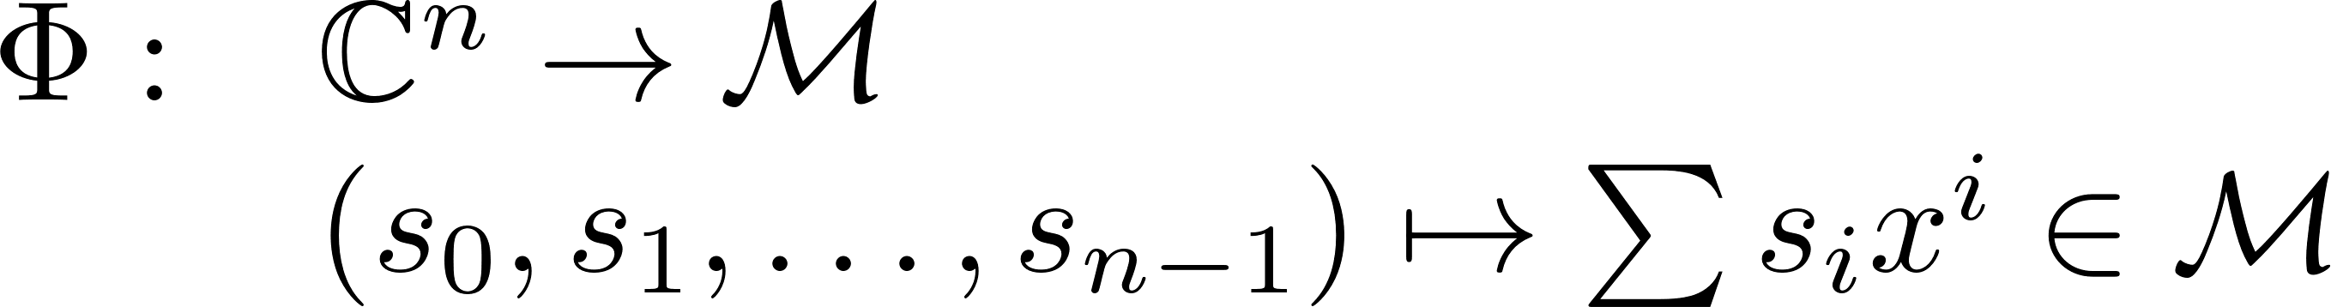
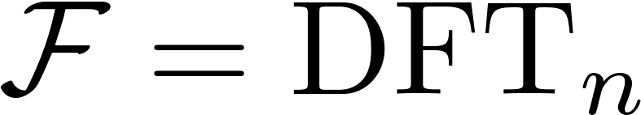
Example: Finite Time Model and DFT
Finite signals:
Signal model:
Spectrum/Fourier transform: Chinese remainder theorem
signals
filters
filtering = cyclic convolution
finite z-transform

Slide 13
Summary so far
Signal model
Shift-invariance: is commutative
  in addition finite makes a polynomial algebra
Infinite and finite time are special cases of signal models
How to go beyond time?
Answer: Derivation of signal model from shift
shift
signal model

Slide 14
Organization
The algebraic structure underlying linear signal processing
From shift to signal model: Time and space
From infinite to finite signal models
Fast algorithms
Conclusions

Slide 15
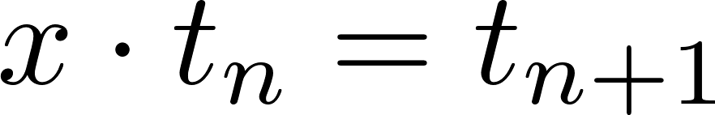
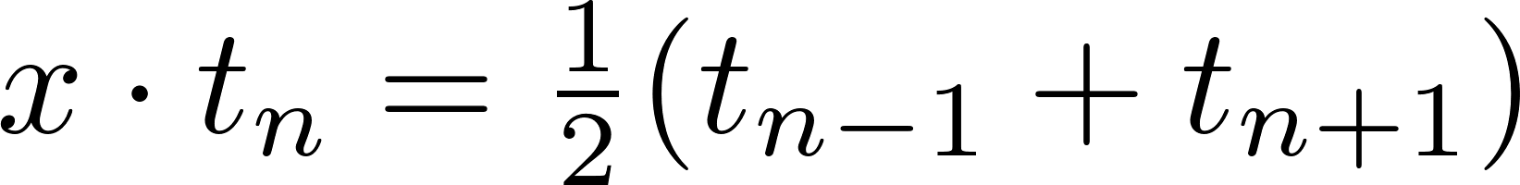


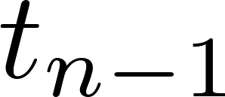
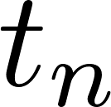
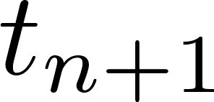
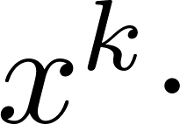
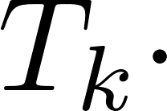
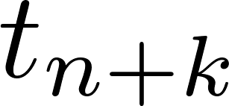
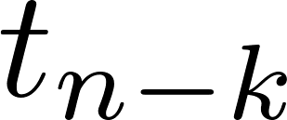
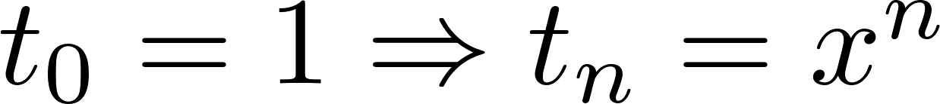

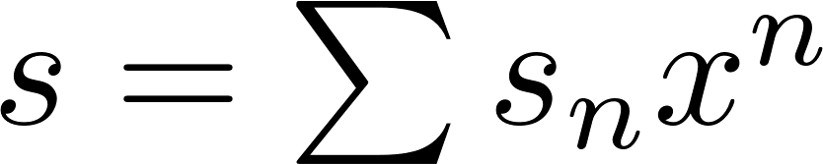
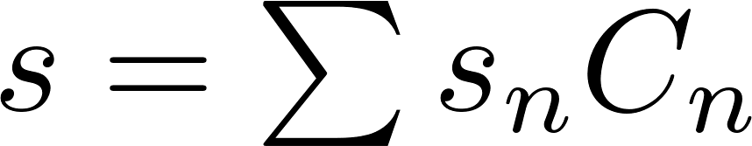
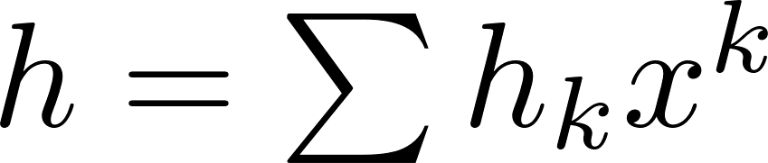
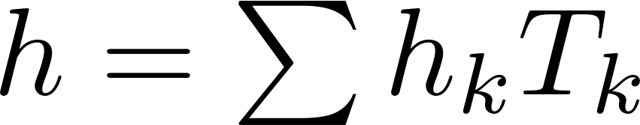
Time
Space
shift
(time) marks
k-fold shift
realization
of (time) marks
signals
filters
Chebyshev polynomials

Slide 16
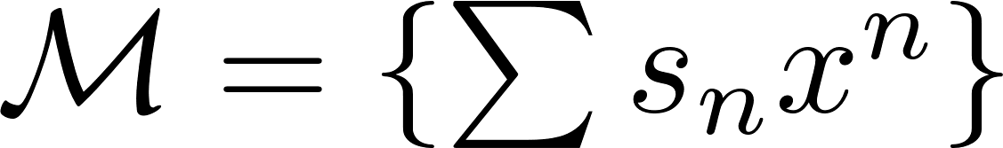
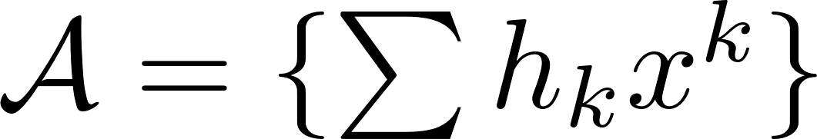
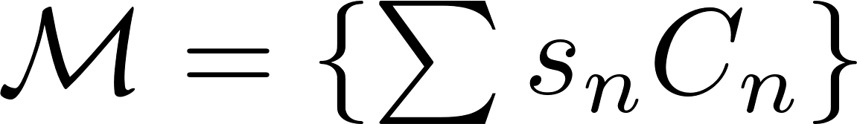
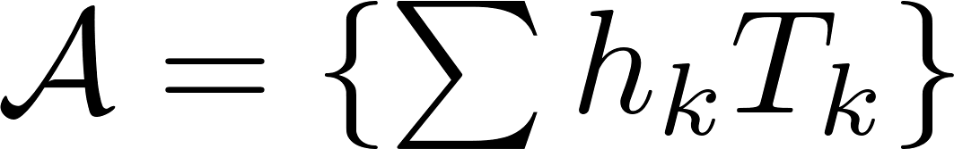
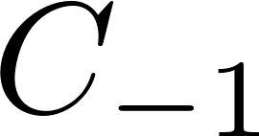



Time and Space (cont’d)
Chebyshev polynomials
Time: done
Space:
Signal model only for right-sided sequences:
z-transform
each a linear combination
of C_{n}, n ≥ 0
linearly independent
C-transform

Slide 17
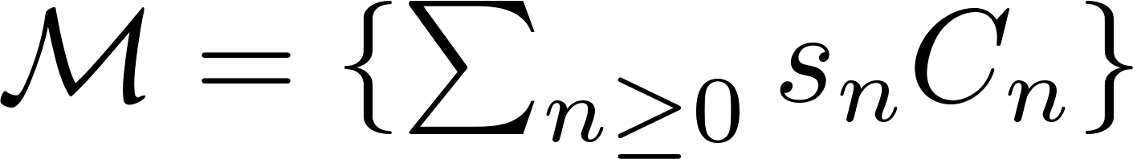
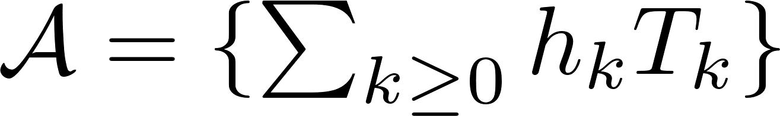


Left Signal Extension
Chebyshev polynomials
Infinite space model:
Simplest signal extension: monomial
Monomial if and only if
left signal extension
depends on choice of C
linearly independent

Slide 18
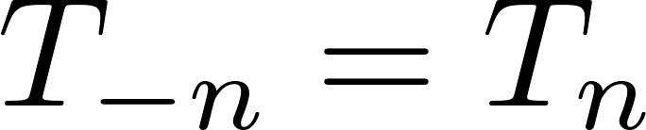
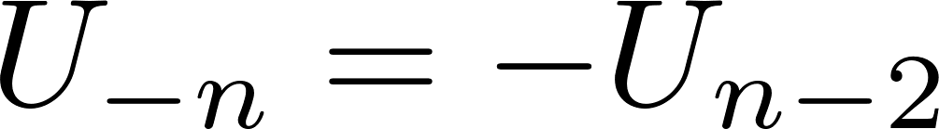
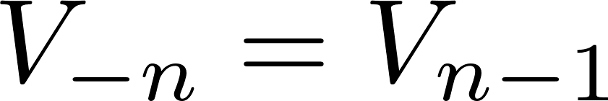
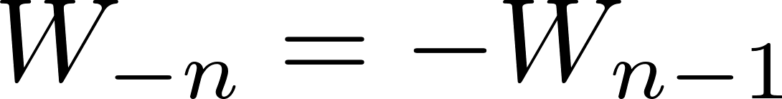
Visualization
Infinite discrete time (z-transform)
Infinite discrete space (C-transform, C = T, U, V, W)
-1
left boundary

Slide 19
Organization
The algebraic structure underlying linear signal processing
From shift to signal model: Time and space
From infinite to finite signal models
Fast algorithms
Conclusions

Slide 20
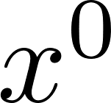
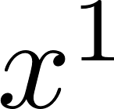
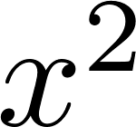
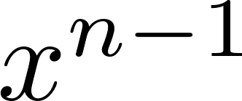




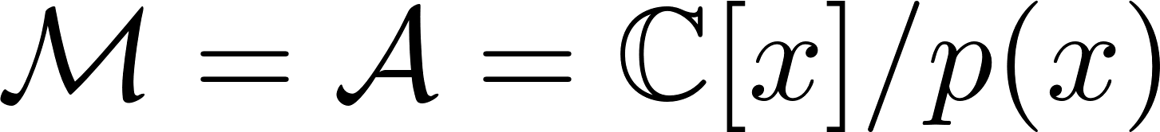
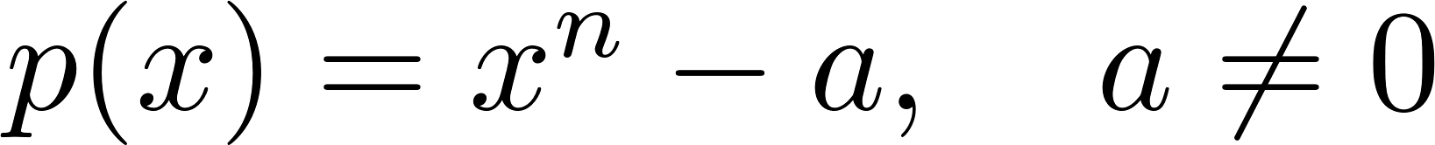

Derivation: Finite Time Model
?
Solution: Right boundary condition
Monomial signal extension:
(a = 1: finite z-transform)
Visualization:

Slide 21
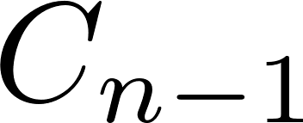
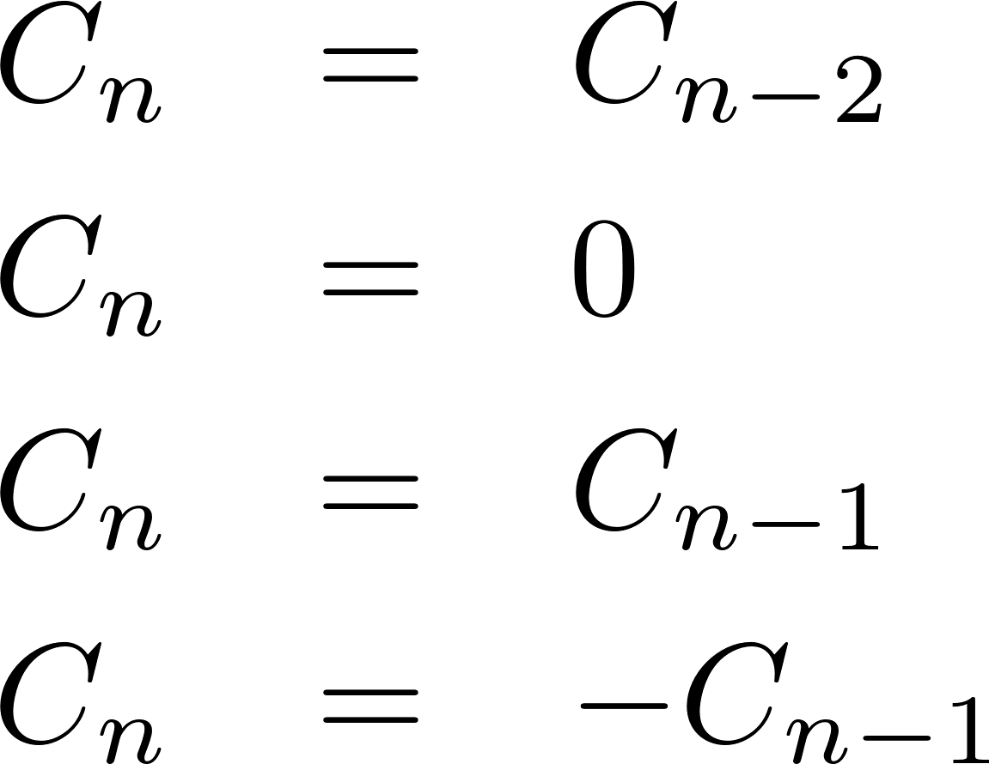

Derivation: Finite Space Model
?
Monomial signal extension: For each
four cases
16 finite space models 16 DCTs/DSTs as Fourier transforms

Slide 22
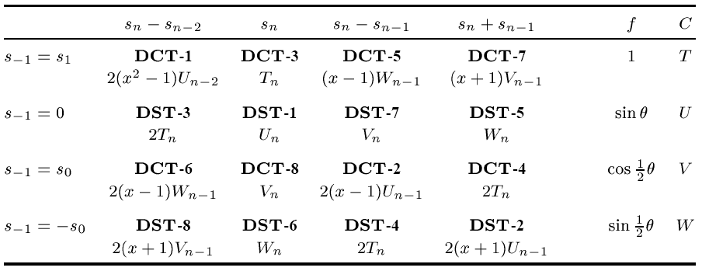
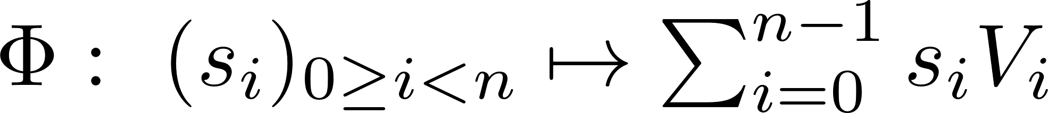

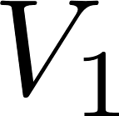
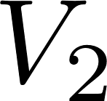

16 Finite Space Models
Example: Signal model for DCT, type 2:
Visualization:

Slide 23
1D Trigonometric Transforms
Signal models for all existing (and some newly introduced) trigonometric transforms (~30)
Explains all existing trigonometric transforms
Gives for each transform associated “z-transform”, filters, etc.
source: “Algebraic Theory of Signal Processing,” Arxiv

Slide 24



More Exotic 1-D Model
Generic next neighbor shift
Space variant but shift invariant
Connects to orthogonal polynomials
Applications?

Slide 25

Top-Down: 1-D Time (Directed) Models
sampling in
frequency
finite or compact
(periodic)
infinite
continuous
sampling
discrete

Slide 26
Top-Down: 1-D Space (Undirected) Models
sampling in
frequency
finite or compact
(xx-symmetric)
infinite
2 choices
4 choices
continuous
sampling
4 choices
16 choices
discrete

Slide 27





Finite Signal Models in Two Dimensions
Visualization (without b.c.) | Signal Model | Fourier Transform
time shifts: x, y
2-D time, separable
space shifts: x, y
16 types
2-D space, separable

Slide 28




time shifts: u, v
time, nonseparable
space shifts: u, v, w
space, nonseparable
space shifts: u, v
space, nonseparable

Slide 29
Organization
The algebraic structure underlying linear signal processing
From shift to signal model: Time and space
From infinite to finite signal models
Fast algorithms
Conclusions

Slide 30





Fast Algorithms: Two Schools
DFT
Cooley-Tukey FFT (general radix)

Slide 31
DCT, type III
Algorithm
derivation
Typical derivation (> 200 such papers)
Reason for existence?
Underlying principle?
All algorithms found?
G. Bi “Fast Algorithms for the Type-III DCT of Composite Sequence Lengths” IEEE Trans. SP 47(7) 1999

Slide 32





Cooley-Tukey FFT Type Algorithms
assume p decomposes
coarse decomposition
complete decomposition
Example:
yields Cooley-Tukey FFT

Slide 33

Application to DCTs/DSTs
Decomposition properties of Chebyshev polynomials

Slide 34








Induced algorithms
DCTs/DSTs
Real DFTs/DHTs
Journal paper shown:
special case k = 3
<many more>

Slide 35
Algebraic Theory of Transform Algorithms
Consolidates the area
Few general principles account for practically all existing algorithms
  General Cooley-Tukey type algorithms
  General prime-factor type algorithms
  General Rader type algorithms
Derivation is greatly simplified
Many (dozens) new algorithms discovered
Applicable to existing and novel linear transforms
  DCTs/DSTs, MDCTs, RDFT, DHT, DQT, DTT, …

Slide 36
Organization
The algebraic structure underlying linear signal processing
From shift to signal model: Time and space
From infinite to finite signal models
Fast algorithms
Conclusions

Slide 37
Markus Püschel and José M. F. Moura
Algebraic Signal Processing Theory: Foundation and 1-D Time
IEEE Transactions on Signal Processing, Vol. 56, No. 8, pp. 3572-3585, 2008
Markus Püschel and José M. F. Moura
Algebraic Signal Processing Theory: 1-D Space
IEEE Transactions on Signal Processing, Vol. 56, No. 8, pp. 3586-3599, 2008
Markus Püschel and José M. F. Moura
Algebraic Signal Processing Theory: Cooley-Tukey Type Algorithms for DCTs and DSTs
IEEE Transactions on Signal Processing, Vol. 56, No. 4, pp. 1502-1521, 2008
Yevgen Voronenko and Markus Püschel
Algebraic Signal Processing Theory: Cooley-Tukey Type Algorithms for Real DFTs
IEEE Transactions on Signal Processing, Vol. 57, No. 1, pp. 205-222, 2009
Jelena Kovacevic and Markus Püschel
Algebraic Signal Processing Theory: Sampling for Infinite and Finite 1-D Space
IEEE Transactions on Signal Processing, Vol. 58, No. 1, pp. 242-257, 2010
Markus Püschel and Martin Rötteler
Algebraic Signal Processing Theory: Cooley-Tukey Type Algorithms on the 2-D Spatial Hexagonal Lattice
Applicable Algebra in Engineering, Communication and Computing, special issue on "The memory of Thomas Beth", Vol. 19, No. 3, pp. 259-292, 2008
Markus Püschel and Martin Rötteler
Algebraic Signal Processing Theory: 2-D Spatial Hexagonal Lattice
IEEE Transactions on Image Processing, Vol. 16, No. 6, pp. 1506-1521, 2007
Aliaksai Sandryhaila, Jelena Kovacevic and Markus Püschel
Algebraic Signal Processing Theory: Cooley-Tukey Type Algorithms for Polynomial Transforms Based on Induction
SIAM Journal on Matrix Analysis and Applications, Vol. 32, No. 2, pp. 364-384, 2011
Aliaksei Sandryhaila, Jelena Kovacevic and Markus Püschel
Algebraic Signal Processing Theory: 1-D Nearest-Neighbor Models
IEEE Transactions on Signal Processing, Vol. 60, No. 5, pp. 2247-2259, 2012

Slide 38

Related Work on Algebraic Methods in SP
Fourier analysis/Fourier transforms on groups G (Beth, Rockmore, Clausen, Maslen, Healy, Terras, …)
  In the algebraic theory the special case
  If G non-commutative, necessarily non-shift-invariant
  Algebraic theory provides associated filters etc., ties to SP concepts
Algebraic methods to derive DFT algorithms (Nicholson, Winograd, Nussbaumer, Auslander, Feig, Burrus, …)
  Recognizes algebra/module for DFT, but only used for deriving algorithms
Origin of this work
  Beth (84), Minkwitz (93), Egner/Püschel (97/98)
  Helpful hints: Steidl (93), Moura/Bruno (98), Strang (99)
Algebraic systems theory (Kalman, Basile/Marro, Wonham/Morse, Willems/Mitter, Fuhrmann, Fliess, …)
  Focuses on infinite discrete time; different type of questions

Slide 39
Algebraic Signal Processing Theory: Conclusions
Signal model: One concept instantiating different SP methods
General (axiomatic) approach to linear SP
Deeper insight into SP
Applications to date:
  New signal models (non-separable 2-D)
  Comprehensive theory of fast algorithms
Signal
Filter
“z-transform”
Spectrum
Fourier transform
Frequency response
…
derivation
Signal model
Shift(s)
SMART project: www.ece.cmu.edu/~smart

Slide 40


Chebyshev Polynomials
back1
back2
back3
Defining three-term recurrence:
Special cases:
Closed forms:
initial:
n ≥ 0

