Slide 1
ARCHITECTURAL TECHNIQUES TO ENHANCE DRAM SCALING
Thesis Defense Yoongu Kim

Slide 2
CPU+CACHE
MAIN MEMORY
STORAGE

Slide 3
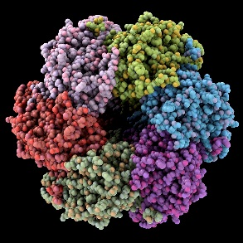
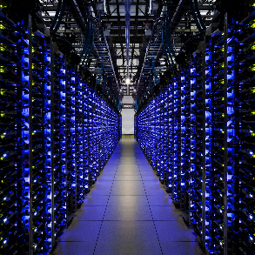
Complex Problems
Large Datasets
High Throughput

Slide 4
DRAM Module
DRAM Chip
‘1’
‘0’
DRAM Cell (Capacitor)

Slide 5
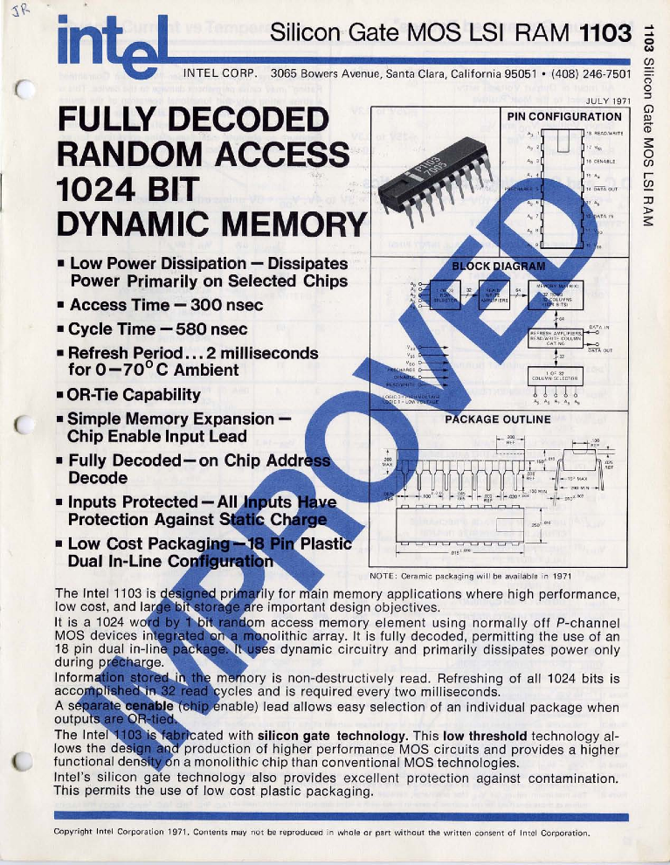
1971
2015
FIRST DRAM CHIP
10³ Cells
10⁹ Cells

Slide 6
10⁹
FUTURE?
CELL SIZE
CELLS/CHIP
10³
1971
2015

Slide 7
DRAM SCALING
TECHNOLOGICAL FEASIBILITY Can we make smaller cells?
ECONOMIC VIABILITY Should we make smaller cells?

Slide 8
1. RELIABILITY TAX 2. PERFORMANCE TAX
SMALLER CELLS
LOWER COST/BIT

Slide 9
1. RELIABILITY
COUPLING BETWEEN NEARBY CELLS
ROW HAMMER (ISCA 2014)
Your DRAM chips are probably broken.

Slide 10
2. PERFORMANCE
ABNORMALLY SLOW OUTLIER CELLS
BANK CONFLICTS (ISCA 2012) Our solution may be adopted by industry.

Slide 11
CO-DESIGN: CPU & DRAM
CPU
DRAM
Memory Management
Arch & Interface
DRAM Controller
Circuits & Devices

Slide 12
THESIS STATEMENT
The degradation in DRAM reliability & performance can be effectively mitigated by making low-overhead, non-intrusive modifications to the DRAM chips and the DRAM controller.

Slide 13
DRAM SCALING
MAIN MEMORY: LARGER, FASTER, RELIABLE, EFFICIENT
ARCHITECTURAL SUPPORT

Slide 14
THREE CONTRIBUTIONS
We show that DRAM scaling is negatively affecting reliability.
We expose a new type of DRAM failure, and propose a cost-effective way to address it.

Slide 15
THREE CONTRIBUTIONS
We propose a high-performance architecture for DRAM that mitigates its growing latency.
We identify bottlenecks in DRAM’s internal design and alleviate them in a cost-effective manner.

Slide 16
THREE CONTRIBUTIONS
We develop a new simulator for facilitating rapid design space exploration of DRAM.
The simulator is the fastest, while also being easy to modify due to its modular design.

Slide 17
OUTLINE
1. RELIABILTY: ROW HAMMER
2. PERF: BANK CONFLICT
3. SIMULATOR: RAMULATOR
4. CONCLUSION

Slide 18
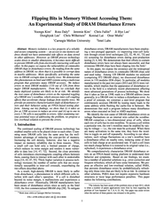
FLIPPING BITS IN MEMORY WITHOUT ACCESSING THEM ISCA 2014
1. ROW HAMMER

Slide 19
DRAM CHIP
WORDLINE
VICTIM
AGGRESSOR
ROW
LOW VOLTAGE
HIGH VOLTAGE
VICTIM
READ DATA FROM HERE, GET ERRORS OVER THERE

Slide 20
GOOGLE’S EXPLOIT
“We learned about rowhammer from Yoongu Kim et al.”
http://googleprojectzero.blogspot.com

Slide 21
GOOGLE’S EXPLOIT
OUR PROOF-OF-CONCEPT
EMPIRICAL ANALYSIS
PROPOSED SOLUTIONS

Slide 22
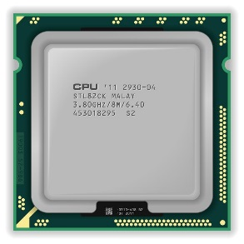
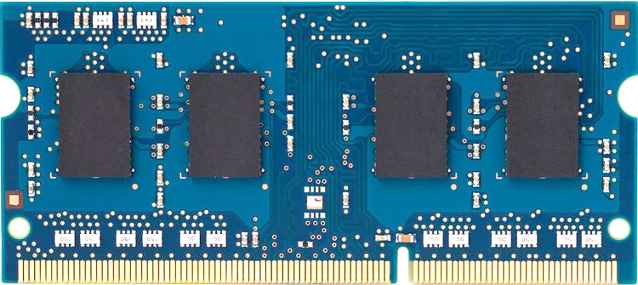
REAL SYSTEM
MANY READS TO SAME ADDRESS
≠
OPEN/CLOSE SAME ROW
x86
DRAM
1. CACHE HITS
2. ROW HITS

Slide 23
x86 CPU
DRAM
LOOP:
mov (X), %reg
mov (Y), %reg
clflush (X)
clflush (Y)
jmp LOOP
X
11111111111
1111
11111111111
11011110010
11111111111
11111111111
10111010111
Y
11111111111
1111
MANY ERRORS!
http://www.github.com/CMU-SAFARI/rowhammer

Slide 24
WHY DO THE ERRORS OCCUR?

Slide 25
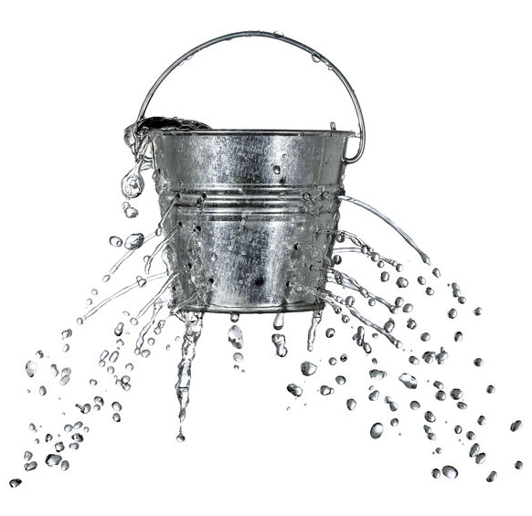
DRAM CELLS ARE LEAKY
‘1’
NORMAL CELL
CHARGE
REFRESH
‘0’
0ms
TIME
64ms

Slide 26
DRAM CELLS ARE LEAKY
AGGRESSOR
‘1’
REFRESH
CHARGE
‘0’
VICTIM CELL
0ms
TIME
64ms

Slide 27
ROOT CAUSE?
COUPLING
Electromagnetic
Tunneling
⇝
⇝
⇝
⇝
⇝
⇝
⇝
⇝
ACCELERATES CHARGE LOSS

Slide 28
AS DRAM SCALES …
CELLS BECOME SMALLER Less tolerance to coupling effects
CELLS BECOME PLACED CLOSER Stronger coupling effects
COUPLING ERRORS MORE LIKELY

Slide 29
ERRORS ARE RECENT Not found in pre-2010 chips
ERRORS ARE WIDESPREAD >80% of chips have errors Up to one error per ~1K cells

Slide 30
PC
FPGA
Test Engine
PCIe
DRAM Ctrl
DRAM

Slide 31
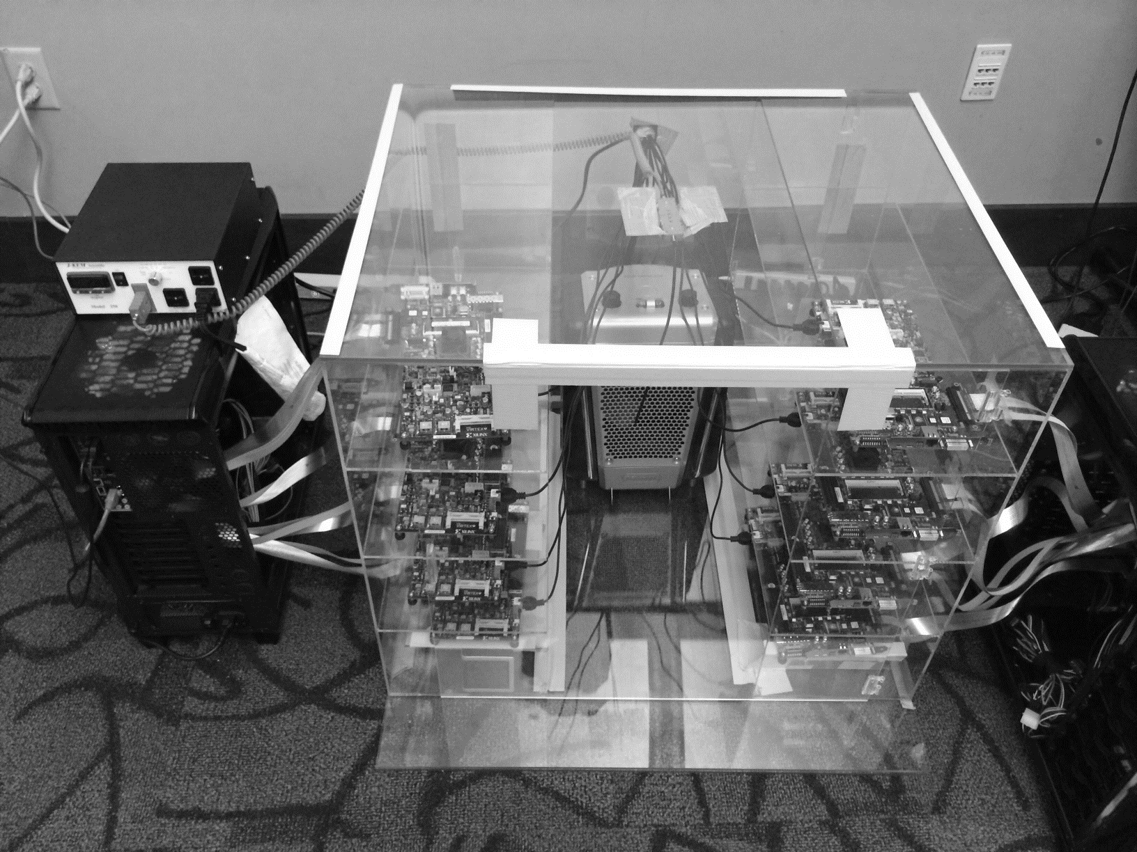
Temperature
Controller
FPGAs
Heater
FPGAs
PC

Slide 32
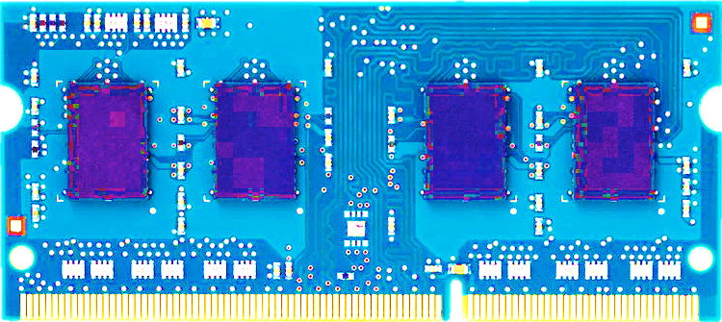
MOST MODULES AT RISK
A VENDOR
86%
(37/43)
B VENDOR
83%
(45/54)
C VENDOR
88%
(28/32)

Slide 33
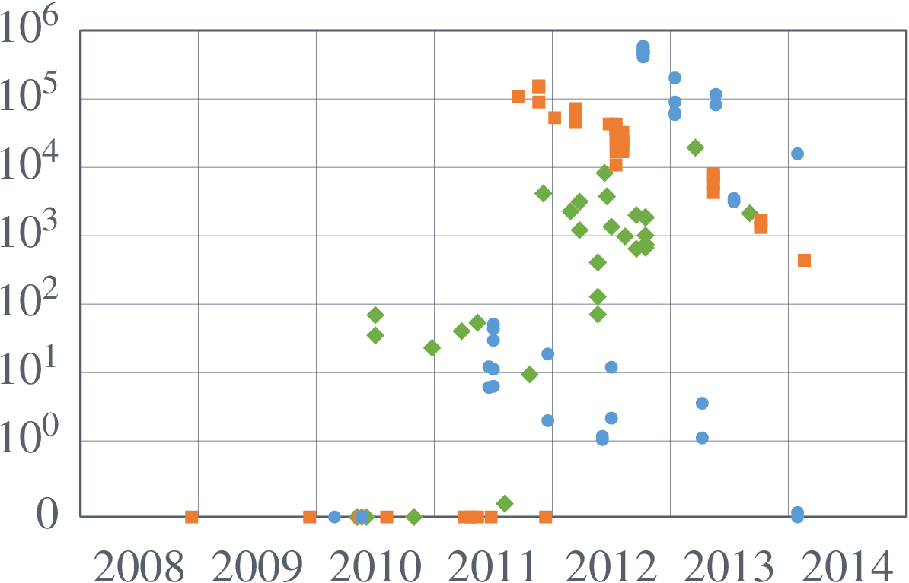
MODULES:  A  B  C
ERRORS PER 10⁹ CELLS
MANUFACTURE DATE

Slide 34
DISTURBING FACTS
AFFECTS ALL VENDORS Not an isolated incident Deeper issue in DRAM scaling
UNADDRESSED FOR YEARS Could impact systems in the field

Slide 35
HOW TO PREVENT COUPLING ERRORS?
Previous Approaches
1. Make Better Chips: Expensive
2. Rigorous Testing: Takes Too Long

Slide 36
ROW
FASTER ACCESS
MORE ERRORS
ROW
MORE ERRORS
ROW
ROW
FREQUENT REFRESH
FEWER ERRORS
ROW
FEWER ERRORS
ROW

Slide 37
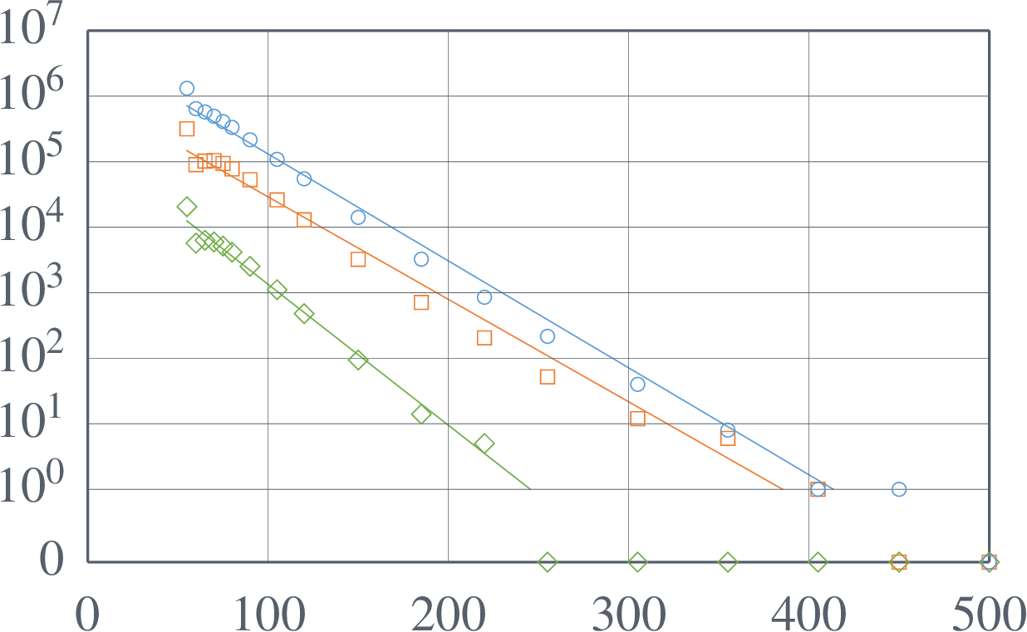
ONE MODULE:  A  B  C
Faster ⟶ Slower
$$\frac{\text{64}\text{ms}}{5\text{00}\text{ns}}=128K$$
TOTAL ERRORS
55ns
500ns
ACCESS INTERVAL (ns)

Slide 38
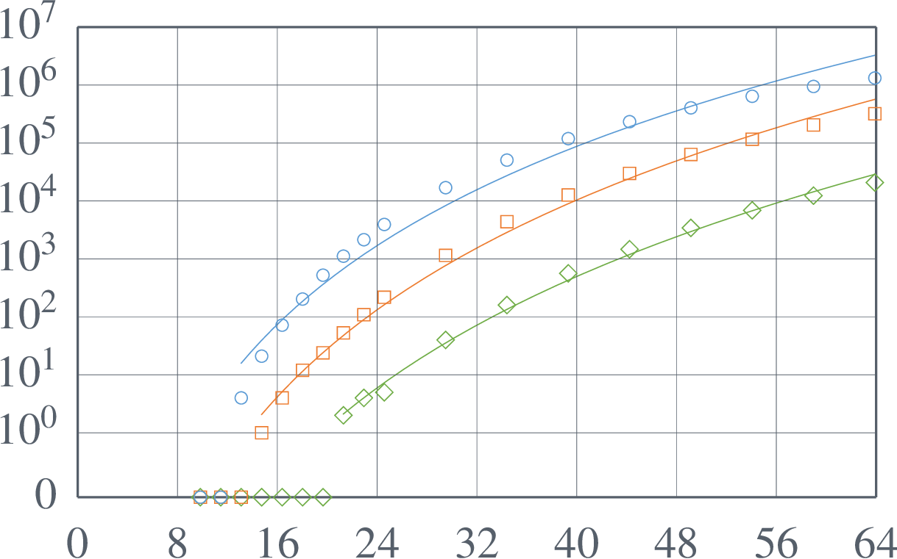
ONE MODULE:  A  B  C
Often ⟵ Seldom
$$\frac{\text{11}\text{ms}}{5\text{5}\text{ns}}=200K$$
TOTAL ERRORS
11ms
64ms
REFRESH INTERVAL (ms)

Slide 39
TWO NAIVE SOLUTIONS
LIMIT ACCESSES TO ROW Access Interval > 500ns
REFRESH ALL ROWS OFTEN Refresh Interval < 11ms
LARGE OVERHEAD: PERF, ENERGY, COMPLEXITY

Slide 40
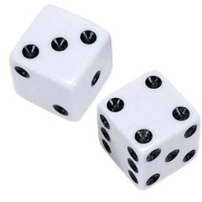
OUR SOLUTION: PARR
Probabilistic Adjacent Row Refresh
After closing any row ...
99.9%
0.1%
Do nothing
Refresh (=Open) adjacent rows

Slide 41
PARR: CHANCE OF ERROR
NO REFRESHES IN N TRIALS Probability: 0.999^{N}
N=128K FOR ERROR (64ms) Probability: 0.999^{128K} = 10^{–56}
STRONG RELIABILITY GUARANTEE

Slide 42
STRONG RELIABILITY
9.4×10^{–14} Errors/Year
LOW PERF OVERHEAD
0.20% Slowdown
NO STORAGE OVERHEAD
0 Bytes

Slide 43
RELATED WORK
Security Exploit (Seaborn@Google 2015)
Industry Analysis (Kang@SK Hynix 2014) “... will be [more] severe as technology shrinks down.”
Targeted Row Refresh (JEDEC 2014)
DRAM Testing (e.g., Van de Goor+ 1999)
Disturbance in Flash & Hard Disk

Slide 44
RECAP: RELIABILITY
CPU
DRAM
Memory Management
Arch & Interface
DRAM Controller
PARR
Circuits & Devices
ROW HAMMER

Slide 45
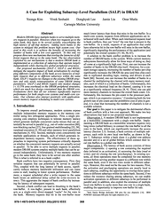
A CASE FOR SUBARRAY PARALLELISM ISCA 2012
2. BANK CONFLICTS

Slide 46
CUTOFF
DRAM
CELLS
FASTEST
SLOWEST
5⨉ “WRITE PENALTY” Source: Samsung & Intel. The Memory Forum 2014

Slide 47
FIGHT LATENCY WITH MORE PARALLELISM

Slide 48
CHIP
BANK
WR
CPU
BANK
WR
DIFFERENT BANKS:
SMALL LATENCY

Slide 49
CHIP
BANK
CPU
BANK
WR
WR
BANK CONFLICT:
LARGE LATENCY

Slide 50
BANK CONFLICT LATENCY
❶
WR
WR
TIME
❷
❸
❶ SERIALIZATION
❷ WRITE PENALTY (GETTING WORSE)
❸ “ROW-BUFFER” THRASHING

Slide 51
BANK
CONNECTS ROWS TO ROW-BUFFER
BITLINES
ROW
MEMORY REQUEST
ROW
MEMORY REQUEST
ROW
MEMORY REQUEST
ROW
MEMORY REQUEST
BUFFER
CACHES A COPY OF OPENED ROW
DATA

Slide 52
HOW TO PARALLELIZE BANK CONFLICTS?
Previous Approaches
1. Have More Banks: Expensive
2. Bank Interleaving: Non-Solution

Slide 53
BANK (LOGICAL VIEW)
ROW
MANY ROWS (~100K)
ROW
ROW
ROW
BUFFER
JUST ONE
CANNOT DRIVE LONG BITLINES

Slide 54
BANK (PHYSICAL VIEW)
SUB ARRAY
ROW
FEWER ROWS (~1K)
DECDR
ROW
BUFFER
DECODER
ROW
DECDR
ROW
LOCAL (SUBARRAY)
BUFFER
GLOBAL (BANK)
BUFFER

Slide 55
SHARING = ROOT OF EVIL
SHARED: 1. GLOBAL DEC. 2. GLOBAL BUF.
NO SUBARRAY
PARALLELISM
SUB ARRAY
ROW
DECDR
ROW
BUFFER
DECODER
ROW
DECDR
ROW
BUFFER
BUFFER

Slide 56
PROBLEM #1: DECODER
ROW1
ROW1 OPENED
ROW1 CLOSED
DECDR
ROW2
BUFFER
ADDR1
BOTH
ADDR3
DECODER
ROW3
ROW3 OPENED
DECDR
ROW4
BUFFER

Slide 57
OUR SOLUTION
ROW1
ALSO OPEN
DECDR
ROW2
BUFFER
ADDR3
BOTH
ADDR1
REG.
DECODER
ROW3
STILL OPEN
DECDR
ROW4
BUFFER
STORES ADDRESS FOR EACH SUBARRAY

Slide 58
PROBLEM #2: BUFFER
ROW1
DECDR
ROW2
BUFFER
DECODER
ROW3
BOTH
DECDR
ROW4
BUFFER
BUFFER

Slide 59
OUR SOLUTION
ROW1
DECDR
ROW2
BUFFER
SELECTS SUBARRAY FOR ACCESS
DECODER
REG.
ROW3
BOTH
DECDR
ROW4
BUFFER
BUFFER

Slide 60
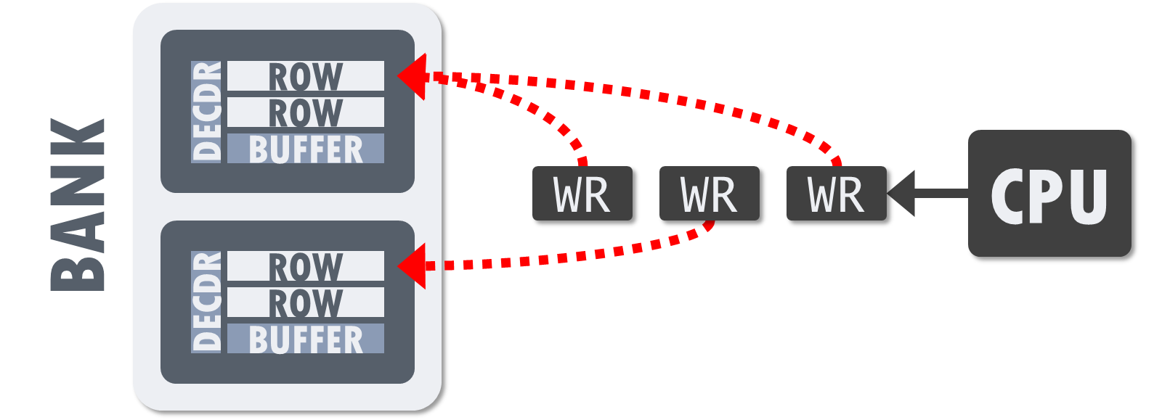
❶
❶
SERIAL SUBARRAYS
WR
❷
❸
WR
❷
❸
WR
TIME
PARALLEL SUBARRAYS
WR
WR
WR
TIME

Slide 61
NONPARALLEL
PARALLEL
+17%
Simulation: Out-of-Order CPU + DDR3-1066
Benchmarks: SPEC/TPC/STREAM/RANDOM

Slide 62
SUBARRAYS
vs.
BANKS
PARALLELISM
8x
8x
SPEEDUP
+17%
+20%
CHIP-SIZE
+0.2%
+36%
Estimated using DRAM area model from Rambus

Slide 63
RELATED WORK
Module Partitioning (e.g., Zheng+ 2008) Divide module into small, independent subsets Narrower data-bus → Higher unloaded latency
Hierarchical Bank (Yamauchi+ 1997) Parallelizes accesses to different subarrays Does not utilize multiple local row-buffers
Cached DRAM (e.g., Hidaka+ 1990)
Low-Latency DRAM (e.g., Sato+ 1998)

Slide 64
RECAP: PERFORMANCE
CPU
DRAM
Memory Management
Arch & Interface
PARALLEL SUBARRAYS
DRAM Controller
SUBARRAY AWARE
Circuits & Devices
SLOW OUTLIERS

Slide 65
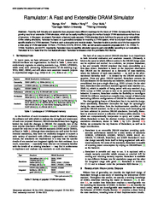
RAMULATOR: A FAST AND EXTENSIBLE DRAM SIMULATOR IEEE CAL 2015
3. RAMULATOR

Slide 66
IDEA
IDEA
IDEA
NEW IDEAS FOR BETTER DRAM ...
MUST BE VETTED BY SIMULATION
DRAM
SIMULATOR

Slide 67
PREVIOUS SIMULATORS
PRO: HIGH FIDELITY
Cycle-accurate DRAM models
CON: LOW FLEXIBILITY
Hardcoded for DDR3/DDR4 DRAM
Difficult to extend to others E.g., LPDDRx, WIOx, GDDRx, RLDRAMx, HBM, HMC

Slide 68
OUR RAMULATOR
BUILT FOR EXTENSIBILITY
Easy to incorporate new ideas
HIGH SIMULATION SPEED
2.5x faster than the next fastest
PORTABLE: SIMPLE C⁺⁺ API

Slide 69
RAMULATOR’S APPROACH
CHANNEL
CHANNEL
DRAM COMMAND & ADDRESS
(INPUTS)
RANK
RANK
Bank
Bank
Bank
Bank
Bank
Bank
BANK
BANK
DRAM SYSTEM (STATE MACHINES)

Slide 70
A
B
CHANNEL
STATE MACHINES ARE DEFINED BY:
STATES
EDGES
D
C
RANK
P
Q
X
BANK
Z
Y
RAMULATOR: RECONFIGURABLE STATE MACHINE
?
TEMPLATE
?
?
?

Slide 71
COMMAND & ADDRESS
Hierarchy
States
Edges
GDDR5
TEMPLATE
Hierarchy
States
Edges
DDR4
TEMPLATE
TEMPLATE
TEMPLATE
TEMPLATE
TEMPLATE
Hierarchy
States
Edges
HBM
TREE OF STATE MACHINES

Slide 72
DRAM TRACE
CPU FRONTEND
FULL SYSTEM
RAMULATOR
PERFORMANCE
POWER (for some)
DRAM CONTROLLER
WIO2
LPDDR4
GDDR5
TMP
DDR4
TMP
TMP
TMP
HBM
TMP
TMP
http://www.github.com/CMU-SAFARI/ramulator

Slide 73
 | Supported DRAM Specifications | Simulation Speed (DDR3)
Ramulator | DDR3/4, LPDDR3/4, GDDR5, HBM, WIO1/2, Subarray Parallelism, etc. | 2.70x
DRAMSim2 (Rosenfeld et al.) | DDR2/3 | 1x
USIMM (Chatterjee et al.) | DDR3 | 1.08x
DrSim (Jeong et al.) | DDR2/3, LPDDR2 | 0.11x
NVMain (Poremba and Xie) | DDR3, LPDDR3/4 | 0.30x

Slide 74
4. CONCLUSION

Slide 75
SUMMARY
Traditional DRAM Scaling at Risk
Architectural Techniques for Coping with Degrading DRAM
Regain Reliability & Performance

Slide 76
CONTRIBUTIONS
We show that DRAM scaling is negatively affecting reliability.
We propose a high-performance, cost-effective DRAM architecture.
We develop a new simulator for facilitating DRAM research.

Slide 77
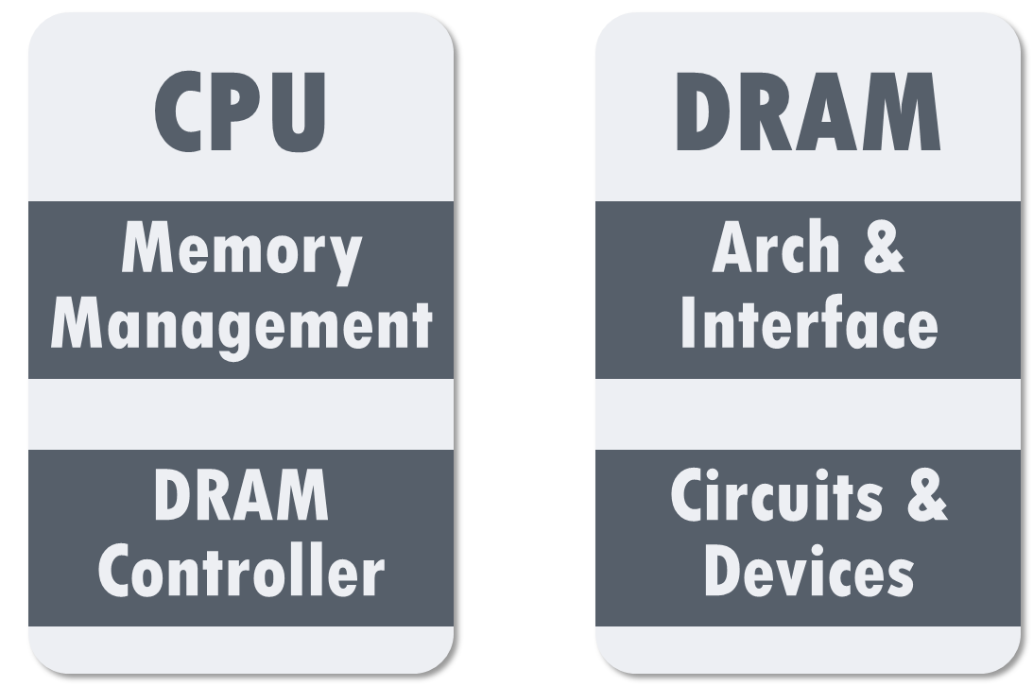
RESEARCH
❷
❶
❷EFFICIENCY
Bank Conflicts Kim et al., ISCA ’12
In-DRAM Page Copy Seshadri et al., MICRO ’13
Tiered Latency Lee et al., HPCA ’13
Fine-Grained Refreshes Chang et al., HPCA ’14
❶RELIABILITY
Row Hammer Kim et al., ISCA ’14
Retention Failures Liu et al., ISCA ’13 Khan et al., SIGMETRICS ’14
Speed vs. Reliability Lee et al., HPCA ’15

Slide 78
RESEARCH
❹
❷
❺
❸
❶
❹COMPRESSION
Simple & Effective Pekhimenko et al., MICRO ’13
❸SCHEDULING
High Throughput Kim et al., HPCA ’10
Quality of Service Kim et al., MICRO ’10 Kim et al., IEEE Micro Top Picks ’11 Subramanian et al., HPCA ’13
❺SIMULATION
Fast & Extensible Kim et al., IEEE CAL ’15

Slide 79
OUTDATED ASSUMPTIONS
DRAM SCALING WILL TAKE CARE OF MAIN MEMORY
LATEST AND CHEAPEST DRAM IS THE GREATEST

Slide 80
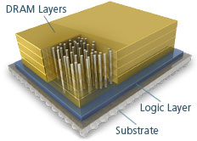
NEW TECHNOLOGIES
NONVOLATILE
MEMORY (NVM)
Image: Loke et al., Science 2012
3-DIMENSIONAL DIE STACKING
Image: Micron Technology, 2015

Slide 81
TREND: HETEROGENEITY
CACHE:
SRAM
eDRAM
3D DRAM
MAIN MEMORY:
DRAM
NVM
STORAGE:
FLASH/HDD

Slide 82
TREND: SPECIALIZATION
BANDWIDTH
GRAPHICS
POWER
MOBILE
LATENCY
NETWORKS
COST
PC/SERVER

Slide 83
HOW TO REFORMULATE THE MEMORY HIERARCHY?

Slide 84
NEW SOFTWARE ABSTRACTIONS Primitives for managing heterogeneity
NEW HARDWARE TRADE-OFFS Defining appropriate roles for each tier
RICH MEMORY CAPABILITIES Memory as more than a “bag of bits”

Slide 85
ARCHITECTURAL TECHNIQUES TO ENHANCE DRAM SCALING
Thesis Defense Yoongu Kim

