Slide 1






Improving 3D NAND Flash Memory Device Reliability by
Exploiting Self-Recovery and Temperature Awareness
HeatWatch
Yixin Luo Saugata Ghose Yu Cai Erich F. Haratsch Onur Mutlu
Notes:
Thank you for the introduction. Today, I will present our work about …

Slide 2



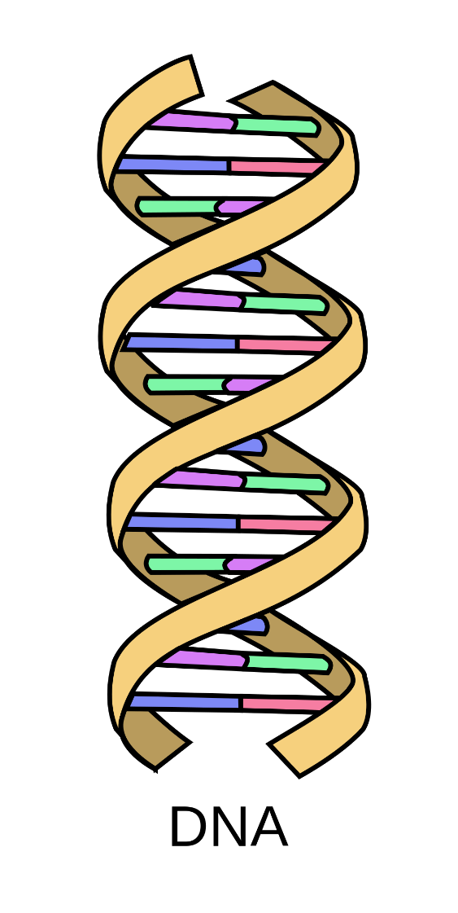
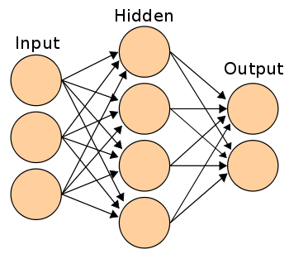

Storage Technology Drivers - 2018
3D NAND Flash Memory
Store large amounts of data reliably
for months to years
Stacked layers
Notes:
Many applications today requires storing large amount of data reliably in the storage for a really long time, which can be up to several years.
(click) In order to keep up with this need, manufactures have introduced 3D NAND technology that stacks multiple flash cell arrays vertically on top of each other.

Slide 3
Executive Summary
3D NAND susceptible to early retention errors
  Charge leaks out of flash cell quickly after programming
  Two unreported factors: self-recovery and temperature
We study self-recovery and temperature effects
We develop a new technique to improve flash reliability
  Experimental characterization of real 3D NAND chips
  Unified Self-Recovery and Temperature (URT) Model
    Predicts impact of retention loss, wearout, self-recovery, temperature on flash cell voltage
    Low prediction error rate: 4.9%
  HeatWatch
    Uses URT model to find optimal read voltages for 3D NAND flash
    Improves flash lifetime by 3.85x
Notes:
However, the problem with 3D NAND flash memory is that it is susceptible to retention errors, where charge leaks out of flash cell over time.
Also, we find there are two unknown factors of retention errors that are understudied in prior work. They are self-recovery and temperature.
In this work, we develop a new understanding of these two factors through experimental characterization of real 3D NAND chips.
Using this characterization, we develop a new unified model that captures retention, wearout, self-recovery and temperature.
We validate that this new model is highly accurate, with an error rate of only 4.9%
We show that this new understanding is beneficial because it enables new reliability techniques.
For example, we develop Heatwatch which uses our model to adapt 3D NAND flash memory to these effects.
This improves lifetime by 3.85x.

Slide 4
Outline
Executive Summary
Background on NAND Flash Reliability
Characterization of Self-Recovery and Temperature Effect on Real 3D NAND Flash Memory Chips
URT: Unified Self-Recovery and Temperature Model
HeatWatch Mechanism
Conclusion
Notes:
First, let me introduce some background about 3D NAND flash memory in order to understand self-recovery and temperature effects.

Slide 5
3D NAND Flash Memory Background
Charge = Threshold Voltage
3D NAND Flash Memory
Higher Voltage State
–
–
–
Data Value = 0
Flash Cell
Read Reference Voltage
Lower Voltage State
Data Value = 1
Notes:
3D NAND flash memory consists of flash cells, each of which holds different amount of charge which determines the threshold voltage of the cell.
And the threshold voltage determines the data value stored in that cell.
For example, for a cell that stores one bit of data, 0 can be assigned to higher voltage state, and 1 assigned to lower voltage state.
We can sense the data value by applying a read reference voltage to the cell that can distinguish between these two states.

Slide 6
Flash Wearout
Program/Erase (P/E) → Wearout
Wearout Effects:
Insulator
1. Retention Loss
(voltage shift over time)
–
–
–
–
–
–
–
2. Program Variation
(init. voltage difference b/w states)
Wearout Introduces Errors
–
–
–
–
–
–
–
–
–
Voltage
Notes:
A flash cell can hold the data for much longer than DRAM as it conceptually uses a layer of insulator to prevent the charge from leaking away.
However, this means that when we program or erase new data to the cell, we have to force the charge to run through this insulator, which causes wearout.
This wearout has two consequences. First, it speeds up retention loss. When the insulator is damaged, charge can be trapped within the insulator and form pathways for other charge to leak away from the flash cell, shifting a cell from higher voltage state to lower voltage state.
Secondly, it decreases program variation. Program variation is the initial voltage gap between states. So larger program variation helps distinguish between different states.
As more and more charge gets permanently trapped within the insulator, it increases the threshold voltage of the lower voltage state. This makes the difference between the higher and lower voltage states smaller.
Both effects make it harder to distinguish between different states, and increases the error rate in NAND flash memory.
At some point, the flash cell can no longer reliable hold the data. We call the duration before this point flash lifetime, which is typically counted in P/E cycles.
(next slide) There are two ways to potentially improve flash lifetime

Slide 7
Improving Flash Lifetime
Errors introduced by wearout
limit flash lifetime
(measured in P/E cycles)
Exploiting the
Self-Recovery Effect
Two Ways to Improve Flash Lifetime
Exploiting the
Temperature Effect

Slide 8
Exploiting the Self-Recovery Effect
Partially repairs damage due to wearout
P/E
P/E
P/E
P/E
P/E
Dwell Time: Idle Time Between P/E Cycles
P/E
P/E
P/E
P/E
P/E
Longer Dwell Time: More Self-Recovery
Reduces Retention Loss
Notes:
Flash cell partially recovers from damage during the dwell time, which is the idle time between P/E cycles.
When the dwell time is longer, the flash cell recovers more. This reduces retention loss in the flash cell, improving reliability.

Slide 9
Exploiting the Temperature Effect
–
–
–
–
–
–
–
High Program Temperature
Voltage
Increases Program Variation
–
–
–
High Storage Temperature
–
Accelerates Retention Loss
Notes:
The second effect is the temperature effect, which changes electron mobility.
During program time, a high temperature allows more charge to be programmed or erased, increasing the program variation.
During retention time, a high temperature makes the charge stored in the flash cell to leak away faster.
So different temperatures affects reliability differently.

Slide 10

Prior Studies of Self-Recovery/Temperature
Planar (2D) NAND
3D NAND
x
Self-Recovery Effect
Mielke 2006
x
Temperature Effect
JEDEC 2010
(no characterization)
Notes:
There are only a few prior works that study self-recovery and temperature effects in planar NAND.
And JEDEC only provides a guideline for temperature effect without characterization.
And these two error characteristics are completely unreported in 3D NAND.

Slide 11
Outline
Executive Summary
Background on NAND Flash Reliability
Characterization of Self-Recovery and Temperature Effect on Real 3D NAND Flash Memory Chips
URT: Unified Self-Recovery and Temperature Model
HeatWatch Mechanism
Conclusion
Notes:
Next, I will introduce our characterization, which is the first characterization of these effects on real 3D NAND chips.

Slide 12


Characterization Methodology
Modified firmware version in the flash controller
  Control the read reference voltage of the flash chip
  Bypass ECC to get raw NAND data (with raw bit errors)
Control temperature with a heat chamber
Heat Chamber
Server
SSD
Notes:
Here is the methodology we use.
This is a toy diagram of our characterization platform, which consists of a form-factor SSD connected to a server machine.
We use a modified firmware version in the flash controller, which allows us to control the read reference voltage of the flash chip,
and to bypass error correction to get raw NAND data.
And, when necessary, we used a heat chamber to control SSD temperature.

Slide 13
Characterized Devices
Real 30-39 Layer 3D MLC NAND Flash Chips
2-bit MLC
01
01
01
01
30- to 39-layer
Notes:
The devices that we characterize are real 3D NAND flash chips from a major flash vendor.
Each chip has 30 to 39 stacked layers. And use MLC flash so each flash cell stores 2 bits of data.

Slide 14
MLC Threshold Voltage Distribution Background
–
–
–
–
–
–
Lowest Voltage State
Highest Voltage State
Probability
Read Reference Voltage
Read Reference Voltage
Read Reference Voltage
11
10
00
01
Threshold Voltage
Threshold Voltage Distribution
Notes:
Each MLC cell has 4 threshold voltage states. We assign a different 2-bit value to each state..
And they are read by three read reference voltages instead of one.
To better understand the reliability of the cell, we typically model the probability distribution (point) of the threshold voltage (point) of each state as a probability density function. We call this the threshold voltage distribution.

Slide 15
Characterization Goal
–
–
–
–
Characterized Metrics
–
–
Retention Loss Speed
(how fast voltage shifts
over time)
Program Variation
(initial voltage difference
between states)
Characterized Phenomena
Self-Recovery Effect
Temperature Effect
Notes:
Using this distribution, we characterize the retention loss speed as how fast the distribution shifts over time,
And the program variation as the difference between the distributions of the highest and the lowest voltage state.
So the goal of our characterization is to evaluate how self-recovery and temperature affects 3D NAND reliability using these two metrics.
In the next few slides, I will show our characterization results that show how self-recovery affects retention time,
And how temperature effects affect both.

Slide 16
Self-Recovery Effect Characterization Results
1 minute
2.3 hour
Dwell time: Idle time between P/E cycles
Increasing dwell time from 1 minute to 2.3 hours slows down retention loss speed by 40%
Notes:
First, to understand the self-recovery effect, we compare the retention loss speed under different dwell times.
The x-axis is the dwell time, which is the idle time between P/E cycles. This correlates with self-recovery effect.
The y-axis is the retention loss speed.
By comparing the highest and lowest points, we conclude that increasing dwell time from 1 minute to 2.3 hours slows down retention loss speed by 40%.

Slide 17
Program Temperature Effect
Characterization Results
70°C
0°C
Increasing program temperature from 0°C to 70°C
improves program variation by 21%
Notes:
Second, to understand program temperature effect, we compare the program variation under different temperatures.
The x-axis is program temperature. The y-axis is the program variation.
By comparing the highest and lowest points, we conclude that increasing temperature from 0 C to 70 C improves program variation by 21%

Slide 18
Storage Temperature Effect
Characterization Results
70°C
0°C
Lowering storage temperature from 70°C to 0°C
slows down retention loss speed by 58%
Notes:
Third, to understand retention temperature effect, we compare the retention loss speed under different temperatures.
The x-axis is the retention temperature. The y-axis is the retention loss speed.
By comparing the highest and lowest points, we conclude that lowering temperature from 70 C to 0 C slows down retention loss speed by 58%.

Slide 19
Characterization Summary
Unified Model
Major Results:
Self-recovery affects retention loss speed
Program temperature affects program variation
Storage temperature affects retention loss speed
Other Characterizations Methods in the Paper:
More detailed results on self-recovery and temperature
  Effects on error rate
  Effects on threshold voltage distribution
Effects of recovery cycle (P/E cycles with
long dwell time) on retention loss speed
Notes:
We conclude that self-recovery and temperature significantly affects flash reliability, and in different ways.
And we provide a new unified model to combine them together.
we have other characterization results in the paper that we won't talk about here

Slide 20
Outline
Executive Summary
Background on NAND Flash Reliability
Characterization of Self-Recovery and Temperature Effect on Real 3D NAND Flash Memory Chips
URT: Unified Self-Recovery and Temperature Model
HeatWatch Mechanism
Conclusion
Notes:
Next, I will talk about our unified model.

Slide 21
Minimizing 3D NAND Errors
Optimal Read Ref. Voltage
Read Ref. Voltage
Probability
00
01
…
Retention Errors
Threshold Voltage
Optimal read reference voltage
minimizes 3D NAND errors
Notes:
The goal of this model is to provide guidelines for minimizing 3D NAND errors. Now let’s look at how we can do that.
Ideally, the read reference voltage is set at the boundary of two neighboring states.
Because of retention loss, the charge leaks away from the flash cell, decreasing its threshold voltage. So the distribution is shifted.
But the flash controller is unaware of that. So some cells in the shaded part of the distribution went across the read reference voltage, and they become retention errors.
One way to reduce this error is to shift the read reference voltage with the distribution.
This minimizes the errors so we call it the optimal read reference voltage.

Slide 22
Predicting the Mean Threshold Voltage
Our URT Model:
V = V₀ + ΔV
Mean Threshold Voltage
Initial Voltage Before Retention
(Program Variation)
Voltage Shift
Due to
Retention Loss
Notes:
The URT model that we propose can predict the mean threshold voltage of ***each state*** so that the flash controller can predict the optimal read reference voltage.
URT predicts the mean voltage as the sum of the initial voltage V0 before retention loss, and the voltage shift due to retention loss.

Slide 23
URT Model Overview
1. Program Variation Component
t_{r}
T_{r}
t_{d}
T_{d}
3. Temperature Scaling Component
t_{r,eff}
PEC
t_{d,eff}
2. Self-Recovery and Retention Component
PEC
T_{p}
V = V₀ + ΔV
Initial Voltage Before Retention
Voltage Shift Due to Retention Loss
Notes:
Here is an overview of this model.
The initial voltage is predicted by the program variation component.
The voltage shift is predicted by two components: self-recovery and retention component and temperature scaling component, which scales the effect of 2 based on temperature
Next, we will go through them one by one.

Slide 24

1. Program Variation Component
Program Temperature
P/E Cycle
PEC
T_{p}
V₀
Initial Voltage
V₀
Validation: R² = 91.7%
Notes:
First, the program variation component.
According to our new understanding, we add program temperature awareness to an existing model.
And we find that the initial voltage is linear with both the P/E cycle count and the program temperature
We validate this model using statistical analysis, and show that it fits real results nicely.

Slide 25

2. Self-Recovery and Retention Component
Retention Time
P/E
Cycle
Dwell Time
t_{r}
PEC
T_{d}
ΔV
Retention Shift
ΔV
Validation: 3x more accurate
than state-of-the-art model
Notes:
Second the self-recovery component.
Based on our new understanding, we add dwell time awareness to an existing model.
And we find that the correlation follows this equation, more details are in the paper.
Our validation shows that this component is 3x more accurate on 3D NAND than the existing model designed for planar NAND.

Slide 26

3. Temperature Scaling Component
Actual Retention Time
Actual Dwell Time
Storage Temp.
Dwell Temp.
t_{r}
T_{r}
t_{d}
T_{d}
t_{r,eff}
t_{d,eff}
Effective Retention Time
Effective Dwell Time
Arrhenius Equation:
Validation: Adjust an important parameter, E_{a}, from 1.1 eV to 1.04 eV
Notes:
Third is the temperature scaling component.
Using the Arrhenius equation recommended by the JEDEC standard, we scale the retention time and dwell time to an effective time that has equivalent effect under room temperature.
However, during validation, we find that because the cell structure is drastically changed in 3D NAND, we can’t use the existing parameters. In fact, we had to adjust the activation energy Ea from 1.1eV to 1.04eV for 3D NAND.

Slide 27
URT Model Summary
1. Program Variation Component
t_{r}
T_{r}
t_{d}
T_{d}
3. Temperature Scaling Component
t_{r,eff}
PEC
t_{d,eff}
2. Self-Recovery and Retention Component
PEC
T_{p}
V = V₀ + ΔV
Voltage Shift Due to Retention Loss
Validation:
Prediction Error Rate = 4.9%
Initial Voltage Before Retention
Notes:
Putting everything together, we have the program variation component that models the initial voltage.
We have the effective retention/dwell time component that models the retention and dwell time.
And we have the self-recovery component that models the self-recovery and retention effects and predicts the retention shift.
We validate the overall model, the prediction error rate of URT is only 4.9%.

Slide 28
Outline
Executive Summary
Background on NAND Flash Reliability
Characterization of Self-Recovery and Temperature Effect on Real 3D NAND Flash Memory Chips
URT: Unified Self-Recovery and Temperature Model
HeatWatch Mechanism
Conclusion
Notes:
Using this model, we develop HeatWatch to improve flash lifetime

Slide 29
HeatWatch Mechanism
Key Idea
  Predict change in threshold voltage distribution
  by using the URT model
  Adapt read reference voltage to near-optimal (V_{opt})
  based on predicted change in voltage distribution
Notes:
The key idea is to adapt the optimal read reference voltage using the URT model.
HeatWatch has two groups of components.
The first group is the tracking components whose job is to efficiently track URT parameters, which are the bubbles that we show in the previous slide.
The second group is the prediction components which uses the flash controller to accurately predict the optimal read reference voltage.
Next, I will go through these components one by one.

Slide 30
HeatWatch Mechanism Overview
Tracking Components
SSD Temperature
Dwell Time
P/E Cycles &
Retention Time
URT
Prediction Components
V_{opt} Prediction
Fine-Tuning URT Parameters

Slide 31
Tracking SSD Temperature
Tracking Components
SSD Temperature
Dwell Time
P/E Cycles &
Retention Time
  Use existing sensors in the SSD
  Precompute temperature scaling factor
  at logarithmic time intervals
URT
Prediction Components
V_{opt} Prediction
Fine-Tuning URT Parameters

Slide 32
Tracking Dwell Time
Tracking Components
SSD Temperature
Dwell Time
P/E Cycles &
Retention Time
  Only need to log the timestamps of last 20 full drive writes
    Self-recovery effect diminishes after 20 P/E cycles
URT
Prediction Components
V_{opt} Prediction
Fine-Tuning URT Parameters

Slide 33
Tracking P/E Cycles and Retention Time
Tracking Components
SSD Temperature
Dwell Time
P/E Cycles &
Retention Time
  P/E cycle count already recorded by SSD
  Log write timestamp for each block
  Retention time = read timestamp – write timestamp
URT
Prediction Components
V_{opt} Prediction
Fine-Tuning URT Parameters

Slide 34
Predicting Optimal Read Reference Voltage
Tracking Components
SSD Temperature
Dwell Time
P/E Cycles &
Retention Time
  Calculate URT using tracked information
  Modeling error: 4.9%
URT
Prediction Components
V_{opt} Prediction
Fine-Tuning URT Parameters

Slide 35
Fine-Tuning URT Parameters Online
Tracking Components
SSD Temperature
Dwell Time
P/E Cycles &
Retention Time
  Accommodates chip-to-chip variation
  Uses periodic sampling
URT
Prediction Components
V_{opt} Prediction
Fine-Tuning URT Parameters

Slide 36
HeatWatch Mechanism Summary
Tracking Components
SSD Temperature
Dwell Time
P/E Cycles &
Retention Time
  Storage Overhead: 0.16% of DRAM in 1TB SSD
URT
Prediction Components
V_{opt} Prediction
Fine-Tuning URT Parameters
  Latency Overhead: < 1% of flash read latency

Slide 37
HeatWatch Evaluation Methodology
28 real workload storage traces
  MSR-Cambridge
  We use real dwell time, retention time values
  obtained from traces
Temperature Model:
Trigonometric function + Gaussian noise
  Represents periodic temperature variation in each day
  Includes small transient temperature variation
Notes:
To evaluate the benefit of HeatWatch, we use 28 real-workload traces from MSR-Cambridge, to provide real dwell time and retention time information.
And we use a temperature model that captures both the periodic temperature variation during a day, and the small transient temperature variations due to a high CPU load.

Slide 38
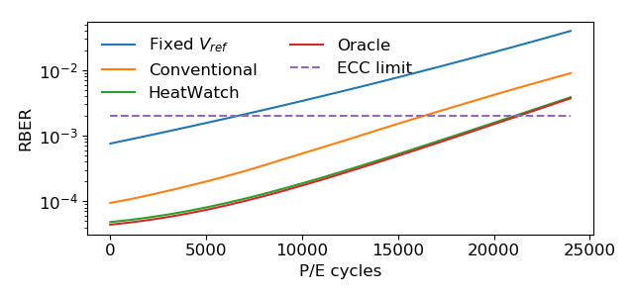
HeatWatch Greatly Improves Flash Lifetime
3.85x over Fixed V_{ref}
Fixed V_{ref}
Oracle
Error Rate
State-of-the-art
ECC limit
HeatWatch
Lifetime (P/E Cycles)
24% over
state-of-the-art
HeatWatch improves lifetime by
capturing the effect of
retention, wearout, self-recovery, temperature
Notes:
Here is the result.
The x-axis is P/E cycles, y-axis is the error rate.
The dotted line shows the error correction limit. Flash lifetime ends when the error rate goes across this limit.
The blue curve shows the baseline where we apply a fixed read reference voltage because we do not know the retention time.
The orange curve shows the conventional model.
The green curve shows the HeatWatch. The Oracle shows the ideal case that we magically applies the actual optimal read reference voltage.
We see that HeatWatch is very close to the oracle.
Overall, HeatWatch improves lifetime by 24% over conventional, and by 3.85 times over the baseline.

Slide 39
Outline
Executive Summary
Background on NAND Flash Reliability
Characterization of Self-Recovery and Temperature Effect on Real 3D NAND Flash Memory Chips
URT: Unified Self-Recovery and Temperature Model
HeatWatch Mechanism
Conclusion

Slide 40
Conclusion
3D NAND susceptible to early retention errors
  Charge leaks out of flash cell quickly after programming
  Two unreported factors: self-recovery and temperature
We study self-recovery and temperature effects
We develop a new technique to improve flash reliability
  Experimental characterization of real 3D NAND chips
  Unified Self-Recovery and Temperature (URT) Model
    Predicts impact of retention loss, wearout, self-recovery, temperature on flash cell voltage
    Low prediction error rate: 4.9%
  HeatWatch
    Uses URT model to find optimal read voltages for 3D NAND flash
    Improves flash lifetime by 3.85x
Notes:
As a conclusion, we have looked at two previously unknown factors that affects 3D NAND retention errors: self-recovery and temperature.
We present an experimental characterization of these two effects on real 3D NAND chips.
And we develop a highly-accurate model that achieves 4.9% error rate.
Using this model, we develop a new technique called HeatWatch that improves flash lifetime by 3.85x.

Slide 41
Improving 3D NAND Flash Memory Device Reliability by
Exploiting Self-Recovery and Temperature Awareness
HeatWatch
Yixin Luo Saugata Ghose Yu Cai Erich F. Haratsch Onur Mutlu
Paper reference:
"HeatWatch: Improving 3D NAND Flash Memory Device Reliability by Exploiting Self-Recovery and Temperature-Awareness“, HPCA 2018
https://www.archive.ece.cmu.edu/~safari/pubs/heatwatch-3D-nand-errors-and-self-recovery_hpca18.pdf
Notes:
Thank you for the introduction. Today, I will present our work about …

Slide 42
References to
Papers and Talks

Slide 43
Our FMS Talks and Posters
FMS 2018
  Yixin Luo, HeatWatch: Exploiting 3D NAND Self-Recovery and Temperature Effects
  Saugata Ghose, Enabling Realistic Studies of Modern Multi-Queue SSD Devices
FMS 2017
  Aya Fukami, Improving Chip-Off Forensic Analysis for NAND Flash
  Saugata Ghose, Vulnerabilities in MLC NAND Flash Memory Programming
FMS 2016
  Onur Mutlu, ThyNVM: Software-Transparent Crash Consistency for Persistent Memory
  Onur Mutlu, Large-Scale Study of In-the-Field Flash Failures
  Yixin Luo, Practical Threshold Voltage Distribution Modeling
  Saugata Ghose, Write-hotness Aware Retention Management
FMS 2015
  Onur Mutlu, Read Disturb Errors in MLC NAND Flash Memory
  Yixin Luo, Data Retention in MLC NAND Flash Memory
FMS 2014
  Onur Mutlu, Error Analysis and Management for MLC NAND Flash Memory

Slide 44
Our Flash Memory Works (I)
Summary of our work in NAND flash memory
  Yu Cai, Saugata Ghose, Erich F. Haratsch, Yixin Luo, and Onur Mutlu, Error Characterization, Mitigation, and Recovery in Flash Memory Based Solid-State Drives, Proceedings of the IEEE, Sept. 2017.
Overall flash error analysis
  Yu Cai, Erich F. Haratsch, Onur Mutlu, and Ken Mai, Error Patterns in MLC NAND Flash Memory: Measurement, Characterization, and Analysis, DATE 2012.
  Yu Cai, Gulay Yalcin, Onur Mutlu, Erich F. Haratsch, Adrian Cristal, Osman Unsal, and Ken Mai, Error Analysis and Retention-Aware Error Management for NAND Flash Memory, ITJ 2013.
  Yixin Luo, Saugata Ghose, Yu Cai, Erich F. Haratsch, and Onur Mutlu, Enabling Accurate and Practical Online Flash Channel Modeling for Modern MLC NAND Flash Memory, IEEE JSAC, Sept. 2016.

Slide 45
Our Flash Memory Works (II)
3D NAND flash memory error analysis
  Yixin Luo, Saugata Ghose, Yu Cai, Erich F. Haratsch, and Onur Mutlu, Improving 3D NAND Flash Memory Lifetime by Tolerating Early Retention Loss and Process Variation, SIGMETRICS 2018.
  Yixin Luo, Saugata Ghose, Yu Cai, Erich F. Haratsch, and Onur Mutlu, HeatWatch: Improving 3D NAND Flash Memory Device Reliability by Exploiting Self-Recovery and Temperature-Awareness, HPCA 2018.
Multi-queue SSDs
  Arash Tavakkol, Juan Gomez-Luna, Mohammad Sadrosadati, Saugata Ghose, and Onur Mutlu, MQSim: A Framework for Enabling Realistic Studies of Modern Multi-Queue SSD Devices, FAST 2018.
  Arash Tavakkol, Mohammad Sadrosadati, Saugata Ghose, Jeremie Kim, Yixin Luo, Yaohua Wang, Nika Mansouri Ghiasi, Lois Orosa, Juan G. Luna and Onur Mutlu, FLIN: Enabling Fairness and Enhancing Performance in Modern NVMe Solid State Drives, ISCA 2018.

Slide 46
Our Flash Memory Works (III)
Flash-based SSD prototyping and testing platform
  Yu Cai, Erich F. Haratsh, Mark McCartney, Ken Mai, FPGA-based solid-state drive prototyping platform, FCCM 2011.
Retention noise study and management
  Yu Cai, Gulay Yalcin, Onur Mutlu, Erich F. Haratsch, Adrian Cristal, Osman Unsal, and Ken Mai, Flash Correct-and-Refresh: Retention-Aware Error Management for Increased Flash Memory Lifetime, ICCD 2012.
  Yu Cai, Yixin Luo, Erich F. Haratsch, Ken Mai, and Onur Mutlu, Data Retention in MLC NAND Flash Memory: Characterization, Optimization and Recovery, HPCA 2015.
  Yixin Luo, Yu Cai, Saugata Ghose, Jongmoo Choi, and Onur Mutlu, WARM: Improving NAND Flash Memory Lifetime with Write-hotness Aware Retention Management, MSST 2015.
  Aya Fukami, Saugata Ghose, Yixin Luo, Yu Cai, and Onur Mutlu, Improving the Reliability of Chip-Off Forensic Analysis of NAND Flash Memory Devices, Digital Investigation, Mar. 2017.

Slide 47
Our Flash Memory Works (IV)
Program and erase noise study
  Yu Cai, Erich F. Haratsch, Onur Mutlu, and Ken Mai, Threshold Voltage Distribution in MLC NAND Flash Memory: Characterization, Analysis and Modeling, DATE 2013.
  Y. Cai, S. Ghose, Y. Luo, K. Mai, O. Mutlu, and E. F. Haratsch, Vulnerabilities in MLC NAND Flash Memory Programming: Experimental Analysis, Exploits, and Mitigation Techniques, HPCA 2017.
Cell-to-cell interference characterization and tolerance
  Yu Cai, Onur Mutlu, Erich F. Haratsch, and Ken Mai, Program Interference in MLC NAND Flash Memory: Characterization, Modeling, and Mitigation, ICCD 2013.
  Yu Cai, Gulay Yalcin, Onur Mutlu, Erich F. Haratsch, Osman Unsal, Adrian Cristal, and Ken Mai, Neighbor-Cell Assisted Error Correction for MLC NAND Flash Memories, SIGMETRICS 2014.

Slide 48
Our Flash Memory Works (V)
Read disturb noise study
  Yu Cai, Yixin Luo, Saugata Ghose, Erich F. Haratsch, Ken Mai, and Onur Mutlu, Read Disturb Errors in MLC NAND Flash Memory: Characterization and Mitigation, DSN 2015.
Flash errors in the field
  Justin Meza, Qiang Wu, Sanjeev Kumar, and Onur Mutlu, A Large-Scale Study of Flash Memory Errors in the Field, SIGMETRICS 2015.
Persistent memory
  Jinglei Ren, Jishen Zhao, Samira Khan, Jongmoo Choi, Yongwei Wu, and Onur Mutlu, ThyNVM: Enabling Software-Transparent Crash Consistency in Persistent Memory Systems, MICRO 2015.

Slide 49
Referenced Papers and Talks
All are available at
  https://www.ece.cmu.edu/~safari/pubs.html
  https://www.ece.cmu.edu/~safari/talks.html
And, many other previous works on
  Challenges and opportunities in memory
  NAND flash memory errors and management
  Phase change memory as DRAM replacement
  STT-MRAM as DRAM replacement
  Taking advantage of persistence in memory
  Hybrid DRAM + NVM systems
  NVM design and architecture

Slide 50
Backup Slides

Slide 51
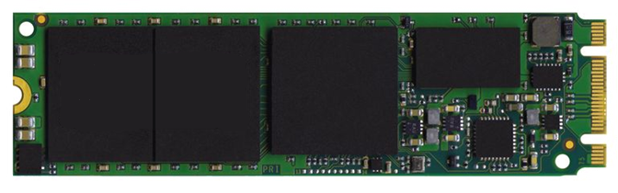
SSD Architecture
SSD
NAND
NAND
SSD Controller
HOST
DRAM

Slide 52
3D vs. 2D Flash Cell Design
Control Gate
Substrate
Charge Trap
(Insulator)
S
Gate Oxide
e
e
e
e
Floating Gate
(Conductor)
e
e
Control
Gate
e
e
e
e
e
e
Tunnel Oxide
e
e
S
D
Gate Oxide
Substrate
D
Tunnel Oxide
Floating-Gate Cell
3D Charge-Trap Cell
Charges stored in insulator, thinner tunnel oxide
→ Faster data retention

Slide 53
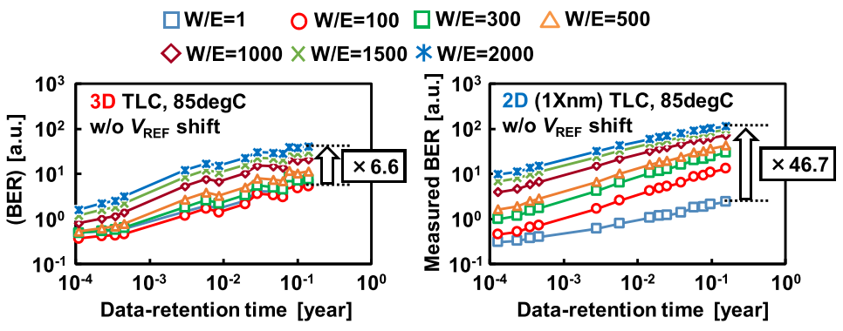
3D vs. 2D Retention Characteristics
3D NAND uniformly affected by wearout
2D NAND very sensitive to wearout
Source: K. Mizoguchi, et al., “Data-Retention Characteristics Comparison of 2D and 3D TLC NAND Flash Memories,” IMW, 2017.

Slide 54
Limitations
Vendor-to-vendor variation
  Self-recovery and temperature effect should be similar for
  3D charge trap NAND (Samsung, Hynix, Toshiba, Sandisk)
Chip-to-chip variation
  Each of our experiments takes several months
  Expect future large-scale study on 3D NAND errors
Not our limitation:
Any process variation within a chip
  Our results include tens of randomly selected flash blocks
  ~1 million cells

Slide 55
Generalizability of Results
Should apply to other 3D NAND flash memory that uses charge trap cells (Samsung, Hynix, Toshiba, Sandisk, and future Micron charge trap devices)

Slide 56
Self-Recovery and Temperature in Planar NAND
UDM [Mielke 2006]
Only models retention shift, no initial voltage
Exponential P/E cycle effect
Activation energy for planar NAND
3 other works propose mechanism and speculate different lifetime improvements
  211x [Mohan+ HotStorage10]
  5.8x [Wu+ HotStorage11]
  2.8x [Lee+ FAST12]

Slide 57
Novelty vs. UDM
3D charge trap cells are more resilient to P/E cycling than floating-gate cells in planar NAND
Different activation energy
Program temperature effect not discussed in planar NAND

Slide 58
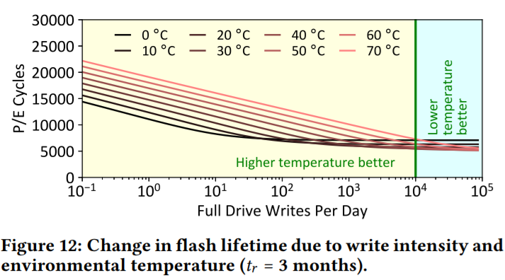
Ideal SSD Temperature
It depends!
  High program temperature increases program variation (good)
  High dwell temperature accelerates self-recovery (good)
  High retention temperature accelerates retention loss (bad)

Slide 59
URT Fine Tuning
Randomly sample 10 wordlines in each chip
Learn V_{opt} by sweeping V_{ref}
Fit URT model with newly learned V_{opt}

Slide 60
HeatWatch Overhead
Storage Overhead:
Tracking SSD Temperature
  26 logarithmic intervals
  208 B
Program temperature, dwell time, program time per block
  1.5 MB
Dwell time
  Timestamp for last 20 full drive writes
  85 B
Latency Overhead:
  <1% of flash read latency (25 us)

Slide 61
HeatWatch: Tracking Components
1. Tracking SSD temperature
  Use existing sensors in the SSD
  Precompute temperature scaling factor
  at logarithmic time intervals
Area = Effective Ret. Time
3
4
2
5
2
3
6
1
7
15
Temperature Effect
14
8
13
4
9
11
12
n
2n
4n
10
8n
Actual Retention Time
Notes:
The first and also the most complex component of them all is the tracking SSD temperature component.
Because we need the SSD temperature to scale the effective retention time and dwell time, which can be arbitrarily long, but we do not have infinite amount of storage to remember this. So we need a mechanism to track SSD temperature efficiently.
The key idea is to divide the retention time into a limited number of logarithmic intervals.
And precompute the effective retention time for each interval by integrating the temperature acceleration factors over time.
To make the calculation faster, we store the precomputed value for each interval in a table.

Slide 62
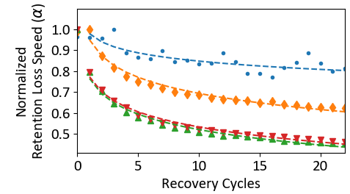
HeatWatch: Tracking Components
2. Tracking dwell time
  Only need to track write frequency for last 20 P/E cycles
Faster Retention Loss
Self-recovery effect plateaus after 20 P/E cycles
Notes:
This is enabled by one of our characterization result.
In this figure, x-axis …
The self-recovery effect keeps reducing retention loss speed, but the effect plateaus after 20 P/E cycles, so the last 20 P/E cycles matters the most.

Slide 63
URT vs. Conventional Model
PEC
t_{r}
PEC
t_{r}
PEC
Conventional
PEC
V = V₀ + ΔV
PEC
T_{p}
T_{r,eff}
PEC
T_{d,eff}
URT
t_{r}
T_{r}
t_{d}
T_{d}
URT adds
self-recovery, temperature
to conventional model
Notes:
We compare HeatWatch with a conventional retention model, which only considers PEC and retention time, which are the black bubbles.
The red bubbles and dots highlights the model components that are different in URT due to 3D NAND differences and our new understanding.

Slide 64
Threshold Voltage Distribution Shifts
V_{a}
V_{b}
V_{c}
Shifted
Original
Probability
Density
ER
11
P1
01
P2
00
P3
10
Threshold Voltage (V_{th})
Raw bit errors
Shifts occur over time due to multiple factors (e.g., retention)
Can cause distribution of one state to cross over the
read reference voltage boundary
  Some cells get misread
  Introduces raw bit errors

Slide 65
Per-Workload Flash Lifetime Improvements

Slide 66
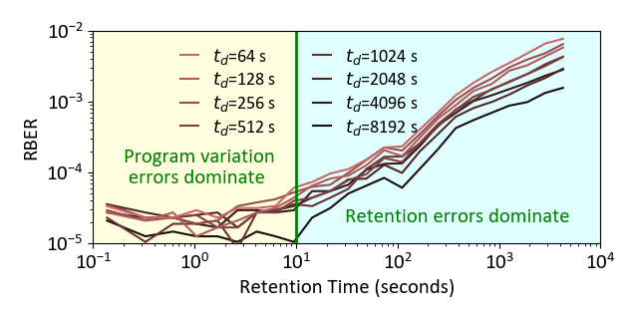
Dwell Time Impact on Error Rate After Retention

Slide 67
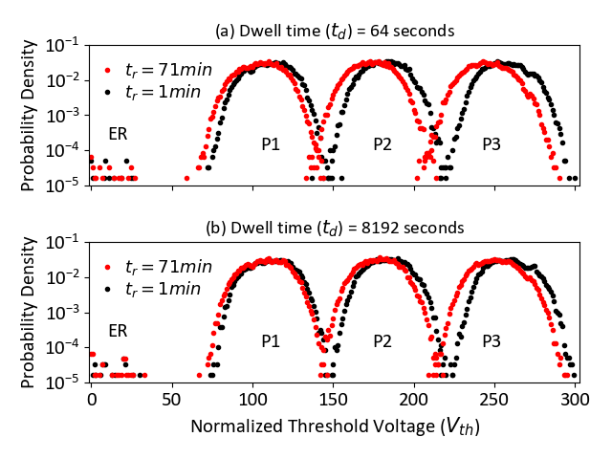
Dwell Time Impact on Threshold Voltage Distributions

Slide 68
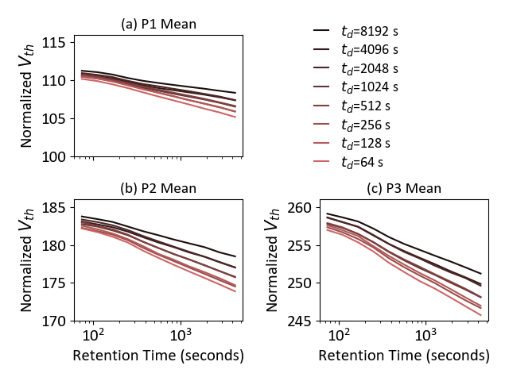
Mean Distribution Voltage vs. Retention for Different Dwell Times

Slide 69
Impact of Dwell Time on Error Rate and Threshold Voltage Distribution Means

Slide 70
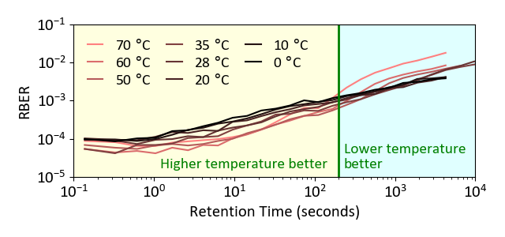
Temperature Impact on Error Rate After Retention

Slide 71
Impact of Programming Temperature on Threshold Voltage Distributions

Slide 72
Impact of Programming Temperature on Error Rate and Threshold Voltage Distribution Means

Slide 73
SRRM Prediction Accuracy

Slide 74
Change in Flash Lifetime Due to
Programming Temperature and Write Intensity

Slide 75
Optimal Read Reference Voltage:
Measured vs. Predicted by URT

Slide 76
Inaccurate Read Reference Voltages
Increase Error Rate

