Slide 1





UH-MEM: Utility-Based
Hybrid Memory Management
Yang Li, Saugata Ghose, Jongmoo Choi, Jin Sun, Hui Wang, Onur Mutlu
Notes:
Thank you!

Slide 2
Executive Summary
DRAM faces significant technology scaling difficulties
Emerging memory technologies overcome difficulties (e.g., high capacity, low idle power), but have other shortcomings (e.g., slower than DRAM)
Hybrid memory system pairs DRAM with emerging memory technology
  Goal: combine benefits of both memories
  in a cost-effective manner
  Problem: Which memory do we place each
  page in, to optimize system performance?
Processor
Memory A
Memory B
Our approach: UH-MEM (Utility-based Hybrid MEmory Management)
  Key Idea: for each page, estimate utility (i.e., performance impact) of migrating page, then use utility to guide page placement
  Key Mechanism: a comprehensive model to estimate utility using memory access characteristics, application impact on system performance
UH-MEM improves performance by 14% on average over the best of three state-of-the-art hybrid memory managers
Notes:
Modern large-scale clusters continue to employ dynamic random access memory (DRAM) as main memory system within each server.
However, DRAM suffers from scaling difficulty, which prevents it from greatly growing in capacity.
As a result, other types of memories, such as 3D-stacked DRAM and non-volatile memory, emerge, which provide high-bandwidth, low-latency, low power, or high capacity substrate without heavily relying on DRAM scaling.
To combine the advantage of different memory technologies, hybrid memory systems, which pair different types of memory together, are proposed.
In hybrid memory systems, memory pages are placed in and migrated between different types of memory, based on the properties of each page.
A key problem for such hybrid memory systems is how to intelligently place memory pages to optimize system performance.
To tackle this problem, we propose UH-MEM, a utility-based hybrid memory management mechanism.
Our goal is to devise a utility metric, which quantifies the performance impact of placing a page across different types of memories, and use the utility metric to guide the page placement decision, such that system performance is optimized.
Our simulation results show that UH-MEM outperforms three state-of-the-art mechanisms by 14% on average for a large amount of workloads.

Slide 3
Outline
Background
Existing Solutions
UH-MEM: Goal and Key Idea
Key Mechanisms of UH-MEM
Evaluation
Conclusion
Notes:
First, let’s look at a brief background.

Slide 4
State-of-the-Art Memory Technologies
DRAM scaling has already become increasingly difficult
  Increasing cell leakage current, reduced cell reliability, increasing manufacturing difficulties [Kim+ ISCA 2014],
  [Liu+ ISCA 2013], [Mutlu IMW 2017], [Mutlu DATE 2017]
  Difficult to significantly improve capacity, speed, energy
Emerging memory technologies are promising
3D-Stacked DRAM | higher bandwidth | smaller capacity
Reduced-Latency DRAM (e.g., RLDRAM, TL-DRAM) | lower latency | higher cost
Low-Power DRAM (e.g., LPDDR3, LPDDR4) | lower power | higher latency higher cost
Non-Volatile Memory (NVM) (e.g., PCM, STTRAM, ReRAM, 3D Xpoint) | larger capacity | higher latency higher dynamic power lower endurance

Slide 5
Hybrid Memory System
Pair multiple memory technologies together to
exploit the advantages of each memory
  e.g., DRAM-NVM: DRAM-like latency, NVM-like capacity
Separate channels: Memory A and B can be
accessed in parallel
Cores/Caches
Memory Controllers
Channel A
Channel B
Memory A
(Fast, Small)
DRAM
Memory B
(Large, Slow)
NVM

Slide 6
Hybrid Memory System: Background
Cores/Caches
Memory Controllers
Channel A
Row Buffer
Bank
Channel B
Memory A
Memory B
(Fast, Small)
…
(Large, Slow)
…
Bank: Contains multiple arrays of cells
  Multiple banks can serve accesses in parallel
Row buffer: Internal buffer that holds the open row in a bank
  Row buffer hits: serviced ~3x faster, similar latency for both Memory A and B
  Row buffer misses: latency is higher for Memory B

Slide 7
Hybrid Memory System: Problem
Cores/Caches
Memory Controllers
Channel A
IDLE
Channel B
Memory A
Memory B
(Fast, Small)
(Large, Slow)
Page 1
Page 2
Which memory do we place each page in,
to maximize system performance?
Memory A is fast, but small
Load should be balanced on both channels
Page migrations have performance and energy overhead

Slide 8
Outline
Background
Existing Solutions
UH-MEM: Goal and Key Idea
Key Mechanisms of UH-MEM
Evaluation
Conclusion

Slide 9
Existing Solutions
ALL [Qureshi+ ISCA 2009]
  Migrate all pages from slow memory to fast memory
  when the page is accessed
  Fast memory is LRU cache: pages evicted when memory is full
  FREQ: Access frequency based approach [Ramos+ ICS 2011], [Jiang+ HPCA 2010]
  Access frequency: number of times a page is accessed
  Keep pages with high access frequency in fast memory
RBLA: Access frequency and row buffer locality based approach [Yoon+ ICCD 2012]
  Row buffer locality: fraction of row buffer hits out of all memory accesses to a page
  Keep pages with high access frequency and low row buffer locality in fast memory

Slide 10
Weaknesses of Existing Solutions
They are all heuristics that consider only a limited part of memory access behavior
Do not directly capture the overall system performance impact of data placement decisions
Example: None capture memory-level parallelism (MLP)
  Number of concurrent memory requests from the same application when a page is accessed
  Affects how much page migration helps performance
Notes:
These proposals consider only a limited number of characteristics, using these few data points to construct a placement heuristic that is specific to the memory types being used in the system.
These heuristic-based approaches do not directly capture the overall system performance benefits of data placement decisions.
Therefore, they can only indirectly optimize system performance, which sometimes leads to sub-optimal data placement decisions.

Slide 11
Importance of Memory-Level Parallelism
Before migration:
Before migration:
requests to Page 1
Mem. B
requests to Page 2
Mem. B
requests to Page 3
Mem. B
After migration:
After migration:
requests to Page 1
Mem. A
requests to Page 2
Mem. A
T
requests to Page 3
T
Mem. B
Mem. A
time
Migrating one page
reduces stall time by T
time
Must migrate two pages
to reduce stall time by T:
migrating one page alone
does not help
Page migration decisions need to consider MLP
Notes:
Should say: On the left, The page has much more utility because it directly affects performance if it is migrated to the fast memory;
On the right. Each page has less utility because migrated alone, neither would affect performance significantly. They both need to be migrated together.
Let’s look at two pages with access latency overlapped with each other
Change animation later

Slide 12
Outline
Background
Existing Solutions
UH-MEM: Goal and Key Idea
Key Mechanisms of UH-MEM
Evaluation
Conclusion

Slide 13
Our Goal
A generalized mechanism that
1. Directly estimates the performance benefit
of migrating a page between
any two types of memory
2. Places only the performance-critical data
in the fast memory

Slide 14
Utility-Based Hybrid Memory Management
A memory manager that works for any hybrid memory
  e.g., DRAM-NVM, DRAM-RLDRAM
Key Idea
  For each page, use comprehensive characteristics to calculate estimated utility (i.e., performance impact)
  of migrating page from one memory to the other in the system
  Migrate only pages with the highest utility
  (i.e., pages that improve system performance the most when migrated)

Slide 15
Outline
Background
Existing Solutions
UH-MEM: Goal and Key Idea
Key Mechanisms of UH-MEM
Evaluation
Conclusion

Slide 16
Key Mechanisms of UH-MEM
For each page, estimate utility using a performance model
  Application stall time reduction
    How much would migrating a page benefit the performance of the application that the page belongs to?
  Application performance sensitivity
    How much does the improvement of a single application’s performance increase the overall system performance?
Migrate only pages whose utility exceeds the migration threshold from slow memory to fast memory
Periodically adjust migration threshold
  $$Utility= {∆StallTime}_{i}×{Sensitivity}_{i}$$

Slide 17
Key Mechanisms of UH-MEM
For each page, estimate utility using a performance model
  Application stall time reduction
    How much would migrating a page benefit the performance of the application that the page belongs to?
  Application performance sensitivity
    How much does the improvement of a single application’s performance increase the overall system performance?
Migrate only pages whose utility exceeds the migration threshold from slow memory to fast memory
Periodically adjust migration threshold
  $$Utility= {∆StallTime}_{i}×{Sensitivity}_{i}$$

Slide 18
Estimating Application Stall Time Reduction
Use access frequency, row buffer locality, and MLP
to estimate application’s stall time reduction
Access frequency
Row buffer locality
Why not row buffer hits?
Hits have equal latency
in both memories, so
no need to track them.
Number of
row buffer misses
Access latency reduction
for the page if migrated

Slide 19
Calculating Total Access Latency Reduction
Use counter to track number of row buffer misses (#RBMiss)
Calculate change in number of
memory cycles if page is migrated
Need separate counters for reads and writes
  Each memory can have different latencies for reads and
  for writes
  Allows us to generalize UH-MEM for any memory
Reduction in miss latency
if we migrate from
Memory B to Memory A
  $${∆Access Latency}_{read} ={\#RB Miss}_{read} × (t_{Mem B, read} −t_{Mem A, read})$$
  $${∆Access Latency}_{write} ={\#RB Miss}_{write} × (t_{Mem B, write} −t_{Mem A, write})$$
Notes:
Use reciprocal of number of outstanding read / write requests that are servicing in the memory device

Slide 20
Estimating Application Stall Time Reduction
Use access frequency, row buffer locality, and MLP
to estimate application’s stall time reduction
Access frequency
Row buffer locality
Number of
row buffer misses
Access latency reduction
for the page due to migration
MLP
Application stall time reduction

Slide 21
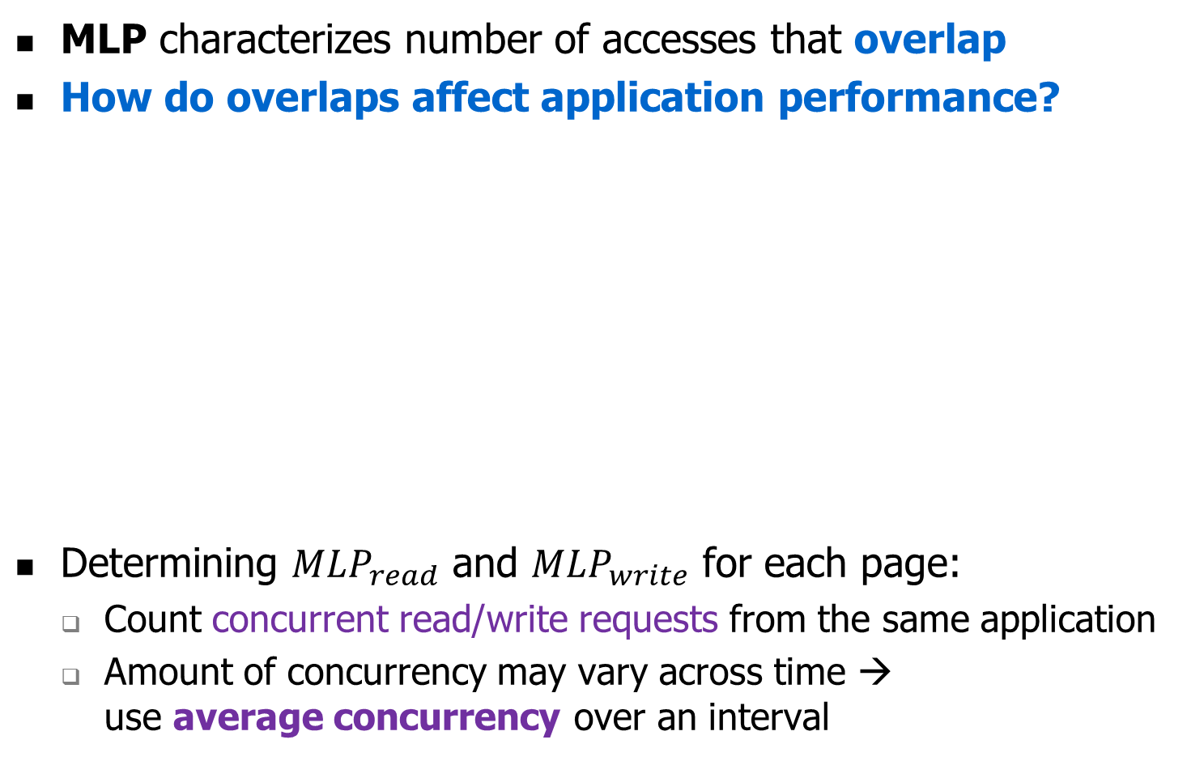
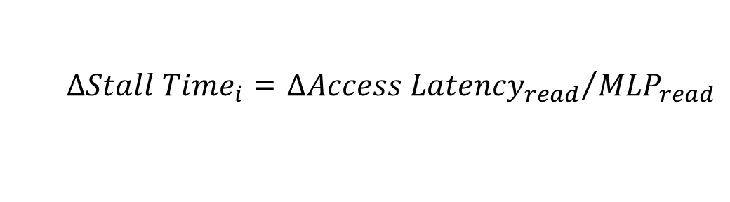
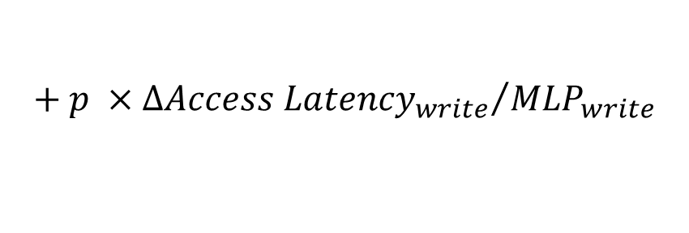
Calculating Stall Time Reduction
MLP characterizes number of accesses that overlap
How do overlaps affect application performance?
Determining ${MLP}_{read}$ and ${MLP}_{write}$ for each page:
  Count concurrent read/write requests from the same application
  Amount of concurrency may vary across time →
  use average concurrency over an interval
More requests overlap →
reductions overlap →
smaller improvement
from migrating
the page
Total number of cycles
reduced for all requests
  ${∆Stall Time}_{i}$ = ${{∆Access Latency}_{read}}/{{MLP}_{read}}$
$$+ p ×{{∆Access Latency}_{write}}/{{MLP}_{write}}$$
Not all writes fall on critical path of execution
due to write queues inside memory:
p is probability that application stalls when queue is being drained
Notes:
Use reciprocal of number of outstanding read / write requests that are servicing in the memory device
Use the number of concurrent read/write requests from the same application as the MLP of the page for reads and writes
The MLP of a page may vary across time → use average MLP of the page in the calculation for stall time reduction

Slide 22
Key Mechanisms of UH-MEM
For each page, estimate utility using a performance model
  Application stall time reduction
    How much would migrating a page benefit the performance of the application that the page belongs to?
  Application performance sensitivity
    How much does the improvement of a single application’s performance increase the overall system performance?
Migrate only pages whose utility exceeds the migration threshold from slow memory to fast memory
Periodically adjust migration threshold
  $$Utility= {∆StallTime}_{i}×{Sensitivity}_{i}$$

Slide 23
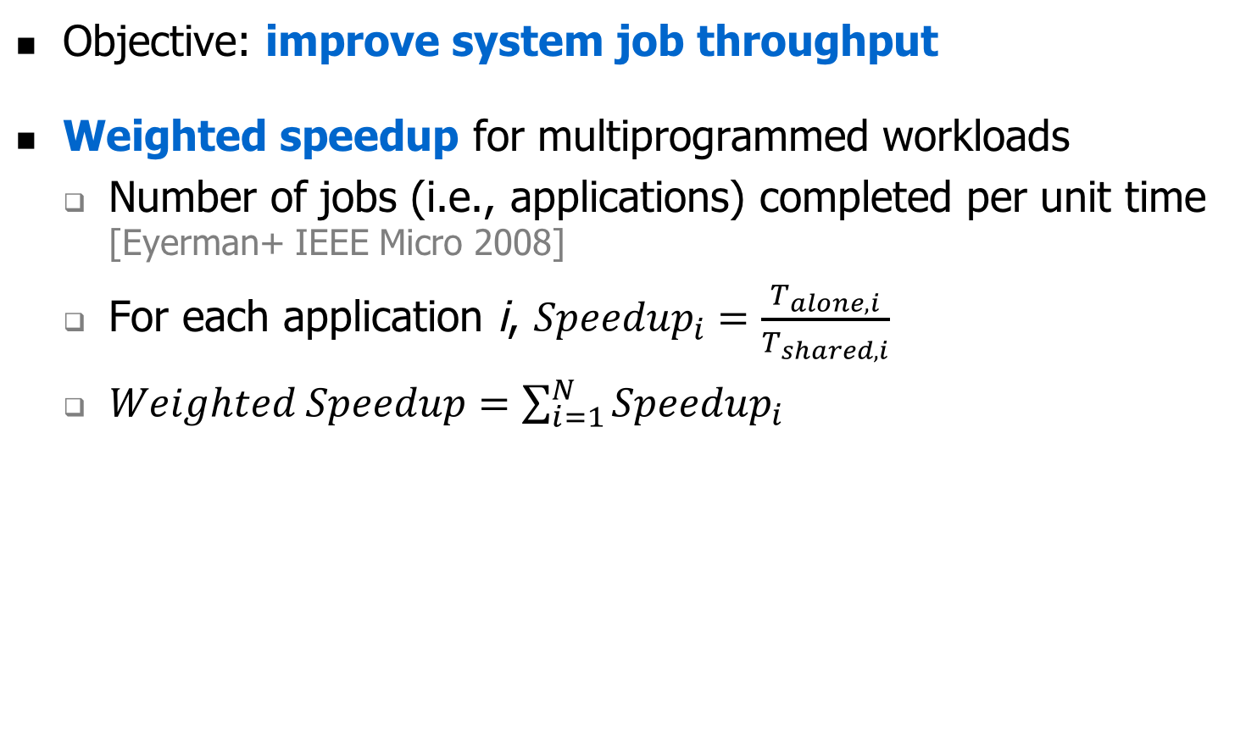
Estimating Application Performance Sensitivity
Objective: improve system job throughput
Weighted speedup for multiprogrammed workloads
  Number of jobs (i.e., applications) completed per unit time [Eyerman+ IEEE Micro 2008]
  For each application i, ${Speedup}_{i}=\frac{T_{alone,i}}{T_{shared,i}}$
  $Weighted Speedup=\sum_{i=1}^{N}{{Speedup}_{i}}$
How does each application
contribute to the weighted speedup?
Notes:
Depending on the design goal
Reflect the system performance by the number of credit completed by the system per unit time

Slide 24
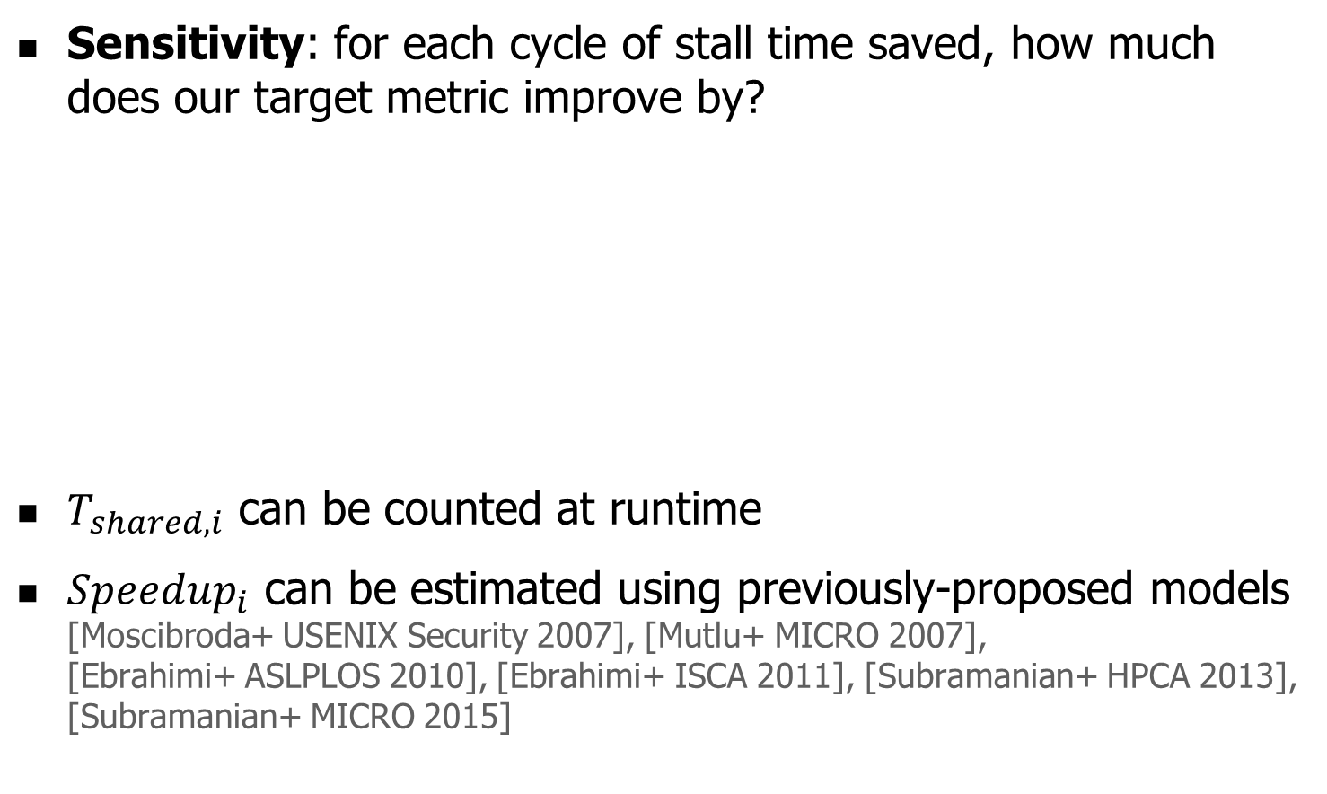
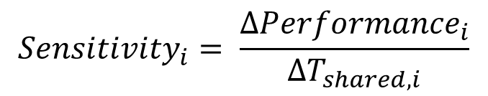

Estimating Application Performance Sensitivity
Sensitivity: for each cycle of stall time saved, how much does our target metric improve by?
$T_{shared, i}$ can be counted at runtime
${Speedup}_{i}$ can be estimated using previously-proposed models
[Moscibroda+ USENIX Security 2007], [Mutlu+ MICRO 2007],
[Ebrahimi+ ASLPLOS 2010], [Ebrahimi+ ISCA 2011], [Subramanian+ HPCA 2013], [Subramanian+ MICRO 2015]
How much of the weighted speedup
did the application save in the last interval?
Derived
mathematically
(see paper
for details)
$${Sensitivity}_{i}= \frac{∆{Performance}_{i}}{∆T_{shared, i}}$$
$$= \frac{{Speedup}_{i}}{T_{shared, i}}$$
Number of cycles saved
in last interval
Notes:
Depending on the design goal
Reflect the system performance by the number of credit completed by the system per unit time

Slide 25
Key Mechanisms of UH-MEM
For each page, estimate utility using a performance model
  Application stall time reduction
    How much would migrating a page benefit the performance of the application that the page belongs to?
  Application performance sensitivity
    How much does the improvement of a single application’s performance increase the overall system performance?
Migrate only pages whose utility exceeds the migration threshold from slow memory to fast memory
Periodically adjust migration threshold
  Hill-climbing algorithm to balance migrations and channel load
  More details in the paper
  $$Utility= {∆StallTime}_{i}×{Sensitivity}_{i}$$

Slide 26
Outline
Background
Existing Solutions
UH-MEM: Goal and Key Idea
Key Mechanisms of UH-MEM
Evaluation
Conclusion

Slide 27
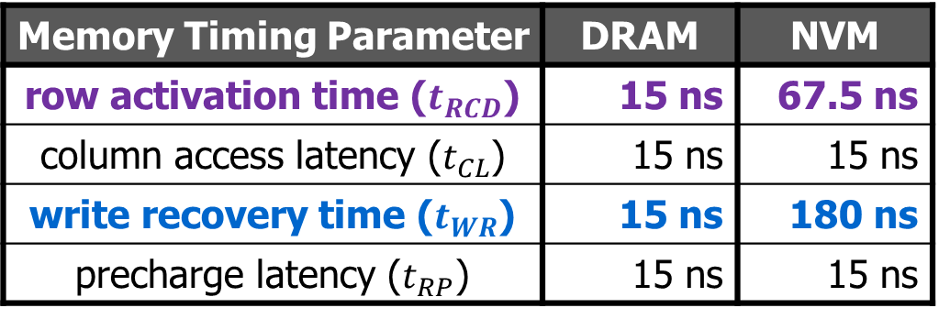
System Configuration
Cycle-accurate hybrid memory simulator
  Models memory system in details
  8 cores, 2.67GHz
  LLC: 2MB, 8-way, 64B cache block
  We will release the simulator on GitHub:
  https://github.com/CMU-SAFARI/UHMEM
Baseline configuration (DRAM-NVM)
  Memory latencies based on real products, prior studies
  Energy numbers derived from prior works [Lee+ ISCA 2009]
Memory Timing Parameter | DRAM | NVM
row activation time ($t_{RCD}$) | 15 ns | 67.5 ns
column access latency ($t_{CL}$) | 15 ns | 15 ns
write recovery time ($t_{WR}$) | 15 ns | 180 ns
precharge latency ($t_{RP}$) | 15 ns | 15 ns
Notes:
Row activation time captures how long it takes to fetch a row from memory array to row buffer;
Write recovery time captures how long it takes to write a data from row buffer to memory array.

Slide 28
Benchmarks
Individual applications
  From SPEC CPU 2006, YCSB benchmark suites
  Classify applications as memory-intensive or
  non-memory- intensive based on last-level cache
  MPKI (misses per kilo-instruction)
Generate 40 multiprogrammed workloads, each consisting of 8 applications
Workload memory intensity: the proportion of
memory-intensive applications within the workload

Slide 29
Results: System Performance
14%
9%
3%
5%
UH-MEM improves system performance
over the best state-of-the-art hybrid memory manager

Slide 30

Results: Sensitivity to Slow Memory Latency
We vary $t_{RCD}$ and $t_{WR}$ of the slow memory
8%
6%
14%
13%
13%
$$t_{RCD}:$$
$$t_{WR}:$$
UH-MEM improves system performance
for a wide variety of hybrid memory systems

Slide 31
More Results in the Paper
UH-MEM reduces energy consumption, achieves similar or better fairness compared with prior proposals
Sensitivity study on size of fast memory
  We vary the size of fast memory from 256MB to 2GB
  UH-MEM consistently outperforms prior proposals
Hardware overhead: 42.9kB (~2% of last-level cache)
  Main overhead: hardware structure to store access frequency, row buffer locality, and MLP

Slide 32
Outline
Background
Existing Solutions
UH-MEM: Goal and Key Idea
Key Mechanisms of UH-MEM
Evaluation
Conclusion

Slide 33
Conclusion
DRAM faces significant technology scaling difficulties
Emerging memory technologies overcome difficulties (e.g., high capacity, low idle power), but have other shortcomings (e.g., slower than DRAM)
Hybrid memory system pairs DRAM with emerging memory technology
  Goal: combine benefits of both memories
  in a cost-effective manner
  Problem: Which memory do we place each
  page in, to optimize system performance?
Processor
Memory A
Memory B
Our approach: UH-MEM (Utility-based Hybrid MEmory Management)
  Key Idea: for each page, estimate utility (i.e., performance impact) of migrating page, then use utility to guide page placement
  Key Mechanism: a comprehensive model to estimate utility using memory access characteristics, application impact on system performance
UH-MEM improves performance by 14% on average over the best of three state-of-the-art hybrid memory managers
Notes:
Modern large-scale clusters continue to employ dynamic random access memory (DRAM) as main memory system within each server.
However, DRAM suffers from scaling difficulty, which prevents it from greatly growing in capacity.
As a result, other types of memories, such as 3D-stacked DRAM and non-volatile memory, emerge, which provide high-bandwidth, low-latency, low power, or high capacity substrate without heavily relying on DRAM scaling.
To combine the advantage of different memory technologies, hybrid memory systems, which pair different types of memory together, are proposed.
In hybrid memory systems, memory pages are placed in and migrated between different types of memory, based on the properties of each page.
A key problem for such hybrid memory systems is how to intelligently place memory pages to optimize system performance.
To tackle this problem, we propose UH-MEM, a utility-based hybrid memory management mechanism.
Our goal is to devise a utility metric, which quantifies the performance impact of placing a page across different types of memories, and use the utility metric to guide the page placement decision, such that system performance is optimized.
Our simulation results show that UH-MEM outperforms three state-of-the-art mechanisms by 14% on average for a large amount of workloads.

Slide 34
UH-MEM: Utility-Based
Hybrid Memory Management
Yang Li, Saugata Ghose, Jongmoo Choi, Jin Sun, Hui Wang, Onur Mutlu
Notes:
Thank you!

Slide 35
Results: Fairness
UH-MEM achieves similar or better fairness
compared with prior proposals

Slide 36
Results: Total Stall Time
UH-MEM reduces application stall time
compared with prior proposals

Slide 37
Results: Energy Consumption
UH-MEM reduces energy consumption
for data-intensive workloads

Slide 38
Results: Sensitivity to Fast Memory Capacity
UH-MEM outperforms prior proposals
under different fast memory capacities

Slide 39
MLP Distribution for All Pages
(a) soplex
(b) xalancbmk
(c) YCSB-B

Slide 40
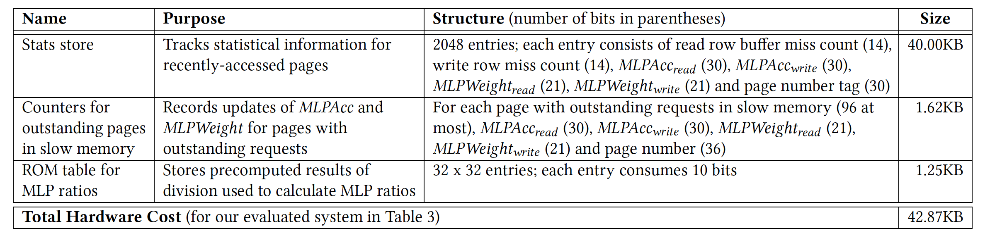
Main Hardware Cost

Slide 41
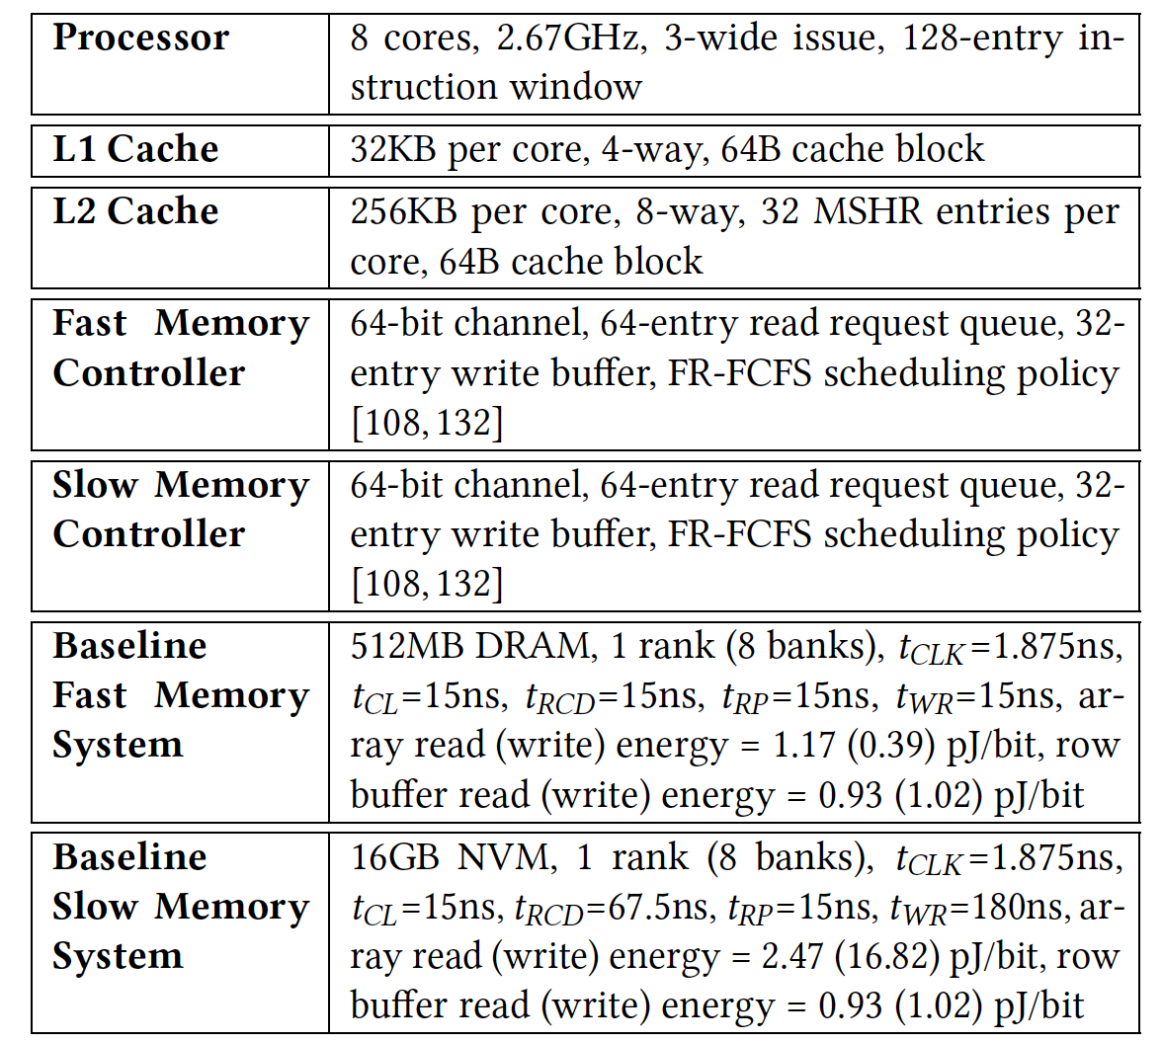
Baseline System Parameters

Slide 42
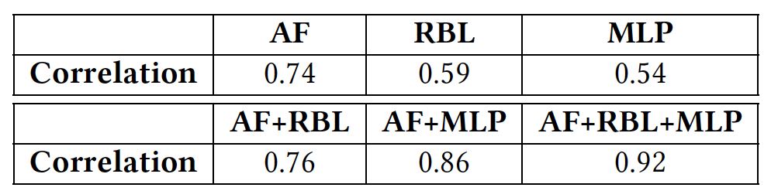
Impact of Different Factors on Stall Time
Correlation coefficients between the average stall time per page and different factors (AF: access frequency; RBL: row buffer locality; MLP: memory level parallelism)

Slide 43
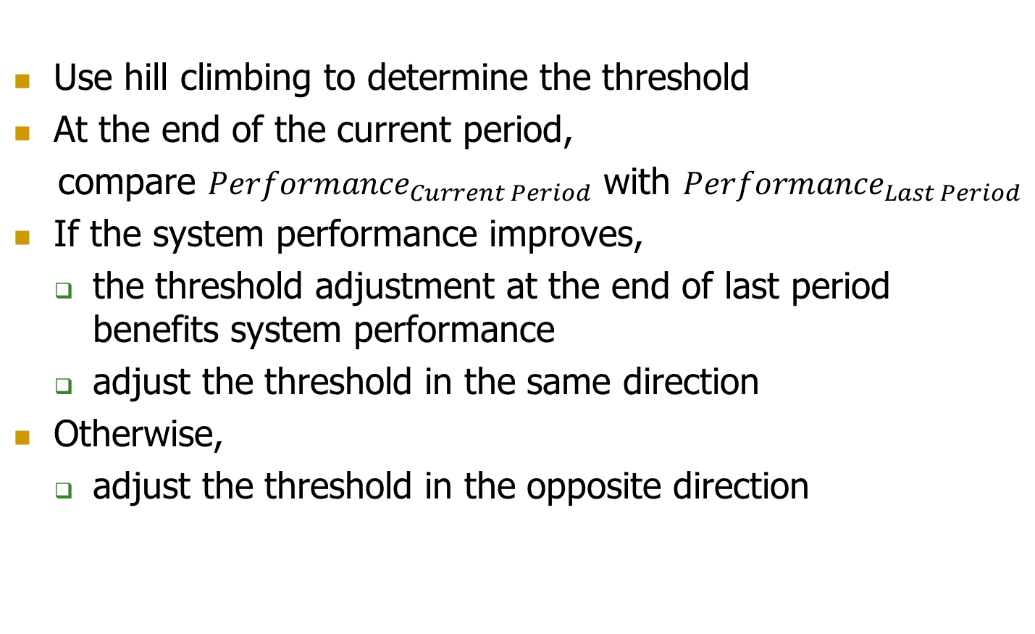
Migration Threshold Determination
Use hill climbing to determine the threshold
At the end of the current period,
compare ${Performance}_{Current Period}$ with ${Performance}_{Last Period}$
If the system performance improves,
  the threshold adjustment at the end of last period benefits system performance
  adjust the threshold in the same direction
Otherwise,
  adjust the threshold in the opposite direction

Slide 44
Overall UH-MEM Mechanism
Period-based approach - each period has a migration threshold
Action 1: Recalculate the page’s utility
Action 2: Compare the page’s utility with the migration threshold, and decide whether to migrate
Action 3: Adjust the migration threshold at the end of a quantum
Adjust the migration threshold
Memory Controllers
Recalculate Page Utility
Compare & Decide
?
Memory A
Memory B
(Fast, Small)
(Large, Slow)

Slide 45
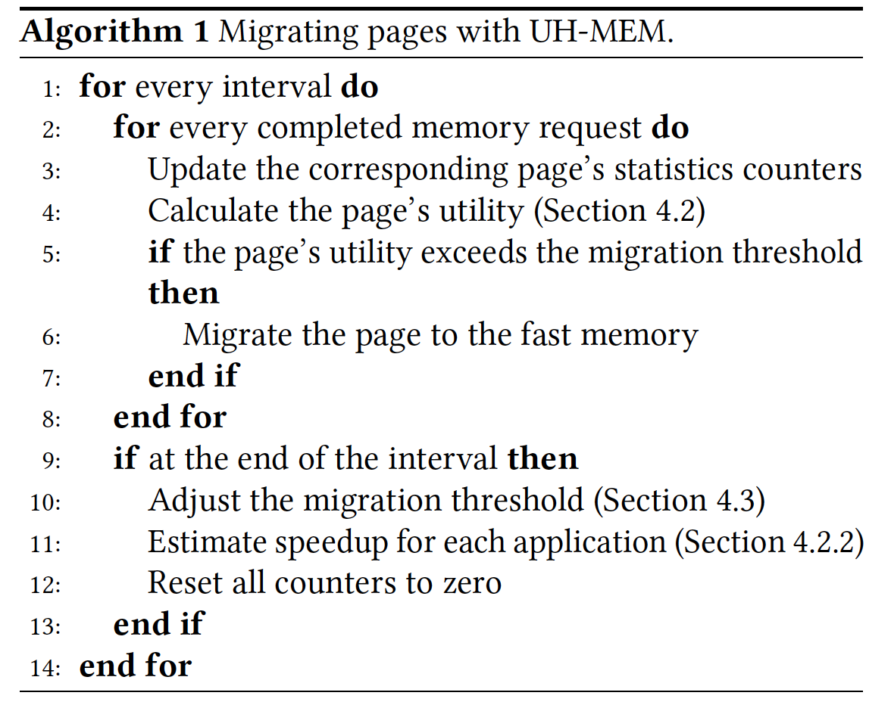
UH-MEM: Putting It All Together

