Slide 1
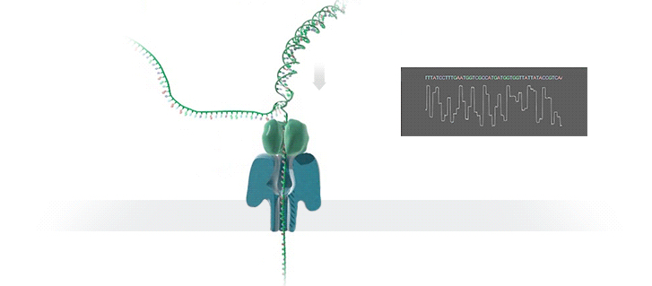
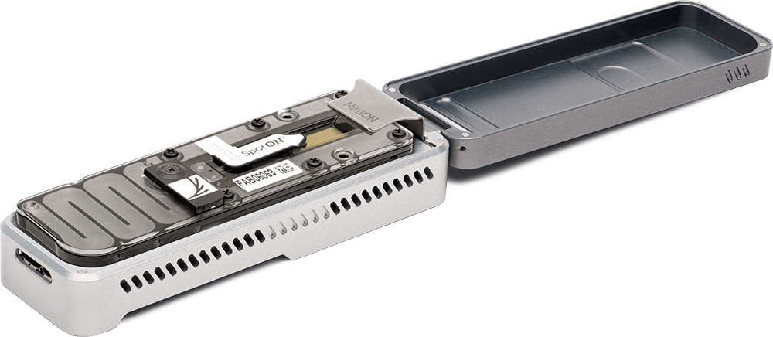
Nanopore Sequencing Technology and Tools:
Computational Analysis of the Current State, Bottlenecks and Future Directions
Damla Senol¹, Jeremie Kim^{1,3}, Saugata Ghose¹, Can Alkan² and Onur Mutlu^{3,1}
¹ Department of Electrical and Computer Engineering, Carnegie Mellon University, Pittsburgh, PA, USA
² Department of Computer Engineering, Bilkent University, Bilkent, Ankara, Turkey
³ Department of Computer Science, Systems Group, ETH Zürich, Zürich, Switzerland
Nanopore Sequencing
Nanopore Sequencing
a single molecule DNA sequencing technology that could potentially surpass current sequencing technologies
promises
higher throughput
lower cost
increased read length
no prior amplification step.
It has one major drawback: high error rates.
Nanopore sequencers rely solely on the electrochemical structure of the different nucleotides for identification and measure the change in the ionic current as long strands of DNA (ssDNA) pass through the nano-scale protein pores.
Biological Nanopores for DNA Sequencing
first proposed in the 1990s,
recently made commercially available in May 2014 by Oxford Nanopore Technologies (ONT).
MinION
first commercial nanopore sequencing device
high-throughput sequencing apparatus
produces real-time data
inexpensive
pocket-sized / portable
Pipeline and Current Tools
Our Goal
Step 1. Basecalling
Translates raw signal output of MinION to generate DNA sequences.
Metrichor [1] (extracted with poretools [2]), nanonet [3], nanocall [4]
Step 2. Genome Assembly for noisy long reads
Using only the basecalled DNA reads, generates longer contiguous fragments called draft assemblies.
canu [5], miniasm [6]
Step 3. Polishing (Optional)
Generates an improved consensus sequence from the draft assembly
nanopolish [7], racon [8]
In order to take advantage of nanopore sequencing, it is important to increase the accuracy and the speed of the whole pipeline.
Although new nanopore chemistry R9 improves the data accuracy, the tools used for nanopore sequence analysis are of critical importance as they should overcome the high error rates of the technology.
Our goal in this work is to comprehensively analyze tools for nanopore sequence analysis, with a focus on understanding the advantages, disadvantages, and bottlenecks of the various tools.
[1] Metrichor. [https://nanoporetech.com/products/metrichor]
[2] Loman, Nicholas J., and Aaron R. Quinlan. "Poretools: a toolkit for analyzing nanopore sequence data." Bioinformatics 30.23 (2014): 3399-3401.
[3] Nanonet. [https://github.com/nanoporetech/nanonet]
[4] David, Matei, et al. "Nanocall: An Open Source Basecaller for Oxford Nanopore Sequencing Data." bioRxiv (2016): 046086.
[5] Berlin, Konstantin, et al. "Assembling large genomes with single-molecule sequencing and locality-sensitive hashing." Nature biotechnology 33.6 (2015): 623-630.
[6] Li, Heng. "Minimap and miniasm: fast mapping and de novo assembly for noisy long sequences." Bioinformatics (2016): btw152.
[7] Loman, Nicholas J., Joshua Quick, and Jared T. Simpson. "A complete bacterial genome assembled de novo using only nanopore sequencing data." Nature methods (2015).
[8] Vaser, Robert, et al. "Fast and accurate de novo genome assembly from long uncorrected reads." bioRxiv (2016): 068122.
Results
Basecaller | Execution Time (Basecalling) | Assembler | Execution Time (Assembly) | # contigs | # bp | # bp / genome length | % Accuracy
Metrichor | - | Canu | 2195m | 1 | 4,586,878 | 0.9882 | 99.7769
 |  | Miniasm | 372sec | 1 | 4,477,194 | 0.9646 | 89.9817
Nanonet | 2517m | Canu | 124m | 2 | 4,559,230 | 0.9822 | 99.7809
 |  | Miniasm | 60sec | 6 | 3,549,677 | 0.9491 | 90.2123
Nanocall (Fast mode) | 5359m | Canu | 154m | 0 | - | - | -
 |  | Miniasm | 607sec | 0 | - | - | -
ONT’s cloud-based basecaller, Metrichor and local basecaller, nanonet perform similarly with high accuracy. However, another local basecaller nanocall is not suitable for R9 data.
Canu, the assembler with error correction, produces high-quality assemblies but is relatively slow compared to Miniasm, the assembler without error correction.
Miniasm is not as accurate as canu, but it is suitable for fast initial analysis and the quality of the assembly can be increased with an additional polishing step.

