Slide 1



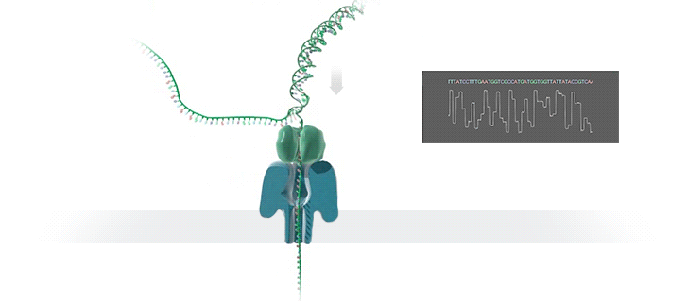
Nanopore Sequencing Technology and Tools:
Computational Analysis of the Current State, Bottlenecks and Future Directions
Damla Senol¹, Jeremie Kim^{1,3}, Saugata Ghose¹, Can Alkan² and Onur Mutlu^{3,1}
¹ Carnegie Mellon University, Pittsburgh, PA, USA ² Bilkent University, Ankara, Turkey ³ ETH Zürich, Zürich, Switzerland
Genome Sequencing
Long Read Analysis
Nanopore Sequencing
Genome sequencing is the process of determining the order of the DNA sequence in an organism’s genome.
  Long reads
    Sequences with thousands of bases
    Sequences with higher error rates
    Suitable for de novo assembly
  De novo assembly is the method of
    Merging the reads in order to construct the original sequence
    Without the aid of a reference genome
    Assembly quality can be improved by using longer reads, since they can cover long repetitive regions.
Nanopore sequencing is an emerging DNA sequencing technology.
Long read length
Portable and low cost
Produces data in real-time
Nanopore sequencers rely solely on the electrochemical structure of the different nucleotides for identification and measure the change in the ionic current as long strands of DNA (ssDNA) pass through the nano-scale protein pores.
Pipeline and Current Tools
Problem & Our Goal
Problem
The tools used for nanopore sequence analysis are of critical importance in order to increase the accuracy of the whole pipeline to take better advantage of long reads, and increase the speed of the whole pipeline to enable real-time data analysis.
Our Goal
Comprehensively analyze current publicly available tools in the whole pipeline for nanopore sequence analysis, with a focus on understanding their advantages, disadvantages, and performance bottlenecks.
Provide guidelines for determining the appropriate tools for each step of the pipeline.
Results and Analysis
 | Step 1 Wall Clock Time (h:m:s) | Step 1 Memory Usage (GB) | Step 2 Wall Clock Time (h:m:s) | Step 2 Memory Usage (GB) | Step 3 Wall Clock Time (h:m:s) | Step 3 Memory Usage (GB) | Number of Contigs | Identity (%) | Coverage (%)
Metrichor + Canu | – | – | – | – | 44:12:31 | 5.76 | 1 | 98.04 | 99.31
Metrichor + Minimap + Miniasm |  |  | 2:15 | 12.30 | 1:19 | 1.96 | 1 | 85.00 | 94.85
Metrichor + Graphmap + Miniasm |  |  | 6:14 | 56.58 | 1:05 | 1.82 | 2 | 85.24 | 96.95
Nanonet + Canu | 17:52:42 | 1.89 | – | – | 11:32:40 | 5.27 | 1 | 97.92 | 98.71
Nanonet + Minimap + Miniasm |  |  | 1:13 | 9.45 | 33 | 0.69 | 1 | 85.50 | 93.72
Nanonet + Graphmap + Miniasm |  |  | 3:18 | 29.16 | 32 | 0.65 | 1 | 85.36 | 92.05
Nanocall + Canu | 47:04:53 | 37.73 | – | – | – | – | – | – | –
Nanocall + Minimap + Miniasm |  |  | 1:15 | 12.19 | 20 | 0.47 | 5 | 80.53 | 96.80
Nanocall + Graphmap + Miniasm |  |  | 5:14 | 56.78 | 16 | 0.30 | 3 | 80.52 | 95.43
Deepnano + Canu | 23:54:34 | 8.38 | – | – | 1:15:48 | 3.61 | 106 | 92.63 | 154.07
Deepnano + Minimap + Miniasm |  |  | 1:50 | 11.71 | 1:03 | 1.31 | 1 | 82.37 | 91.62
Deepnano + Graphmap + Miniasm |  |  | 5:18 | 54.64 | 58 | 1.10 | 1 | 82.39 | 91.60
  Observation 1: Basecalling with Recurrent Neural Networks performs better than basecalling with Hidden Markov Models in terms of accuracy, speed, and memory usage. However, it has scalability limitations due to data sharing between threads.
  Observation 2: Sharing the computation of a read between parallel threads provides a constant and low memory usage, but data sharing between multiple sockets degrades the parallel speedup when number of threads reaches higher values.
Observation 4: Canu, an assembler with error correction, produces high-quality assemblies but is slow compared to Miniasm, an assembler without error correction.
Miniasm is suitable for fast initial analysis, and the quality of its assembly can be increased with an additional polishing step.
Observation 5: Nanopolish is compatible only with reads basecalled by Metrichor.
Polishing the draft assembly generated with Canu takes 5h52m and increases the accuracy from 98.04% to 99.46%.
Polishing the draft assembly generated with Miniasm takes 5d2h54m and increases the accuracy from 85.00% to 92.31%.
Observation 3: Storing minimizers instead of all k-mers does not affect the accuracy of
the whole pipeline. However, Minimap has a lower memory usage and higher speed
than GraphMap, since computation is decreased by shrinking the size of the dataset
that needs to be considered.

