Slide 1
Flipping Bits in Memory Without Accessing Them
DRAM Disturbance Errors
Yoongu Kim
Ross Daly, Jeremie Kim, Chris Fallin, Ji Hye Lee,
Donghyuk Lee, Chris Wilkerson, Konrad Lai, Onur Mutlu

Slide 2
DRAM Chip
Row of Cells
Wordline
Row
Victim Row
Row
Aggressor Row
V_{LOW}
Closed
V_{HIGH}
Opened
Row
Victim Row
Row
Repeatedly opening and closing a row induces disturbance errors in adjacent rows

Slide 3
Quick Summary of Paper
We expose the existence and prevalence of disturbance errors in DRAM chips of today
110 of 129 modules are vulnerable
Affects modules of 2010 vintage or later
We characterize the cause and symptoms
Toggling a row accelerates charge leakage in adjacent rows: row-to-row coupling
We prevent errors using a system-level approach
Each time a row is closed, we refresh the charge stored in its adjacent rows with a low probability

Slide 4
1. Historical Context
2. Demonstration (Real System)
3. Characterization (FPGA-Based)
4. Solutions

Slide 5
A Trip Down Memory Lane
IBM’s patent on DRAM
1968
Intel commercializes DRAM (Intel 1103)
1971
Suffered bitline-to-cell coupling
Bitline
Bitline
“... this big fat metal line with full level signals running right over the storage node (of cell).”
– Joel Karp (1103 Designer)
Interview: Comp. History Museum
Cell
2013
8um
6um
2014

Slide 6
A Trip Down Memory Lane
IBM’s patent on DRAM
1968
Intel commercializes DRAM (Intel 1103)
1971
Suffered bitline-to-cell coupling
Earliest DRAM with row-to-row coupling
2010
We observe row-to-row coupling
2013
Intel’s patents mention “Row Hammer”
2014

Slide 7
Lessons from History
Coupling in DRAM is not new
Leads to disturbance errors if not addressed
Remains a major hurdle in DRAM scaling
Traditional efforts to contain errors
Design-Time: Improve circuit-level isolation
Production-Time: Test for disturbance errors
Despite such efforts, disturbance errors have been slipping into the field since 2010

Slide 8
1. Historical Context
2. Demonstration (Real System)
3. Characterization (FPGA-Based)
4. Solutions

Slide 9
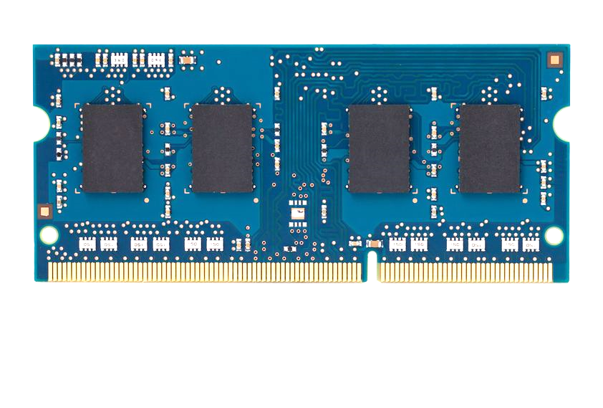
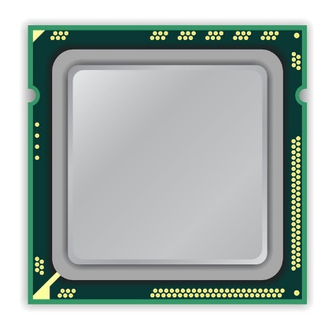
How to Induce Errors
x86 CPU
DRAM Module
DDR3
Avoid cache hits
Flush X from cache
Avoid row hits to X
Read Y in another row
111111111
X
111111111
111111111
111111111
Y
111111111
111111111

Slide 10
How to Induce Errors
x86 CPU
DRAM Module
DDR3
loop:
mov (X), %eax
mov (Y), %ebx
clflush (X)
clflush (Y)
mfence
jmp loop
001110111
111111111
X
111111111
1111
111111111
101111101
110001011
111111111
Y
1111
111111111
011011110
111111111

Slide 11
Number of Disturbance Errors
In a more controlled environment, we can induce as many as ten million disturbance errors
Disturbance errors are a serious reliability issue
CPU Architecture | Errors | Access-Rate
Intel Haswell (2013) | 22.9K | 12.3M/sec
Intel Ivy Bridge (2012) | 20.7K | 11.7M/sec
Intel Sandy Bridge (2011) | 16.1K | 11.6M/sec
AMD Piledriver (2012) | 59 | 6.1M/sec

Slide 12
Security Implications
Breach of memory protection
OS page (4KB) fits inside DRAM row (8KB)
Adjacent DRAM row → Different OS page
Vulnerability: disturbance attack
By accessing its own page, a program could corrupt pages belonging to another program
We constructed a proof-of-concept
Using only user-level instructions

Slide 13
Mechanics of Disturbance Errors
Cause 1: Electromagnetic coupling
Toggling the wordline voltage briefly increases the voltage of adjacent wordlines
Slightly opens adjacent rows → Charge leakage
Cause 2: Conductive bridges
Cause 3: Hot-carrier injection
Confirmed by at least one manufacturer

Slide 14
1. Historical Context
2. Demonstration (Real System)
3. Characterization (FPGA-Based)
4. Solutions

Slide 15
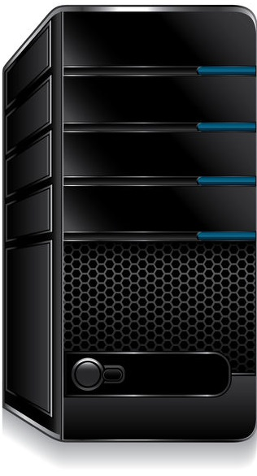
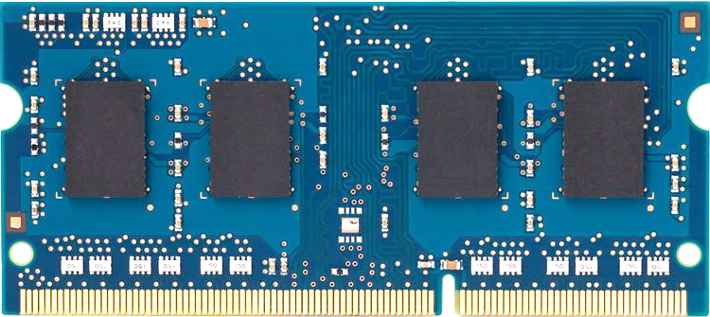
Infrastructure
PC
FPGA Board
Test Engine
PCIe
DRAM Ctrl

Slide 16
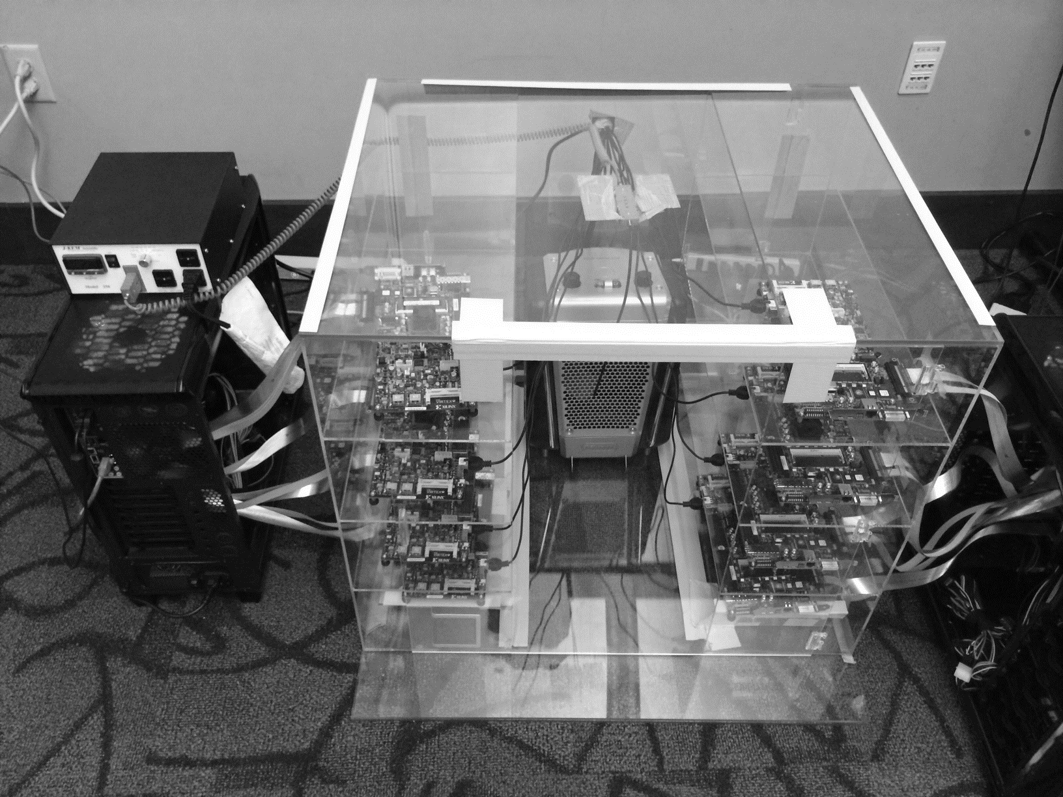
Temperature
Controller
FPGAs
Heater
FPGAs
PC

Slide 17
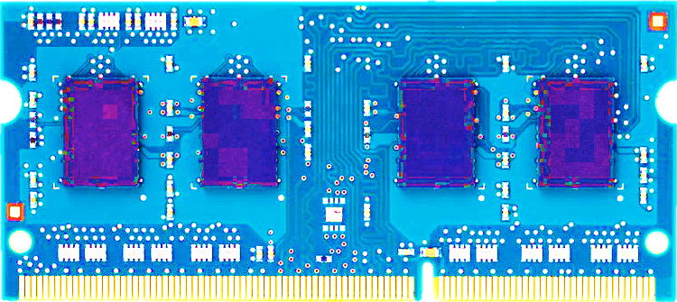
Tested DDR3 DRAM Modules
Company A
Company B
Company C
43
54
32
Total: 129
Vintage: 2008 – 2014
Capacity: 512MB – 2GB

Slide 18
Characterization Results
Most Modules Are at Risk
Errors vs. Vintage
Error = Charge Loss
Adjacency: Aggressor & Victim
Sensitivity Studies
Other Results in Paper

Slide 19
1. Most Modules Are at Risk
A company
B company
C company
86%
(37/43)
83%
(45/54)
88%
(28/32)
Up to
1.0×10⁷ errors
Up to
2.7×10⁶ errors
Up to
3.3×10⁵ errors

Slide 20
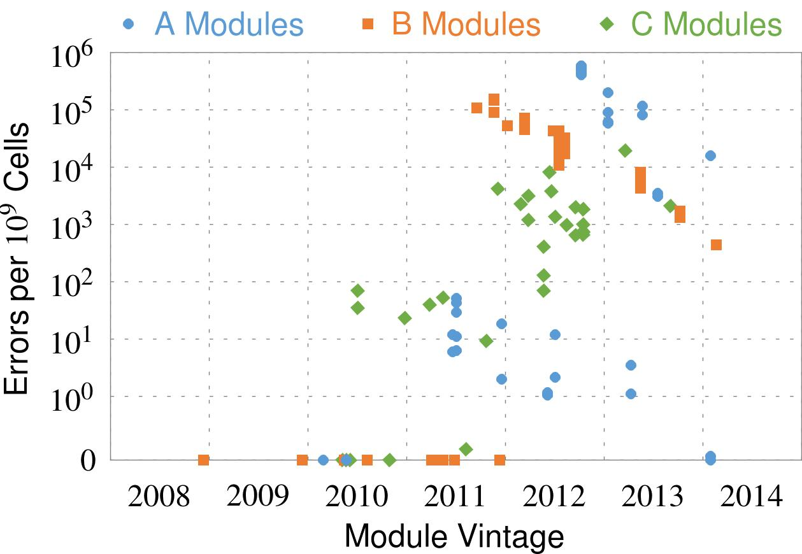
2. Errors vs. Vintage
First
Appearance
All modules from 2012–2013 are vulnerable

Slide 21
3. Error = Charge Loss
Two types of errors
‘1’ → ‘0’
‘0’ → ‘1’
A given cell suffers only one type
Two types of cells
True: Charged (‘1’)
Anti: Charged (‘0’)
Manufacturer’s design choice
True-cells have only ‘1’ → ‘0’ errors
Anti-cells have only ‘0’ → ‘1’ errors
Errors are manifestations of charge loss

Slide 22
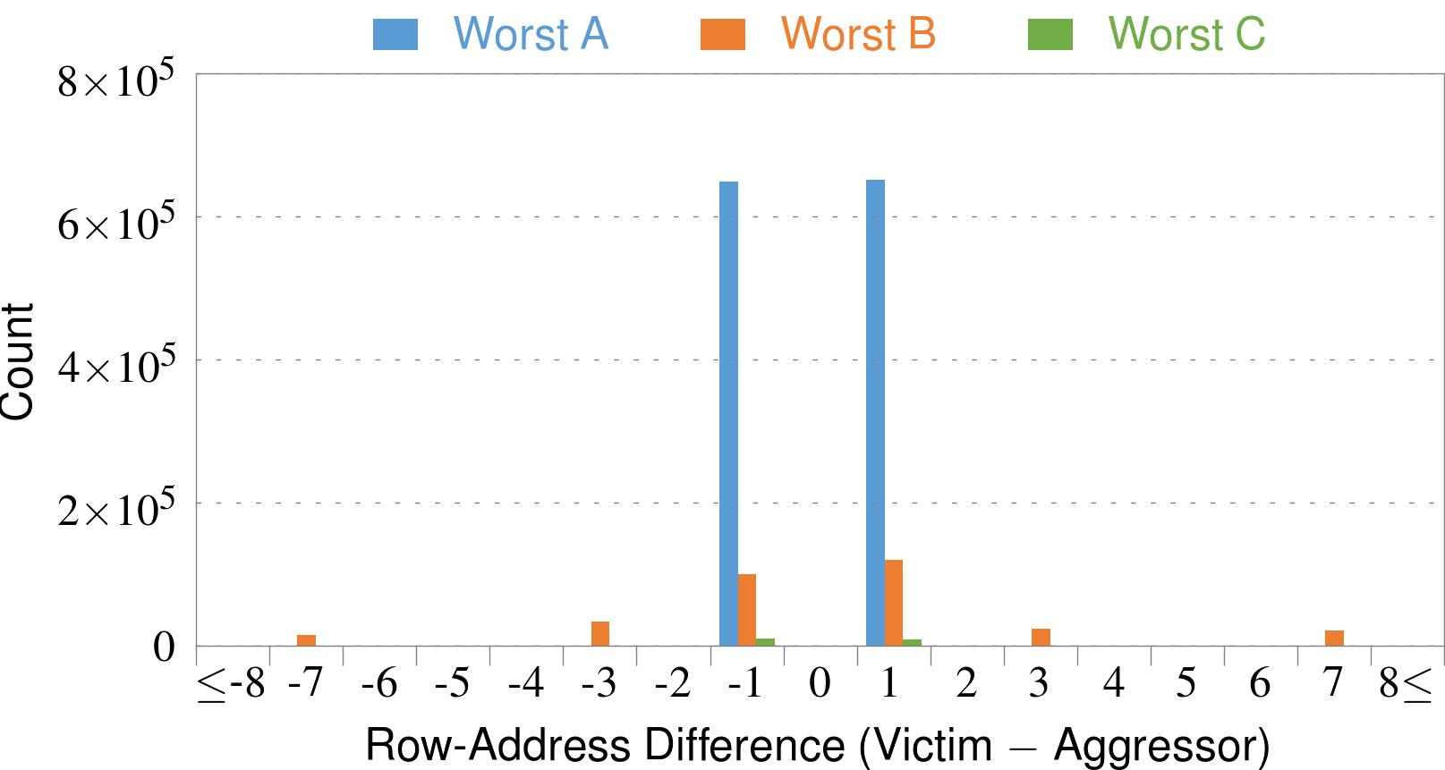
4. Adjacency: Aggressor & Victim
Adjacent
Adjacent
Adjacent
Non-Adjacent
Non-Adjacent
Note: For three modules with the most errors (only first bank)
Most aggressors & victims are adjacent

Slide 23
5. Sensitivity Studies
time
Test Row 0
Test Row 1
Test Row 2
···
Fill Module
with Data
Open
Open
···
Find Errors
in Module
Refresh Periodically
❶
Access-Interval: 55–500ns
❷
Refresh-Interval: 8–128ms
❸
Data-Pattern: all ‘1’s, all ‘0’s, etc.

Slide 24
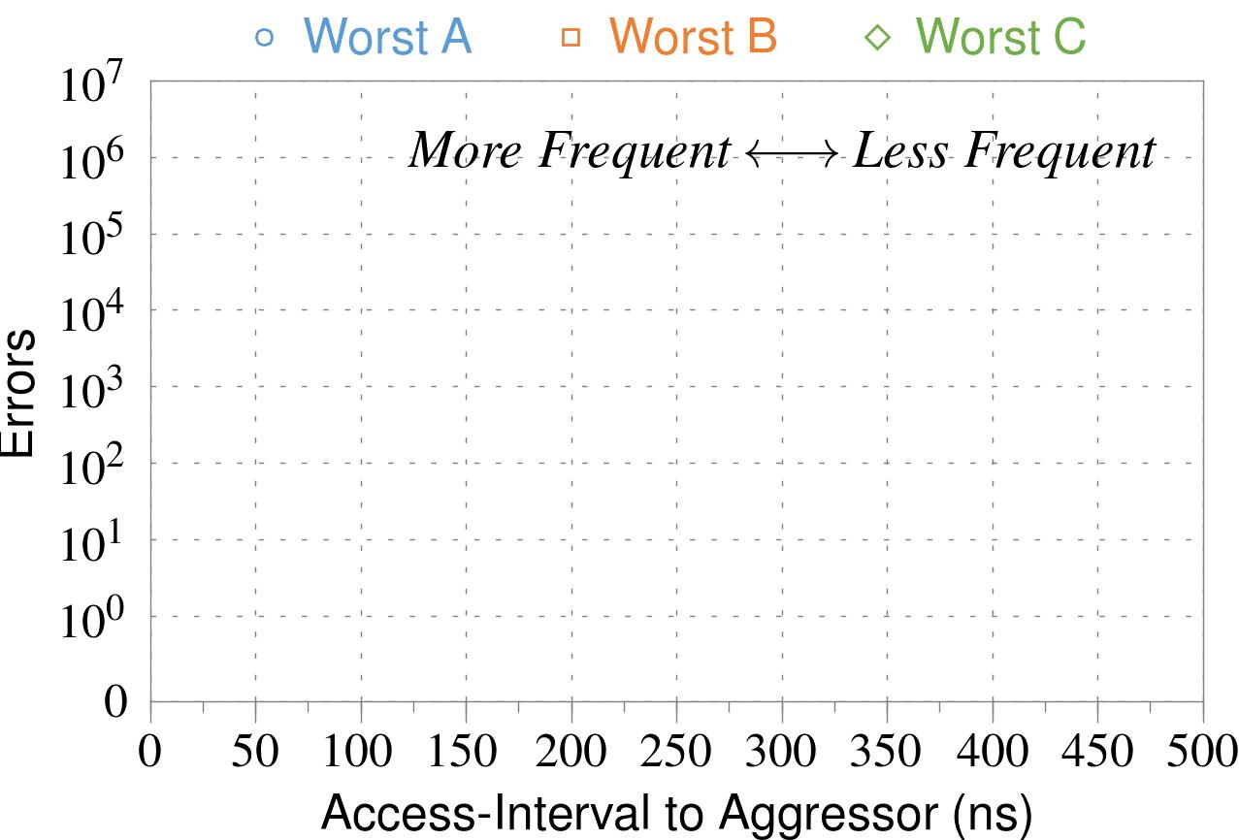
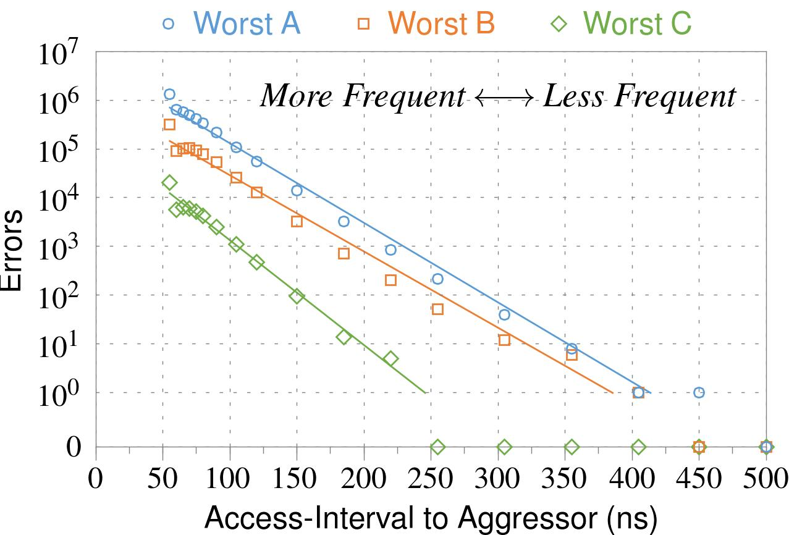
❶ Access-Interval (Aggressor)
Not Allowed
500ns
55ns
Note: For three modules with the most errors (only first bank)
Less frequent accesses → Fewer errors

Slide 25
5. Sensitivity Studies
time
Test Row 0
Test Row 1
Test Row 2
···
Fill Module
with Data
Open
Open
···
Find Errors
in Module
Refresh Periodically
❶
Access-Interval: 55–500ns
❷
Refresh-Interval: 8–128ms
❸
Data-Pattern: all ‘1’s, all ‘0’s, etc.

Slide 26
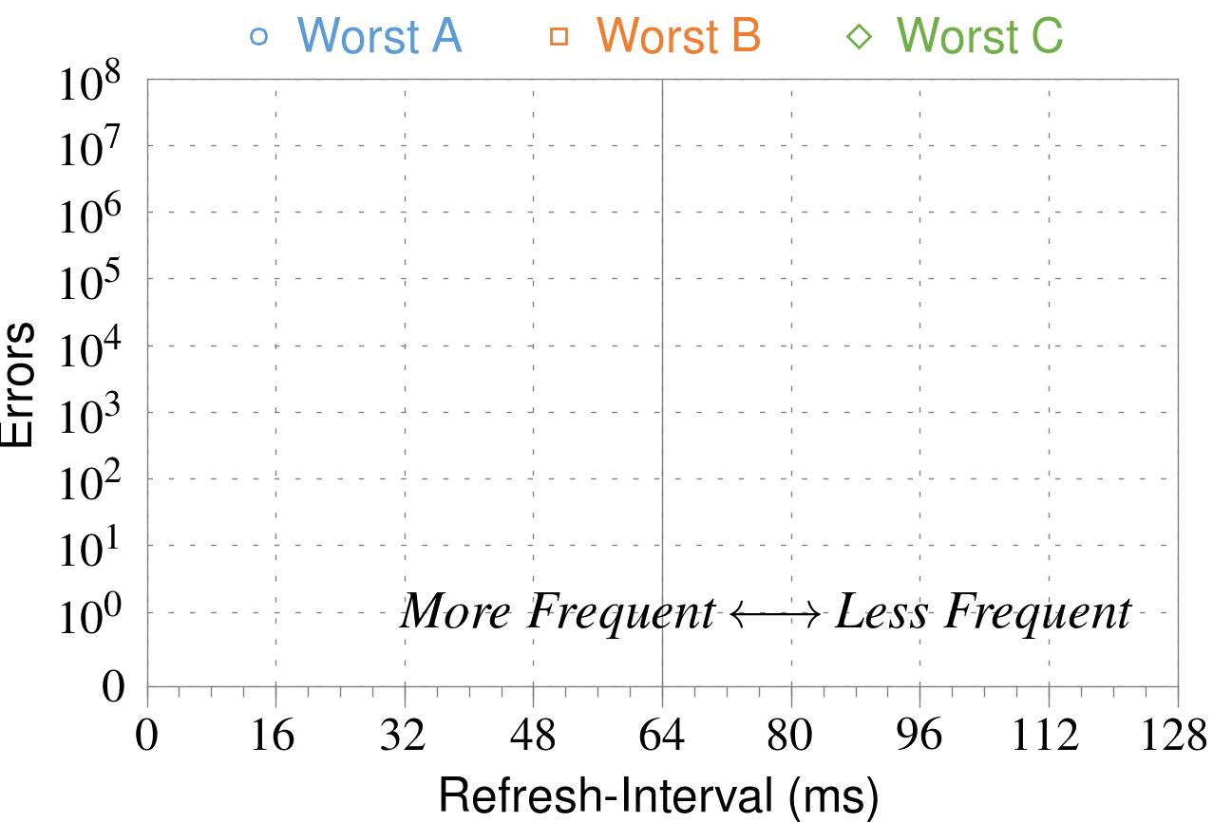
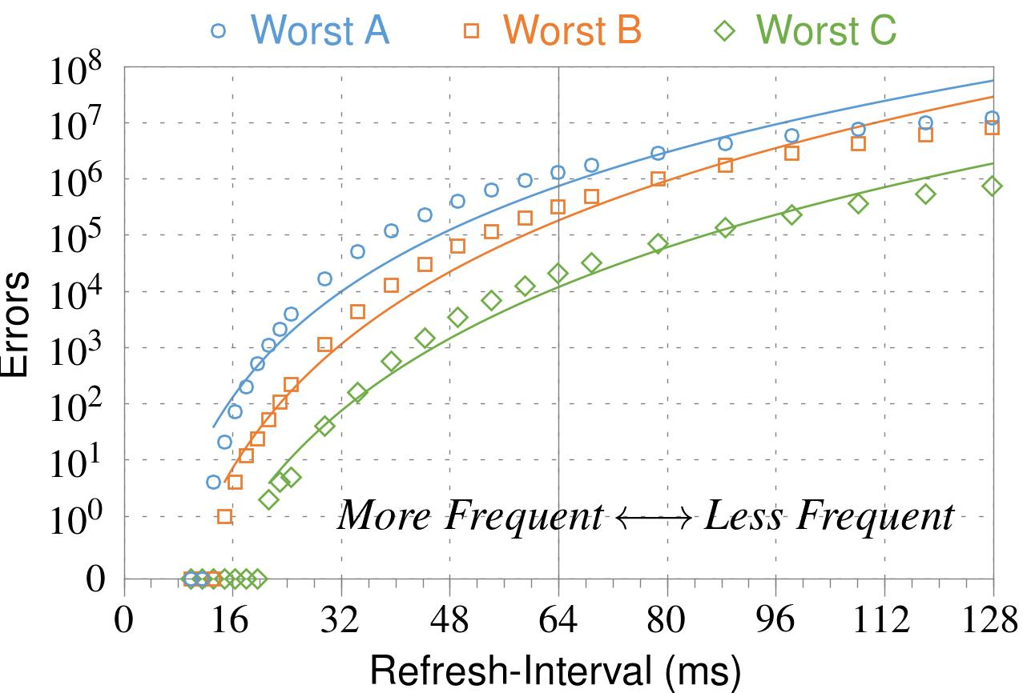
❷ Refresh-Interval
~7x frequent
64ms
Note: Using three modules with the most errors (only first bank)
More frequent refreshes → Fewer errors

Slide 27
5. Sensitivity Studies
time
Test Row 0
Test Row 1
Test Row 2
···
Fill Module
with Data
Open
Open
···
Find Errors
in Module
Refresh Periodically
❶
Access-Interval: 55–500ns
❷
Refresh-Interval: 8–128ms
❸
Data-Pattern: all ‘1’s, all ‘0’s, etc.

Slide 28
❸ Data-Pattern
Solid
RowStripe
111111
111111
111111
000000
111111
111111
10x Errors
111111
000000
~Solid
~RowStripe
000000
000000
000000
111111
000000
000000
000000
111111
Errors affected by data stored in other cells

Slide 29
Naive Solutions
❶ Throttle accesses to same row
Limit access-interval: ≥500ns
Limit number of accesses: ≤128K (=64ms/500ns)
❷ Refresh more frequently
Shorten refresh-interval by ~7x
Both naive solutions introduce significant overhead in performance and power

Slide 30
Characterization Results
Most Modules Are at Risk
Errors vs. Vintage
Error = Charge Loss
Adjacency: Aggressor & Victim
Sensitivity Studies
Other Results in Paper

Slide 31
6. Other Results in Paper
Victim Cells ≠ Weak Cells (i.e., leaky cells)
Almost no overlap between them
Errors not strongly affected by temperature
Default temperature: 50°C
At 30°C and 70°C, number of errors changes <15%
Errors are repeatable
Across ten iterations of testing, >70% of victim cells had errors in every iteration

Slide 32
6. Other Results in Paper (cont’d)
As many as 4 errors per cache-line
Simple ECC (e.g., SECDED) cannot prevent all errors
Number of cells & rows affected by aggressor
Victims cells per aggressor: ≤110
Victims rows per aggressor: ≤9
Cells affected by two aggressors on either side
Very small fraction of victim cells (<100) have an error when either one of the aggressors is toggled

Slide 33
1. Historical Context
2. Demonstration (Real System)
3. Characterization (FPGA-Based)
4. Solutions

Slide 34
Several Potential Solutions
Cost
Make better DRAM chips
Power, Performance
Refresh frequently
Cost, Power
Sophisticated ECC
Cost, Power, Complexity
Access counters

Slide 35
Our Solution
PARA: Probabilistic Adjacent Row Activation
Key Idea
After closing a row, we activate (i.e., refresh) one of its neighbors with a low probability: p = 0.005
Reliability Guarantee
When p=0.005, errors in one year: 9.4×10⁻¹⁴
By adjusting the value of p, we can provide an arbitrarily strong protection against errors

Slide 36
Advantages of PARA
PARA refreshes rows infrequently
Low power
Low performance-overhead
Average slowdown: 0.20% (for 29 benchmarks)
Maximum slowdown: 0.75%
PARA is stateless
Low cost
Low complexity
PARA is an effective and low-overhead solution to prevent disturbance errors

Slide 37
Conclusion
Disturbance errors are widespread in DRAM chips sold and used today
When a row is opened repeatedly, adjacent rows leak charge at an accelerated rate
We propose a stateless solution that prevents disturbance errors with low overhead
Due to difficulties in DRAM scaling, new and unexpected types of failures may appear

Slide 38
Flipping Bits in Memory Without Accessing Them
DRAM Disturbance Errors
Yoongu Kim
Ross Daly, Jeremie Kim, Chris Fallin, Ji Hye Lee,
Donghyuk Lee, Chris Wilkerson, Konrad Lai, Onur Mutlu

