Slide 1
Accelerating Pointer Chasing in 3D-Stacked Memory: Challenges, Mechanisms, Evaluation
Kevin Hsieh
Samira Khan, Nandita Vijaykumar, Kevin K. Chang,
Amirali Boroumand, Saugata Ghose, Onur Mutlu

Slide 2
Executive Summary
Our Goal: Accelerating pointer chasing inside main memory
Challenges: Parallelism challenge and Address translation challenge
Our Solution: In-Memory PoInter Chasing Accelerator (IMPICA)
Address-access decoupling: enabling parallelism in the accelerator with low cost
IMPICA page table: low cost page table structure
Key Results:
1.2X – 1.9X speedup for pointer chasing operations, +16% database throughput
6% - 41% reduction in energy consumption

Slide 3
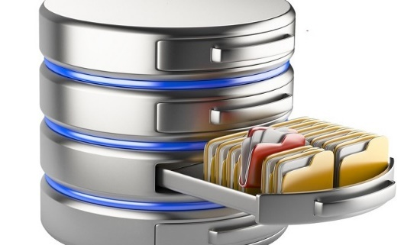
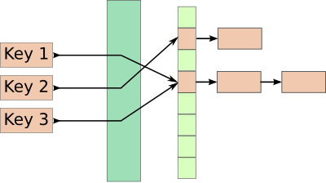
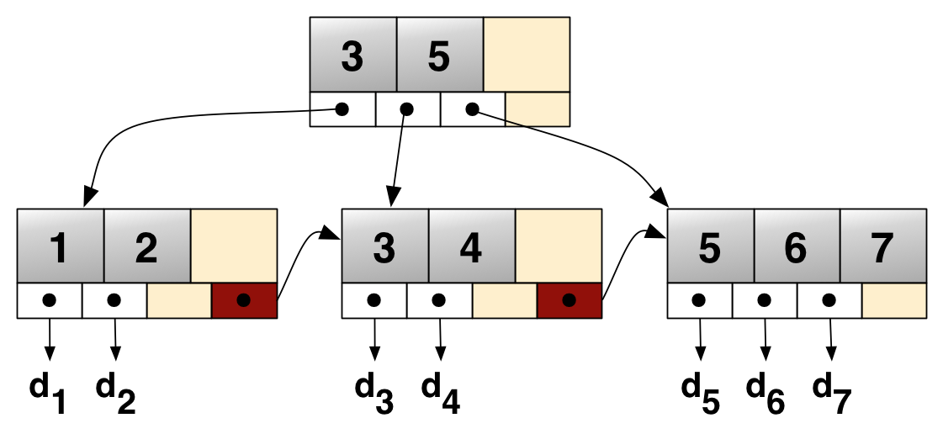
Linked Data Structures
Linked data structures are widely used in many important applications
Linked data structures are
connected by pointers
Database
Key-value stores
B-Tree
Hash Table

Slide 4
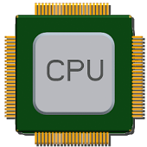
The Problem: Pointer Chasing
Traversing linked data structures requires chasing pointers
Find(A)
H
Addr (A)
Addr (E)
Addr (H)
E
Q
Data (H)
Data (E)
A
F
M
Data (A)
MEM
Serialized and irregular access pattern
6X cycles per instruction in real workloads

Slide 5
Our Goal
Accelerating pointer chasing inside main memory
Find(A)
H
Find
(A)
E
Q
Data (A)
DRAM layers
A
F
M
MEM
Logic layer

Slide 6
Outline
Motivation and Our Approach
Parallelism Challenge
IMPICA Core Architecture
Address Translation Challenge
IMPICA Page Table
Evaluation
Conclusion

Slide 7
Parallelism Challenge
Time
CPU core
Comp
Memory
access
Comp
CPU core
Comp
Memory
access
Comp
In-Memory Accelerator
Comp
Memory access
Comp
Comp
Memory access
Comp
Slower for two operations
Faster for one operation

Slide 8
Parallelism Challenge and Opportunity
A simple in-memory accelerator can still be slower than multiple CPU cores
Opportunity: a pointer-chasing accelerator spends a long time waiting for memory
CPU core
CPU core
CPU core
Accelerator
Comp
Memory access (10-15X of Comp)
Comp

Slide 9
Our Solution: Address-Access Decoupling
Time
CPU core
Comp
Memory
access
Comp
CPU core
Comp
Memory
access
Comp
Address-access decoupling enables parallelism in both engines with low cost
Address Engine
Comp
Comp
Comp
Comp
Memory access
Access Engine
Memory access

Slide 10
IMPICA Core Architecture
DRAM
DRAM Dies
DRAM Layers
Logic Layer
Memory Controller
IMPICA Cache
Access Queue
Request Queue
Address
Engine
Access
Engine
Traversal 1
Response Queue
Traversal 2
To/From CPU

Slide 11
Outline
Motivation and Our Approach
Parallelism Challenge
IMPICA Core Architecture
Address Translation Challenge
IMPICA Page Table
Evaluation
Conclusion

Slide 12
Address Translation Challenge
The page table walk requires multiple memory accesses
Pointer (VA)
TLB/MMU
Pointer (PA)
PTW
No TLB/MMU on the memory side
Duplicating it is costly and creates compatibility issue
PTW
PTW
PTW
PTW
Page table walk

Slide 13
Our Solution: IMPICA Page Table
Completely decouple the page table of IMPICA from the page table of the CPUs
IMPICA Page Table
CPU Page Table
Map linked data structure into IMPICA regions
IMPICA page table is a partial-to-any mapping
Virtual Page
Physical Page
IMPICA Region
Virtual Page
Physical Page
Virtual Address Space
Physical Address Space

Slide 14
IMPICA Page Table: Mechanism
Virtual Address
Bit [47:41]
Flat page table
saves one memory access
Bit [40:21]
Bit [20:12]
Bit [11:0]
Region Table
+
Tiny region table is almost always in the cache
+
Flat Page Table (2MB)
Small Page Table (4KB)
+
Physical Address

Slide 15
Outline
Motivation and Our Approach
Parallelism Challenge
IMPICA Core Architecture
Address Translation Challenge
IMPICA Page Table
Evaluation
Conclusion

Slide 16
Evaluated Workloads
Microbenchmarks
Linked list (from Olden benchmark)
Hash table (from Memcached)
B-tree (from DBx1000)
Application
DBx1000 (with TPC-C benchmark)

Slide 17
Evaluation Methodology
Simulator: gem5
System Configuration
CPU
4 OoO cores, 2GHz
Cache: 32KB L1, 1MB L2
IMPICA
1 core, 500MHz, 32KB Cache
Memory Bandwidth
12.8 GB/s for CPU, 51.2 GB/s for IMPICA
Our simulator code will be released in Dec.
https://github.com/CMU-SAFARI

Slide 18
Result – Microbenchmark Performance
1.9X
1.3X
1.2X

Slide 19
Result – Database Performance
+16%
+5%
+2%
-0%
-4%
-13%

Slide 20
Energy Consumption
-6%
-10%
-24%
-41%

Slide 21
More in the Paper
Interface and design considerations
CPU interface and programming model
Page table management
Cache coherence
Area and power overhead analysis
Sensitivity to IMPICA page table design

Slide 22
Conclusion
Performing pointer-chasing inside main memory can greatly speed up the traversal of linked data structures
Challenges: Parallelism challenge and Address translation challenge
Our Solution: In-Memory PoInter Chasing Accelerator
Address-access decoupling: enabling parallelism with low cost
IMPICA page table: low cost page table structure
Key Results:
1.2X – 1.9X speedup for pointer chasing operations, +16% database throughput
6% - 41% reduction in energy consumption
Our solution can be applied to a broad class of in-memory accelerators

Slide 23
Accelerating Pointer Chasing in 3D-Stacked Memory: Challenges, Mechanisms, Evaluation
Kevin Hsieh
Samira Khan, Nandita Vijaykumar, Kevin K. Chang,
Amirali Boroumand, Saugata Ghose, Onur Mutlu

Slide 24
Microarchitecture Metrics

Slide 25
Sensitivity to IMPICA TLB size & Page Table Design

Slide 26
Full IMPICA Core Architecture
DRAM
DRAM Dies
DRAM Layers
Logic Layer
Memory Controller
IMPICA Cache
Inst RAM
Data RAM
Access Queue
Address
Engine
Access
Engine
Request Queue
Response Queue
To/From CPU

Slide 27
CPU Interface
We use packet-based interface between CPU and IMPICA
Execution steps
CPU sends function call and parameter to IMPICA
The packet is written to IMPICA data RAM
IMPICA loads the function into inst RAM
IMPICA writes results to the data RAM, from which the CPU polls the results.

Slide 28
Programming Model
An IMPICA program is written as a function in the application code with a compiler directive
The compiler compiles these functions into IMPICA instructions and wraps the function calls with communication codes

Slide 29
Page Table Management
The application allocates the memory for its linked data structures with a special API
The OS reserves a portion of the virtual address space as IMPICA regions
The OS maintains the coherence between CPU page table and IMPICA page table in the page fault handler

Slide 30
IMPICA Page Table Size
Region Table
4 entries (covers a 2TB memory range)
68 B
Flat page table (each)
2²⁰ entries
8 MB
Small page table (each)
2⁹ entries
4 KB

Slide 31
Handling of Multiple Memory Stacks
The OS knows the IMPICA region because of our page table management
The OS always maps the IMPICA region of the same application into the same memory stack, including the corresponding IMPICA page table

Slide 32
Cache Coherence
We execute every function that operates on the IMPICA regions in the accelerator
It can be extended with more advanced cache coherence mechanism.

Slide 33
Limit of Parallelism
The parallelism of IMPICA is limited by
Data RAM size (for call stacks)
Memory access time vs. address computation time
The size of the queues
Each IMPICA core can easily parallelize 10 – 15 pointer chasing requests.

Slide 34
Area and Power Overhead
CPU (Cortex-A57) | 5.85 mm² per core
L2 Cache | 5 mm² per MB
Memory Controller | 10 mm²
IMPICA (+32KB cache) | 0.45 mm²
Power overhead: average power increases by 5.6%

