Slide 1
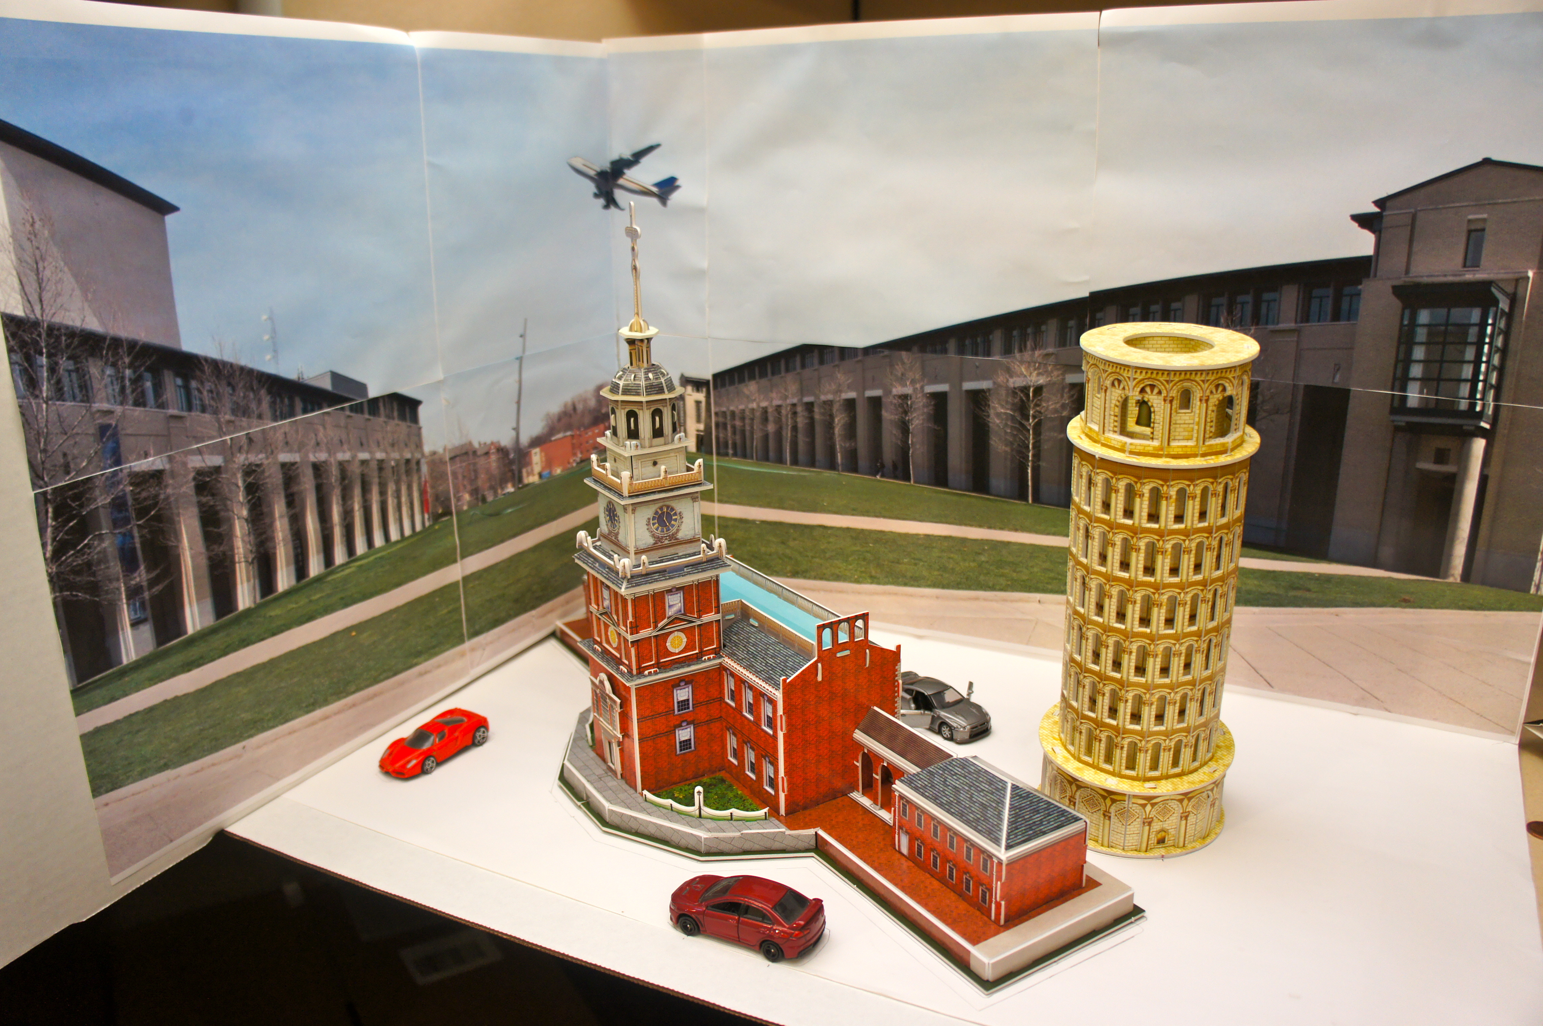
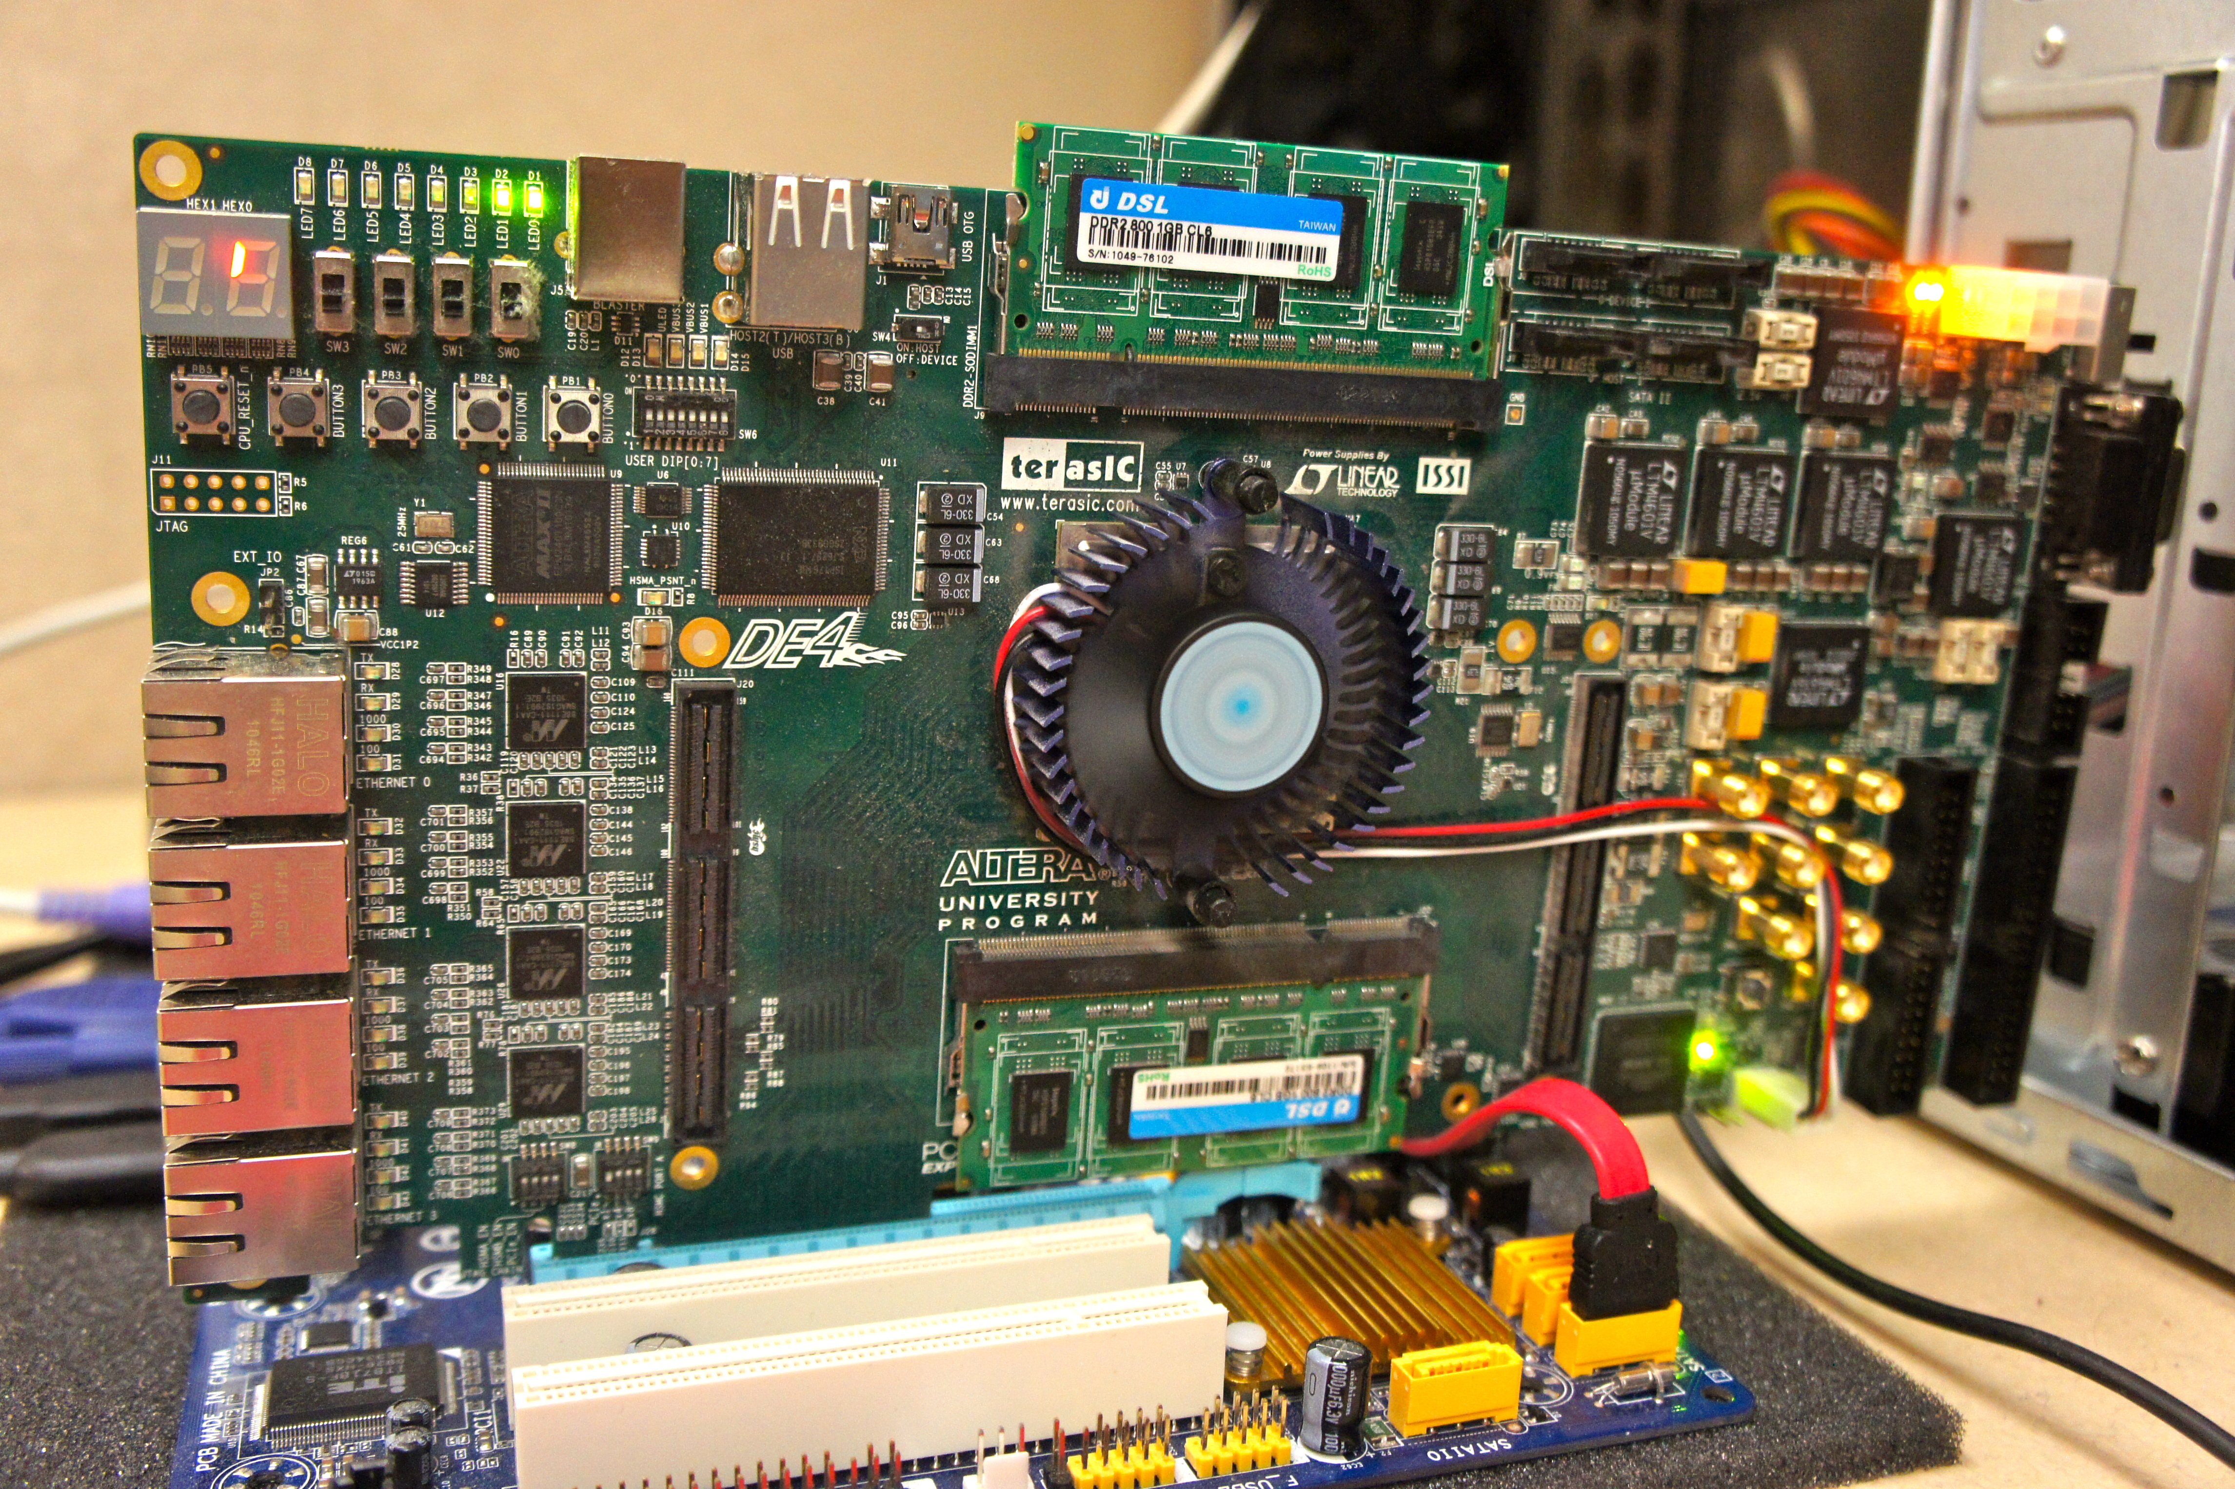
REALTIME 3D RECONSTRUCTION OF REALWORLD SCENES
Yu Wang, Hyun Soo Park, Peter Milder, James C. Hoe, Yaser Sheikh (CMU); Eriko Nurvitadhi, Mei Chen (Intel)
(1) OVERVIEW
(3) FEATURE MATCHING ACCELERATOR
3D point
cloud (corpus)
Feature matching: for each feature in each incoming image, find 2 nearest neighbor (L2-norm) in 3D point cloud corpus
Target Descriptor (TD)
Match
3D point cloud corpus of known reference descriptors (RD)
Input Video
30K-60K TDs/ sec
(VGA)
2 nearest neighbor
10K-1M RDs
Camera pose
estimation
We offload the feature matching bottleneck onto HW
custom HW architecture to do exact matching
orders of magnitude more efficient than SW implementation
Compute-bound: R⋅N/corpus_size TD per sec
Memory-bound : T⋅BW/corpus_size TD per sec
Video Stream
Reconstructed Scene
Problem: Perceptually responsive systems require realtime 3D knowledge of environment
Example: to track user movements in a space, and the nearby objects in that space that user can interact with
Project goal: produce a low energy, memory-bandwidth efficient embedded solution for realtime 3D reconstruction of dynamic environments from monocular video
Matching Accelerator
Corpus
in
DRAM
BW desc/sec
N parallel stations
distances
RD
Station
- pipelined
- R L2_norms/sec
TD
B
TD stream
Buffer
- hold T descriptors at a time
- hold per descriptor nearest
neighbor bookkeeping
Nearest neighbor update
(2) CAMERA POSE ESTIMATION
Given a video stream from a camera, and a 3D point cloud corpus of the area, estimate camera pose w.r.t the corpus
(4) FPGA PROOF-OF-CONCEPT
Video Stream
Feature
Extraction
Feature
Matching
Others
Camera
Pose
Feature matching on Altera DE4 board (Stratix IV GX FPGA)
utilizes 10 parallel stations, runs at 150 MHz clock freq
occupies ~200K (50%) FPGA logic & 1MB (47%) on-chip mem
15 ms & 32 ms per VGA frame (14K & 22K corpus)
Corpus
Performance of software (SW) implementation
24x & 144x faster over SW on OoO proc (14K & 22K corpus)
On an OoO proc
(2.93 GHz)
On an in-order embedded proc
(1.3 GHz)
32x & 257x faster over SW on embedded proc (14K & 22K corpus)
Realtime speed (31+ fps)
Mobile Camera
3D Point Cloud Corpus
Note: we use SIFT feature, and our SW uses fast approximate method for matching. The accuracy of this method may become unacceptable with larger corpus sizes. Exact matching is preferred, but very slow to do in SW (for our experiments, ~10x slower than approximate)
SW is too slow even on an aggressive OoO proc (1+ sec/frame), and much worse on an embedded proc
Input Video Stream
Prototyping Platform
(Altera DE4 Board)
3D Camera Motion
What’s next
Accelerate feature extraction
3D point cloud corpus reconstruction in realtime
As corpus size increases with larger and/or more complex scenes, feature matching becomes the bottleneck

