Slide 1
Sythethesia
Alan Gerber, Cem Onyuksel, Evan Tobac, James Forbes

Slide 2
Status Update
Project Idea: color-to-sound gun, allows user to “hear the rainbow”, sound properties defined by RGB content, tweakable via smartphone
Status:
Project idea slightly changed, decided against Bluetooth in favor of Wifi
Form factor will be decided later when electronics are functioning
Gumstix and LEDs acquired
Set up twice-weekly mandatory group meetings as status checkpoints
Survey!

Slide 3
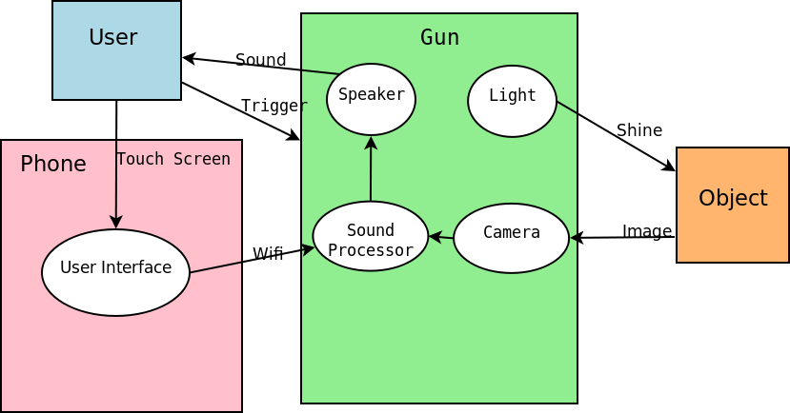
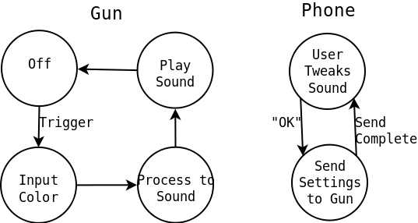
Architecture
Idle

Slide 4
Use Cases

Slide 5
Risks & Mitigation
Risk | Mitigation
Wifi connection cuts out between phone and sensor | Use most recent configuration settings Reconnect Wifi
Not enough light for camera to identify colors | Add a brighter LED to light scene Calibrate system for darker colors
Battery life is shorter than expected | Lower battery life expectations Use rechargeable/better batteries
Camera interface draws too much power or is too clunky | Buying both sensors and camera to determine best form of input

