Slide 1
Team Chiron
Rachata Ausavarungnirun
Carl Vanderlip
Wenyan Lu
Kaimin Hu

Slide 2
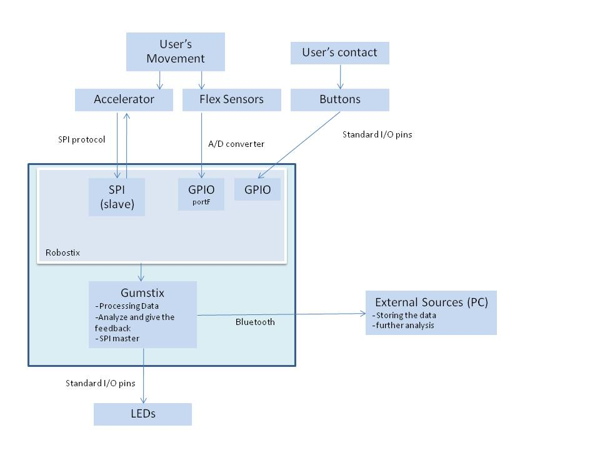
Status Update(cont.)
What’s being developed so far.

Slide 3
Status Update
What we accomplished so far
Establish the communication between the gumstix and robostix.
Setting up the robostix for the I/O, LEDs and buttons.
Setting up A/D input on the robostix for the flex sensors.
Risk mitigated so far
Some of the drivers in the robostix is corrupted; need to update the files in order to get it to work correctly.
There is no easy way to connect SPI pins on the robostix; need to use bit banging and manually write the driver for the accelerometer.
The Bluetooth connection sometimes gets unstable when using for a long period of time. Reducing the connection speed might help the connection.

Slide 4
Status Update (cont.)
Assumption we are making
The accelerometer can pinpoint the position of the player within a 2x2 meters area.
The contact between the hand and the button will not create too much discomfort for the player.

Slide 5
Demo
Input: The button is pressed/release, sending an input to the I/O port, and report it to the console. Output: The board detects the incoming signal, upon getting the data, it sends out/cut the current to drive/disable the LED.

